Slide 1


Course Title
Rockin’ all year long …
It’s about making music!!!

Slide 2

The long-term plan
For a productive program to develop, you should allow at least three years.
Generally, at the five year mark, you
can expect tangible success.
If your goal is to make money, you have the wrong motivation.

Slide 3
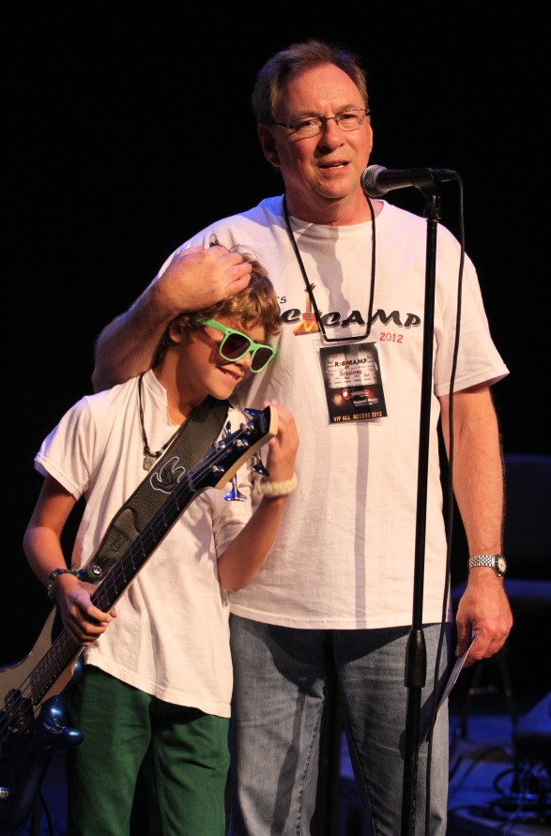
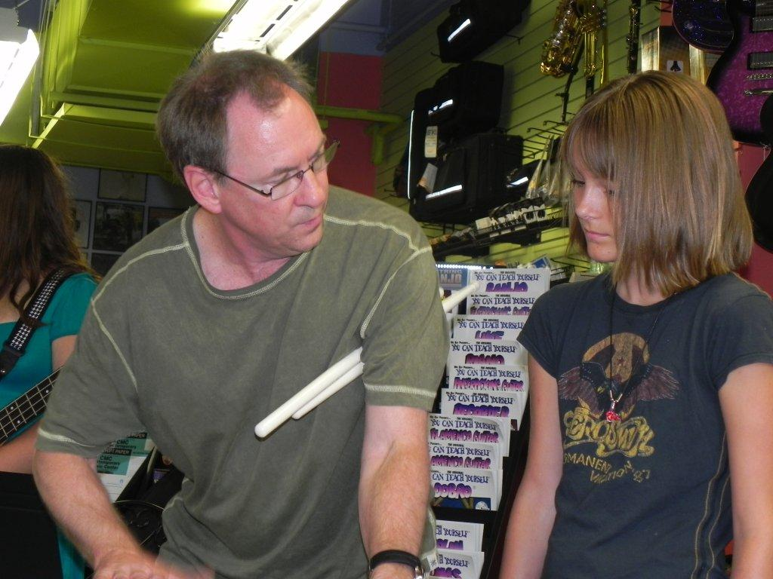
Rules of engagement
The most important rule: personally engage.
The students need to know you have a personal investment in the their outcome!

Slide 4

Quality should be your only priority!

Slide 5
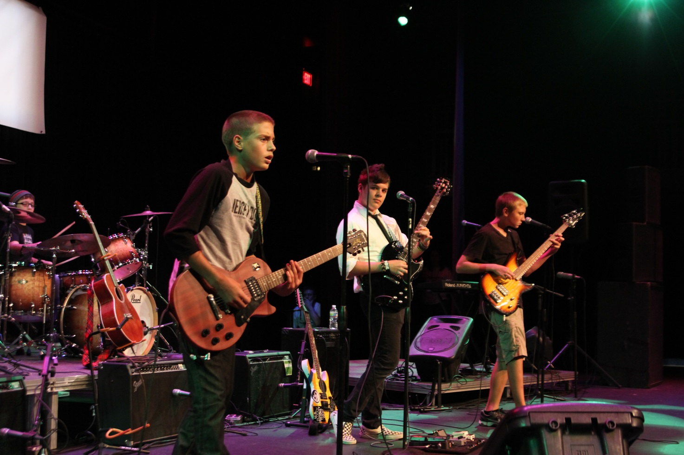
A willing investment in gear locks in a guaranteed return of a memorable experience!
…and
returning
customers

Slide 6
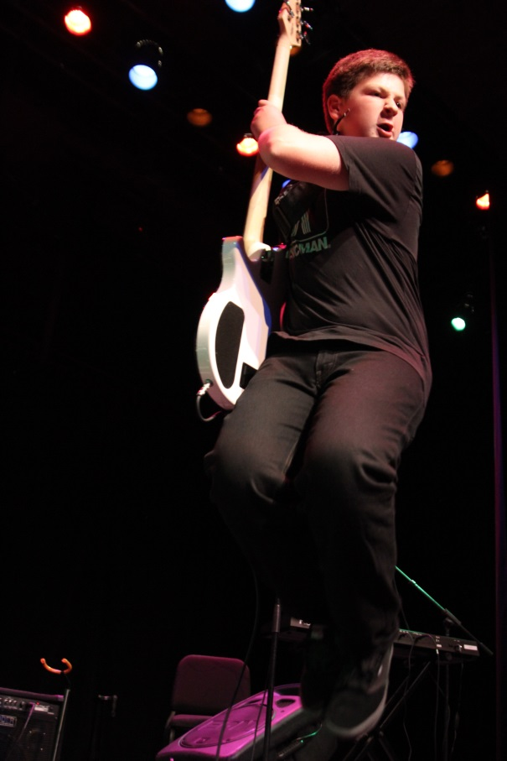
The purpose of a great program
The purpose of a great program is to provide the students a quality experience of stage performing.
Success follows
when it’s done right.

Slide 7
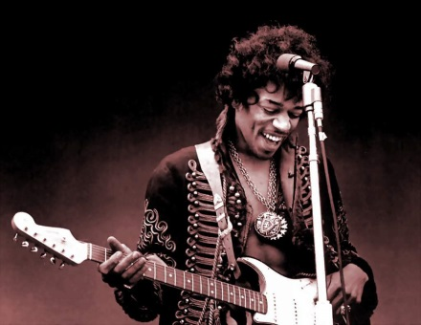
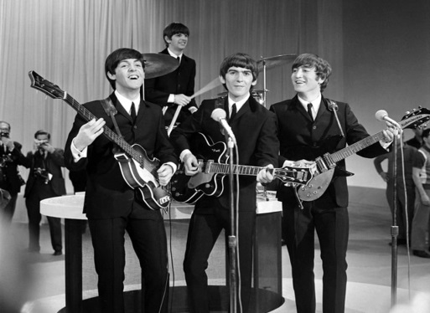
Making it Gel
Let the students weigh in on choice of material, but monitor music choices.
This is a great opportunity to share
your understanding of music history.
Day one, you have four hours to make them realize they are a band.
Day one, you have an hour to make them realize this will be the most fun-er-est hard work they have ever done.

Slide 8
Logistics
Organizing the bands is a nightmare, and that never gets easier!
You have to work around the family vacations and family plans of 4-6 families in each band.
Families that have both parents work may have transportation issues.

Slide 9
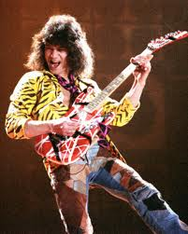

More Logistics
Talent levels vary.
Work ethics vary.
Some kids in the same band like very different types of music.
Some kids don’t want to sing.
Perception of talent can sometimes be distorted.

Slide 10
And still more logistics
Set your program standard so high it can’t be easily duplicated.
Make sure to have great teachers.
Pay your teachers well and they will return.

Slide 11
What you should expect
Expect to have to educate customers. Your job will be helping them understand the difference of a “true” quality program.
Expect mutinies. Everyone thinks they can do this. Success brings just as many problems as it does rewards.

Slide 12
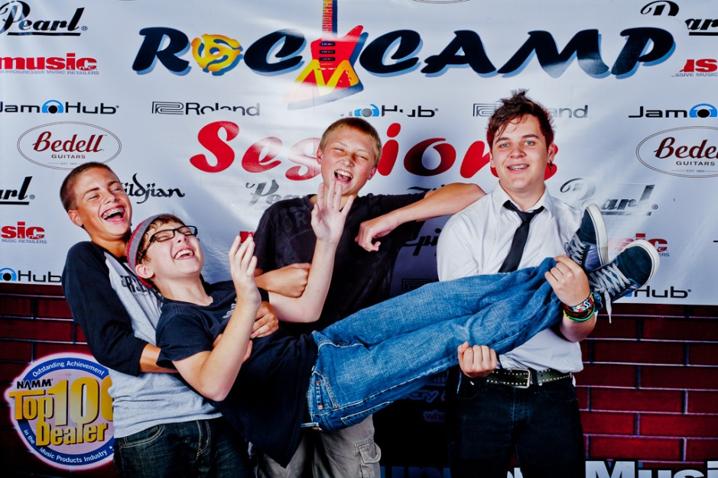
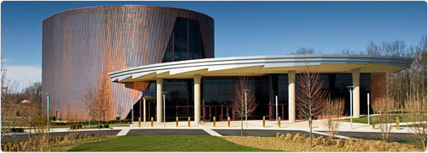
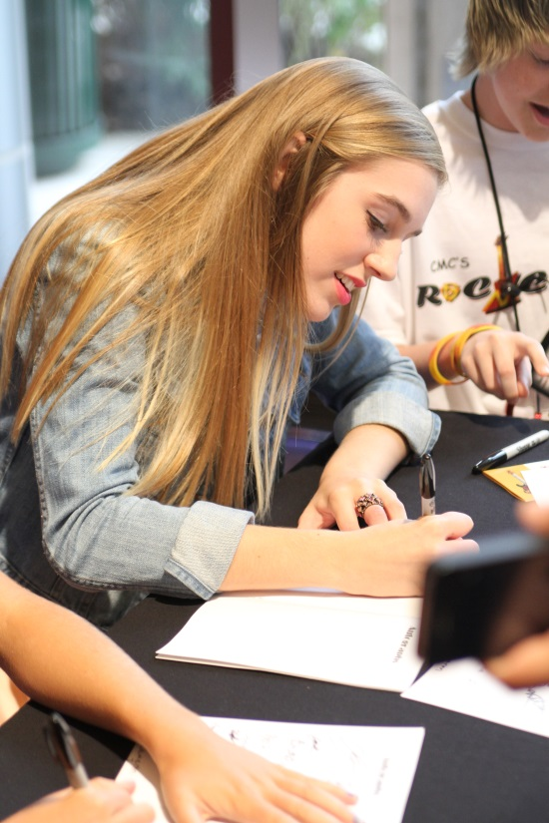
Impact
Have the show at the best venue you can.
Deliver an exceptional experience to the young artist.

Slide 13

Keep Playin that Rock and Roll
A winter program keeps students engaged
CMC holds a winter
program called Sessions.
Sessions classes
are held for 1 hour a week
for twelve weeks

Slide 14
Commitment
A great Rock Camp or group program comes with a price tag.
Equipment isn’t cheap, neither is design or promotion …
JamHub is your friend and will keep your camps going into the winter.

Slide 15

Final Thoughts
If you haven’t had extensive performance
experience, rock camps may not be a natural
format for your store.
To do this right, you need a good understanding of live performance and production.

Slide 16
Menzie Pittman… Contact info
Menzie@ContemporaryMusicCenter.com
www.ContemporaryMusicCenter.com

