Slide 1


Slide 2

Marketing Locally on the Internet

Slide 3
Presented by
John Arnold

Slide 4
Finding local prospects
with search engines

Slide 5

What is Relevant to Search Engines?
Organic
Paid
Local
Your Web Page
Notes:
Say no to Flash – doesn’t work on almost all mobile devices.

Slide 14
Getting Your Business on the Map
Claim all existing local listings
  Search Engines
  Local review sites
  Create new listings if necessary
Update your business information
  Complete your profile
  Add pictures, videos, links, and special offers
Ask customers to review your business
  Review comments and reply when necessary

Slide 15
Finding local prospects
with geo-targeted display ads

Slide 23
Display Advertising Old Model
Content Websites
Your Advertising
Notes:
Say no to Flash – doesn’t work on almost all mobile devices.

Slide 24
Display Advertising Networks
Content Publishers
Advertising Network
Your Advertising
Notes:
Say no to Flash – doesn’t work on almost all mobile devices.

Slide 25
Display Advertising Options
Millions of sites
Targeted content
Pay for clicks
Track your results
Re-targeting options

Slide 26
Access to Display Networks
Google
  google.com/ads/displaynetwork
Bing
  advertising.microsoft.com
Yahoo!
  advertisingcentral.yahoo.com
Customized advertising tools
  AdReady.com

Slide 27
Finding local prospects
through mobile devices

Slide 28

GPS
Camera
Accelerometer
Gyroscope
RF SIM
NFC
USSD
RFID
Communication
SMS
MMS
Content
Mobile Internet
Mobile Apps
Commerce
Mobile Payment
Mobile Wallet
Mobile Email
Voice
Proximity

Slide 29

SMS (Text Messaging)
Short Messaging Service Basics
  Promote your common short code and keywords at all points-of-interest
  Use opt-in incentives
  Deliver location-relevant content
Notes:
Capture long code for terminology purposes.
PSMS 2006 in north america.
2005 first short codes in the US

Slide 30

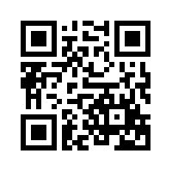
Mobile Internet
Web sites accessed on a mobile device
  Promote your mobile site URL at all points of interest
  Use mobile bar codes that point to your site
  Use micro-sites and maps
Scan for more information
Notes:
Say no to Flash – doesn’t work on almost all mobile devices.

Slide 31

Mobile Applications
Programs designed to work with the native operating system
  Offer downloads through app stores or mobile sites
  Push content through the apps
  Use apps to reward loyalty, entertain or improve productivity
Notes:
pull in the flurry slide here.

Slide 32

Mobile Content
Text, images, videos, and sound enabled on a mobile device.
  Promote downloadable content at all points-of-interest
  Offer streaming content such as videos
  Provide location-relevant content
Notes:
MB – “Put in mobile content video thingy”

Slide 33
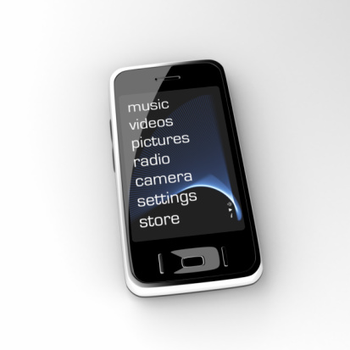
Capabilities and Enablers
Ask for mobile interactions!
  Camera
  Social Sharing
  Ratings & Reviews
  WiFi

Slide 34





Conclusion
John Arnold
O: +1.303.532.1062
M: +1.303.669.0958
E: john@johnarnold.com
T: @ArnoldMarketing
W: JohnArnold.com

