Slide 1


Slide 2

Yelp Help! Make Online Reviews Work for You

Slide 3
About Your Speaker…
Robin Jean Sassi, Esq.

Slide 4
About Your Speaker…
Owner, San Diego Music Studio, Est. 1994
Robin Jean Sassi, Esq.

Slide 5

About Your Speaker…
Owner, San Diego Music Studio, Est. 1994
Robin Jean Sassi, Esq.

Slide 6
About Your Speaker…
Owner, San Diego Music Studio, Est. 1994
California Licensed Attorney
  Corporate Law
  Business Litigation
  Trusts and Estates
  Disclaimer: The presentation you hear today is not meant to be legal advice and is for educational purposes only. Each individual situation is unique and laws vary from state to state. Conversations here do not establish an attorney-client relationship.
Robin Jean Sassi, Esq.

Slide 7

The Online World of Reviews…

Slide 8

The Online World of Reviews…

Slide 9

The Online World of Reviews…

Slide 10
Rule #1

Slide 11
Rule #1
Do NOT engage in an online argument.

Slide 12
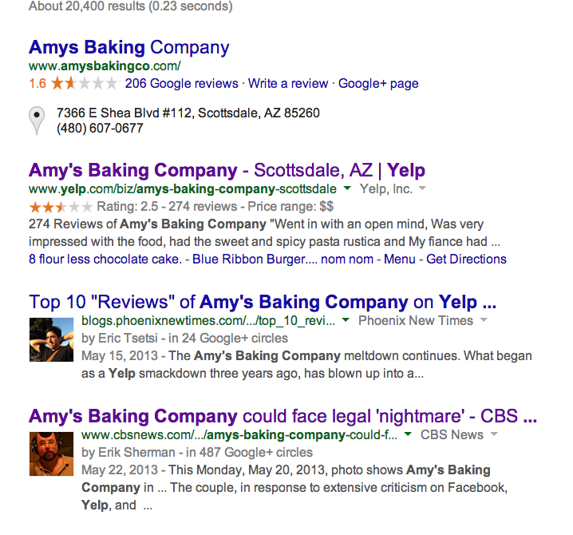
Rule #1
Do NOT engage in an online argument.

Slide 13
What NOT to do…

Slide 14
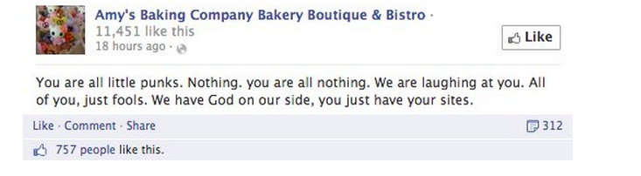
What NOT to do…

Slide 15
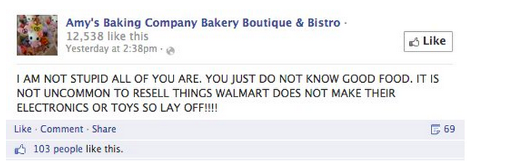
What NOT to do…

Slide 16
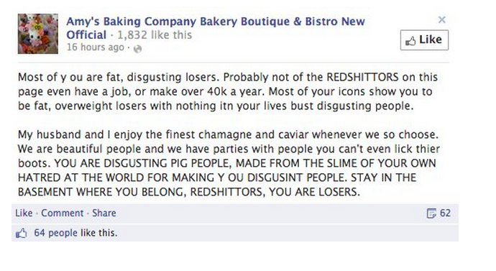
What NOT to do…

Slide 17

What NOT to do…

Slide 18
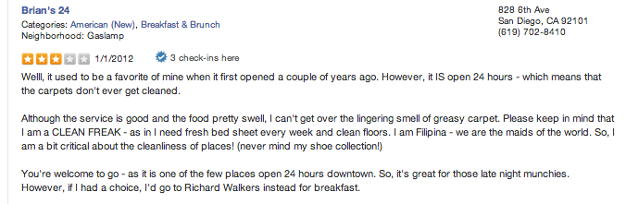
Remember! Don’t take your argument online!
How to handle it?
To respond… or not to respond…

Slide 19
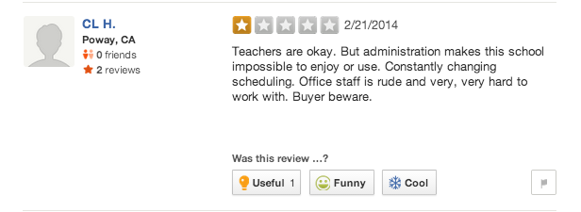
Remember! Don’t take your argument online!
How to handle it?
To respond… or not to respond…

Slide 20
Rule #1: Do NOT engage in an online argument.

Slide 21
Rule #1: Do NOT engage in an online argument.
Rule #2: Keep the GOOD reviews coming!

Slide 22
Rule #2: Keep the GOOD reviews coming!

Slide 23
Rule #2: Keep the GOOD reviews coming!
Review other businesses.

Slide 24
Rule #2: Keep the GOOD reviews coming!
Review other businesses.
Use current social media platforms to promote reviews.

Slide 25
Rule #2: Keep the GOOD reviews coming!
Review other businesses.
Use current social media platforms to promote reviews.
Do surveys – and request a review.

Slide 26
Rule #2: Keep the GOOD reviews coming!
Review other businesses.
Use current social media platforms to promote reviews.
Do surveys – and request a review.
Encourage employees to provide excellent service by giving incentives.

Slide 27
Rule #2: Keep the GOOD reviews coming!
Review other businesses.
Use current social media platforms to promote reviews.
Do surveys – and request a review.
Encourage employees to provide excellent service by giving incentives.
It doesn’t hurt to ask.

Slide 28

Rule #2: Keep the GOOD reviews coming!
Review other businesses.
Use current social media platforms to promote reviews.
Do surveys – and request a review.
Encourage employees to provide excellent service by giving incentives.
It doesn’t hurt to ask.

Slide 29
Rule #1: Do NOT engage in an online argument.
Rule #2: Keep the GOOD reviews coming!
Rule #3: Be true to your store.

Slide 30
Rule #3: Be true to your store.

Slide 31
Yelp Help! Make Online Reviews Work for You

