Slide 1

How to Get an Endorsement Deal
Jen Lowe
Friedman, Kannenberg & Company, P.C.

Slide 2
What’s your deal to get a deal?

Slide 3

Notes:
If you are looking for free gear – you are not looking with the right set of eyes or with the right heart.

Slide 4

Notes:
How much have you built your own brand?

Slide 5
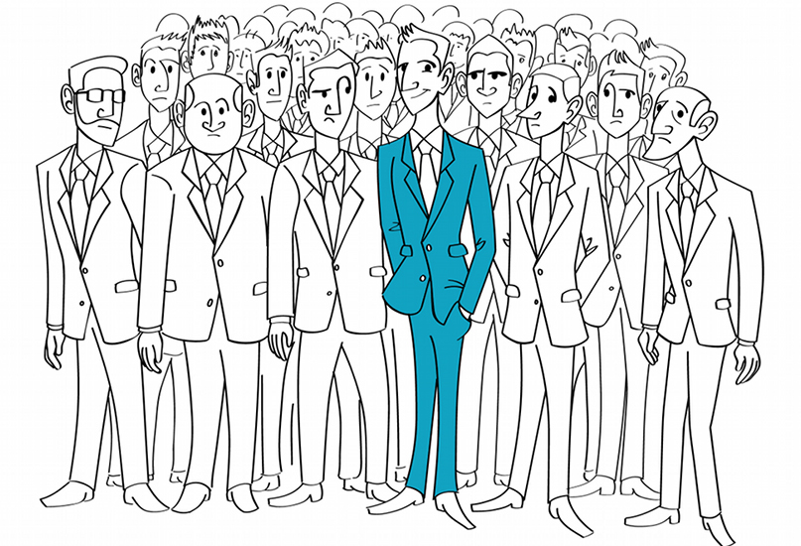
Notes:
Value – what makes you stand out – how can you help sell more gear

Slide 6
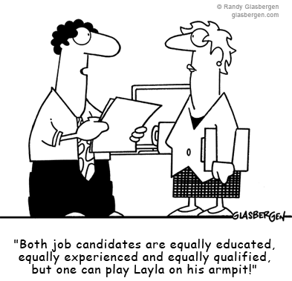
Notes:
Value – what makes you stand out – how can you help sell more gear

Slide 7
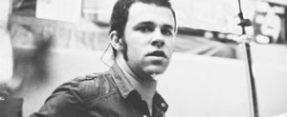
Notes:
Case study – Dusty Saxton

