Slide 1

Course Title

Slide 2
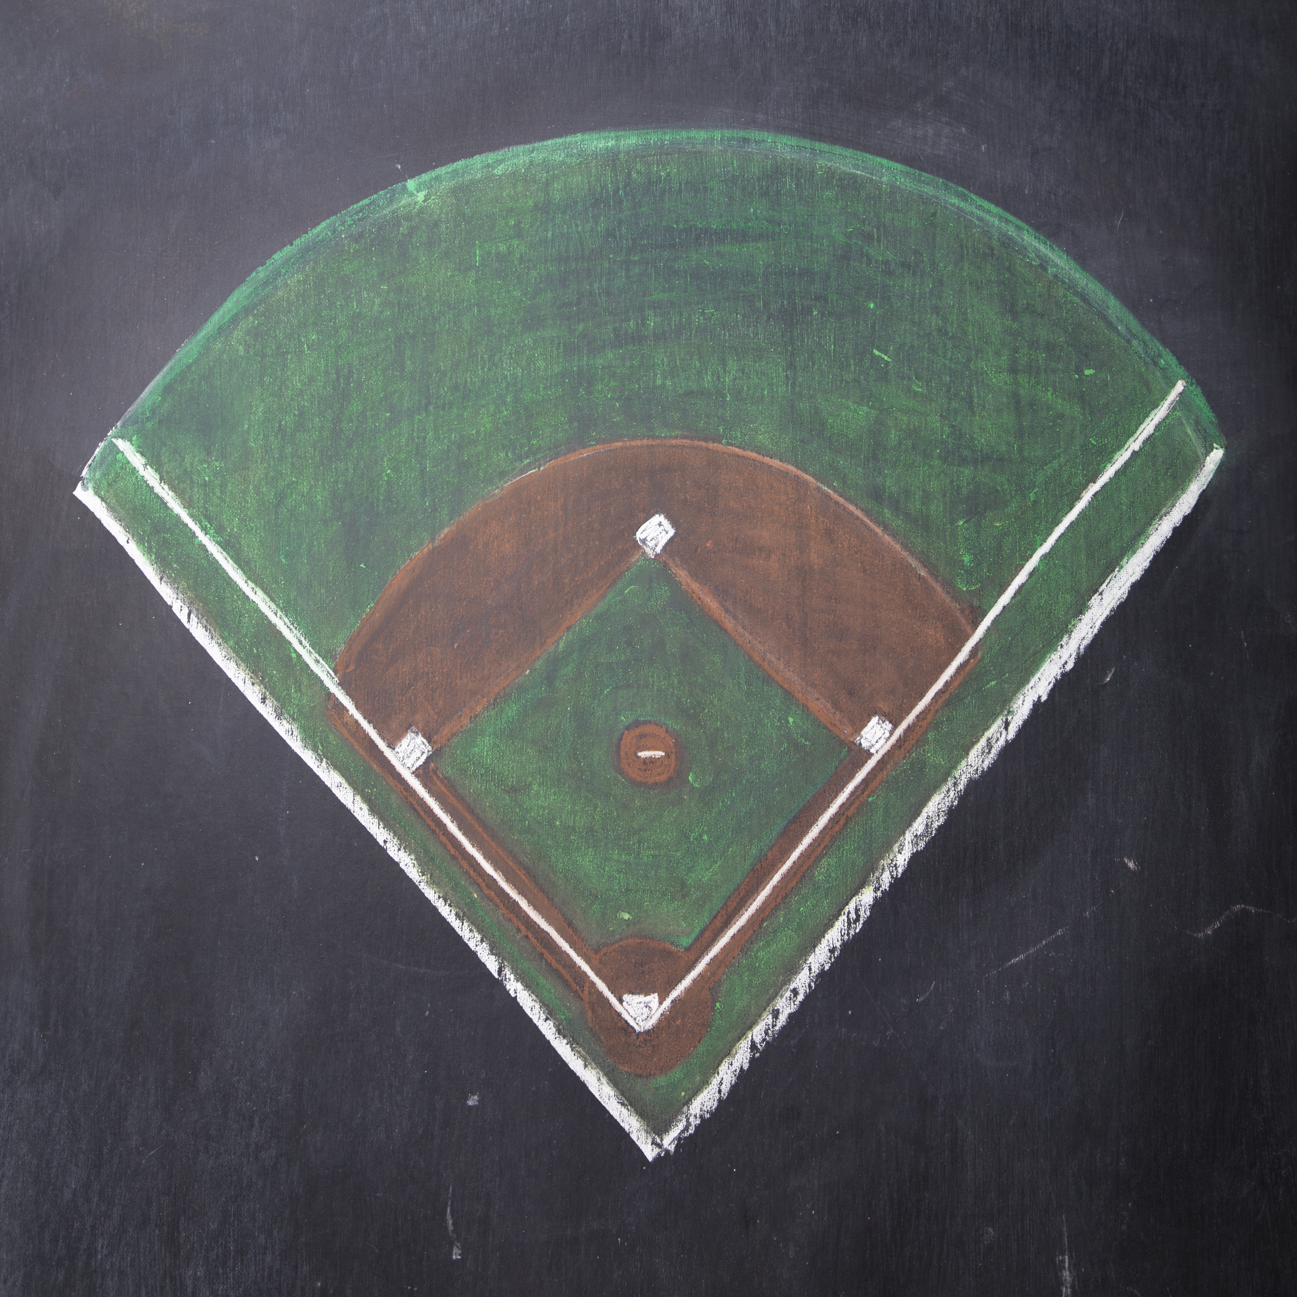




Covering Your Social Media Bases
Grant Billings
Music Store Owner & Customer Whisperer
Notes:
Good afternoon and thank you for coming.
Social Media landscape changes quickly
Today - focusing on efficient use of the 4 most effective platforms
Who are the players? (click)

Slide 3

The Players
Notes:
1/7th of the world’s population
1 billion people
167 million US
18m -Canada
73% of the online population.
For most customers - ubiquitous
FB rules social media

Slide 4


The Players
Notes:
142 million US
10m Canada
Younger
Tend to follow celebrities/causes – not businesses

Slide 5

The Players
Notes:
Raise your hand - Google+
Raise your hand - Gmail account
Everybody with a Gmail account is on Google+
Even with their dominance, they are trailing FB
When/if that changes,
You want to already be there
without big time or capital investment

Slide 6

The Players
Notes:
Raise your hand if you’re on LinkedIn
Many overlook LinkedIn as a way to connect with retail customers.
Professional Facebook
Search by their email or name and city and try to connect with them.
Much more likely to connect with you here than friend you on FB
Allows you to be an individual, but only showing your professional side

Slide 7

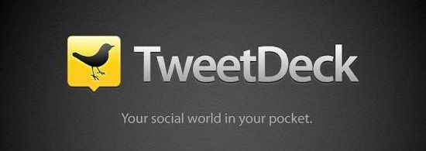
The Coach
Notes:
If these are the players,
How do we get them to play as a team?
I use Hootsuite – others available
It’s free or $10/mo for 2 users
Allows scheduled posting to multiple outlets
Let me repeat that…

Slide 8
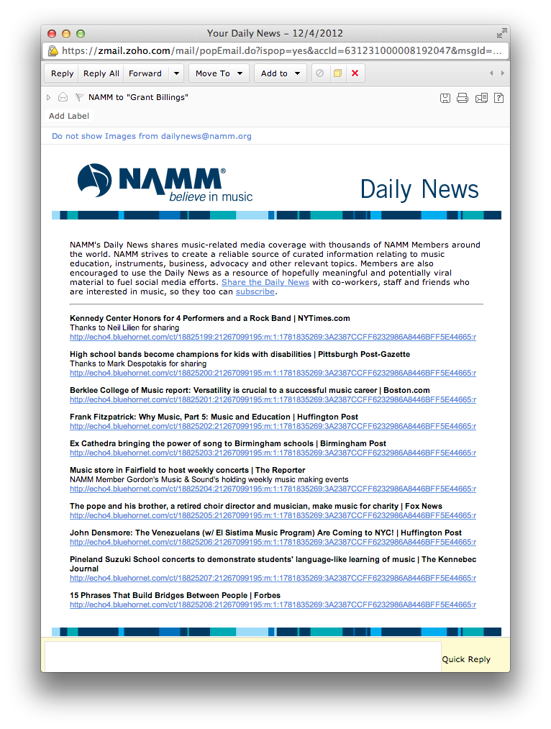
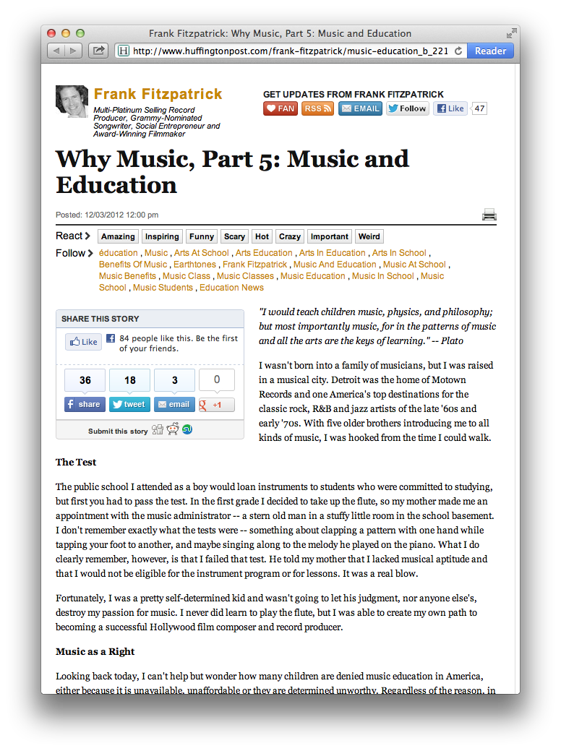
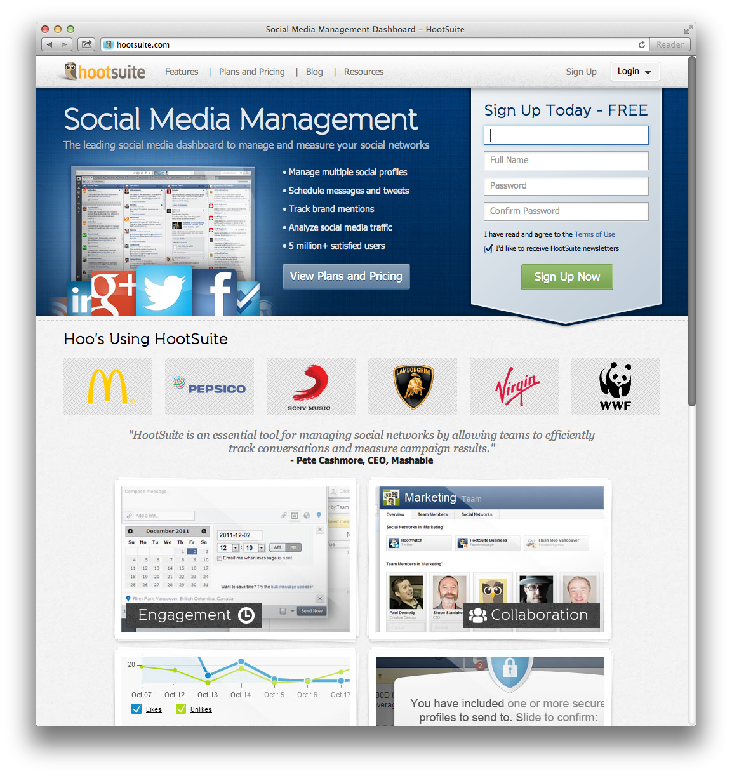
Calling the Plays
Notes:
Here’s how the play is called

Slide 9
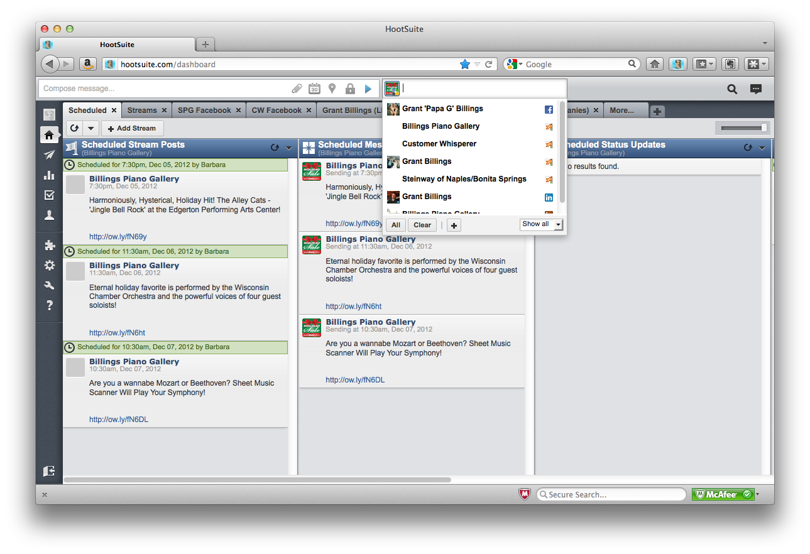
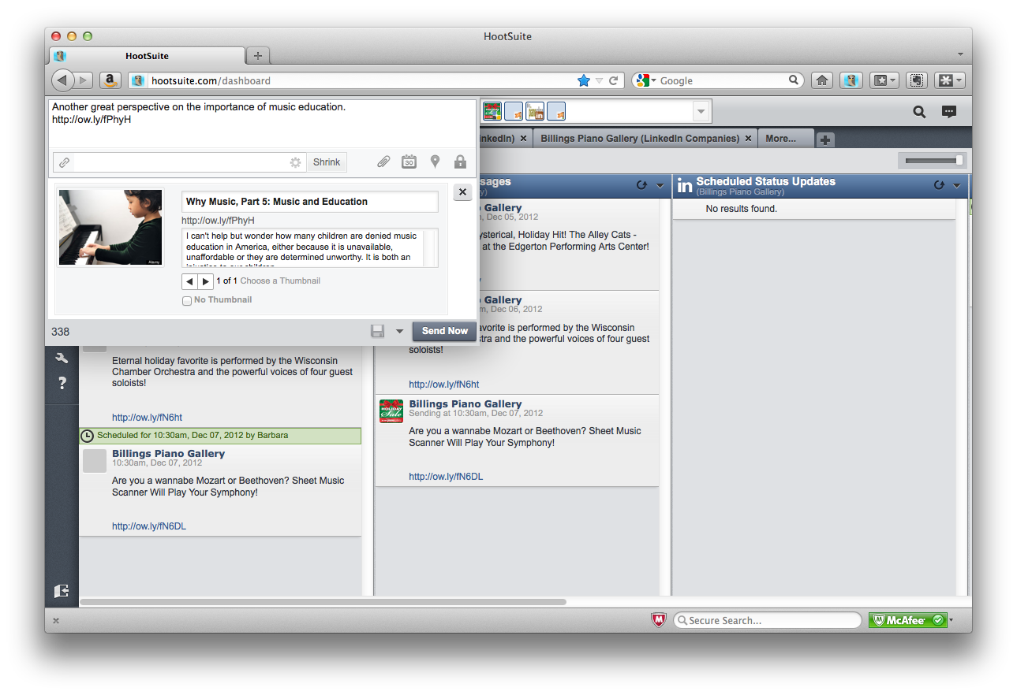
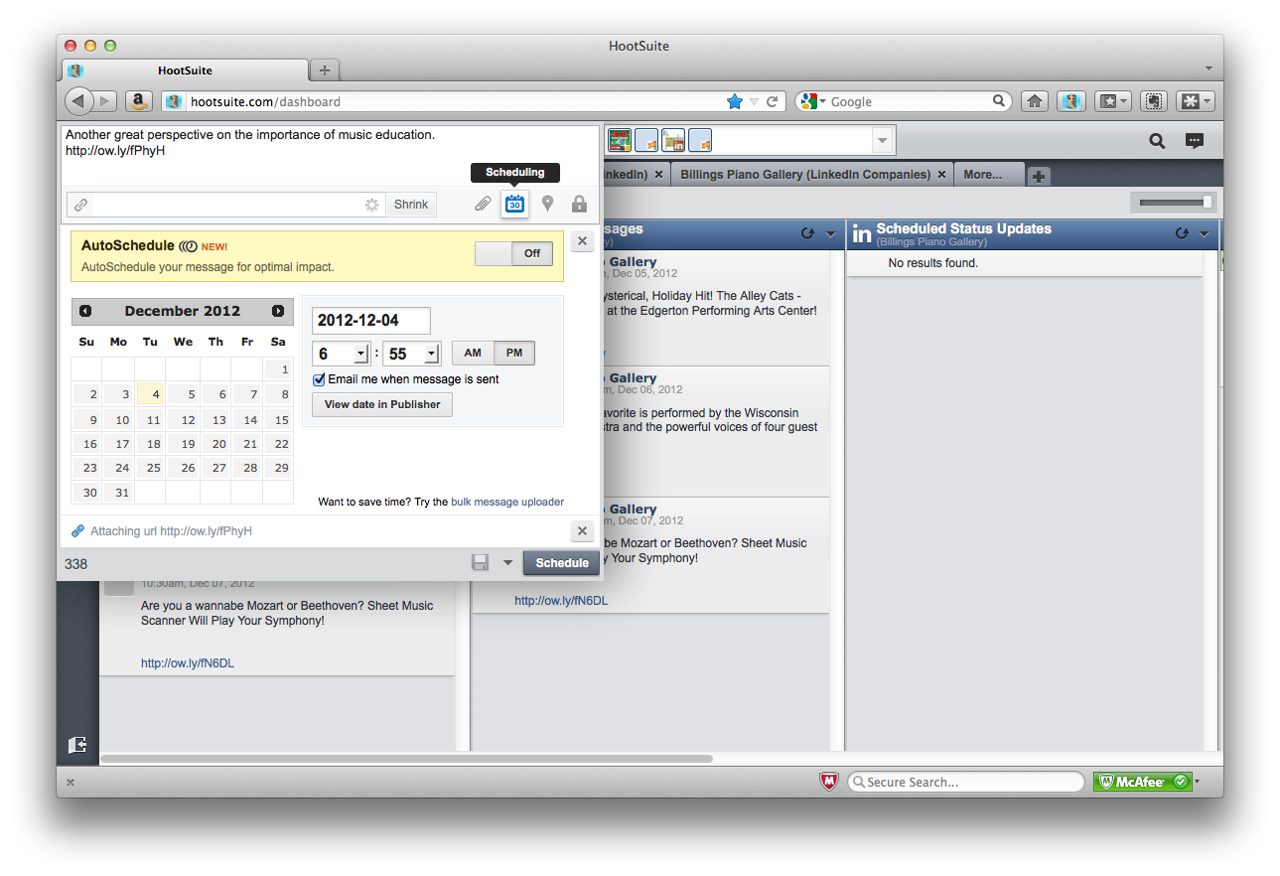
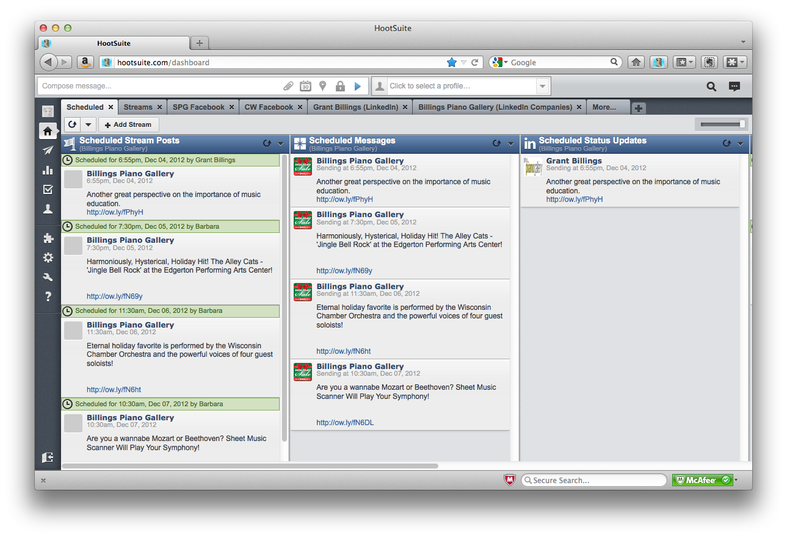
Calling the Plays
Notes:
After choosing social media sites
I can even post to the FB page for Fla
Design my post – add a relevant hook instead of copying
Importance of Schedule
Now, I can see the schedule

Slide 10
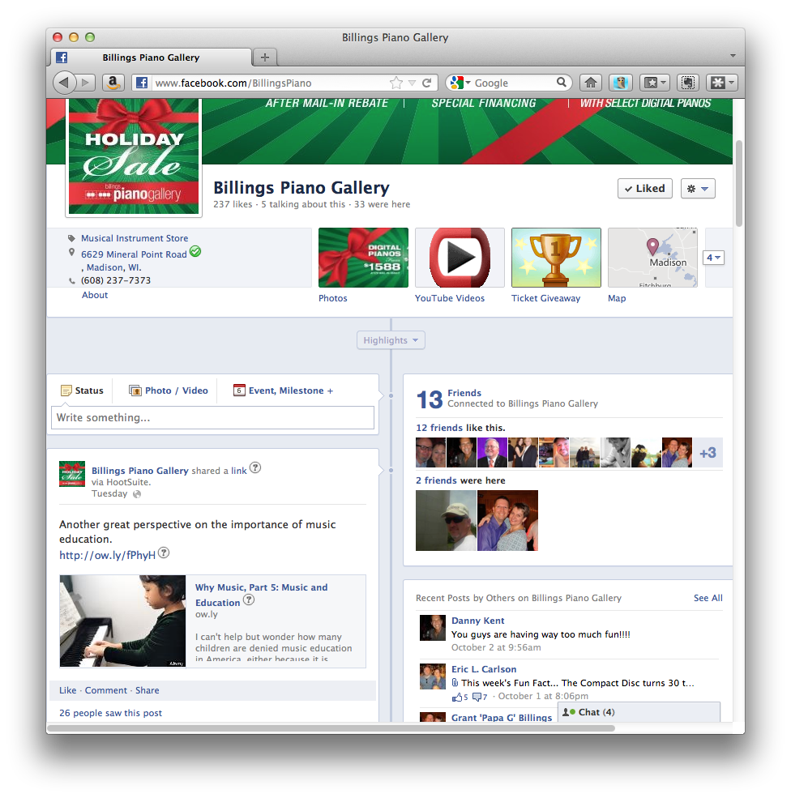
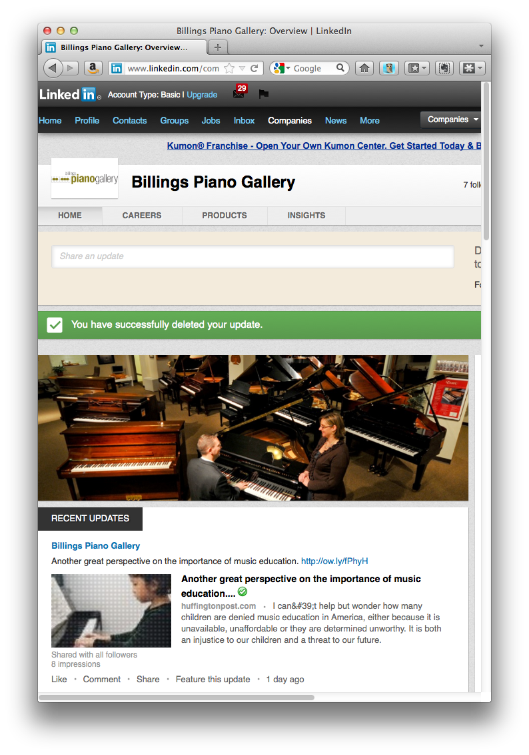
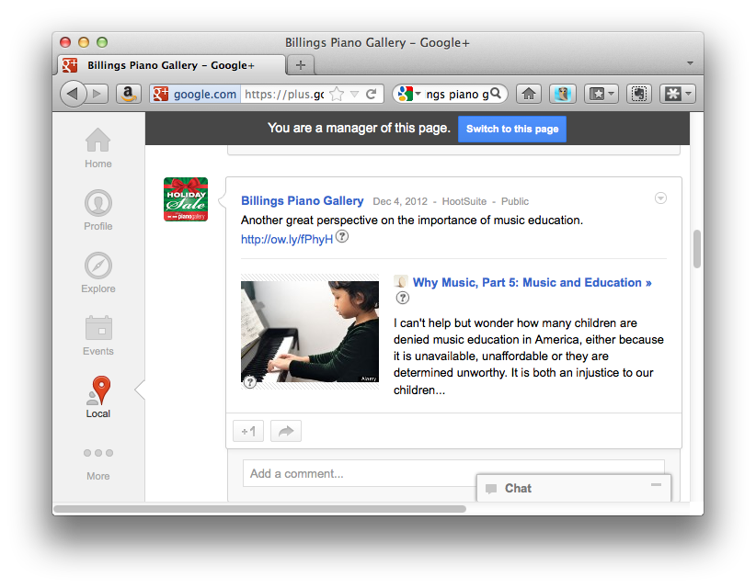
It’s a Triple!
Notes:
After dinner, I see that, at 6:55
When people are just starting to use social media
Posted to FB (click)
Google+ (click)
Is there an easier way to already be there if people start using it?
And LinkedIn
Which base did I miss?

Slide 11
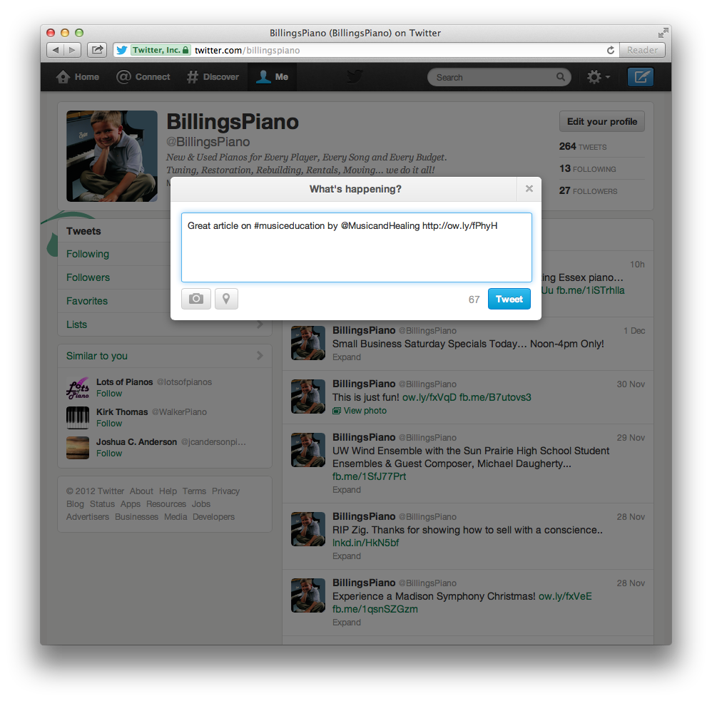
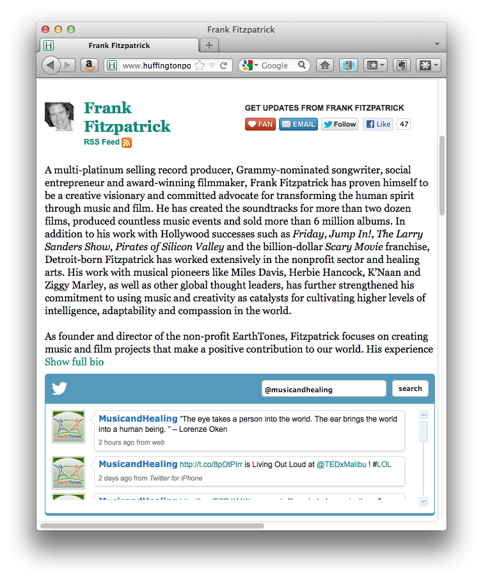
Twitter-speak
Great article on
#musiceducation
by
@MusicandHealing
http://ow.ly/fPhyH
Notes:
It’s different
FB – G+ - LI noticed on Timeline
Twitter – Hashtags and Handles (click)
Remember that original article? (click)
Followed link to bio/Twitter feed for handle
Checked Twitter for the hashtag “musiceducation” (click)
Tweet with both that will be seen – hopefully followed – by others.
Tweets without both are basically useless.
Twitter is a lot more work.
If you’re going to put time in, do it right.

Slide 12
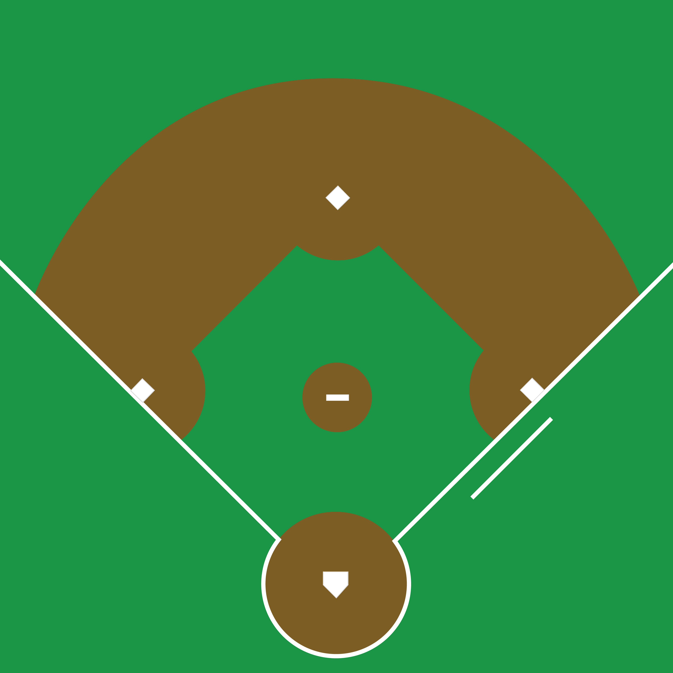
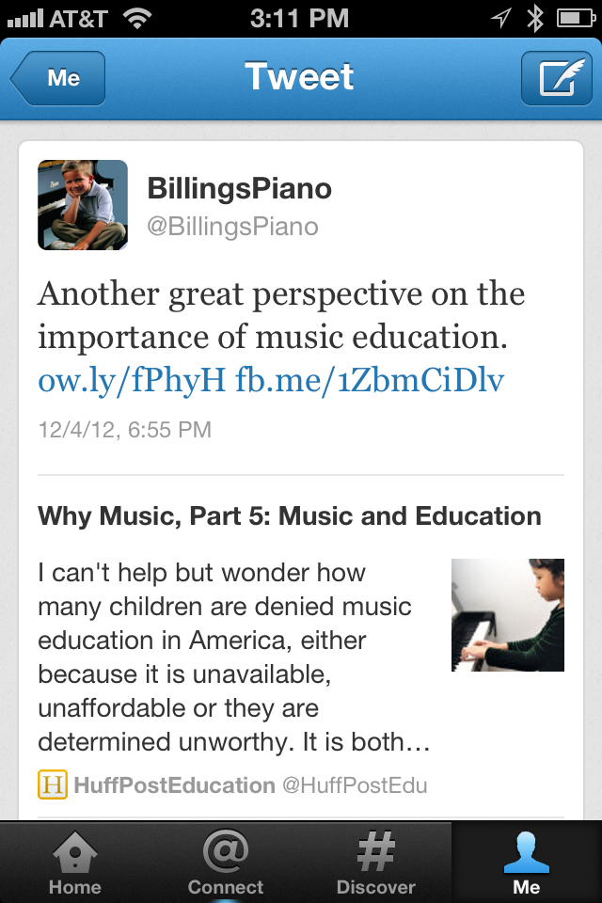
All bases… covered!
Notes:
I have covered all my bases, though.
Here’s how it looks on a mobile phone
Which is how most people will view it.

Slide 13

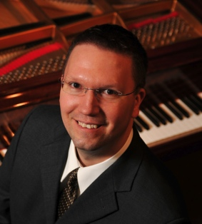
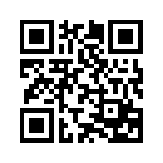
Covering Your Social Media Bases
Grant Billings
grant@billingspiano.com
/grantbillings88
@customerwhisper
/grantbillings
/grantbillings?
Notes:
So I know what you’re thinking… am I on social media?
If time – Get endorsed on LinkedIn

