Slide 1

“How to sell products, not boxes”
Personalized Customer Service

Slide 2
International House of Music, Inc.
The reason for being in the music industry since 1902 is providing quality and personalized service.
We strive to impact the current and upcoming generations proving that we care about them, their career, their future; on stage, at rehearsals or in the studio.
www.ihomi.com

Slide 3
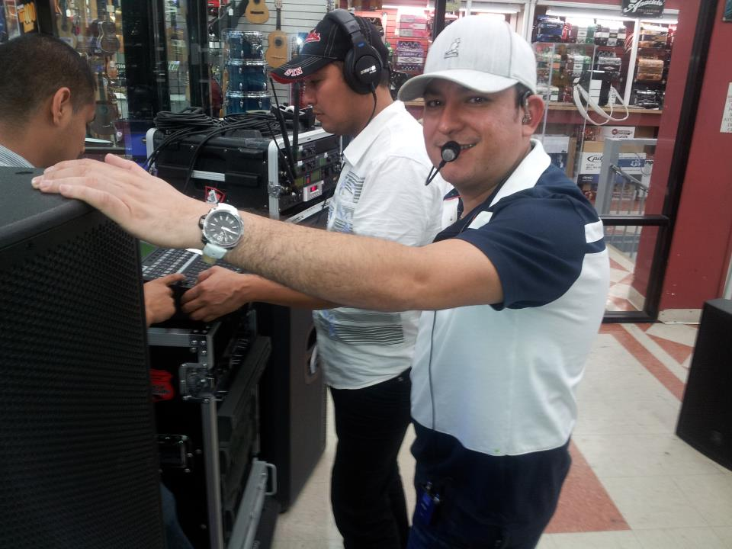
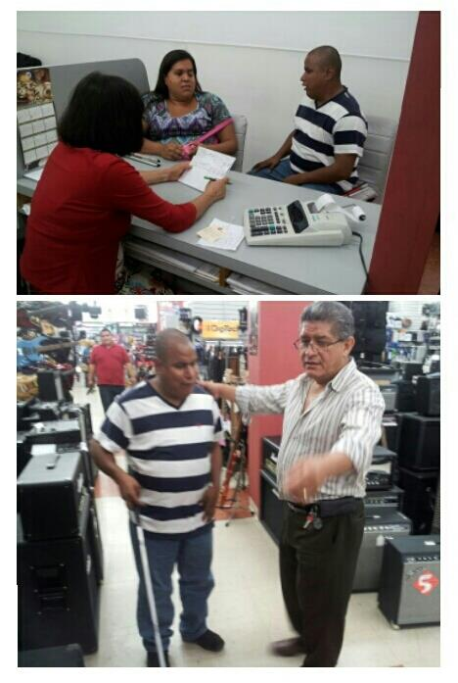
1.Resources we use
Musician needs
Jesus Ojeda / Int’l Artist
Julio & Cynthia Ruiz – Local Artists

Slide 4
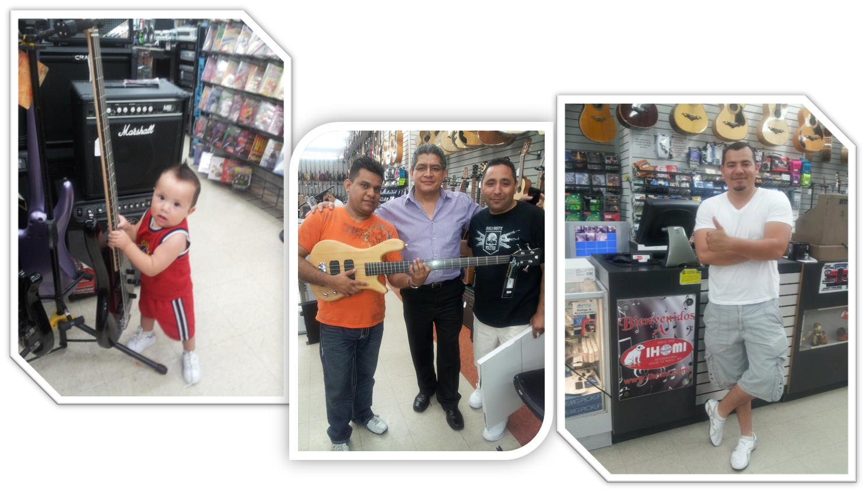
1. Resources we use
Kindness and Gracefulness
First time shoppers
Eight years shopping at IHOMI
Third Generation

Slide 5
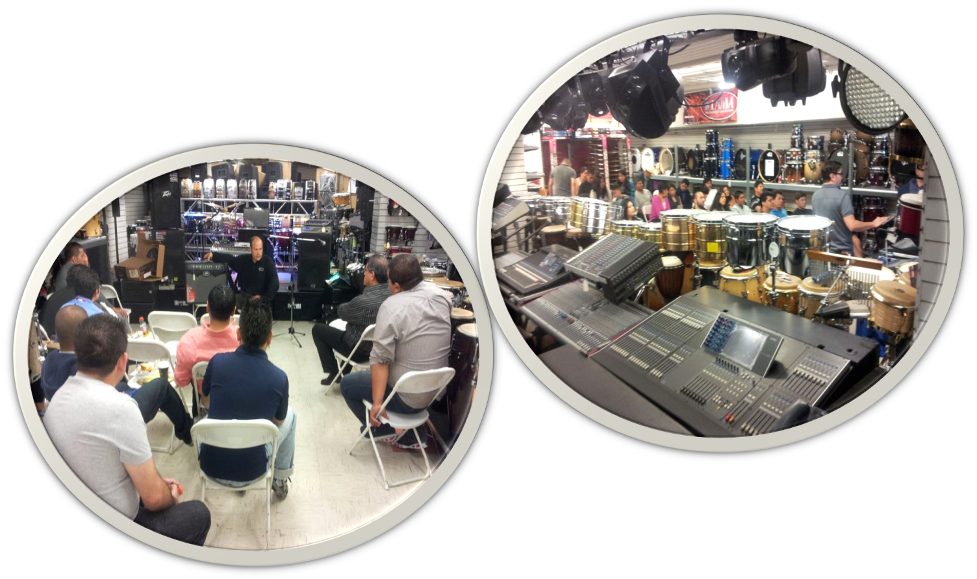
2. Steps we take
Passion and Knowledge / Vendors
Peavey Staff Training
PreSonus Staff Training

Slide 6
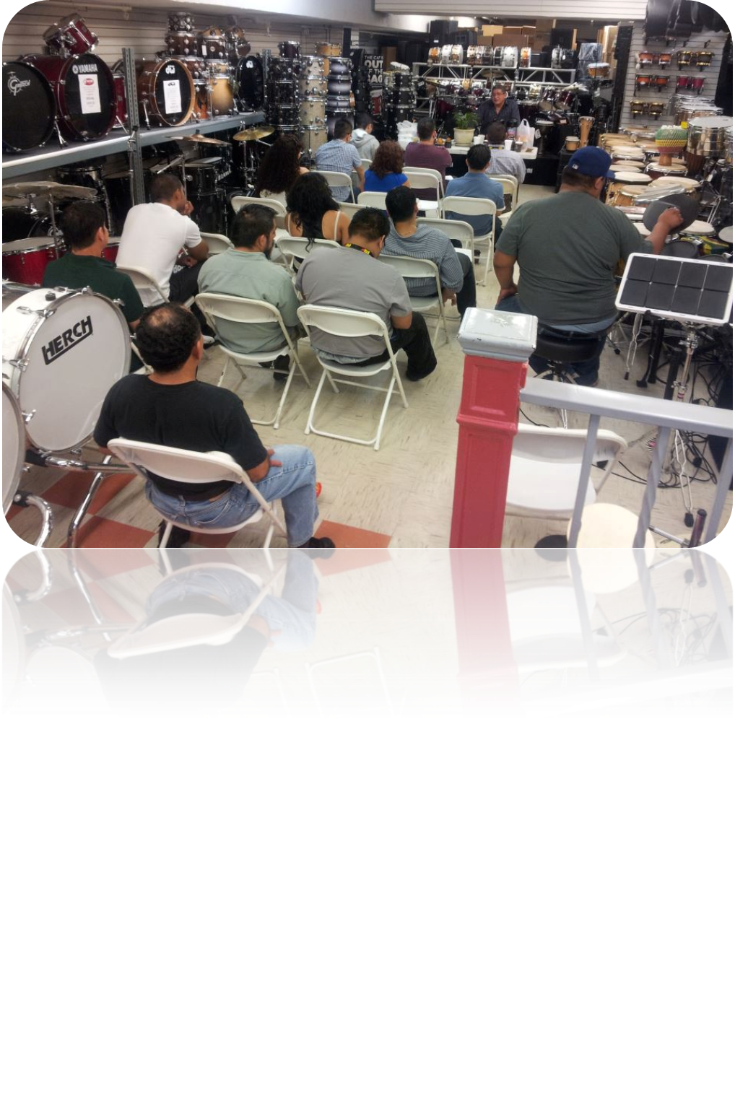
2. Steps we take
STAFF
Passion, dedication and Knowledge / Management

Slide 7
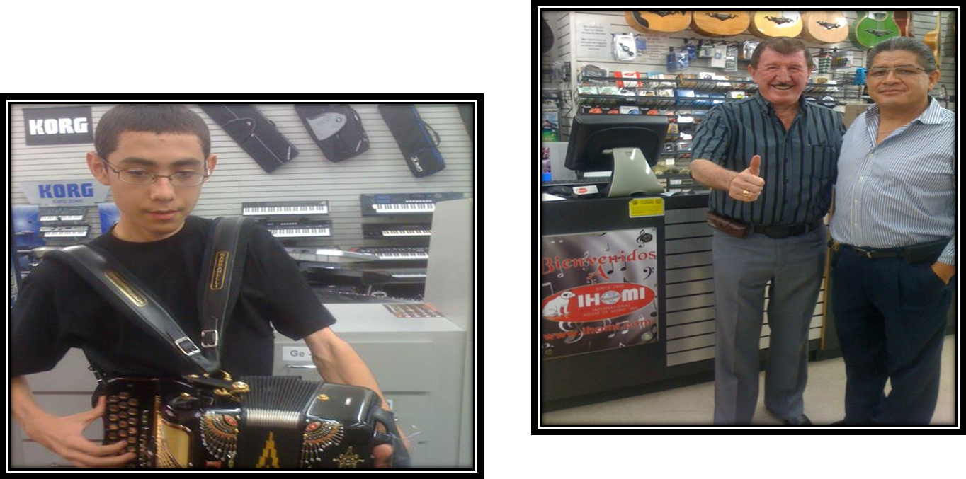


3.Measurable Results
Repeated Sales
German Lizarraga / Int’l Music Director
Ramiro Garcia / Local Artist

Slide 8

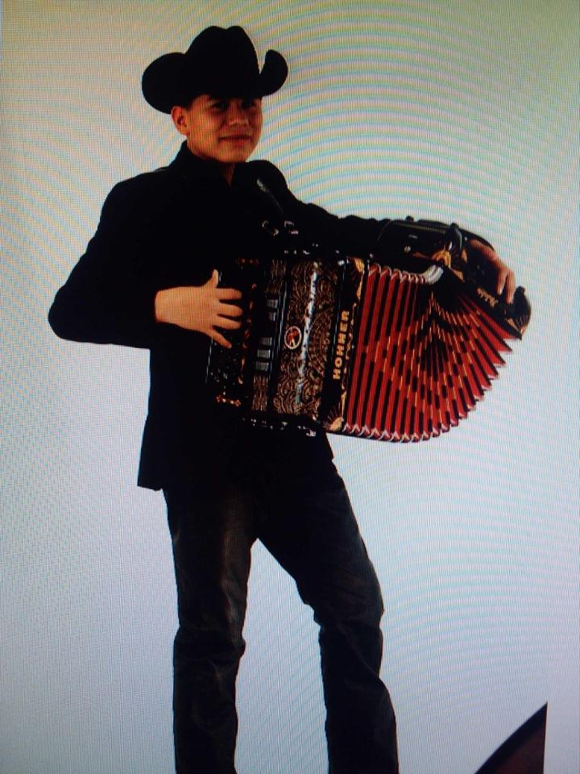
3.Measurable Results
Repeated Sales
Roberni Silva / Int’l Accordionist
Voz de Mando / Int’l Band

Slide 9
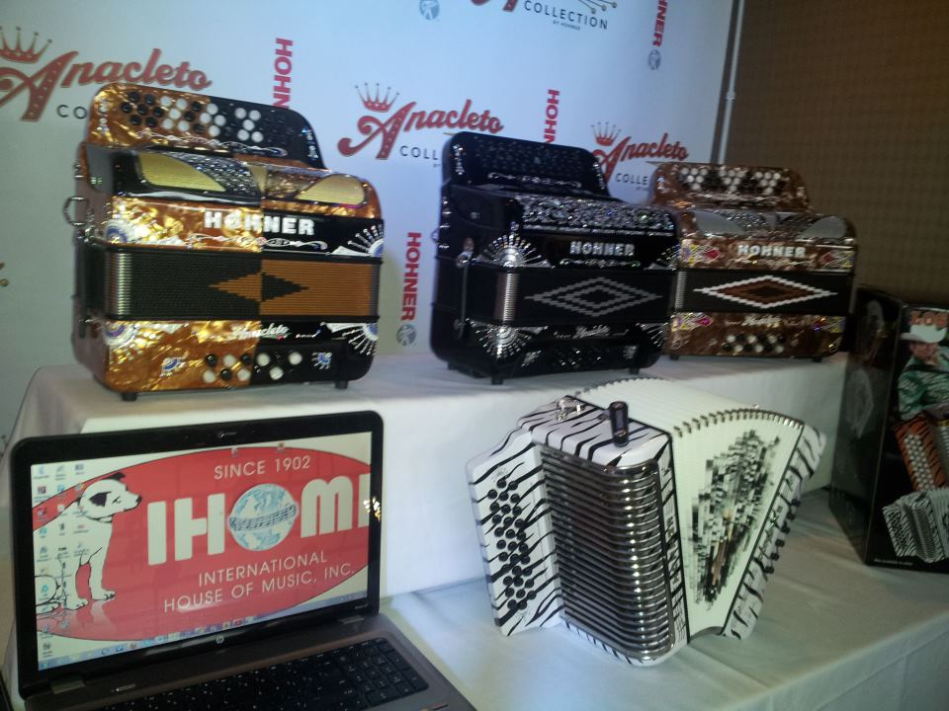
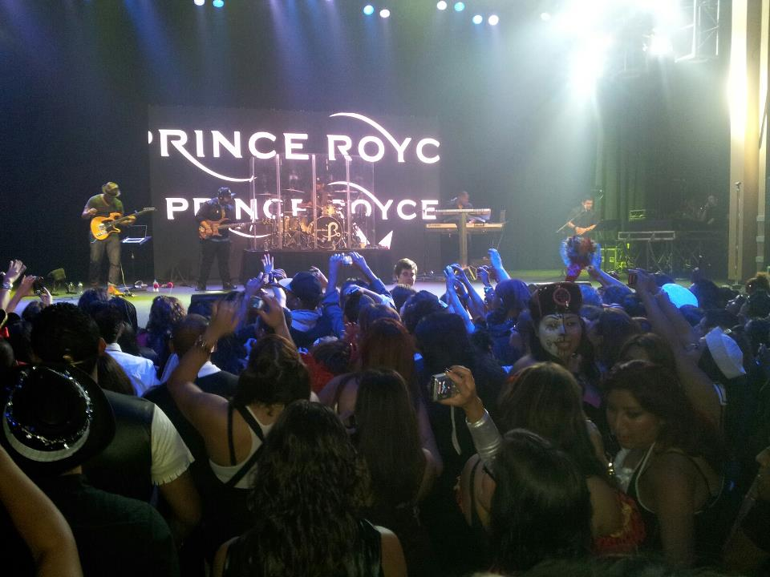
3. Measurable Results
Publicity
Prince Royce – Int’l Artist
Music Awards / HOHNER

Slide 10
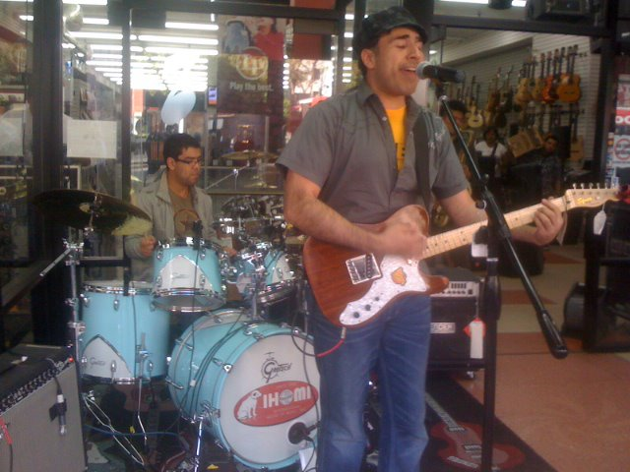
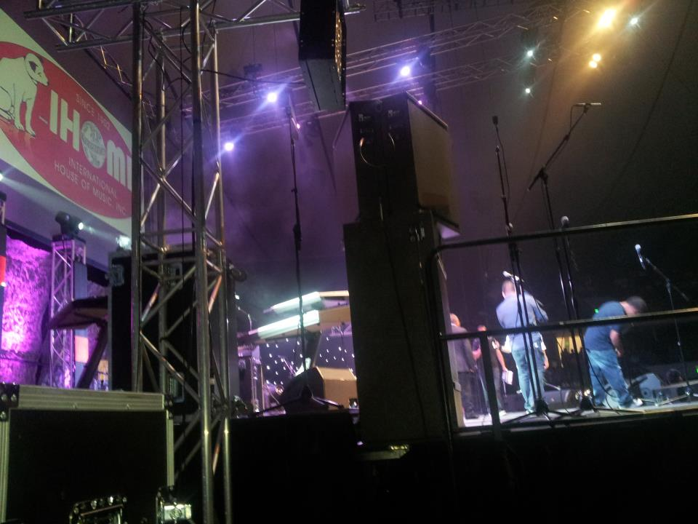
3.Measurable Results
Publicity
Live Christian Music Recording/Miel San Marcos
Malacates / Int’l Music Band

Slide 11
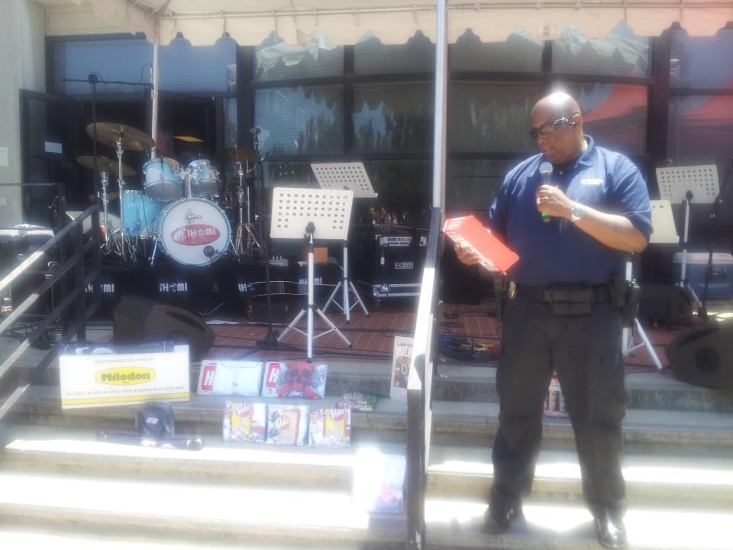
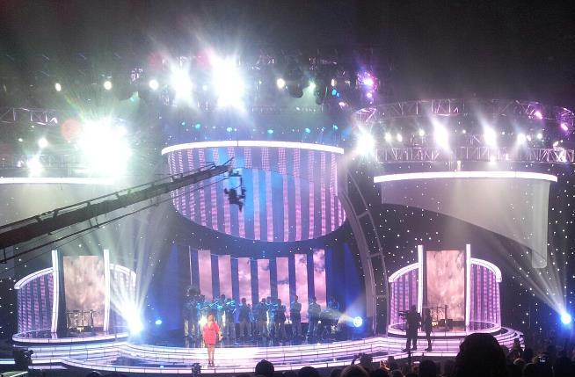
3. Measurable Results
Publicity
LAPD Benefit Event
Billboard Awards

Slide 12
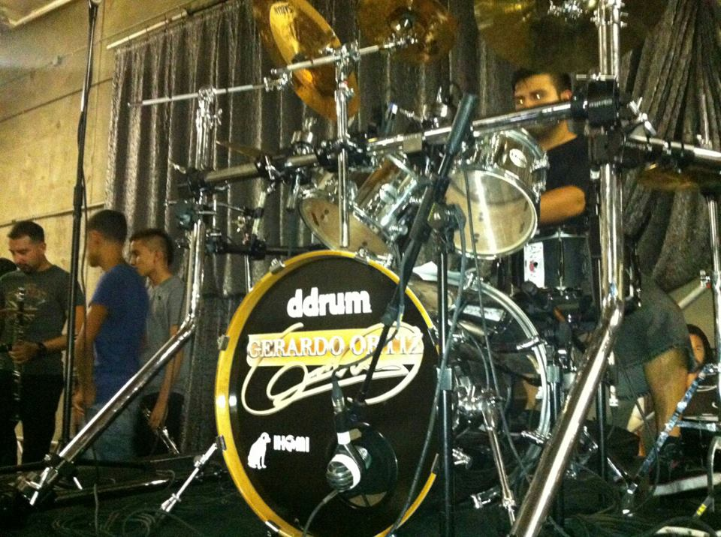
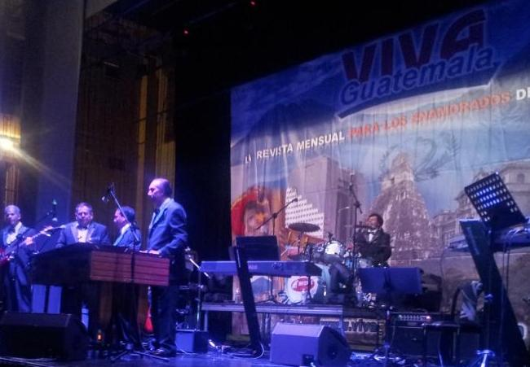
3.Measurable Results
Publicity
Traditional Christmas Celebration
Gerardo Ortiz / Intl Artist

Slide 13




A way to thank doing business with IHOMI
Publicity

