Slide 1


Slide 2

Simple Tech Tools to Boost Your Profits
Billy Cuthrell

Slide 3

Technology is
Rapidly changing our daily lives - more than at any other period in history
Easily attainable - more technologies are available online. Remember CDs, DVDs or physical software?
Easily integrated - much of the tech we use on a daily basis is in the form of apps on our mobile devices. These can be integrated into our retail environments. However, as we see the Internet of Things continue to evolve, we will see more connected devices and platforms, so mobile devices will expand to include wearable technologies (watches, fitness devices, etc. …)
Easily updatable - the price of many technologies is constantly driving down making technology easier to update on a frequent basis.

Slide 4
Five Tech Items to Use Right Now

Slide 5
But....
Before we get to the items, let’s briefly discuss the criteria for my picks.
(Because all tech is not created equal)

Slide 6
1. Affordability
Tech gets cheaper all the time. Consider the falling price of a computer chip or digital storage in the last 5, 10 and 15 years.

Slide 7
2. Accessibility
If It Breaks or We Need Help Setting It Up or Hacking It, How Easy Is The Problem Solved?

Slide 8
3. Ease of Use
How Easy Is It for Me to Use?
How Easy Is It for My Staff to Use?

Slide 9
And Now …
Five Tech Items to Use Right Now

Slide 10
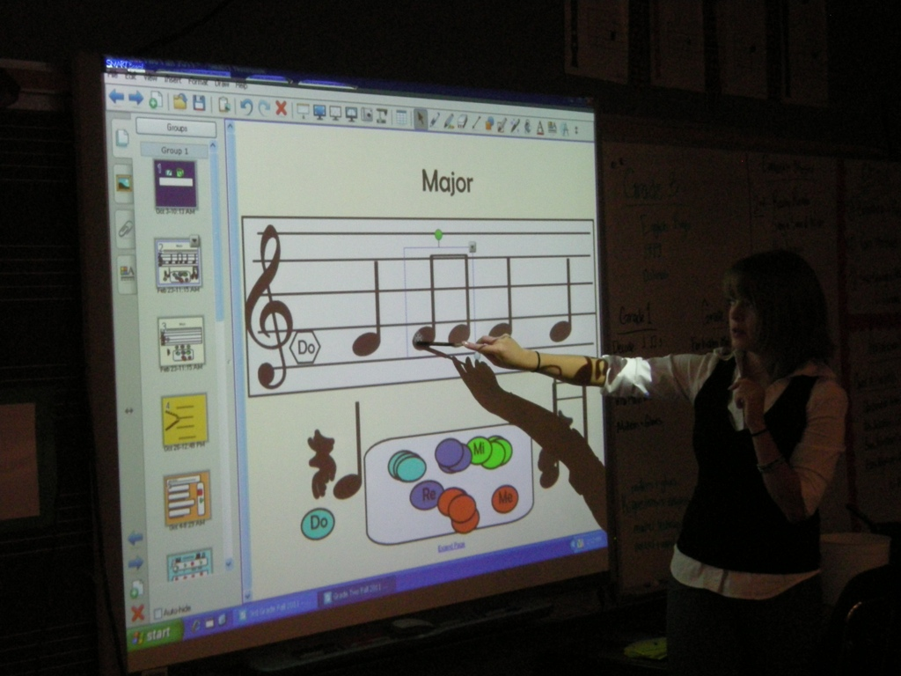
The Lesson Room
Smart Boards

Slide 11
Smart Boards can accommodate different learning styles. Tactical learners can use the screen and learn by touching and marking on the board, audio learners can have a discussion and visual learners can observe the teaching on the board.
Smart Boards are easy to maintain.
Smart Boards make brainstorming sessions fun. You can not only put together text/ideas but also images, diagrams or videos.
Smart Board games can be played on the board itself. All forms of media – videos, photographs, graphs, maps, illustrations, games, etc. – can be used on the board, making it incredibly dynamic in nature. This expands the range of content that you can use for teaching or presenting new information.

Slide 12
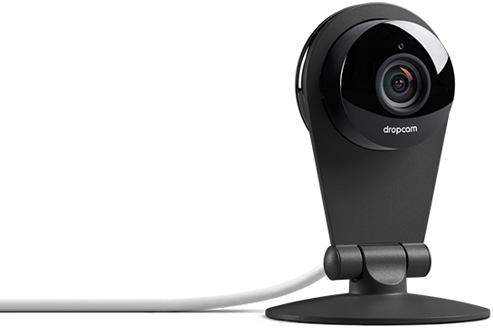
dropcam

Slide 13
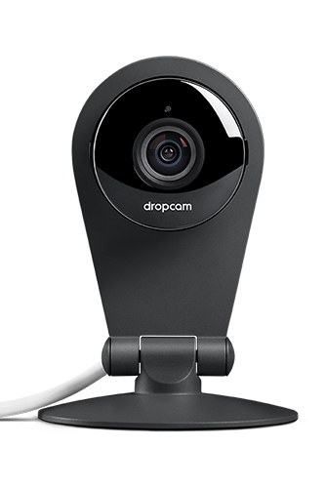
Why use a dropcam in the lesson room?
Wi-Fi enabled - allows anyone to watch anywhere. Grandparents in Hawaii can watch grandchildren’s lessons in North Carolina. Other features include 8x zoom, 130° field of view, free access to your live video from a computer, tablet or smartphone, built-in mic and speaker.

Slide 14
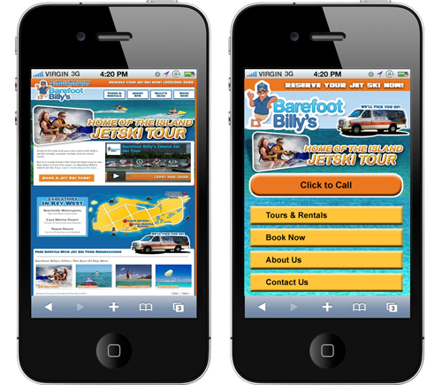
The Retail Store
A Website Optimized for Mobile Devices

Slide 15
Mobile Advertising Is Exploding and Will Grow Much Faster Than All Other Digital Ad Categories*
Mobile is growing faster than all other digital advertising formats in the U.S., as advertisers begin allocating dollars to catch the eyes of a growing class of "mobile-first" users.*
New data from BI Intelligence finds that U.S. mobile ad spend will top nearly $42 billion in 2018, rising by a five-year compound annual growth rate (CAGR) of 43% from 2013.*
What does this mean? As more potential customers find your ads, videos and online listings on mobile devices, your website should be optimized for mobile, as they will click directly to you on that same device.
* Source: Business Insider Intelligence.

Slide 16
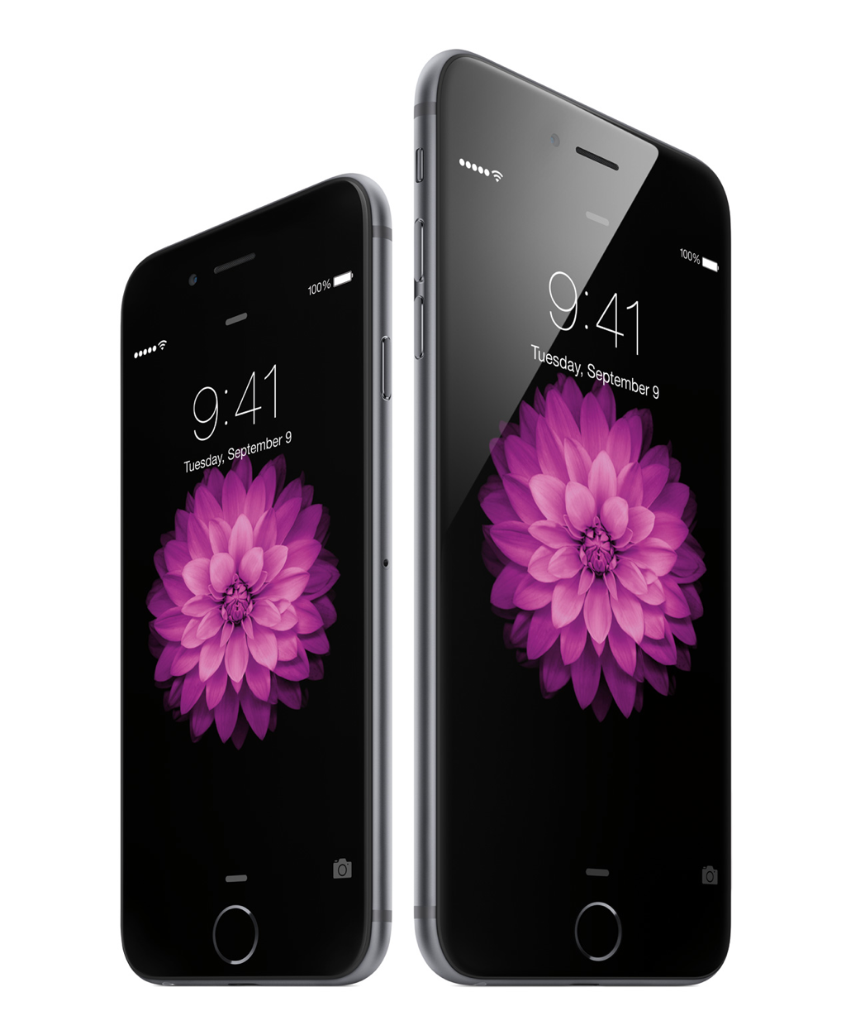

Slide 17
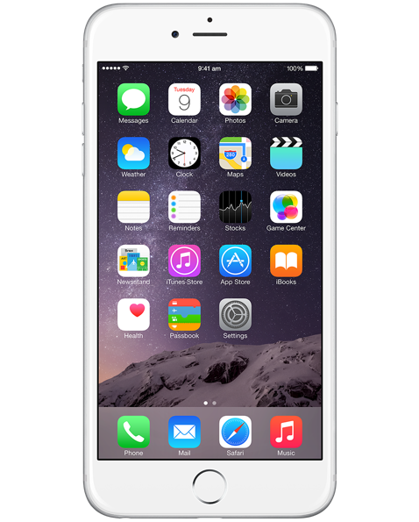
We supply our managers with iPhones, and they have been one of the most important tools used in my retail landscape.
Stable operating system. Not to say Android is not as stable, but my staff has more experience with iOS.
Sales can be made from any contact point in your store. Mobile devices as POS systems.
Faster searches for product/price comparisons.
Apps. Metronomes and learning tools can be used by teachers, not to mention the use of video, access to music and, on iPhone 6, the time lapse feature.
Granted, the iPhone may fall short of my affordability criteria if you switch the phone out at every update cycle, but if you dollar cost average the retail price over the length of use, it is affordable technology. It also has been easy for us to integrate in my shops, and we’ve had no problems with any of our units.

Slide 18
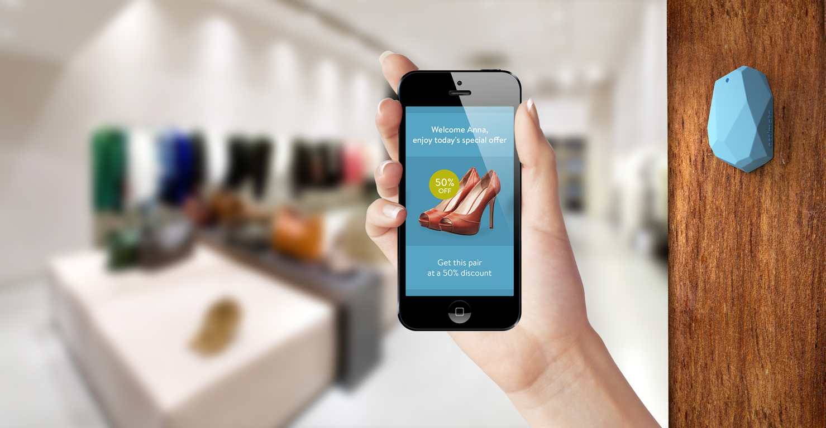
For the Sales Floor:
Beacons

Slide 19
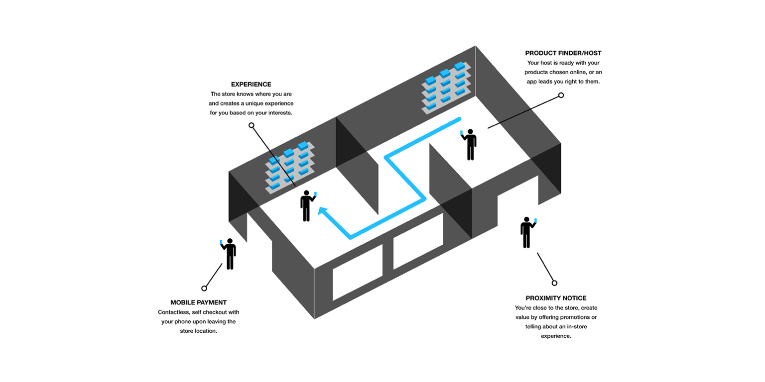
How Do Beacons Work?

Slide 20
In summary, technology is rapidly changing the way we conduct business, interact with customers and manage our retail environments.
Mobile technology continues to grow at a rapid pace, and the Internet of Things, where all items are connected, continues to evolve into product categories we never thought possible.
If you are not consistently using technologies or you do not have a dedicated person to assist you in integrating technologies into your store, start now.

Slide 21
Thank You For Attending!
For more tech ideas, pick up this month’s edition of Music Inc. magazine and read my Retail Doctor column.
Feel Free To Contact Me billy@RaleighMusicLessons.com

