Slide 1

Innovative DIY Store Design
Ideas You Can Use
– Jen Lowe @jenjenlowe

Slide 2
What is the one idea you cannot live without?

Slide 3
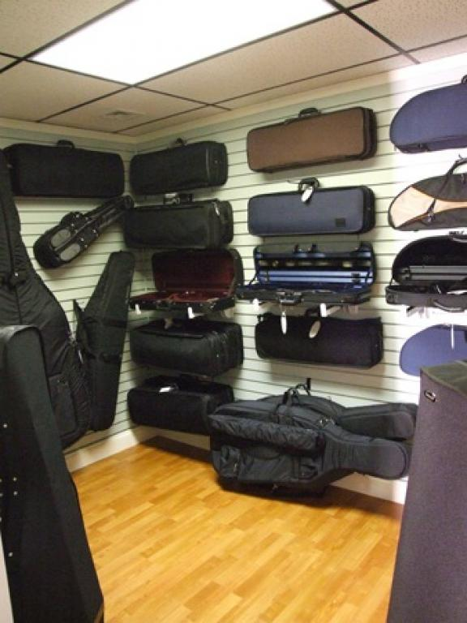

Slide 4
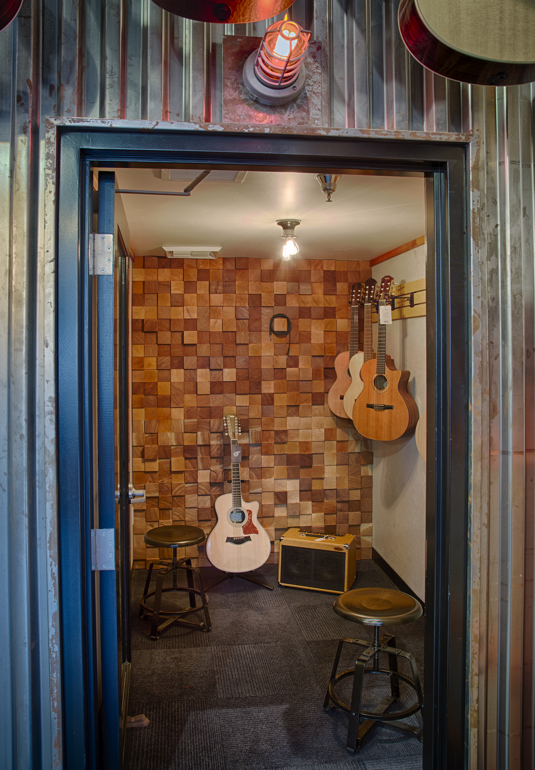

Slide 5
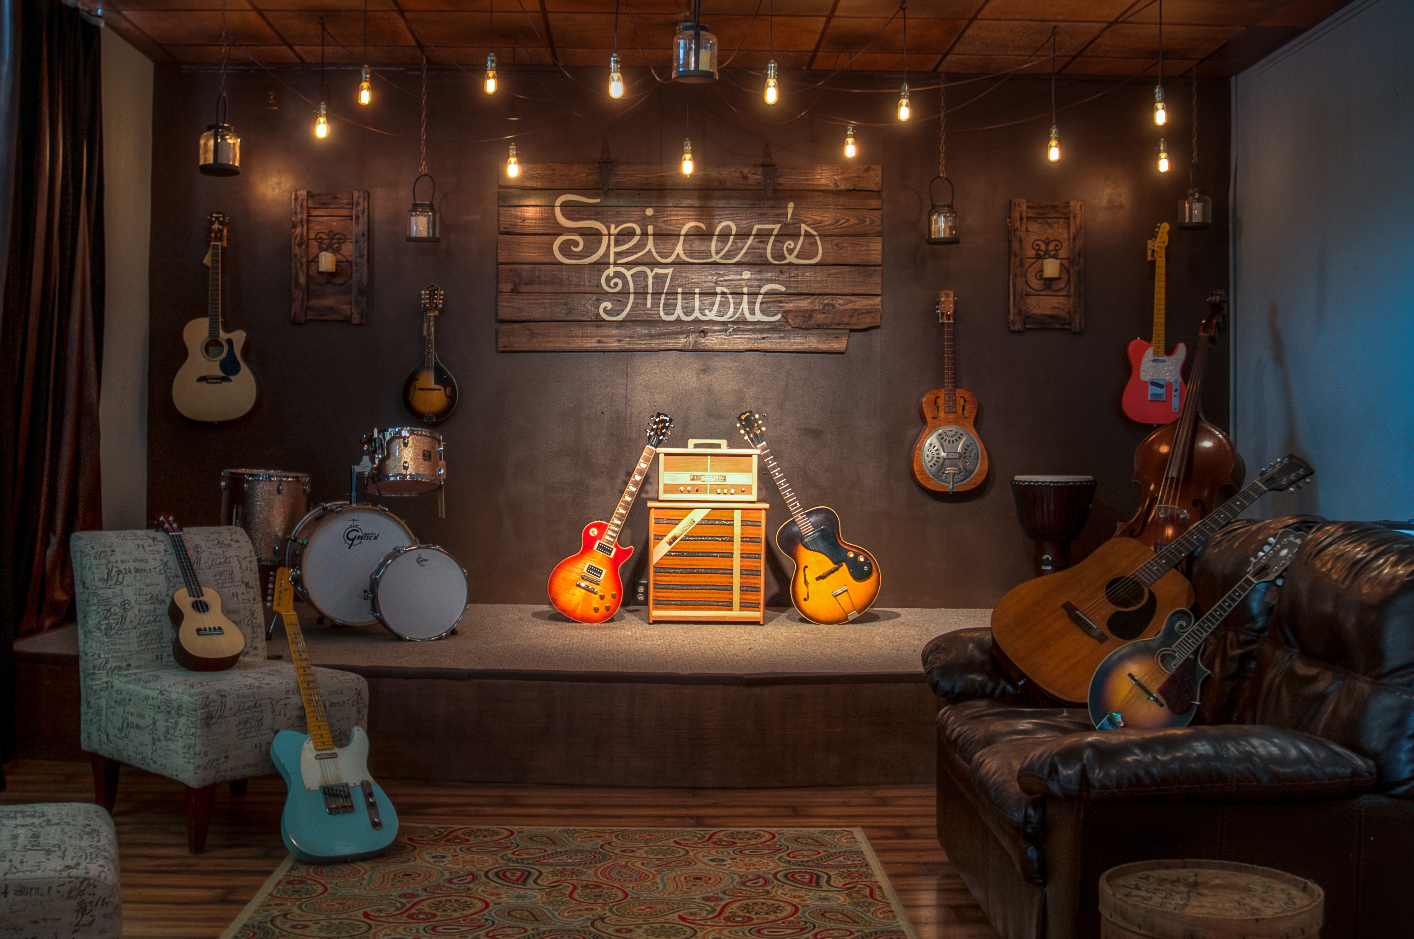

Slide 6
What is the one idea you implemented for under $1,000?

Slide 7
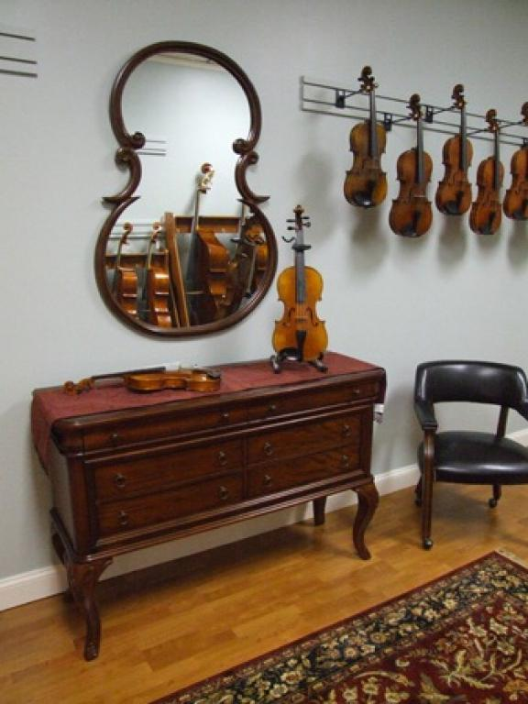

Slide 8
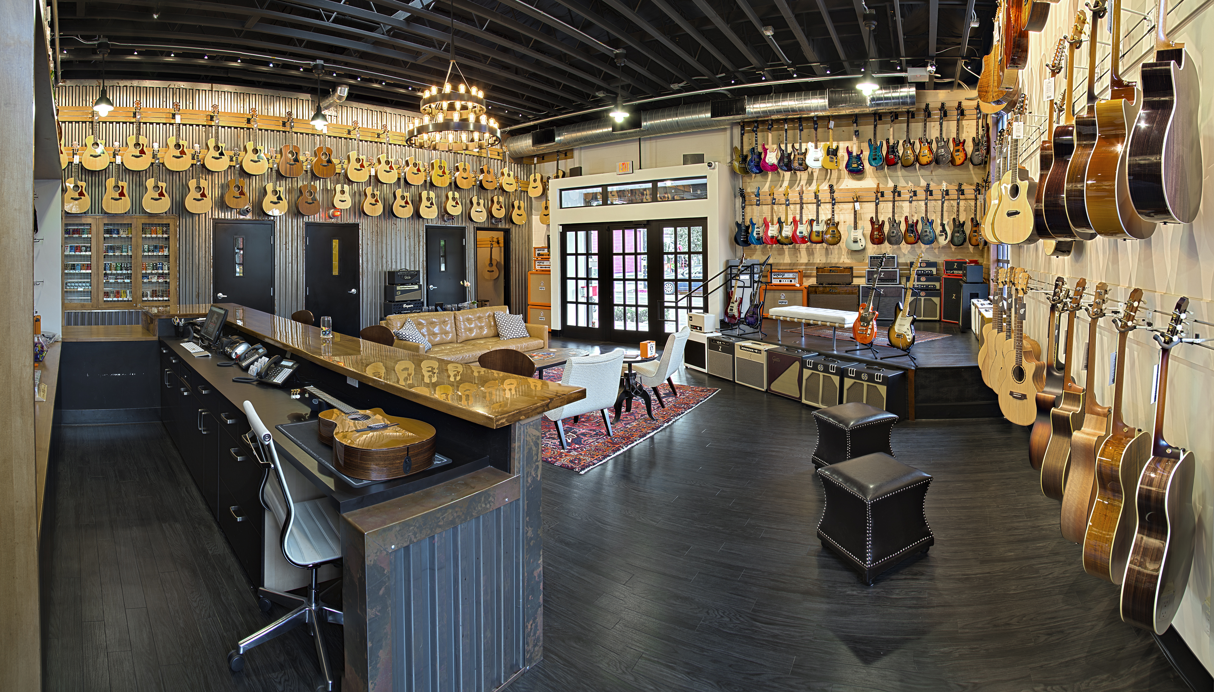

Slide 9
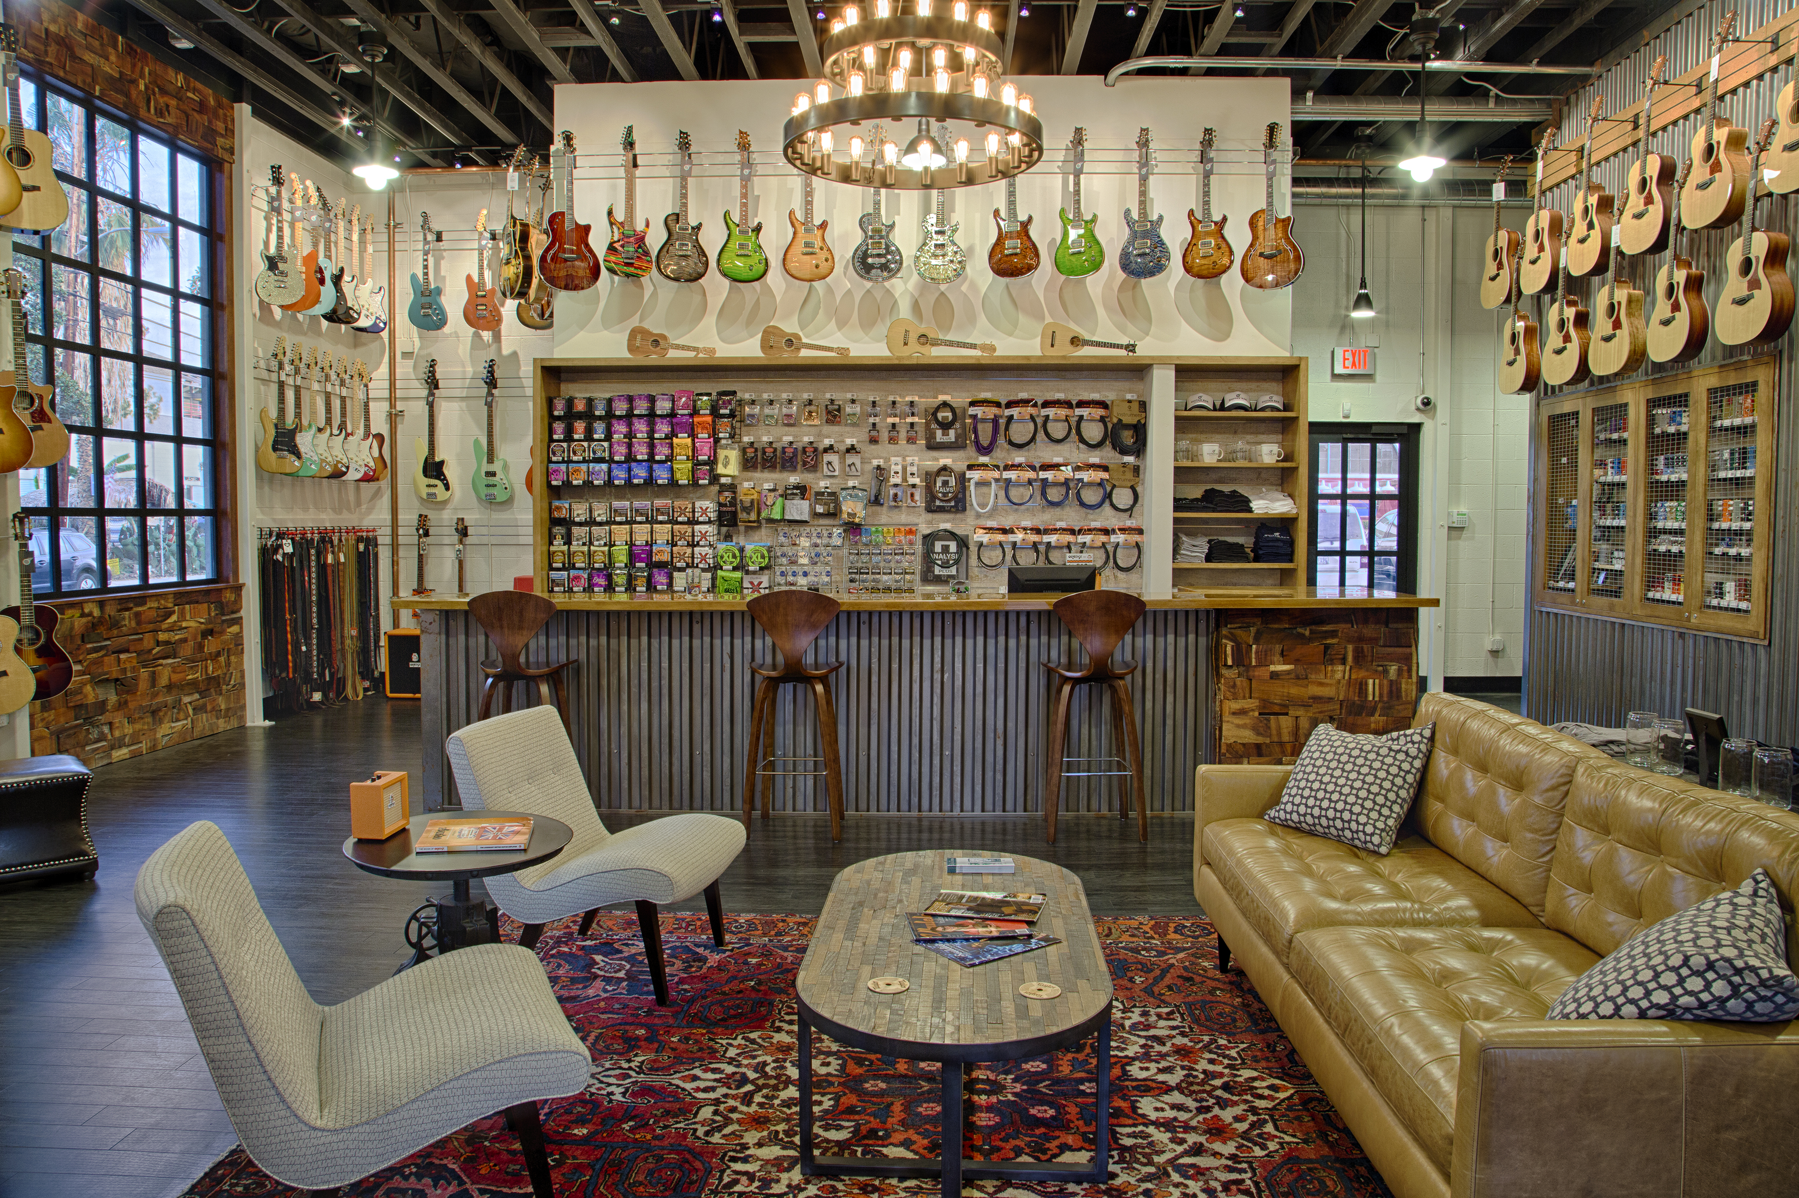

Slide 10
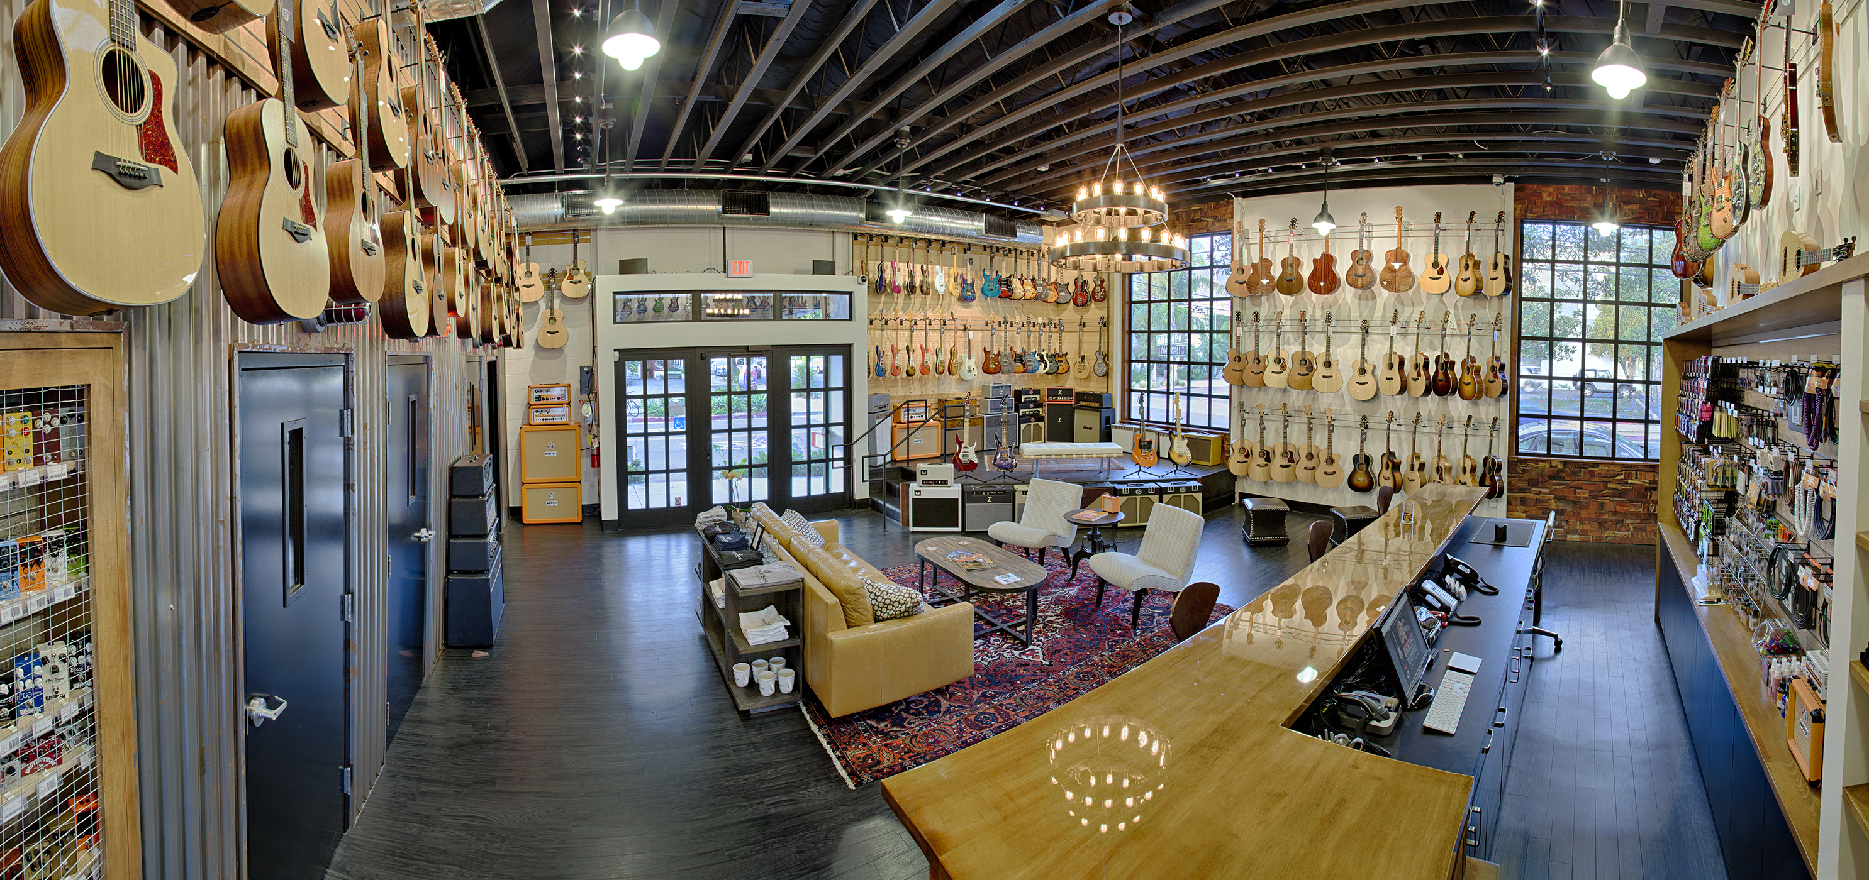

Slide 11
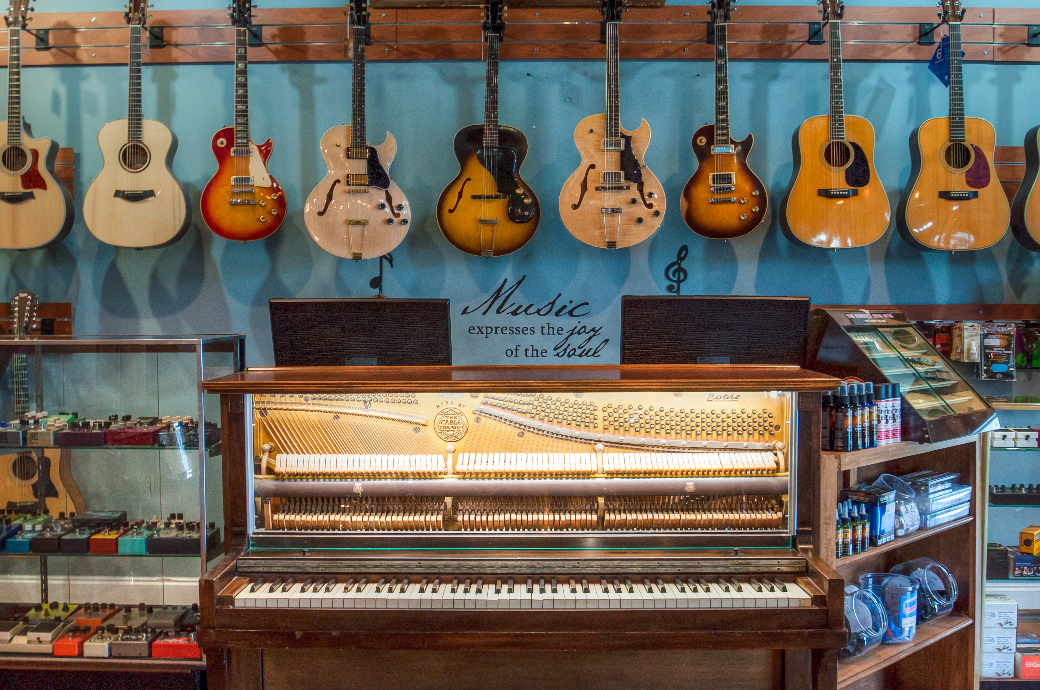

Slide 12
What is the one idea you implemented that was a DIY?

Slide 13
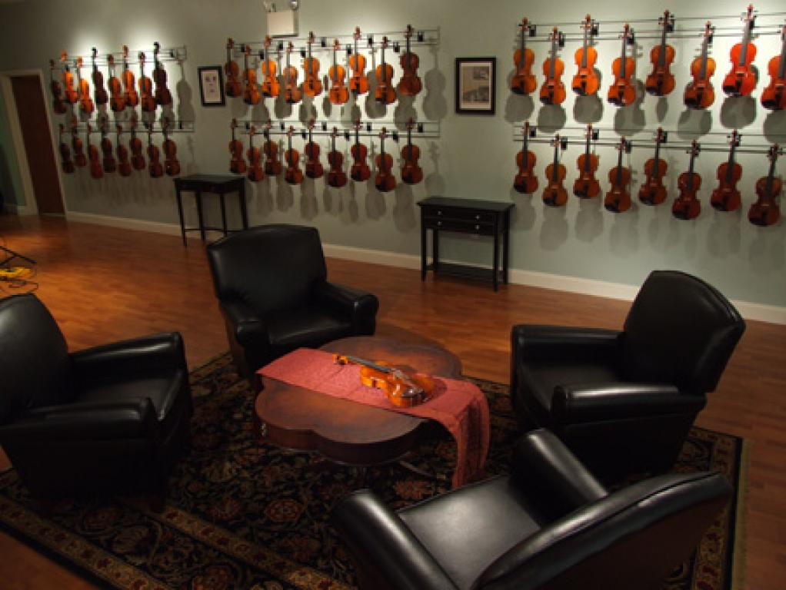

Slide 14
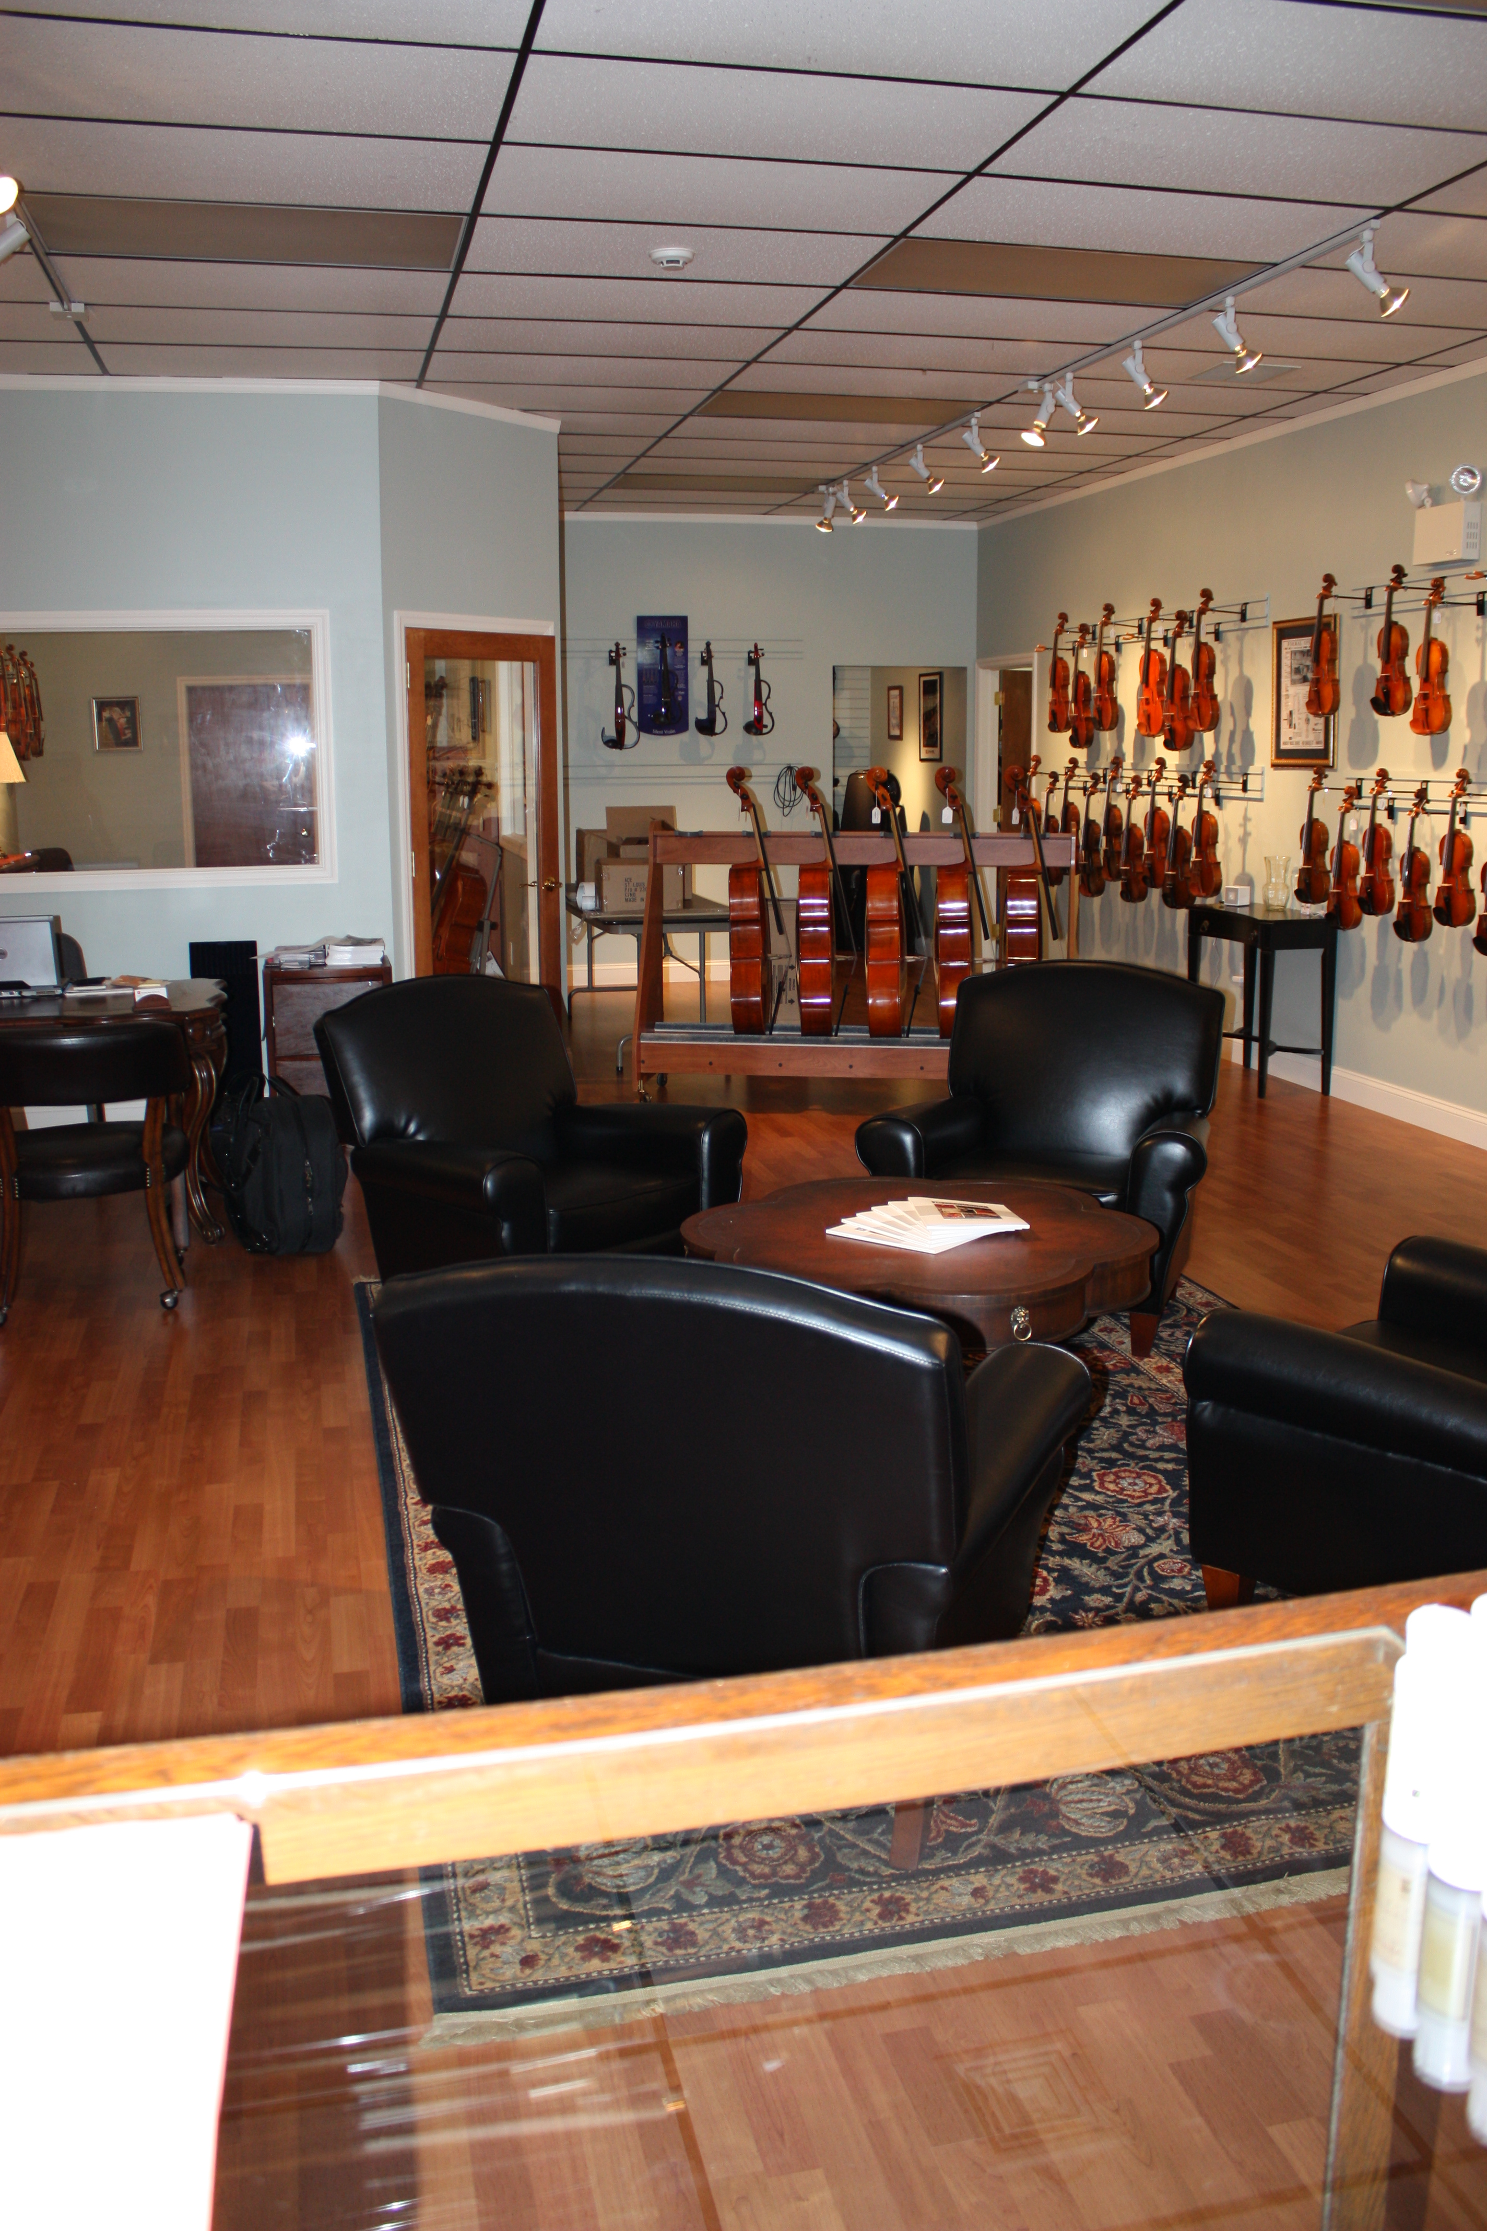

Slide 15
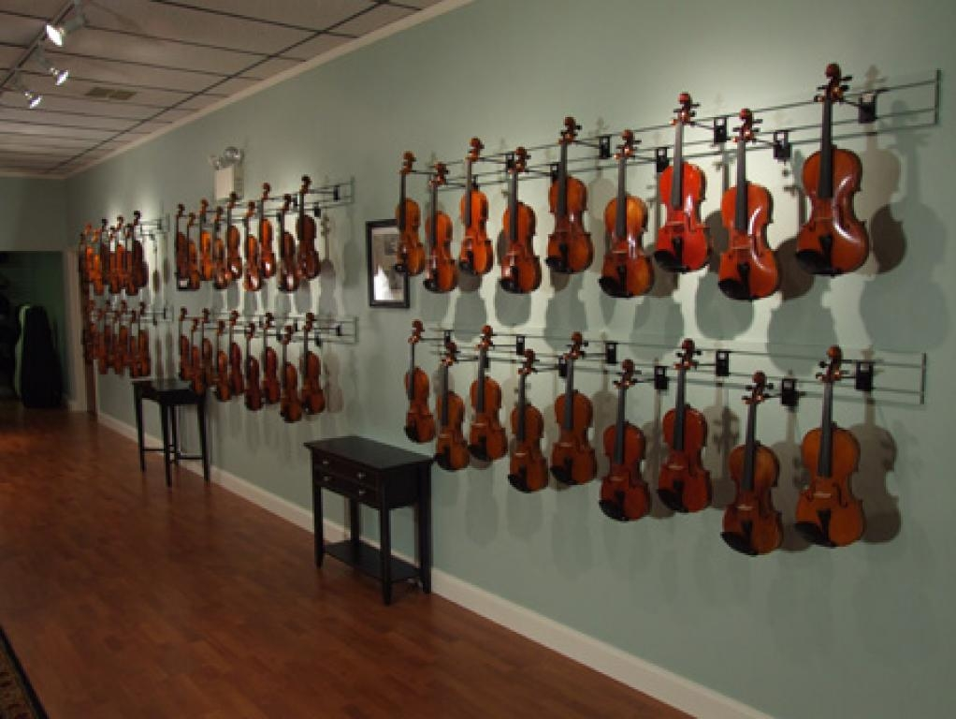

Slide 16


Slide 17


Slide 18
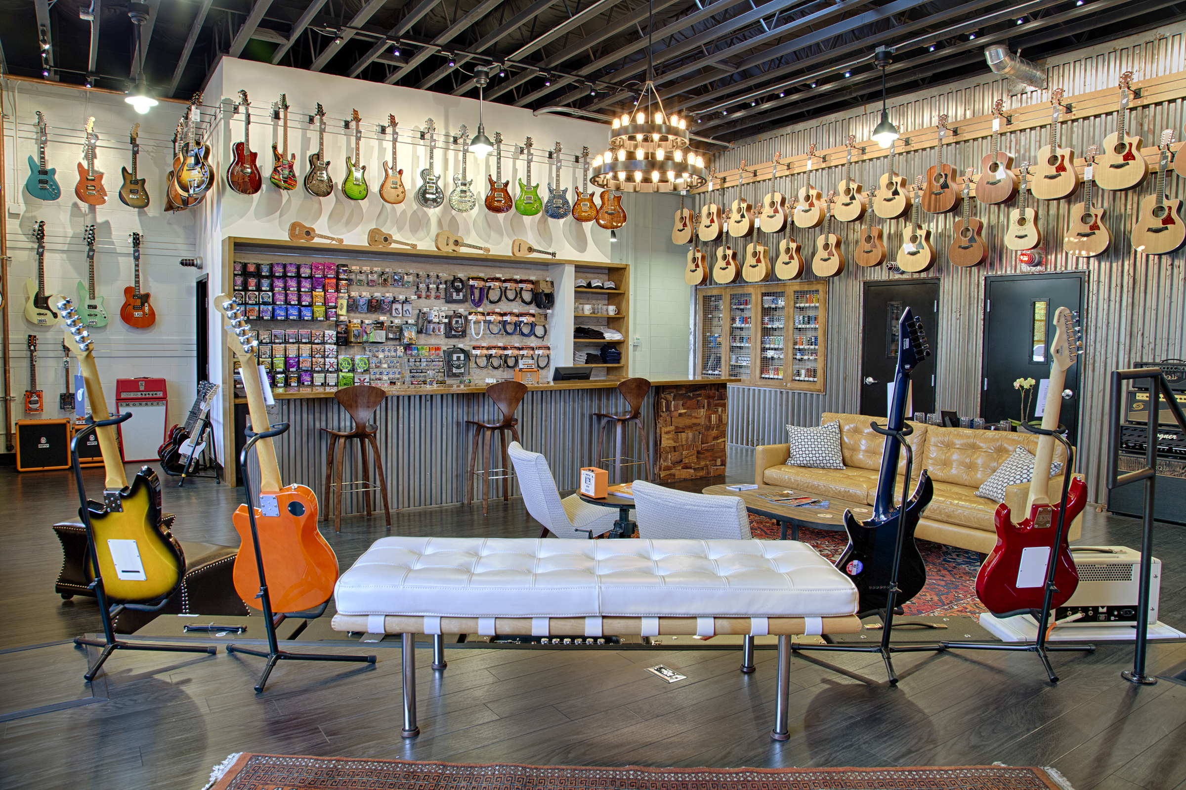

Slide 19
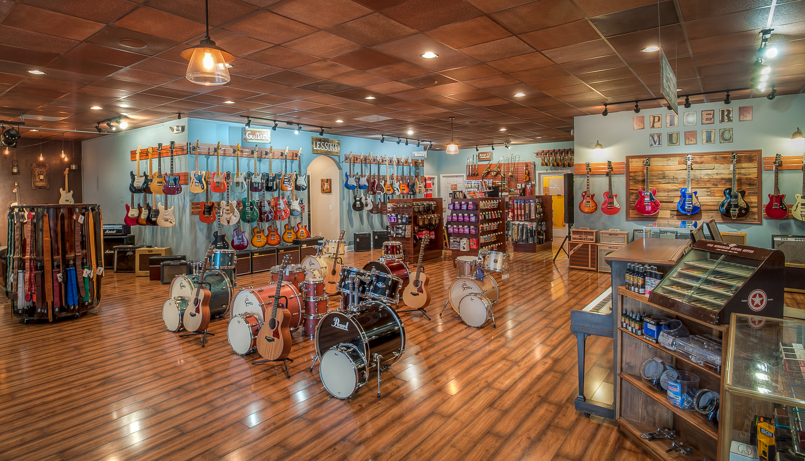

Slide 20
