Slide 1


Lessons:
Loss Leader or
Profit Center

Slide 2
What Does Loss Leader Mean?
A business strategy in which a business offers a product or service at a price that is not profitable for the sake of offering another product/service at a greater profit or to attract new customers.
What is a Profit Center?
A business unit or department which is treated as a distinct entity enabling revenues and expenses to be determined so that profitability can be measured.

Slide 3

What Does Loss Leader Mean?
A business strategy in which a business offers a product or service at a price that is not profitable for the sake of offering another product/service at a greater profit or to attract new customers.
What is a Profit Center?
A business unit or department which is treated as a distinct entity enabling revenues and expenses to be determined so that profitability can be measured.
Silos

Slide 4
A business strategy in which our business offers a service that supports our products and creates new and repeat customers.
Profit Center - Vertical integration
A business unit or department which is treated as a distinct entity enabling revenues and expenses to be determined so that profitability can be measured.
Horizontal integration of metrics is when the measures of success for an area look across departmental boundaries to search for the effect on the company as a whole.
Cross-functional management (CFM) manages business processes across the traditional boundaries of the functional areas.
Cross-functional management consists of area managers working together to make sure they support the activities and interests of the company.

Slide 5


Our Mission
Our People
Our Programs
Our Facilities
Teacher Partnerships
  Recruitment
  Policies
Our Students
  Recruitment
  Performances
Our Experience

Slide 6
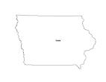
“To Enrich People’s Lives Through Participation in Music”

Slide 7
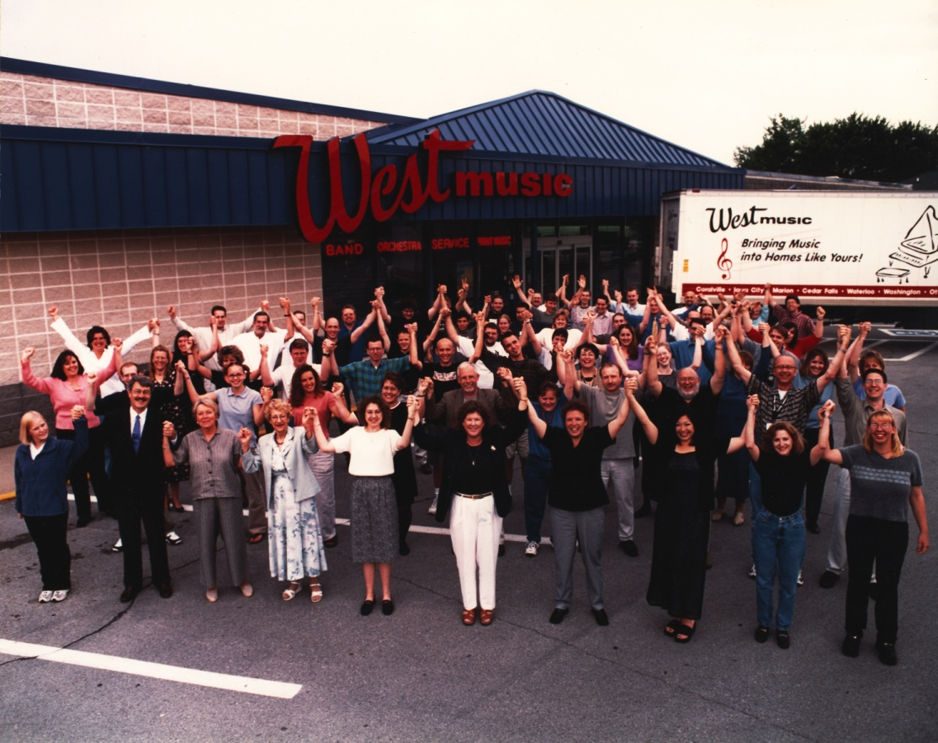
175 Associates
Team Leader
Studio Coordinators
KLC Teachers
Kindermusik Teachers
Music Therapists
Our People

Slide 8

Kindermusik
MiniMusic
Birthday Parties
Individual lessons
  39 different instruments & voice
Group
  Guitar, Piano, and Harmonica
  Musical Moments
  Yamaha Quick Play
Keyboard Learning Center
Weekend Warriors
New Horizons
Our Programs

Slide 9



Music Therapy Services
  Adaptive lessons
  Sound Reach Choir
Our Programs

Slide 10
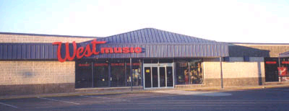
5 Retail Stores
72 Lesson Studios
6 Performance Stages
Over 3,500 students weekly
Our Facilities

Slide 11

Recruitment
Interviewing & Testing
Teacher Agreement
Policies
Rates & Payments
Meetings
Workshops
Recitals
Studio Bucks
Adopt-a-Teacher
Working Partnership Program
Our Partners

Slide 12
Adopt-a-Teacher Program
What are the expectations of all West Music sales associates?
Adopt a minimum of 3 teachers
Establish a personal meet and greet with the teacher
  Outline program
  Complete a teacher profile on each (update CRM)
Meet with each partner at least one time per month in a casual setting to share stories and updates.
  Incorporate at least one new product into their lesson program. (accessory item, music, instrument, etc.)
  Write a teacher tale about their/student experience.
  Incorporate as a Teacher Feature in Newsletter

Slide 13
Adopt-a-Teacher Program
What Can the teachers and students expect from this partnership?
Enhanced experience for teachers and their students.
  More positive experience creates retention and word of month recruitment
Input into inventory stocking decisions.
Personal attention
  Feel like part of the Team!
Studio dollars rewards
  One studio dollar earned for each $100 a student purchases
  Double studio dollars for special events (TBA)
Ability to purchase products at partnership pricing

Slide 14

A Program for Teachers and Their Students
Opportunities to Earn Business Development Grants
Free Use of Recital Facilities
Free Attendance to Master Classes, Concerts, Clinics and Seminars
Discounts on Print Music and Accessories

Slide 15

Recruitment
Registration
Policies
Clinics
Workshops
Studio Stock Sale
Performance Opportunities
Our Students

Slide 16


Looking4Lessons
  Space Scheduling
  Student Scheduling
  Monthly Rent Statements
Weekly Reporting
  New Registrations
  Drops
  Re-Registration
Monthly Reporting
  Profit Loss Statement
  Dashboard
  Related Sales
Profit Center?
The Numbers

Slide 17

Questions?

