Slide 1


Beware of How You “Treat” Your Music Teachers
Presented By
Alan M. Friedman, CPA and Daniel Jobe
Friedman, Kannenberg & Company, P.C.

Slide 2

Session Objectives
Pros & Cons between classifying music teachers as employees vs. independent contractors
Criteria used to determine the employment status of a worker by most tax authorities
Classification guidance

Slide 3
“Employee” Designation
Pros –
Control work schedule
Control teaching methods
Control teaching rates
Control compensation & benefits
Limited issues with tax authorities
Cons –
Burden of payroll taxes
Burden of unemployment taxes
Burden of worker’s comp insurance
Burden of health insurance, retirement and other benefits without discrimination

Slide 4
“Independent Contractor” Designation
Pros –
No payroll taxes
No insurance costs
No retirement benefits
No employment benefits
No payroll accounting
Minimized tax reporting (1099-MISC at year-end)
Cons –
No control over work schedule
No control over teaching methods
No control over teaching rates

Slide 5
BEWARE…
The incorrect classification can cause you to be held responsible for…
All back federal & state payroll taxes
All back unemployment taxes
All back employment benefits
BAD…VERY BAD !!

Slide 6
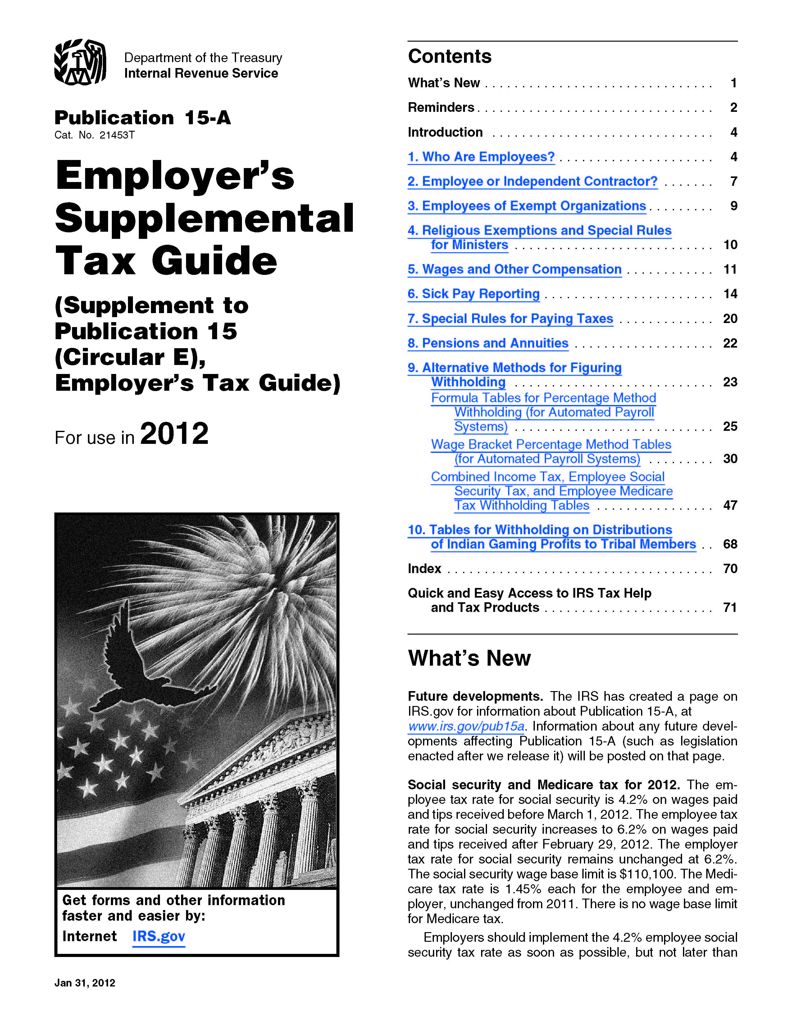
IRS Guidelines
The IRS updates Publication 15A each year with a section entitled “Who Are Employees?”
Status is determined based on the degree of control in 3 categories:
    Behavioral Control
    Financial Control
    Type of Relationship

Slide 7


Understandingthe Three Categories

Slide 8

I. Behavioral Control
Facts that show whether the business has a right to direct & control how the worker does the tasks for which the worker is hired, such as…

Slide 9
When and Where to Work
Employee: Required to work set hours at a specific assigned location
Contractor: Retains the right to complete work at any time and rents or leases a location where work is performed

Slide 10
Instructions
Employee: Must follow mandatory instructions as to where, when and how to perform work
Contractor: Performs work based upon independently established procedures or industry specs

Slide 11
Services Rendered Personally
Employee: Required to render services personally
Contractor: Has assistants or employees while retaining the right to hire others to perform the required work

Slide 12
Hiring, Supervising and Paying
Employee: Does not supervise or hire others
Contractor: Hires assistants at his/her expense to perform all or part of project

Slide 13
Order or Sequence Set
Employee: Required to perform task in a set manner, routine or schedule
Contractor: Has full discretion over routine or manner in which to perform services

Slide 14
Training
Employee: Receives and/or is required to receive training
Contractor: Skilled professional requiring no training to adequately perform services

Slide 15

II. Financial Control
Facts that show whether the business has a right to control the business aspects of the worker’s job, such as…

Slide 16
Business Expenses
Employee: Business or training expenses are paid or reimbursed
Contractor: No reimbursement for business or training expenses

Slide 17
Significant Investment
Employee: Does not invest in facilities and/or equipment used to perform work
Contractor: Possesses and invests in facilities and equipment to perform services

Slide 18
Furnish Tools or Equipment
Employee: Tools and materials are furnished
Contractor: Furnishes own tools and materials

Slide 19
Services Available to General Public
Employee: Services are not offered to general public and points toward control
Contractor: Offers services to public, advertise, and are free to seek out business opportunities

Slide 20
Payment to Worker
Employee: A person guaranteed a regular wage paid at regular intervals
Contractor: Compensation determined separately by project or based on fixed fee

Slide 21
Realization of Profit or Loss
Employee: Compensation for services at fixed rate regardless of profitability
Contractor: Shoulders the possibility of incurring a loss and realizing a profit

Slide 22

III. Type of Relationship
Facts that show the parties’ type of relationship, such as…

Slide 23
Regular and Continuous Relationship
Employee: Services are part of a continuing relationship
Contractor: Provides services and contracts for separate and distinct projects, not on continuing basis

Slide 24
Right to Discharge
Employee: Can be discharged at any time with no liquidated damages
Contractor: Cannot be discharged other than for failure to perform contracted service

Slide 25
Right to Terminate
Employee: May terminate relationship at any time
Contractor: May terminate work relationship only upon completion of contract or breach by other party

Slide 26
Key Aspect of the Business
Employee: Works for the business in a capacity assigned by employer
Contractor: The work performed is the main revenue source and integral to the sustainability of the business

Slide 27

Some Advice & Guidance

Slide 28
Structure the Relationship
To best assure a favorable outcome in the event of tax scrutiny, employers should:
  Have “written” contracts or arrangements with their music teachers
  Have an attorney review all documents
  If need be, request assistance from the IRS in determining status by filing a Federal Form SS-8

Slide 29


Slide 30
IRS Guidance
In a 1970 Court Case, the IRS challenged the worker status of music teachers at a music conservatory. These teachers taught students in accordance with a curriculum provided by the school, as well as provided private instruction to students as part of a lesson program administrated by the school.

Slide 31
IRS Guidance
Upon completion of their audit, the IRS issued Revenue Ruling 70-338 which stated “Teachers instructing regular classes at a music conservatory for regular remuneration are employees of the school; however, teachers who instruct pupils in private lessons in return for a percentage of the fees collected by the conservatory are not employees.”
Essentially, the determining issue was who had control over how the student was taught.

Slide 32

Need more help?
Contact Jen Lowe after this seminar
to set up a meeting time

