Slide 1


Slide 2

Introducing:
Robin Walenta
President/CEO
West Music Company

Slide 3
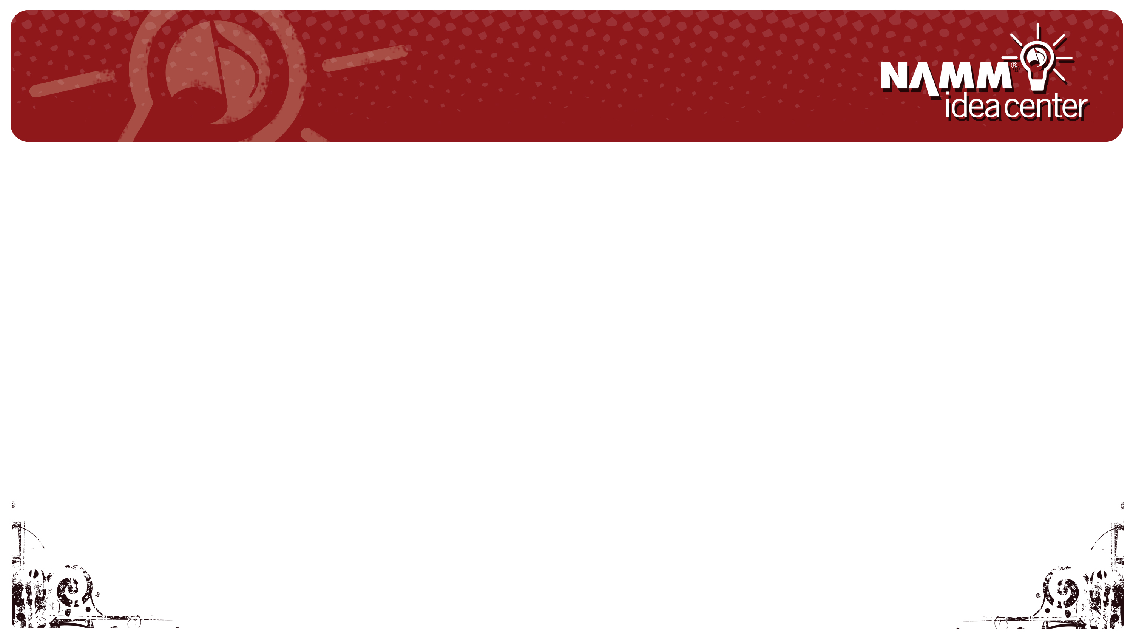

Customer Relationship Management
Develop a true customer relationship-based culture that supports all associates in establishing a repeat and loyal customer base.

Slide 4
Customer Relationship Management
A business approach that integrates people, process, and technology to maximize relationships with all customers.
A comprehensive approach that provides seamless collaboration between customers facing functions
The ultimate competitive edge which allows a business to identify, capture and retain its most profitable customers, cross-sell and up-sell to them through multiple channels, and provide true satisfaction and loyalty in the process.

Slide 5

Why do most CRM implementations fail?
Disconnect between vision and execution.
“Too many CRM projects focus on the mechanics (technology and single channels) rather than the ultimate goal: increasing the value of the customer relationship.
At times, decisions about technology are made well before achieving clarity on customer strategy. “
-Barton Goldenberg

Slide 8
Customer Relationship Management
A business approach that integrates people, process and technology to maximize relationships with all customers.
  People 50%
    This is where most initiatives break down
      People will try to sabotage the process (what’s in it for me?)
      Many people are resistant to change
      It is difficult to learn new processes and systems
Creating a Customer Based Culture vs. an Operational Based Culture will require CHANGE.
Effective change management is about:
Awareness – Understanding – Acceptance – Involvement - Commitment

Slide 9
Customer Relationship Management
A business approach that integrates people, process, and technology to maximize relationships with all customers.
  Process 30%
    Outline your process flow – identifying obstacles that exist that prevent outstanding customer service
      Drive process improvement
      Look to drive efficiency
      Establish performance goals
      Introduce new ideas from best in class industry practices

Slide 10
Customer Relationship Management
A business approach that integrates people, process, and technology to maximize relationships with all customers.
  Technology 20%
    Technology is there to support your culture and to create efficiencies in your communications and operations
    Three Phases:
      Customer Inbound (purchases)
      Customer Outbound (prospects)
      Marketing (profiling)
You must get buy in from all the people and only bring in technology once the culture is established

Slide 11
Operations Improvement
Drives
Increased Customer Satisfaction
Drives
Increased Customer Loyalty
Drives
Increase Profits
Satisfied customers are economic assets with high returns and low risk

Slide 12
Customer Loyalty vs.
Customer Satisfaction
They are not the same thing!
More than half of lost customers were satisfied.
Loyalty is a higher order of commitment
  Loyalty is an emotion
  Loyalty invokes emotional attachment from the customer
  Loyalty occurs when an individual has a vested interest in maintaining a close relationship

Slide 13
CULTURE
Engineering Our Customers Experience
Pay attention to the entire customer experience in cultural design
Understand what the customer wants
Design a culture that means more than just the numbers
People will forget what you said, they will forget what you did, but they will never forget how you made them feel.
- Maya Angelou

Slide 14
CULTURE
Engineering Our Customers Experience
Pay attention to the entire customer experience in cultural design
Design – go out and be your customer so you can get the entire experience
Take a form/document and pretend you are the customer and fill it out
  Identify what you as the customer do not understand or like about the process
  Observe a customer interacting with the form
  Review policy/procedure with all stakeholders and remove unnecessary or uncomfortable steps

Slide 15
CULTURE
Engineering Our Customers Experience
Understand what the customer wants
It must be compelling and captivating
Shift away from policies and procedures that control the customer
Today’s customers want flexibility and empowerment
They have an increased focus on gratification and entitlement
They are connecting service with the product
They have an increased appetite for value
More connected and informed than ever before
Human contact still matters – 70% are shopping in a combination of multi-channel experiences.

Slide 16
CULTURE
Engineering Our Customers Experience
Design a culture that means more than just the numbers
Understand what the customer wants
Have more than just a concern for the numbers
Support your people with a sense that – YOU CARE
What you are doing is bigger than technology
Its about how we connect
You have heard of a Carbon footprint…
but have you heard of the KARMA footprint?
It’s the feelings that you create in the world and how you make people feel.

Slide 17
Referrals / COI
Advocates
Top 20% of customers deliver 80% of revenue and 100% of profit
Key Account Management
Loyal Customers
Lifetime Customer Value
Loyalty Program
Inactive Customers
Customer Survey/Incentive
Customer Profiling
Increasing Importance
Customers
Customer Interactions
Prospect Management
Prospects and Suspects
85% Wish they Would Have
Want to be Players

