Slide 1


Slide 2

Monetize Your Facebook Page

Slide 3
Presented by
John Arnold

Slide 4
Social Media
Money-Making
Basics

Slide 5
The SM Time & Money Matrix
High
High
Time
Low
Low
Money

Slide 6
The SM Time & Money Matrix
“Viral”
High
High
Time
Low
Low
Money

Slide 7
The SM Time & Money Matrix
“Viral”
Advertise
High
High
Time
Low
Low
Money

Slide 8
The SM Time & Money Matrix
Socialize
“Viral”
Advertise
High
High
Time
Low
Low
Money

Slide 9
The SM Time & Money Matrix
Socialize
Campaign
“Viral”
Advertise
High
High
Time
Low
Low
Money

Slide 10

Going ‘Viral’
No viral model, just go for it!
  Entertaining content
  Shock value
  Humor
  Extreme value

Slide 11

Socializing
Focus on building a personal relationship
    IFUIUFM (I’ll follow you if you follow me)
    Sharing content
    Commenting and liking
    Asking and answering questions
    Limited promotions

Slide 12

Social Advertising
Many targeting and budget options
  Profile information
  Location
  Type of relationship
  Cost per click (cpc)
  Cost per thousand (cpm)
Popular options
  Facebook and LinkedIn display ads
  Featured tweets
  YouTube video ads
  Advertising networks

Slide 16
Running Social Media Campaigns
Sweepstakes
Contest
Coupon
Group Deal
Product Giveaway
Favorite Picks
Gifts
Trivia
Quiz

Slide 20
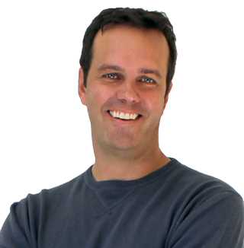

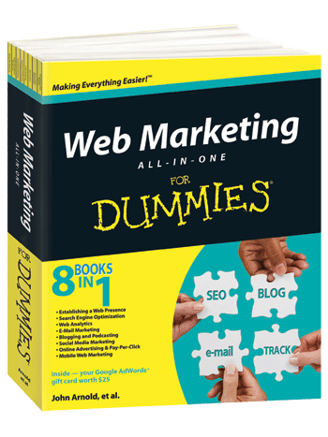
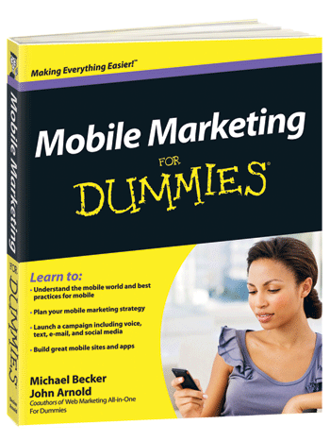
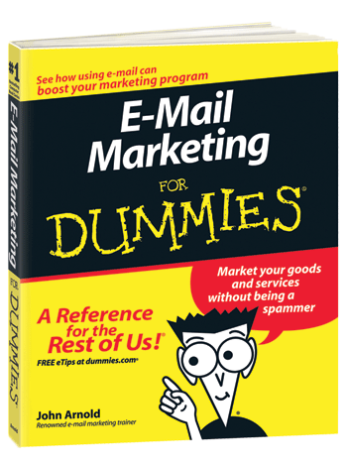
Conclusion
John Arnold
O: +1.303.532.1062
M: +1.303.669.0958
E: john@johnarnold.com
T: @ArnoldMarketing
W: JohnArnold.com

