Slide 1

Turning Facebook Likes into Sales
Rick Camino
CEO, Hello Music
Rick@HelloMusic.com

Slide 2
Background

Slide 3
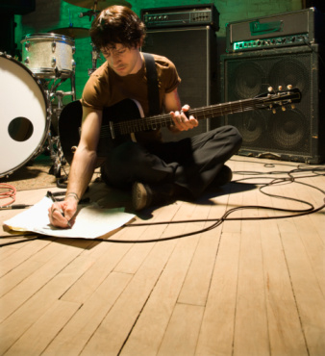
FACEBOOK FACTS
71% of all USA internet users are on Facebook
50% are 18-34
Users have an average of 229 friends
50% login daily for an average of 13.5 minutes

Slide 4
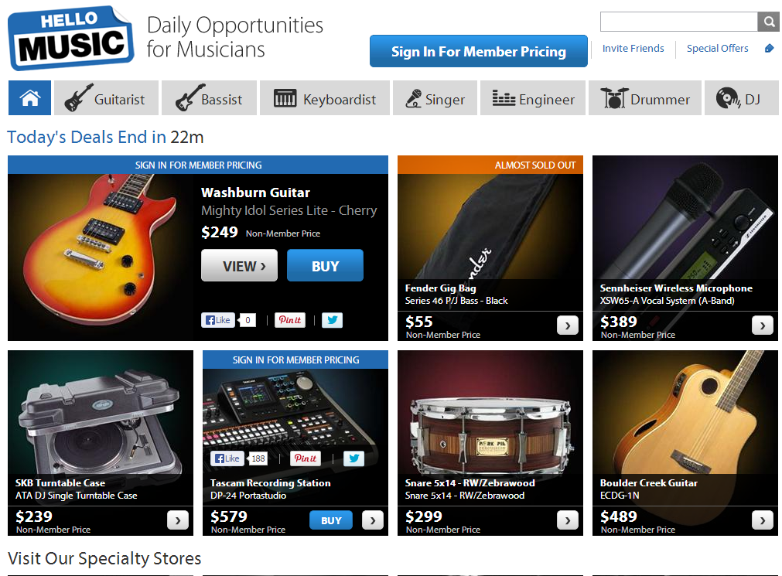

Social Commerce Platform for musicians
Community (Members Only)
Curated Content
Commerce
C2C marketplace

Slide 5
Strategy

Slide 6
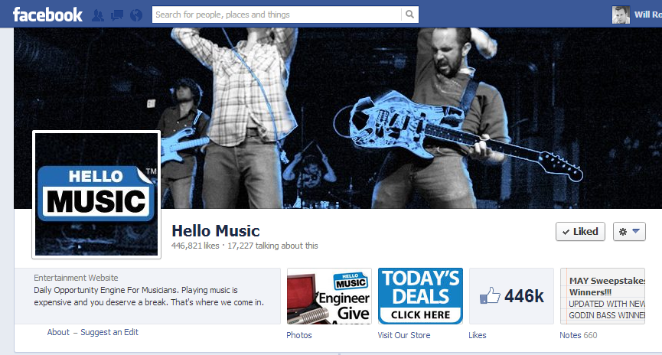
BENEFITS OF FACEBOOK
Brand extension
A place for us to listen and converse
Social endorsement / word of mouth
Membership acquisition
Source of revenue
Notes:
Extension of our brand
[Talking points]
We know our community doesn’t live on our site so we have to take Hello Music to them
Facebook in many cases is our first soft touch point with many of our future members
We give them a tastes of what they will see on our site, communicate back and forth, figure out what products they like and they don’t like and adjust and iterate new products
A place for us to listen
If we listen to our community on Facebook as we do other social media avenues (like Twitter for example) we can gauge what they want, what they don’t want and hone our communication skills so as to enhance their experience with our brand.
When we say listen we actually listen to them.
We ask them what they want to see and sometimes allow them to dictate what we put up next month, next week or even sometime the next day so we are really listening to them and giving them what they want. They are actually being heard by Hello Music in real-time and we are iterating off of listening to them. This is a very satisfying experience for both the consumer and us as a Brand because we only exist at the pleasure of the members in our community no matter where they live.

Slide 7
TARGET A SEGMENT OF YOUR CONSUMER’S JOURNEY
Awareness
Familiarity
Consideration
Purchase
Loyalty

Slide 8
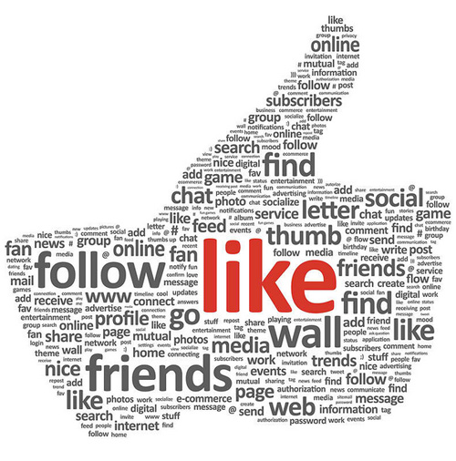
FOCUS ON SPECIFIC ACTIONS
  Likes – Social endorsement and demand gauge
  Shares – Amplification of content to friends
  Comments – Engagement and conversation
  Clicks – Redirect to a landing page

Slide 9
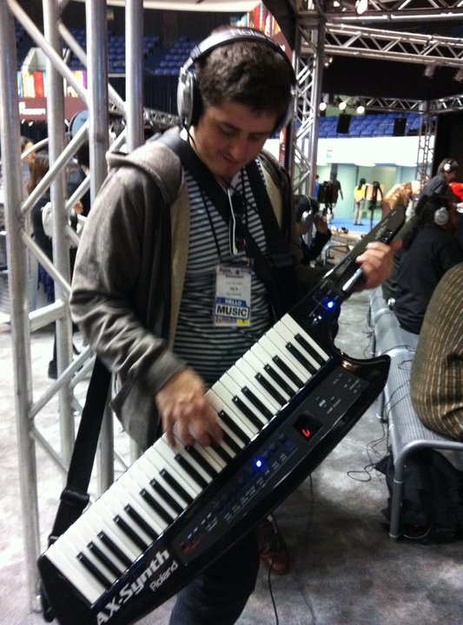
CUSTOMER INSIGHTS
  Demographics via Facebook Connect’s interface (API)
    Name
    Email Address
    Gender
    Age
    Location
    Birthday
    Etc.

Slide 10
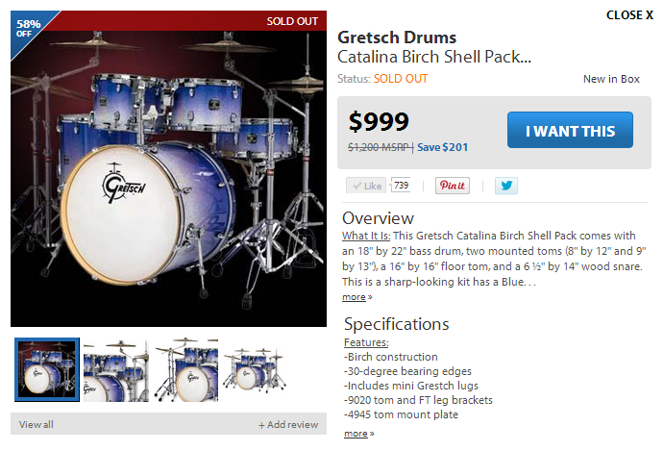
CUSTOMER DEMAND GAUGE
  Volume of likes can indicate potential sales demand
  Historical Likes can influence re-orders
  Targeted campaigns, using member emails collected from Facebook API

Slide 11
Tactics

Slide 12
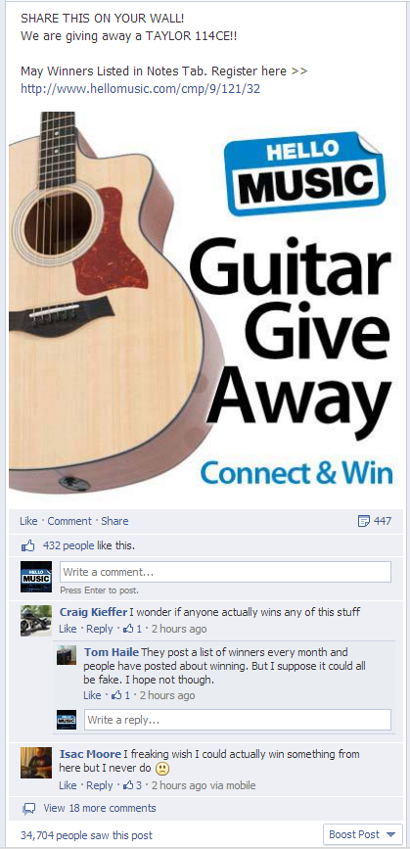
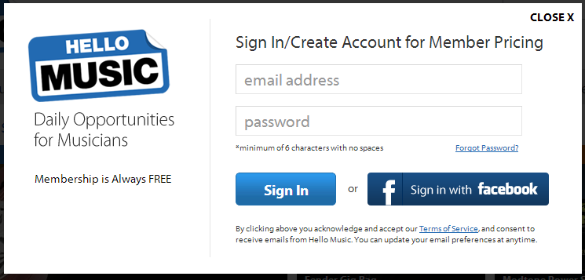
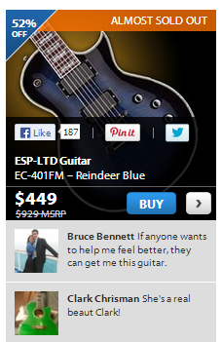
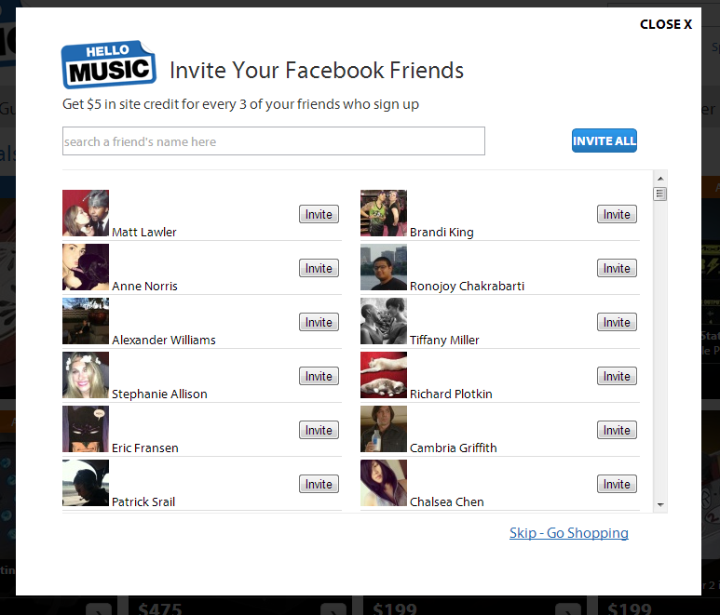
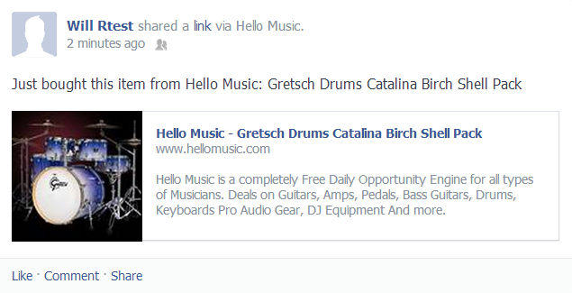
Leveraging Facebook
Acquisition
Sign In
Endorsement
Referrals
Amplification

Slide 13


TACTICS THAT WORK
Pre-sales – Early access to the hottest products and services
Exclusives - Facebook only products & services
Feedback – Poll and survey our community
Coupons & Promotions – Early access to limited quantity deals
Sweepstakes – Give-a-way dream products
Other – Trivia, feature fans, SWAG giveaways, customer support and assistance

Slide 14
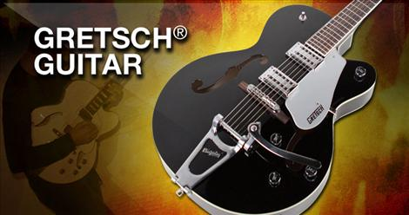
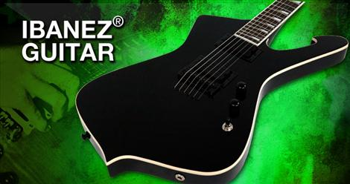
TIPS AND TRICKS:
Use sexy images of your gear to drive engagement
Respond to any and all constructive feedback
  Positive or negative
  Great feedback deserves a great response
Resolve issues and concerns openly
Notes:
We want to connect with our community no matter where they are. We realize they aren’t going to be on our site all day long so we reach them where they do spend a lot of their time and we all know everyone is on Facebook. Our first touch point with a lot of our members is Facebook.

Slide 15
Results

Slide 16
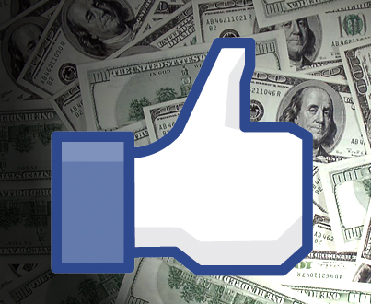
A highly effective platform
4,000,000 musicians weekly
450,000+ Facebook members
35% of Hello Music traffic
25% of daily sales originate from Facebook

Slide 17
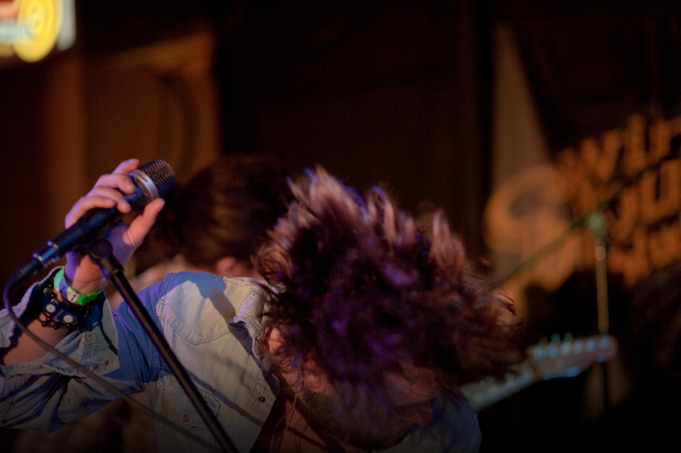
THANKS

