Slide 1

Course Title

Slide 2
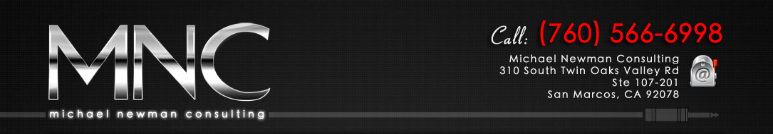
Best Facebook Marketing Examples You Can Use
Michael Newman
Michael Newman Consulting

Slide 3
What we will cover…
Facebook examples inside and outside the M.I. Industry that any size company can use
The strategies behind the examples
Tools and third party services you can use
Ways to drive fans to your site & purchase product
(This session assumes basic knowledge of Facebook)

Slide 4
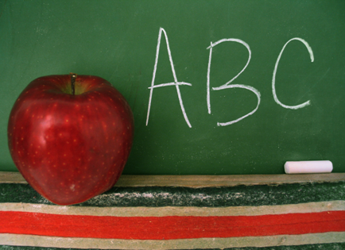
Facebook Posting Techniques and Strategies

Slide 5
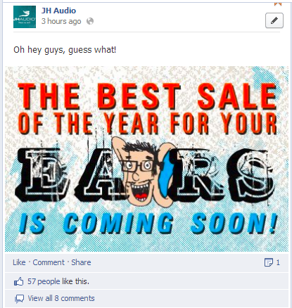
  Make your image sizes match your post intent
  Increases engagement when fans can see entire image in their newsfeed
  Single column page post: 403px
  Double column page post: 843px
  Milestone image: 843px

Slide 6
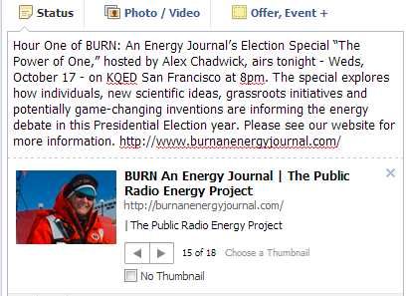
Posting using just the link image is boring
Most people post this way
Image choices are limited to what is on the page
Some pages may not have images
Image is only a small thumbnail

Slide 7
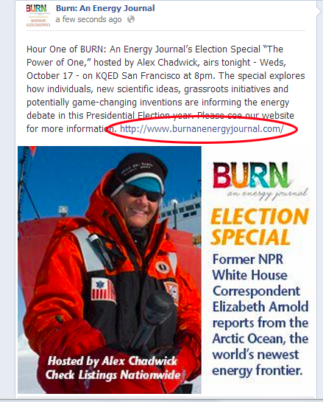
Include a link and upload an image
People see your content on their newsfeed not on your page
Creates better engagement and branding possibilities
Engagement = increased reach
Allows you to choose the best image for the post
Remember ideal image sizes

Slide 8
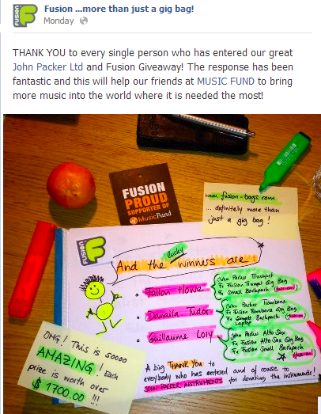
Fusion Gig Bags sweeps winner announcement
When you don’t have a picture, get creative
Image increases engagement from fans
Keep art supplies handy

Slide 9
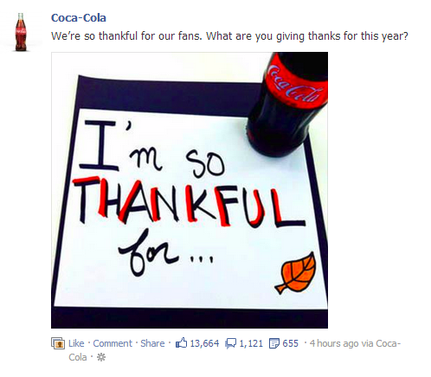
This post was created in minutes and uploaded via phone
Creates a more personal and intimate message (like a handmade birthday card)
Fill in the blank message gets huge engagement

Slide 10
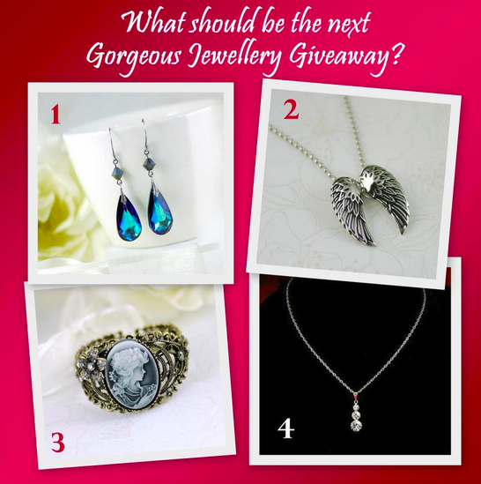
Put your engagement message in your images
Fans see your content in their newsfeed, not on your page so make images count
Make engagement easy
This post: 218 comments and 199 Likes

Slide 11

Mix quirky and fun with your business messages (Chocolate for Breakfast)
This post received almost 200 Likes and almost 100 shares
Take a risk – trying to cater to everyone all the time is boring
Fans will share fun stuff
Page has 14,000 Likes
Notes:
From the Chocolate for Breakfast page

Slide 12
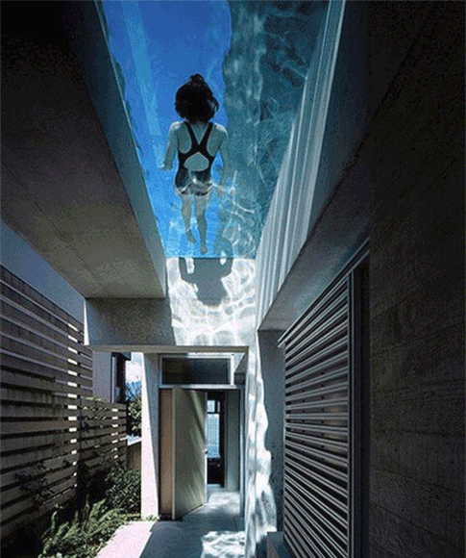
Pool service supply company posts images of striking pools and asks for engagement (Pool Supply World)
“Click Like if you want to live here.”
Their Facebook reach is very high due to striking pool images
Almost 70,000 fans
This post: 621 Likes and 84 shares

Slide 13
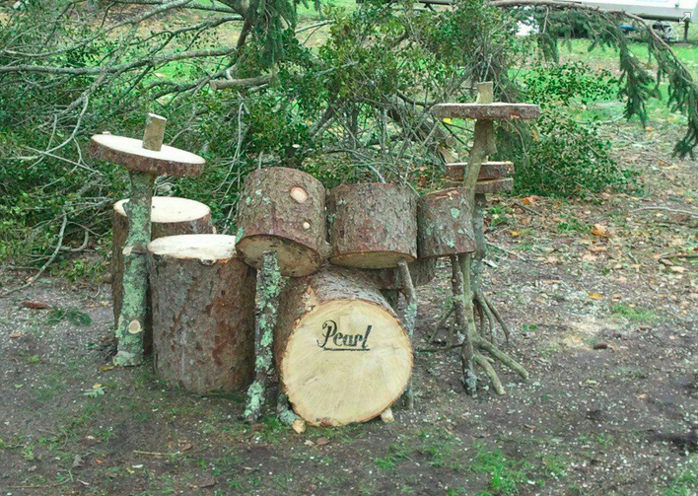
Peter Vassill’s The Definitive Recording Guide: For Drummers by Drummers
41,000 Likes
144,248 People Talking About This
Posts great images daily
Speaks like a drummer

Slide 14
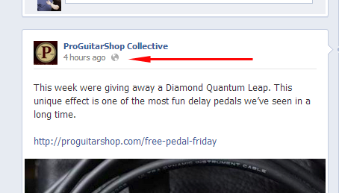
Using the post’s permalink
Continue to drive people to engaging posts using the permalink even when the post “falls off” the page

Slide 15
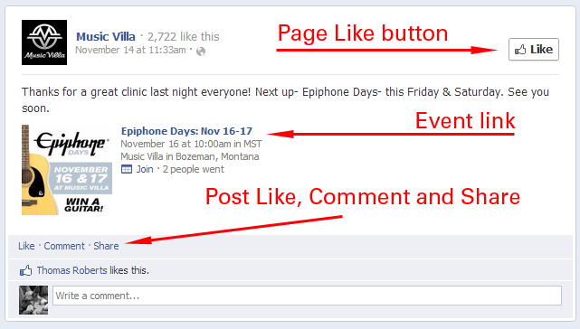
Permalink provides Page Like and Post Like, Comment and Share
Copy the URL from the browser

Slide 16
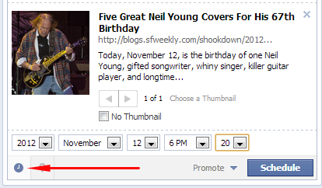
Schedule your posts
Schedule your posts for best visibility times
Use Edgerank Checker to determine best post times
Click on the clock in the bottom left hand corner to schedule

Slide 17

Use the Event option in posts for in-store events
Allows fans and friends of fans to see the event
Fans can follow the conversation about the event
Provides a dedicated page and link you can message
Tab is created when you create your first event so fans can review all your events in one place

Slide 18
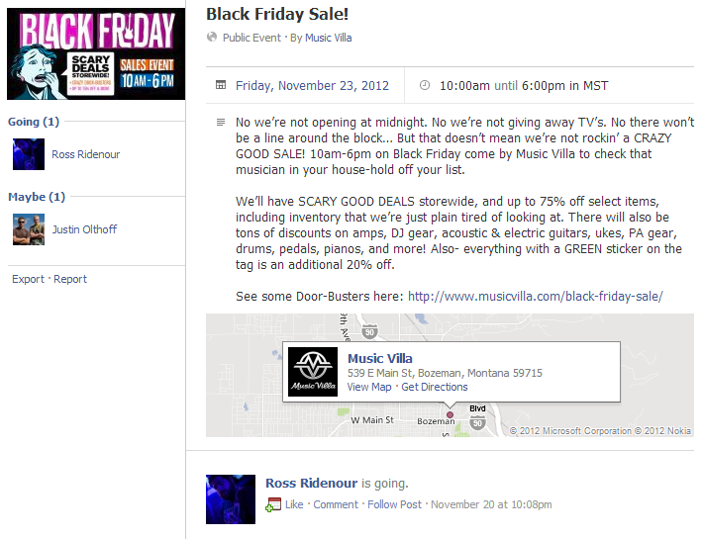
Event: Music Villa Black Friday store sale
Fans engage with the event and friends see this

Slide 19
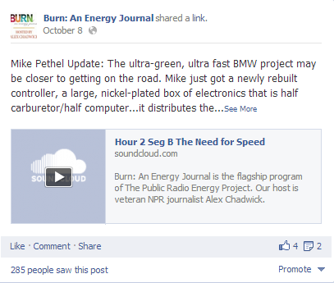
Use Audio Samples
No video to demo?
Use Soundcloud to embed audio into fans newsfeed for a guitar amp, pedal demo
They can hear your audio directly in their newsfeed on their personal page
Include site product link too

Slide 20
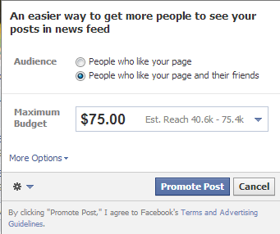
Promote Your Post
Typically a small percentage of your fans see your posts
Use the promoted post option to reach more fans and friends of fans
Helps get your content “above the noise” in the crowded newsfeed space

Slide 21
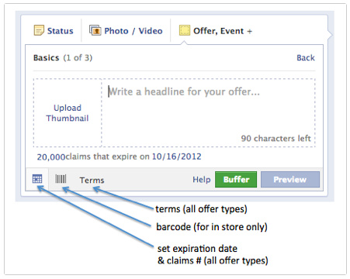
Create an offer: choose in store, online, or both
Shows up in fans’ newsfeed – differentiated from ads
Set quantity, time period, terms and even bar code
Set time for post
Requires Promoted Post option

Slide 22
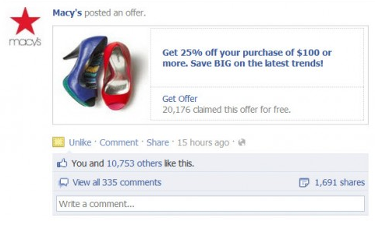
Macy’s Post Offer
Use a great image!
Create exclusives on Facebook – customers will Like your page to receive more offers
Track the results with the in store bar code offers

Slide 23
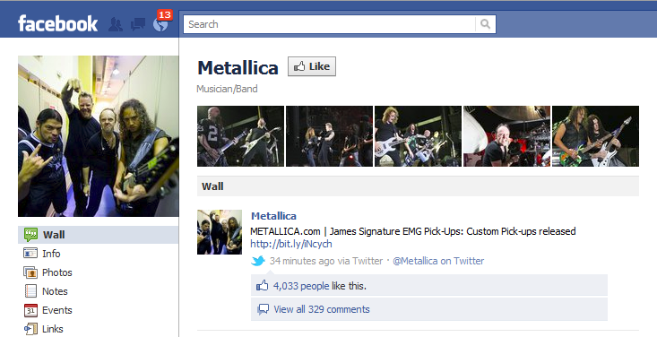
Work together with bands or other companies for best results
Ask others to post your content on their pages
Share e-mails for your promotions
Facebook Co-Marketing

Slide 24
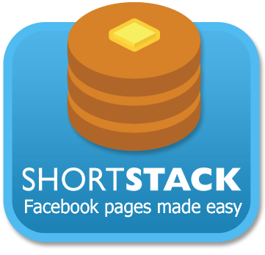
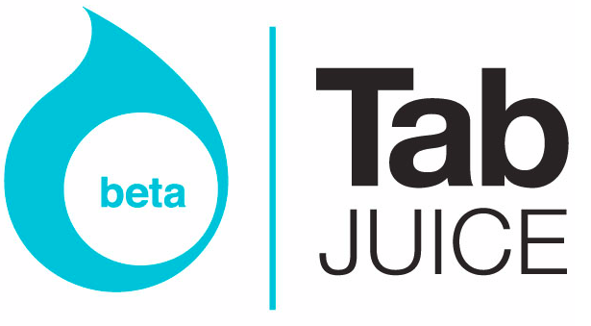




Using Facebook Apps
Shortstack, TabJuice, Pagemodo, Socialbakers, Involver, Fanmachine

Slide 25

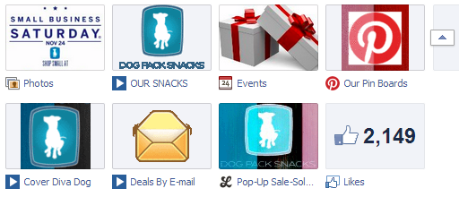
Use apps to create lots of content
Keep people on your page!
Highlight products, coupons, sales, reviews, store events, sweeps, newsletter, blog, videos, email sign up, etc.
Shortstack, TabJuice, Pagemodo, Socialbakers, Involver, Fanmachine

Slide 26
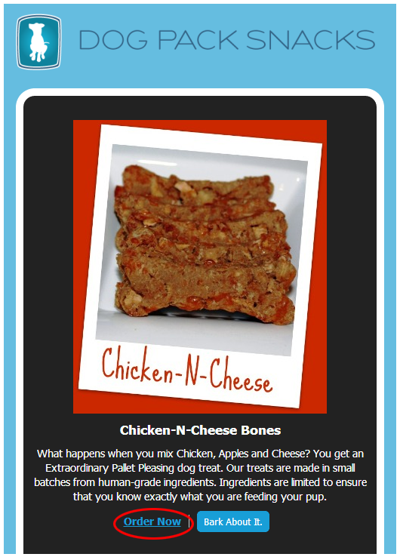
Highlight products and provide links directly to your shop or product pages
Shortstack app service allows indefinite number of links per image – area defined by user
Link to your online store instead of using a Facebook e-commerce app
Many don’t trust Facebook yet

Slide 27
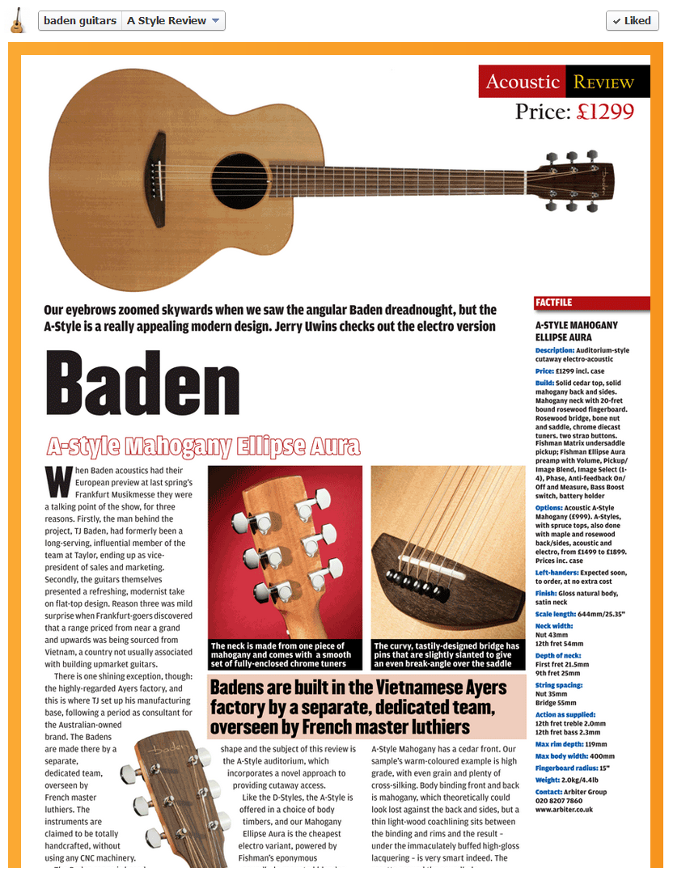
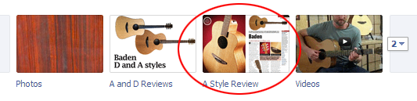
Format documents to 810 pixels wide and use the I-frame app
A standard Wordpress blog will “squeeze” to proper dimensions
Create links under the images to your online store or product page

Slide 28
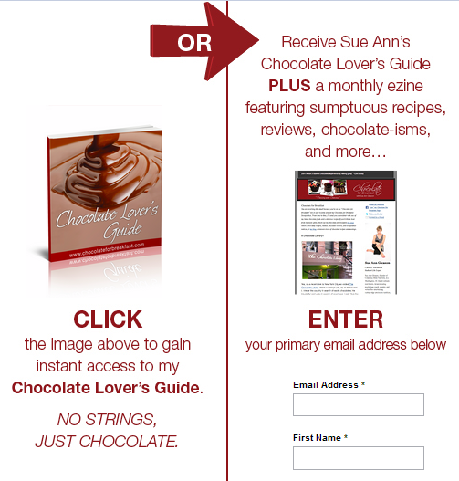
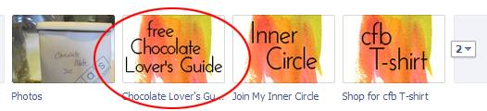
Include a newsletter sign up tab
Use quality images to encourage newsletter signups

Slide 29


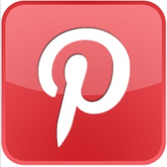
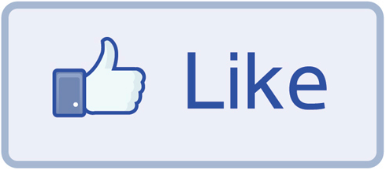
Traffic flow for a promotion
Share
Options
After
Purchase
Banner ads
Email Blast
Facebook Ads
Facebook Tab
Website Landing Page
Purchase
or
Dealer Locator
Shop
Coupon revealed
Site link

Slide 30
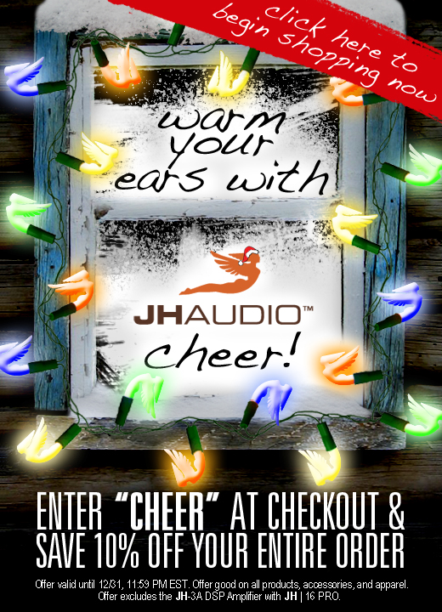
Coupon code revealed after “Like”
Image links to JH Audio site’s main product page
Unique coupon code is used to track purchases to measure R.O.I.
Easy implementation with third party apps already mentioned

Slide 31

Promote your sweeps/coupons on high traffic sites
Animated GIFs: better click throughs, more content
Make your images and call to action really count

Slide 32
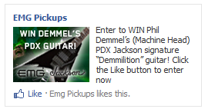
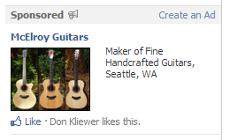
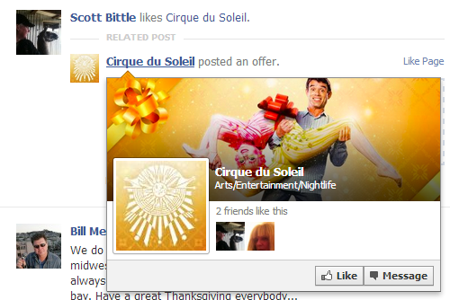
For Promotions…
Use Sponsored Stories to reach friends of fans
Use Promoted Posts to reach more of your fan base
Use traditional Facebook ads to target your campaign

Slide 33

Use Facebook check-ins for store integration

Slide 34
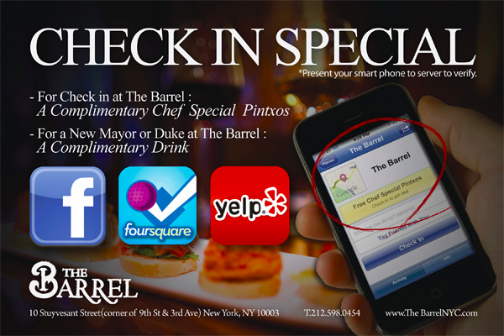
Go to “Places” in Facebook Ads for help
Friends of fans see the check-ins
Use simple cost effective rewards: picks, polish, T-Shirts, 10% off purchase
http://ads.ak.facebook.com/ads/FacebookAds/Places_advertisers.pdf
Notes:
May need to claim your business through your phone – Facebook places
http://ads.ak.facebook.com/ads/FacebookAds/Places_advertisers.pdf

Slide 35
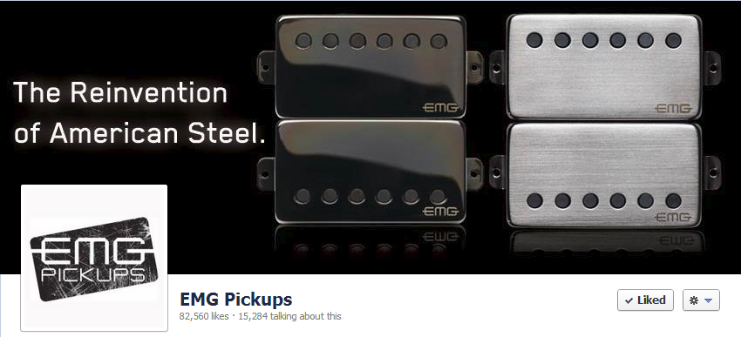
Make your cover images memorable.

Slide 36
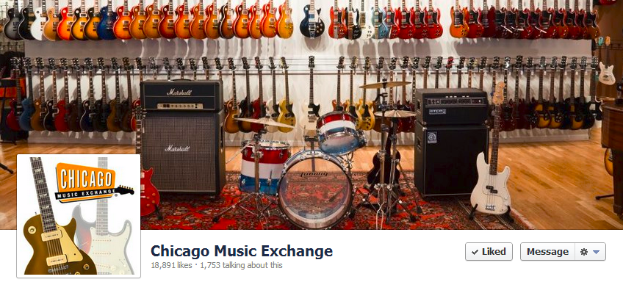
Great images drive people to your store.
Notes:
From the Chocolate for Breakfast page

Slide 37
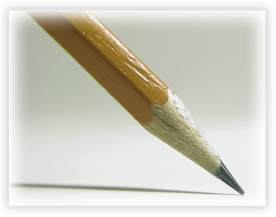
In summary…

Slide 38
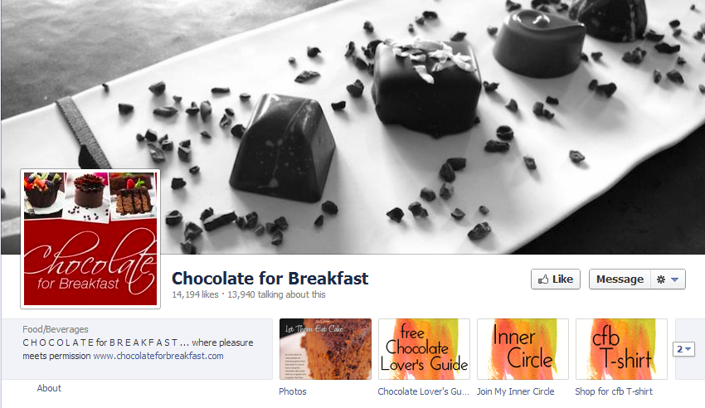
Like quality pages with your personal account
Notes:
From the Chocolate for Breakfast page

Slide 39
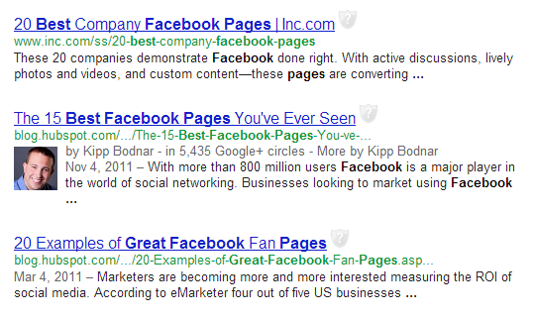
Use web search to find quality Facebook pages

Slide 40
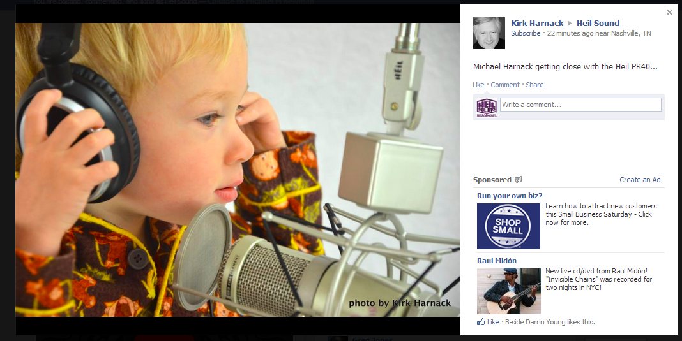
Your fans are your best sales force. Motivate them.
Heil Sound fan post
Average FB users has 130 friends

Slide 41
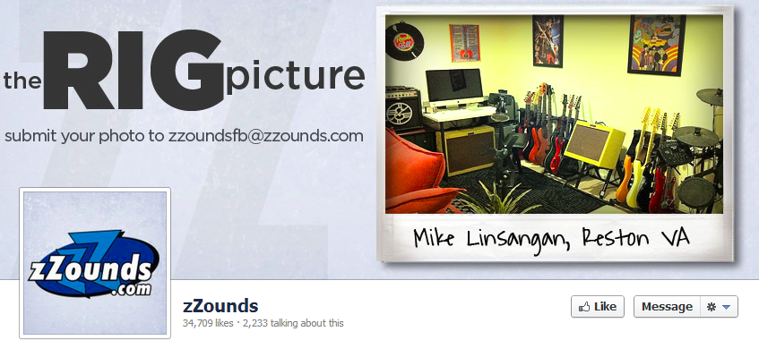
Remember, this is social marketing! Do it right!

Slide 42
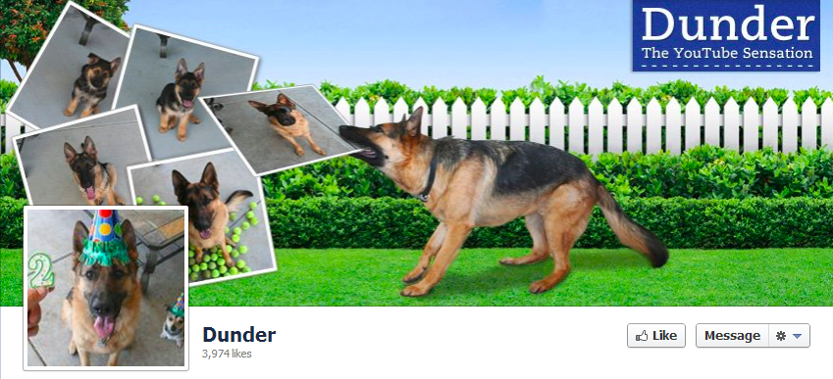
Thank you! Questions?

