Slide 1

Course Title

Slide 2
Marketing to Maximize Repeat and Referral Business
John Arnold

Slide 3
Agenda
Part 1 – Building a profitable customer list
Part 2 – Leveraging your list to gain referrals, repeat business, and loyalty

Slide 4
Building a profitable customer list
Part 1

Slide 5

Communication ROI

Slide 6
Communication ROI
Advertise
7-10 Messages Before A Customer is Ready to Buy

Slide 7
Communication ROI
Advertise
“I want to
shop around”
“I want to make an
Informed decision”
“I don’t
have time”
“I want to
compare prices”
“I don’t
trust you”
“It’s not the
right time”
7-10 Messages Before A Customer is Ready to Buy

Slide 8
Communication ROI
Advertise
Educate
Differentiate
Ask for the sale
“I want to
shop around”
“I want to make an
Informed decision”
“I don’t
have time”
“I want to
compare prices”
“I don’t
trust you”
“It’s not the
right time”
7-10 Messages Before A Customer is Ready to Buy

Slide 9
Value of a Good Customer List
High
Attention
Advertising
Desire
Communication
Trust
Relationship
Highest cost
Lower cost
Lowest cost
Lowest value
Higher value
Highest value
Cost
Low
Value
High

Slide 10
Customer List Value Chain
Collect Information
Exchange value for contact info
Deliver Messages
Offer multiple options
Align Frequency
Target content to interests

Slide 11
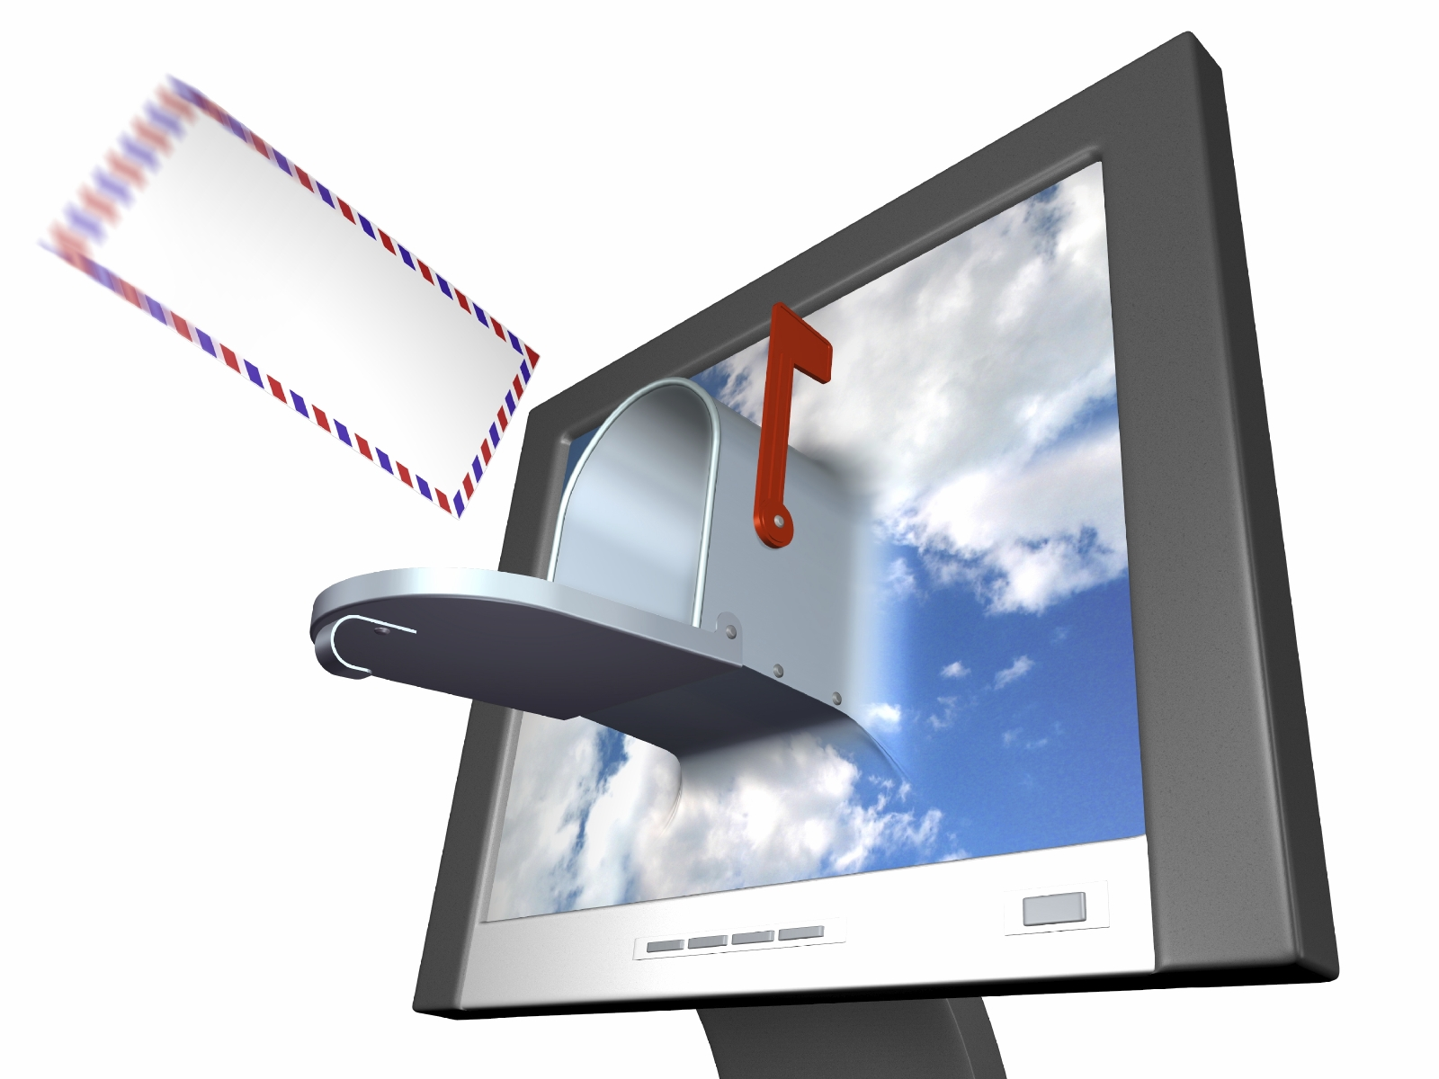
Collecting Contact Information
Website Signup

Slide 12
Collecting Contact Information
Website Signup
Shopping Cart

Slide 13
Collecting Contact Information
Website Signup
Shopping Cart
Physical Point of Sale

Slide 14
Collecting Contact Information
Website Signup
Shopping Cart
Physical Point of Sale
Phone Calls

Slide 15
Collecting Contact Information
Website Signup
Shopping Cart
Physical Point of Sale
Phone Calls
Social Media

Slide 16
Collecting Contact Information
Website Signup
Shopping Cart
Physical Point of Sale
Phone Calls
Social Media
Networking

Slide 17
Collecting Contact Information
Website Signup
Shopping Cart
Physical Point of Sale
Phone Calls
Social Media
Networking
Mobile Devices

Slide 18
Information to Collect
The Basics
Advanced
Email Address
Personal email
Business email
Mobile Phone Number
Text to sign up
Mobile signup form
Social Media Contact
Social address
Follow back
Email Behavior
Individual preferences
Buying cycles
Mobile Behavior
Device type
Sophistication
Social Behavior
Promoter
Detractor

Slide 19
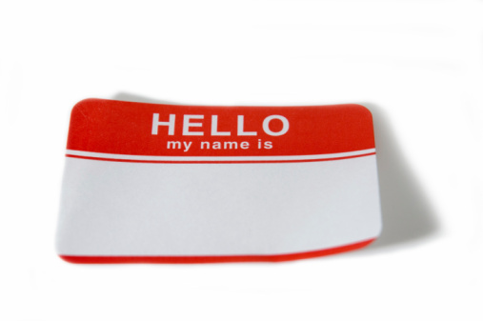
Tips for Collecting Information
Take your time
  Don’t ask for too much information at first
  Collect as the relationship grows
Exchanging value over time
  Information
  Possibility of a discount
  Immediate incentives
  Special privileges

Slide 20
Leveraging your list to gain referrals, repeat business, and loyalty
Part 2

Slide 21
Referrals, Loyalty, and Repeat Sales
Content
Communication
Commerce
Customer Experience
Worth Reading
+ Worth Sharing
= Referrals
Relevance
+ Value
= Loyalty
Convenience
+ Validation
= Repetition

Slide 22
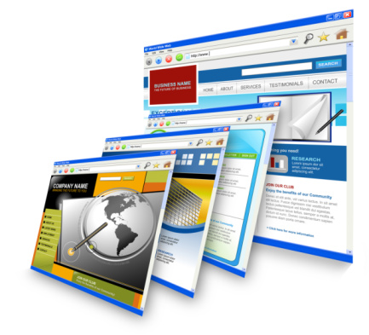
Effective Content
Purpose of content
  Educate
  Differentiate
  Ask for action
Types of content
  Text – limited is better
  Images – key to your brand
  Video – becoming more important
  Links – drive toward actions

Slide 23






Effective Communication
C.O.P.E.
  Create
  Once
  Publish
  Everywhere
T3
  Testing
  Targeting
  Timing

Slide 24
Targeting and Timing
Not Ready to Buy
Capture Contact Info
Educational Content
Ready to Buy Now
Ask for the Sale
Incentives
Product Information
20%
80%
Adjust Balance According to Your Average Buying Cycle

Slide 25
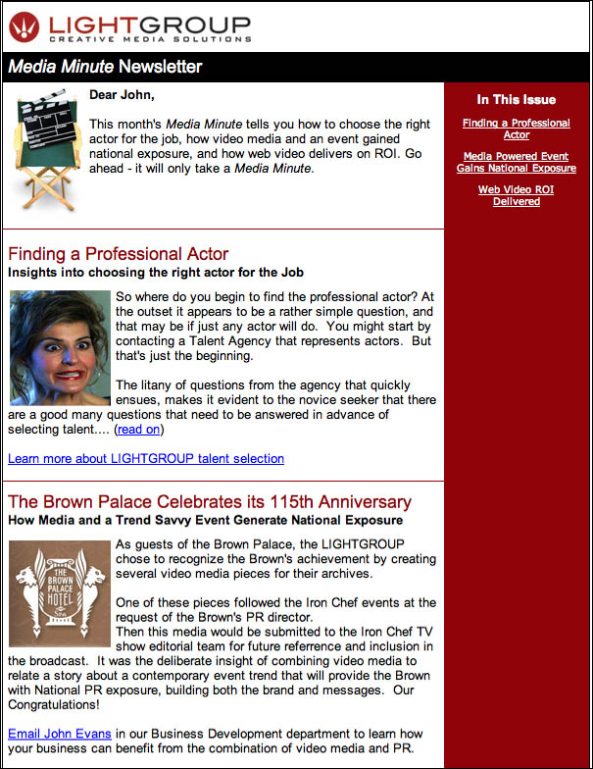
Informative Communications
Inform with…
  Newsletters
  Product information
  Articles & blogs
  Facts & opinions
  Video
  Instructions

Slide 26
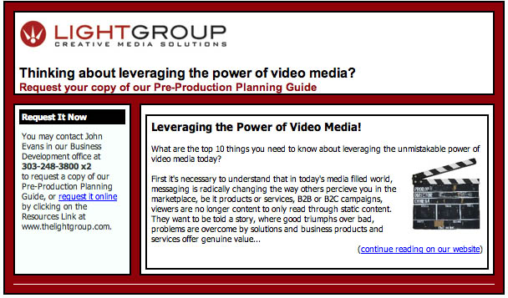
Promotional Communications
Promote with…
  Incentives
  Special events
  Special privileges
  Limited offers
  VIP status
  Loyalty rewards

Slide 27

Relational Communications
Relate with…
  Welcome emails
  Thank you emails
  Holiday greetings
  Transactional emails
  Reminders
  Procedural emails

Slide 28
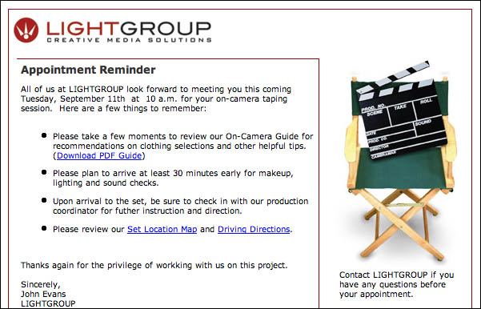
Brand Consistency
Just noticeable difference
  Logos
  Colors
  Images
  Videos
  Text
  Personality

Slide 29
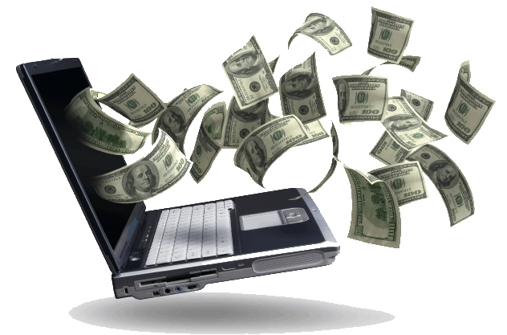
Effective Commerce
Speak your customer’s buying language
  In store discounts
  Mobile gift cards
  Buy online, ship to customer
  Buy online, pick up at store
  The Ultimate: Standing orders

Slide 30
Automating Communications
Template
Customized content
Fixed design elements
Auto-responder
Timeless content
Triggered by an action
Sequence
Series of content
Triggered by an event

Slide 31
Marketing to Maximize Repeat and Referral Business
Conclusion and Questions

