Slide 1


“GIMME SOME CREDIT”
(Tips for Getting Inventory Financing)
A Panel moderated by…
Alan Friedman, CPA

Slide 2


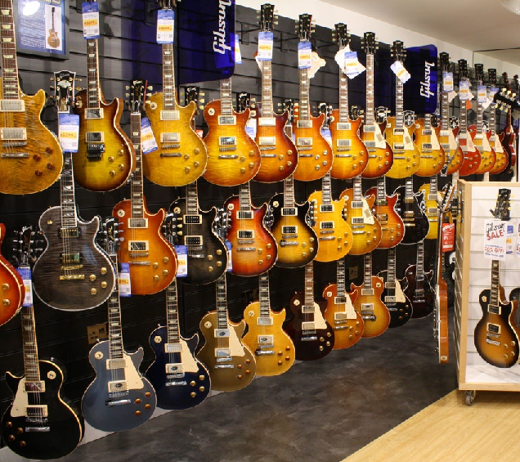
Why do we need these credit tips?
Need Product
Need Sales
Need $$$

Slide 3
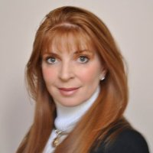
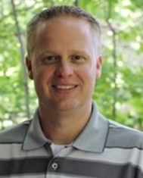
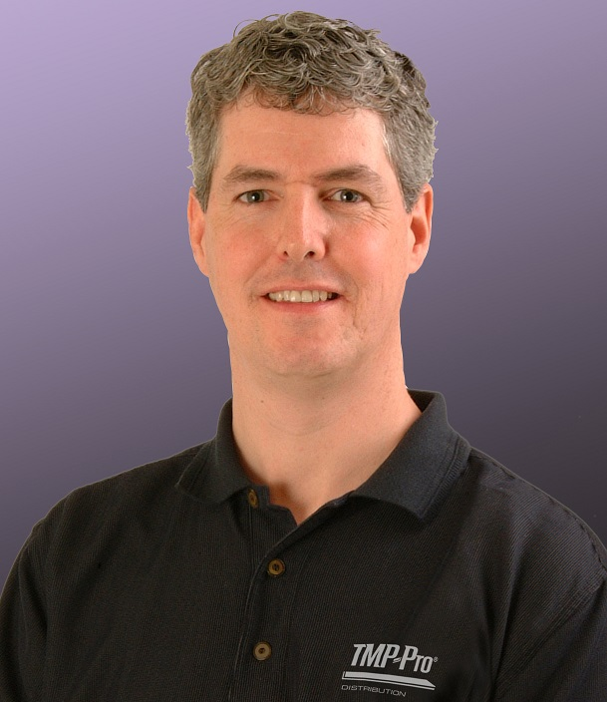
Our Increditable Panelists
John
Deb
Daniel

Slide 4
Alan’s 4 questions for our panelists

Slide 5

Alan’s 4 questions for our panelists

Slide 6

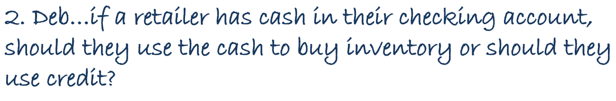
Alan’s 4 questions for our panelists

Slide 7
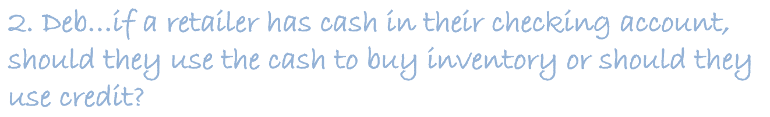
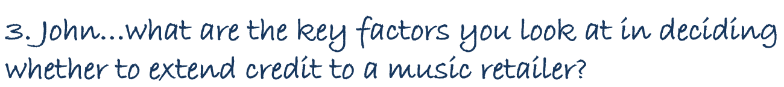
Alan’s 4 questions for our panelists

Slide 8
The last question for all…

Slide 9
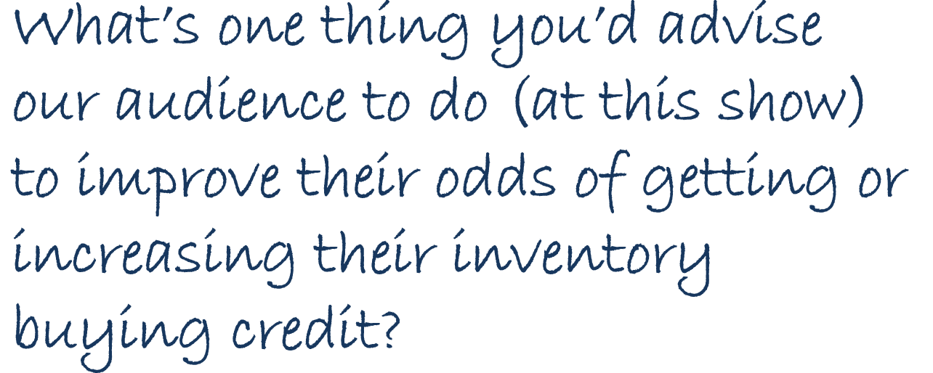
The last question for all…

Slide 10
Any Questions for our panelists?

Slide 11
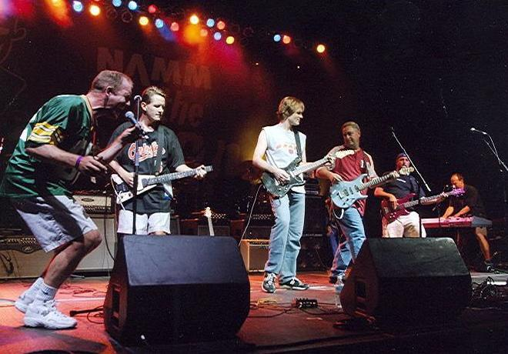
“Printz” rockin’ the Hilton Lobby
tonight @ 9:00pm

