Slide 1

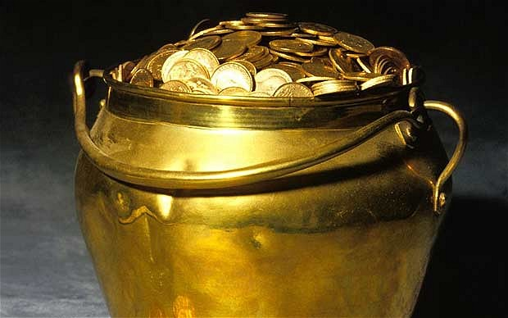

Proven Money Makers for 2015
A Panel moderated by…
Alan Friedman, CPA

Slide 2
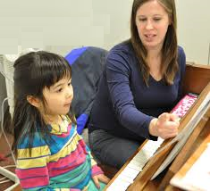
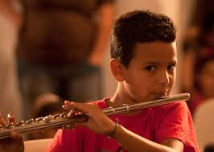

The Proven Money Makers for 2015
Print Music
Lessons
Rentals

Slide 3
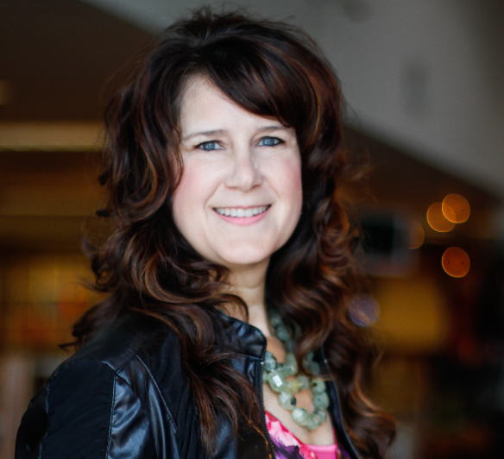
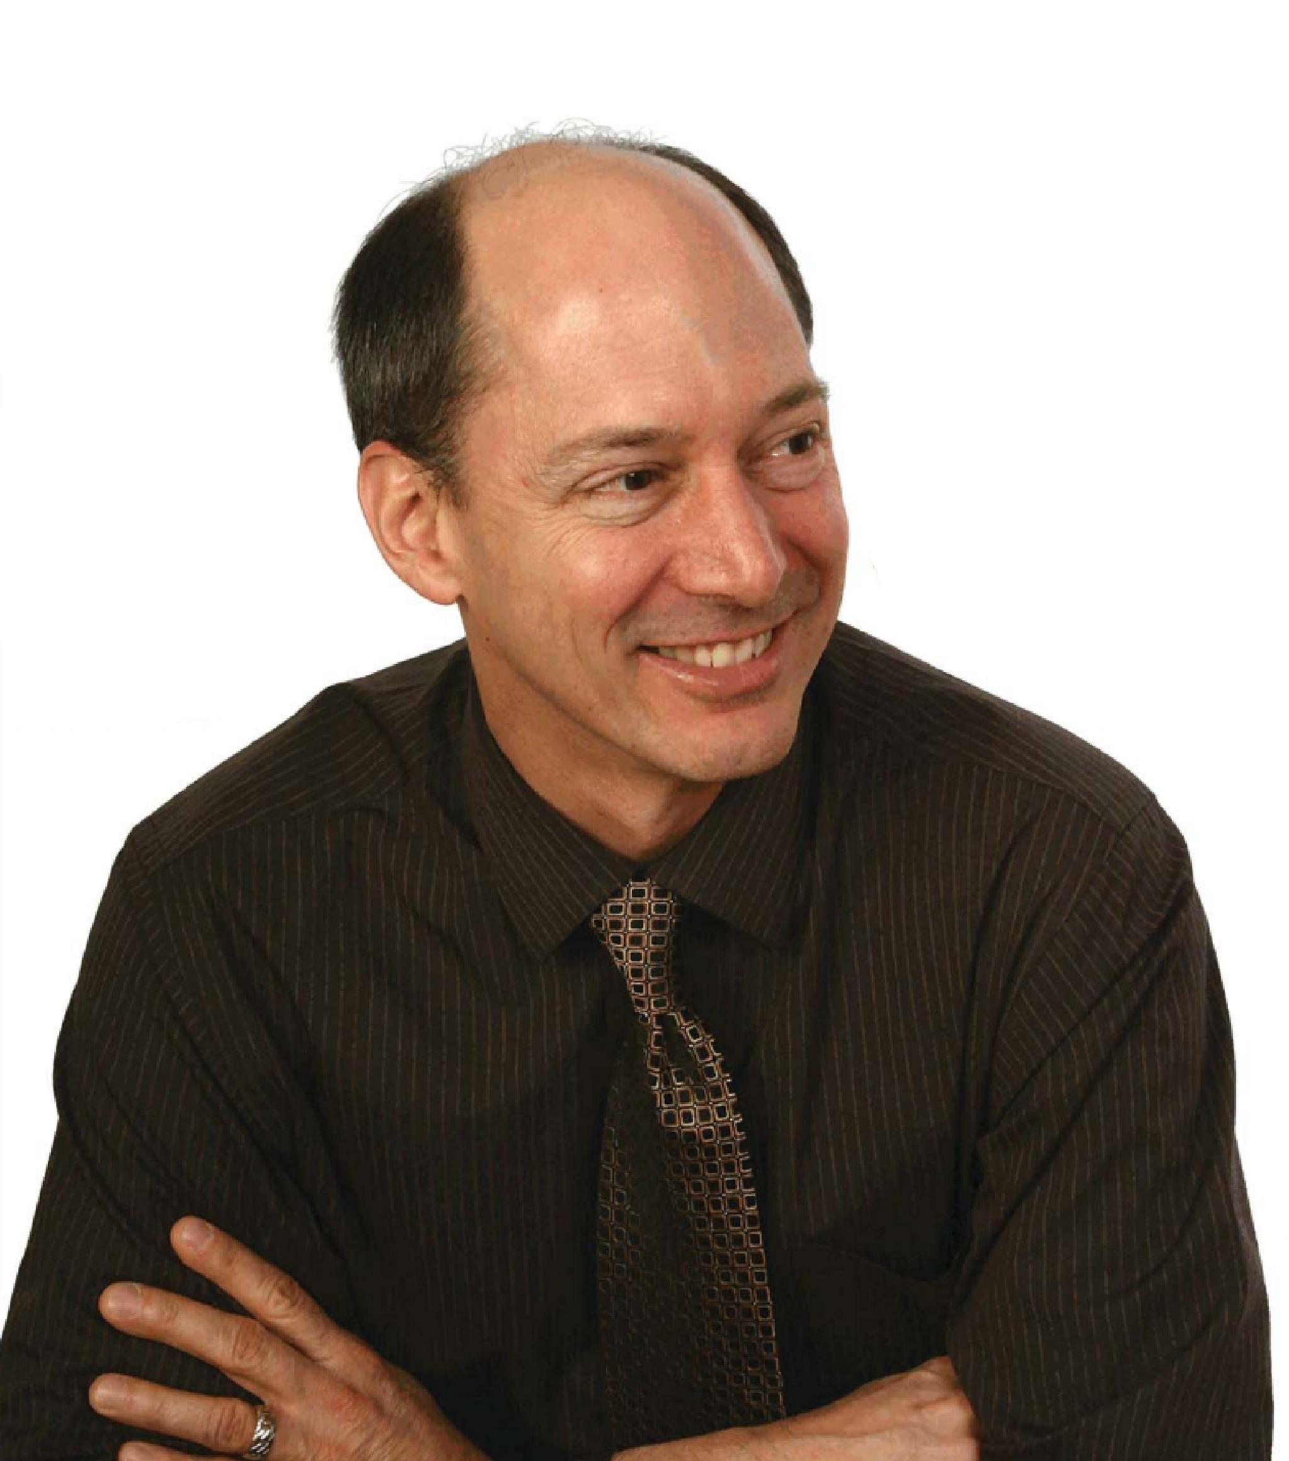
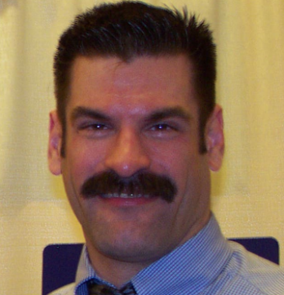
The “Other” Proven Money Makers
Bob
Gayle
Frank

Slide 4
Alan’s questions for our panelists
1. Why has “lessons/print/rentals” been so successful for you and your store?
2. Where is “lessons/print/rentals” going in 2015?
3. What advice do you have for our audience who want to get into or promote further these products & services?

Slide 5
Any Questions for our panelists?

Slide 6
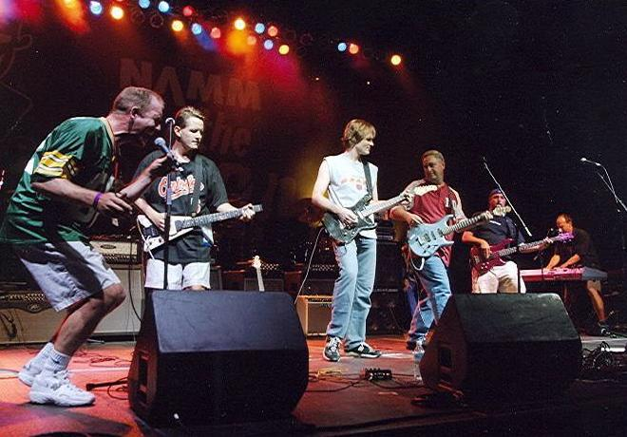
“Printz” rockin’ the Hilton Lobby
Saturday night @ 9:00pm

