Slide 1

“How to Implement Your Social Media Strategy”

Slide 2

“How to Implement
Your Social Media Strategy”
Danny Rocks
The Company Rocks

Slide 3









Which Sites?

Slide 4
Facebook Strategies
How Dealers are Using Facebook
Facebook Friday Videos
Sharing Information
Engaging Customers
In-Store Performances

Slide 5
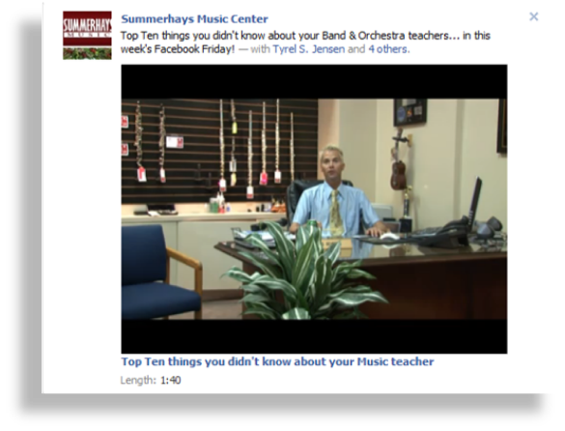
Facebook Strategies

Slide 6
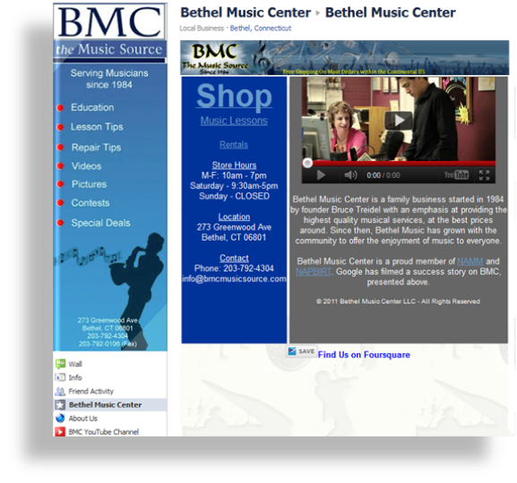
Facebook Strategies

Slide 7
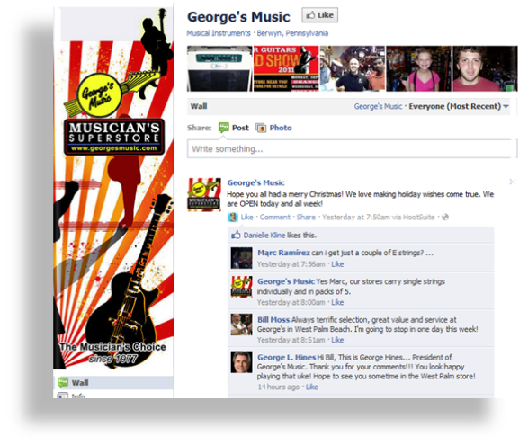
Facebook Strategies

Slide 8
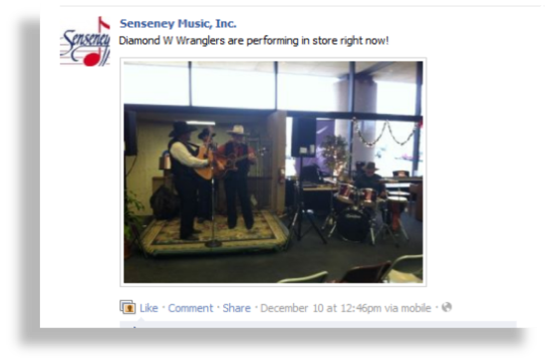
Facebook Strategies

Slide 9
Facebook + YouTube
How Dealers are Integrating Facebook with YouTube
Product Demonstrations
Suggestions for Holiday Gifts
Student Showcases
Contests

Slide 10
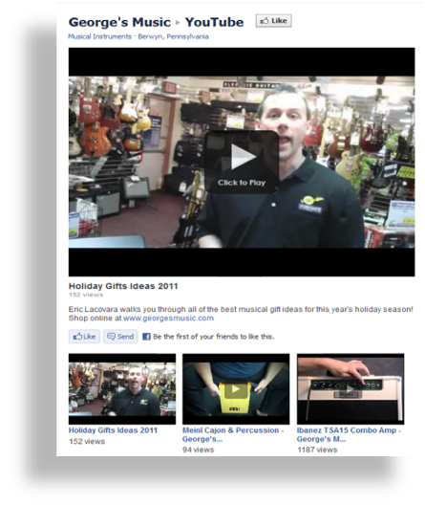
Facebook + YouTube

Slide 11

Facebook + YouTube

Slide 12
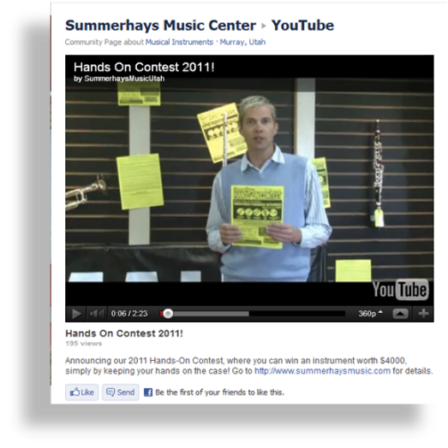
Facebook + YouTube

Slide 13

Social Media Strategies

Slide 14
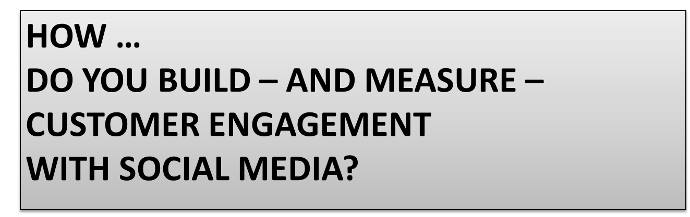
Social Media Strategies

Slide 15

Social Media Strategies

Slide 16
Take-Aways
Strategy for Implementation at Your Store
What is the one thing that you learned today?
What is the one strategy that you plan to implement?
How will you implement this strategy?
How will you measure your success?

Slide 17

Questions?

Slide 18

Thank You!
Danny Rocks
www.thecompanyrocks.com
danny@thecompanyrocks.com

