Slide 1


Slide 2

The Top 10 Marketing & Promotion Ideas That Experts Say “Try Now!”
Scott Robertson, APR
& Panel

Slide 3
Chris White, White House of Music
Gordy Wilcher, Owensboro Music
Scott Cook, Sarasota Guitar Company

Slide 4

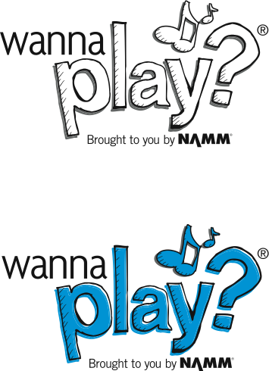
IDEA #10 – Tap into NAMM’s Wanna Play campaign

Slide 5


Slide 6
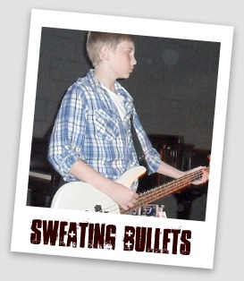

Slide 7
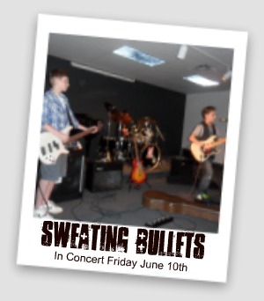

Slide 8
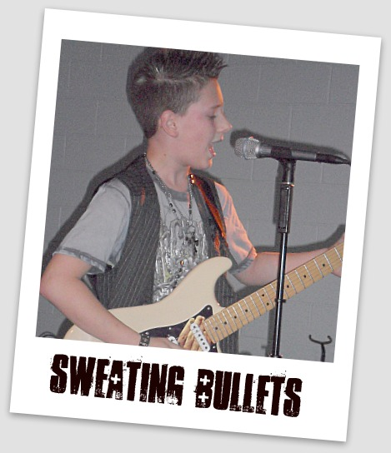

Slide 9
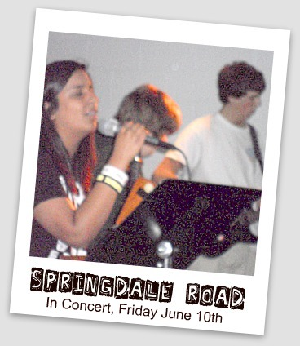

Slide 10
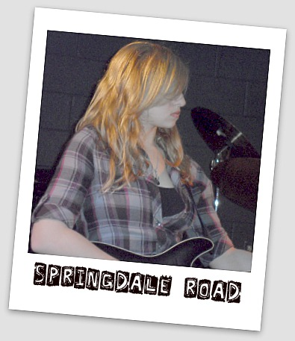

Slide 11
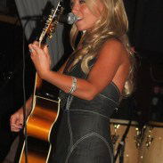
IDEA #9 – Use an Open Mic event as an Open House

Slide 12
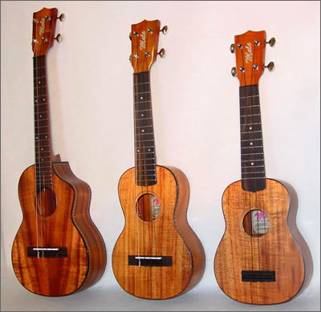
IDEA #8 – Ukes, Ukes Ukes…

Slide 13


IDEA #7 – Connect with Social Media

Slide 14
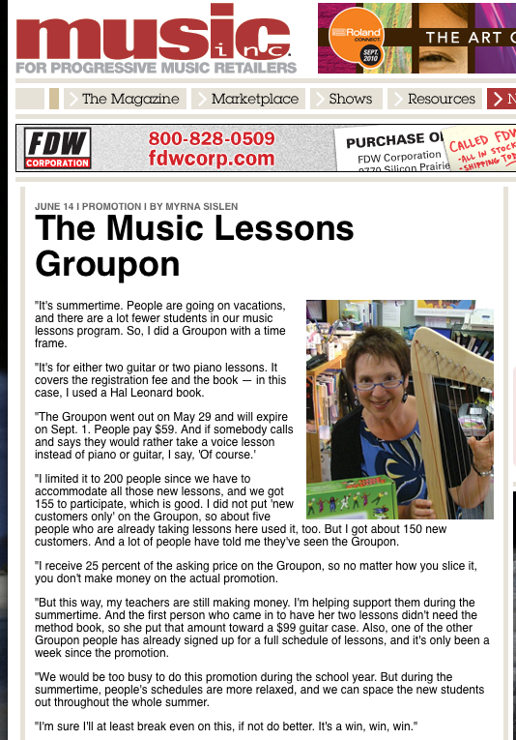

IDEA #6 – Group lessons with Groupon

Slide 15
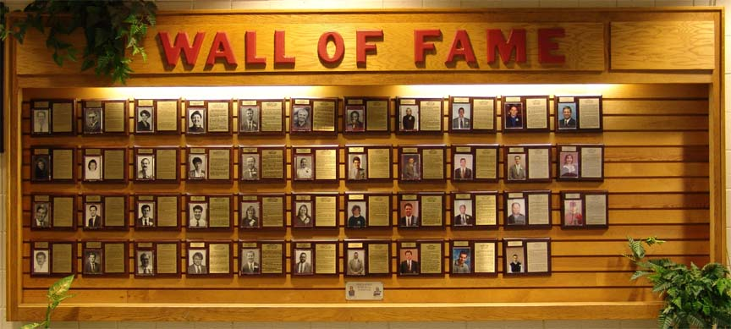
IDEA #5 – Local Wall of Fame

Slide 16




IDEA #4 – Network with your local Chamber of Commerce

Slide 17

IDEA #3 – SCORE some great business advice

Slide 18

IDEA #2 – Consider a closed door sale

Slide 19
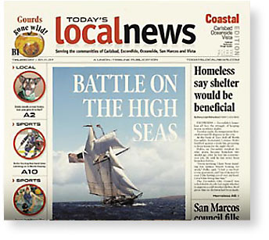
IDEA #1 – Power of PR

Slide 20
For more great ideas, visit namm.org/nammu
THANKS!!!

