Slide 1

Course Title
Moving Inventory:
Pick the Winners & Lose the Others!

Slide 2



Slide 3


Slide 4
Step One:
Get a POS

Slide 5
Step 2: Identify the Winners
Run weekly by Department
Top 20 Sold by Retail $ w/Quantity on Hand (QOH)
Top 20 sold by Units w/QOH

Slide 6
Step 2: Identify the Winners
Run Weekly: Store Wide
Top 100 by $ w/QOH
Top 100 units w/QOH

Slide 7
Step 3: Find the Losers
Run Monthly, Quarterly & Annually
Bottom 20 by $ w/QOH
Bottom 20 by units w/QOH

Slide 8

Advanced Analysis
GMROI: An inventory profitability evaluation ratio that analyzes a store's ability to turn inventory into cash above the cost of the inventory.
It is calculated by dividing the gross margin by the average inventory cost.
A ratio higher than 1 means the firm is selling the merchandise for more than what it costs the store to acquire it. The opposite is true for a ratio below 1.

Slide 9
Advanced Analysis
Average Inventory: You're average inventory on hand for any given period.
Measured monthly is the best.
Calculation: Beginning Inventory + Ending Inventory / 2 = Avg Inv

Slide 10
Advanced Analysis
Inventory Turnover: A ratio showing how many times a store's inventory is sold and replaced over a period (usually one year)
Inv Turns = COGS / Average Inventory

Slide 11
Advanced Analysis
Run or Create an Inventory Analysis Report
Start with Category or Sub-Category view first
Re-run for details to analyze problem departments

Slide 12
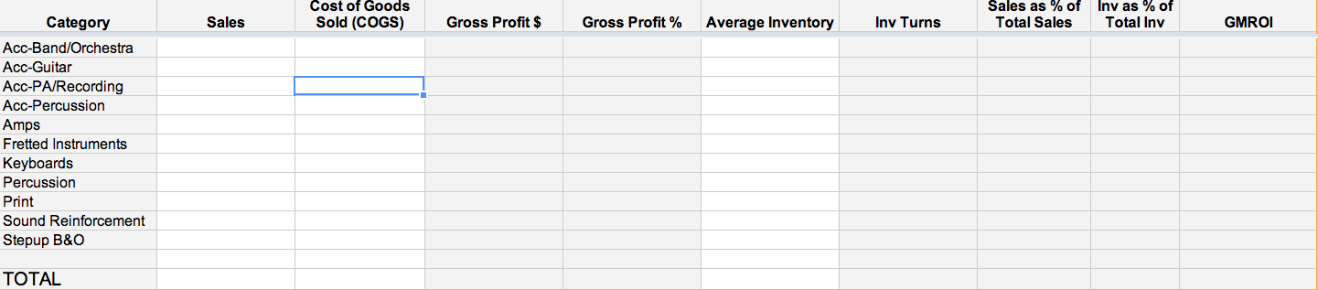
Advanced Analysis

Slide 13
Advanced Analysis
Scan in this order for problems:
GMROI,
then Avg Inv
  to see how much of a problem it is
  the larger the avg inv, the more of an effect it’s having.

Slide 14
Advanced Analysis
If GMROI is low, and avg inv is high, then these are the likely culprits:
  Too few turns
  Margin too low
  Carrying too much inv for the level of sales

Slide 15
Advanced Analysis
The Fix:
Increase turns
Raise margins
Reduce inventory

Slide 16
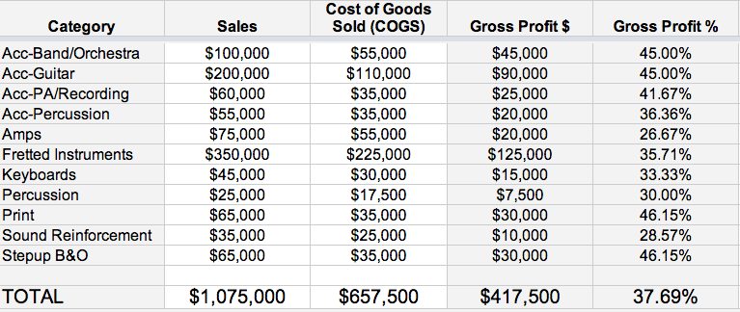
Advanced Analysis

Slide 17
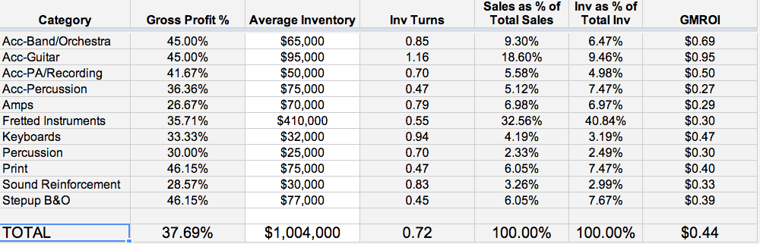
Advanced Analysis

Slide 18


Slide 19
Questions?
Donovan@SpringfieldMusic.com

