Slide 1


Slide 2
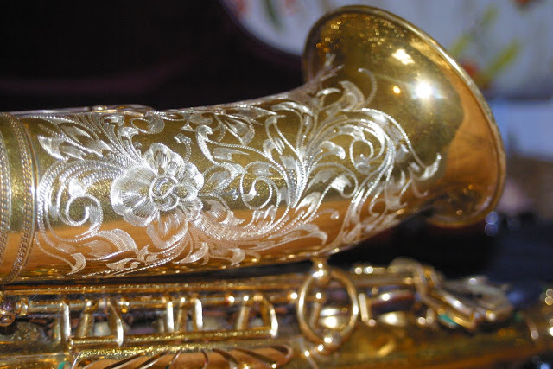
5 Ways to Turn Your Repair Department Into a Profit Center
Robert Christie

Slide 3
Opportunity Knocks
Instrument Arrival
Estimates
Custom Work and Step-Up Repair
Billing
Maintenance Agreements

Slide 4
Instrument Arrival
Condition and Type of Mouthpiece
Grease, Oil, Swabs, Accessories
Reeds
Name Tag / Shop Sticker

Slide 5


Estimates
Who Makes the Call
Work Beyond “Playing Condition”
Maintenance Records
Up-Selling Repair Jobs

Slide 6


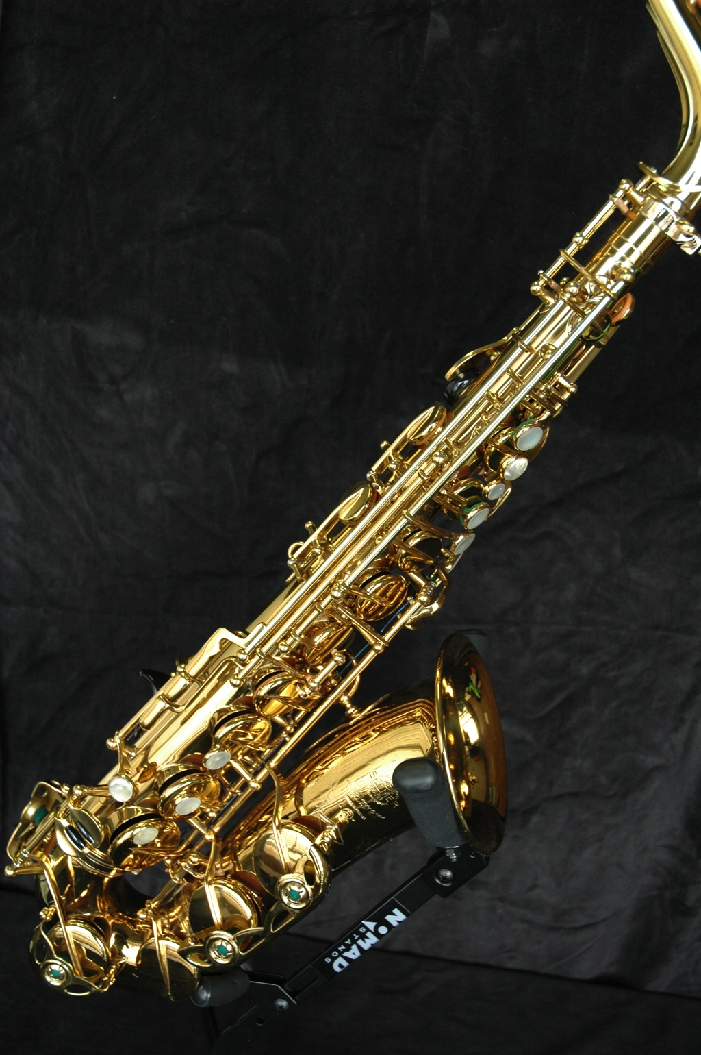

Custom Work and Step-Up Repair

Slide 7
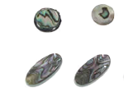
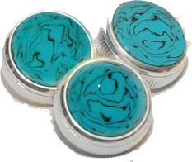

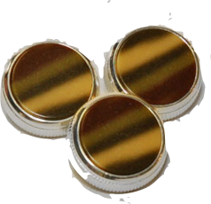

Simple Can = Profit
Up-Sell Pads
Prepackaged “Custom” Add-Ons
Teflon Treatment
Receivers and Leadpipes

Slide 8
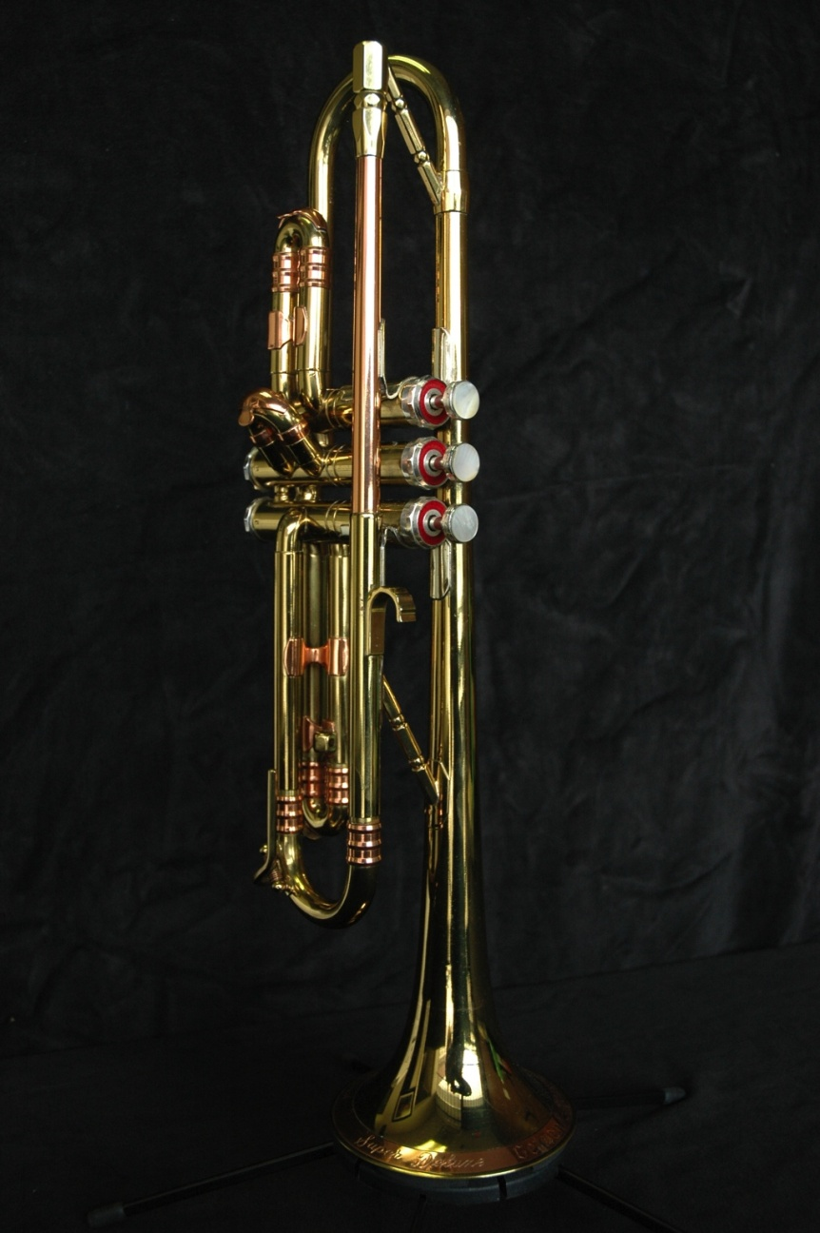
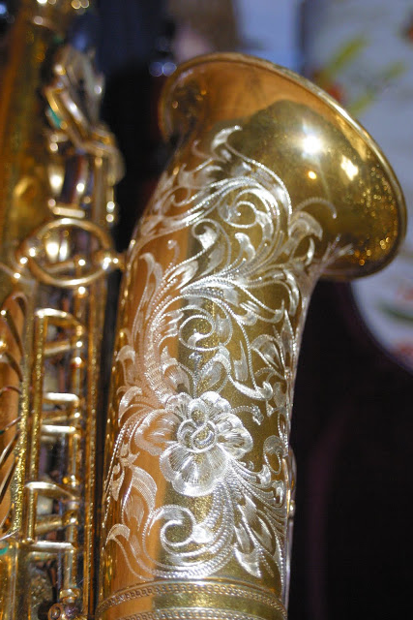
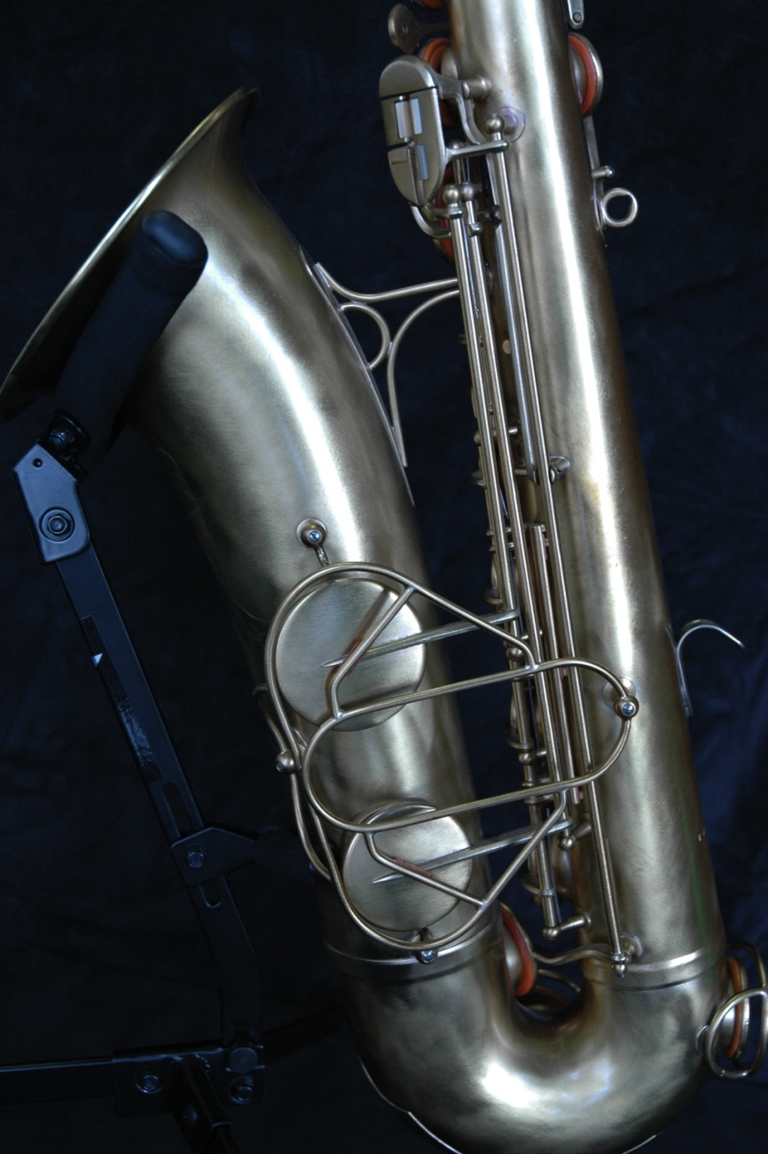
Custom Finishing
Engraving
Plating

Slide 9

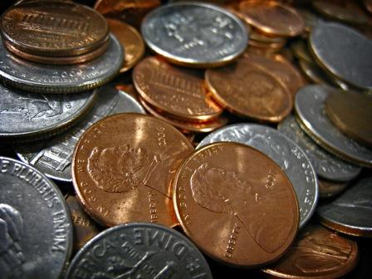
Billing
Flat Rate Jobs
VS.
Hourly Rate Jobs
Recover the “hidden” cost of shop supplies

Slide 10
Maintenance Agreements
On Conversion of a Rental
  The 30-day check-up
  Complete bill /offer M.A.
School Maintenance
  Year-end cleaning
On Return of a Repair
  Discuss lowering costs by proper servicing
  Add-on opportunity if missed on intake
On A New Instrument
  The 30-day check-up

Slide 11
Each Customer Contact Is A Sales Opportunity
Rental Conversion
Arrival in the Shop
Custom Work
Maintenance Agreements
Step-Up Sale
The Estimate

Slide 12

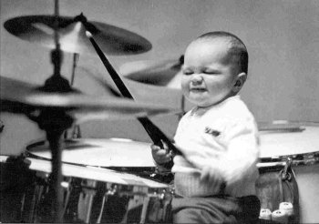
THANK YOU!!
Robert Christie
A & G Central Music robert@schoolmusiconline.com www.schoolmusiconline.com
248-541-6843

