Slide 1


Slide 2
Customers behind on Instrument Rental Payments?

Slide 3
Customers behind on Instrument Rental Payments?
Surefire Ways to IMPROVE your collections!

Slide 4
Customers behind on Instrument Rental Payments?
Surefire Ways to IMPROVE your collections!

Slide 5

Customers behind on Instrument Rental Payments?
Surefire Ways to IMPROVE your collections!

Slide 6
Customers behind on Instrument Rental Payments?
Surefire Ways to IMPROVE your collections!

Slide 7
Customers behind on Instrument Rental Payments?
Surefire Ways to IMPROVE your collections!

Slide 8
About Your Speakers…

Slide 9
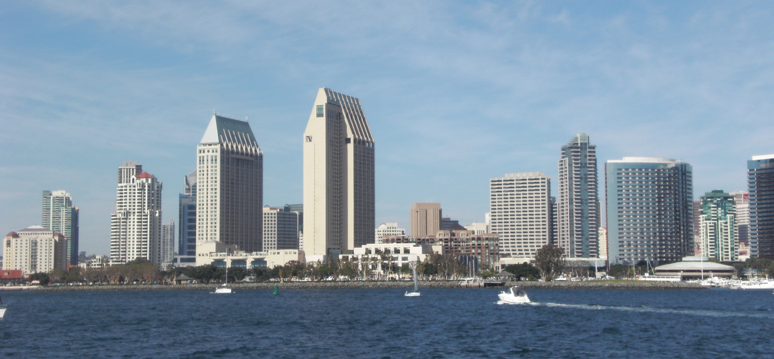
About Your Speakers…
Robin Jean Sassi
Owner, San Diego Music Studio, Est. 1994
California Licensed Attorney
  Corporate Law
  Business Litigation
  Trusts and Estates

Slide 10
About Your Speakers…
Robin Jean Sassi
Owner, San Diego Music Studio, Est. 1994
California Licensed Attorney
  Corporate Law
  Business Litigation
  Trusts and Estates
Kimberly Deverell
Head of Operations, San Diego Music Studio, Est. 1994
  Oversees a team of teachers, brick and mortar retail and online operations employees
  Over 15 years experience in collecting

Slide 11
When to start the collection process?

Slide 12

When to start the collection process?

Slide 13
When to start the collection process?
RIGHT AWAY!!!

Slide 14
Establish a Timeline

Slide 15

Establish a Timeline

Slide 16
Establish a Timeline
Week 1: Phone call.

Slide 17
Establish a Timeline
Week 1: Phone call.
Week 2: Phone call, letter & email

Slide 18
Establish a Timeline
Week 1: Phone call.
Week 2: Phone call, letter & email
Week 3: Phone call, email

Slide 19
Establish a Timeline
Week 1: Phone call.
Week 2: Phone call, letter & email
Week 3: Phone call, email
Week 4: Phone call, email

Slide 20
Establish a Timeline
Week 1: Phone call.
Week 2: Phone call, letter & email
Week 3: Phone call, email
Week 4: Phone call, email
Week 5: Formal Letter #2 (Certified) with a Small Claims packet.

Slide 21
Some Little “Do’s” and “Don’ts”

Slide 22

Some Little “Do’s” and “Don’ts”

Slide 23
Some Little “Do’s” and “Don’ts”
Do: Keep a paper trail

Slide 24
Some Little “Do’s” and “Don’ts”
Do: Keep a paper trail
Don’t: Harass the customer

Slide 25
They still didn’t pay… now what?

Slide 26

They still didn’t pay… now what?

Slide 27
Small Claims Court

Slide 28

Small Claims Court

Slide 29

Small Claims Court

Slide 30
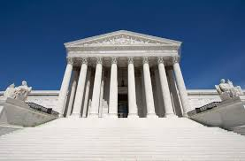
Small Claims Court

Slide 31
Some tips before you file….

Slide 32

Some tips before you file….

Slide 33
Some tips before you file….
Know where your customer is employed

Slide 34
Some tips before you file….
Know where your customer is employed
Know where your customer banks

Slide 35
Some tips before you file….
Know where your customer is employed
Know where your customer banks
Know the last 4 of their SSN

Slide 36
Some tips before you file….
Know where your customer is employed
Know where your customer banks
Know the last 4 of their SSN
Don’t know? Tips to find out!

Slide 37
Small Claims Court (Before Trial)

Slide 38
Small Claims Court (Before Trial)

Slide 39
Small Claims Court (Before Trial)
Get the forms

Slide 40
Small Claims Court (Before Trial)
Get the forms
Follow the directions

Slide 41
Small Claims Court (Before Trial)
Get the forms
Follow the directions
Serve the Defendant

Slide 42
Small Claims Court (During Trial)

Slide 43
Small Claims Court (During Trial)

Slide 44
Small Claims Court (During Trial)
Have all your paperwork organized

Slide 45
Small Claims Court (During Trial)
Have all your paperwork organized
Proof of Service

Slide 46
Small Claims Court (During Trial)
Have all your paperwork organized
Proof of Service
Timeline of events

Slide 47
Small Claims Court (During Trial)
Have all your paperwork organized
Proof of Service
Timeline of events
Be prepared to argue your case!

Slide 48
Small Claims Court (After Trial)

Slide 49
Small Claims Court (After Trial)

Slide 50
Small Claims Court (After Trial)
Yay! You won! Now what???

Slide 51
Small Claims Court (After Trial)
Yay! You won! Now what???
More Paperwork

Slide 52
Small Claims Court (After Trial)
Yay! You won! Now what???
More Paperwork
Garnish Wages, Bank Levy

Slide 53


Slide 54


Slide 55


Slide 56


Slide 57


Slide 58


Slide 59


