Slide 1

How to Budget for Increased Profitability
Alan Friedman & Daniel Jobe
Friedman, Kannenberg & Company, PC

Slide 2
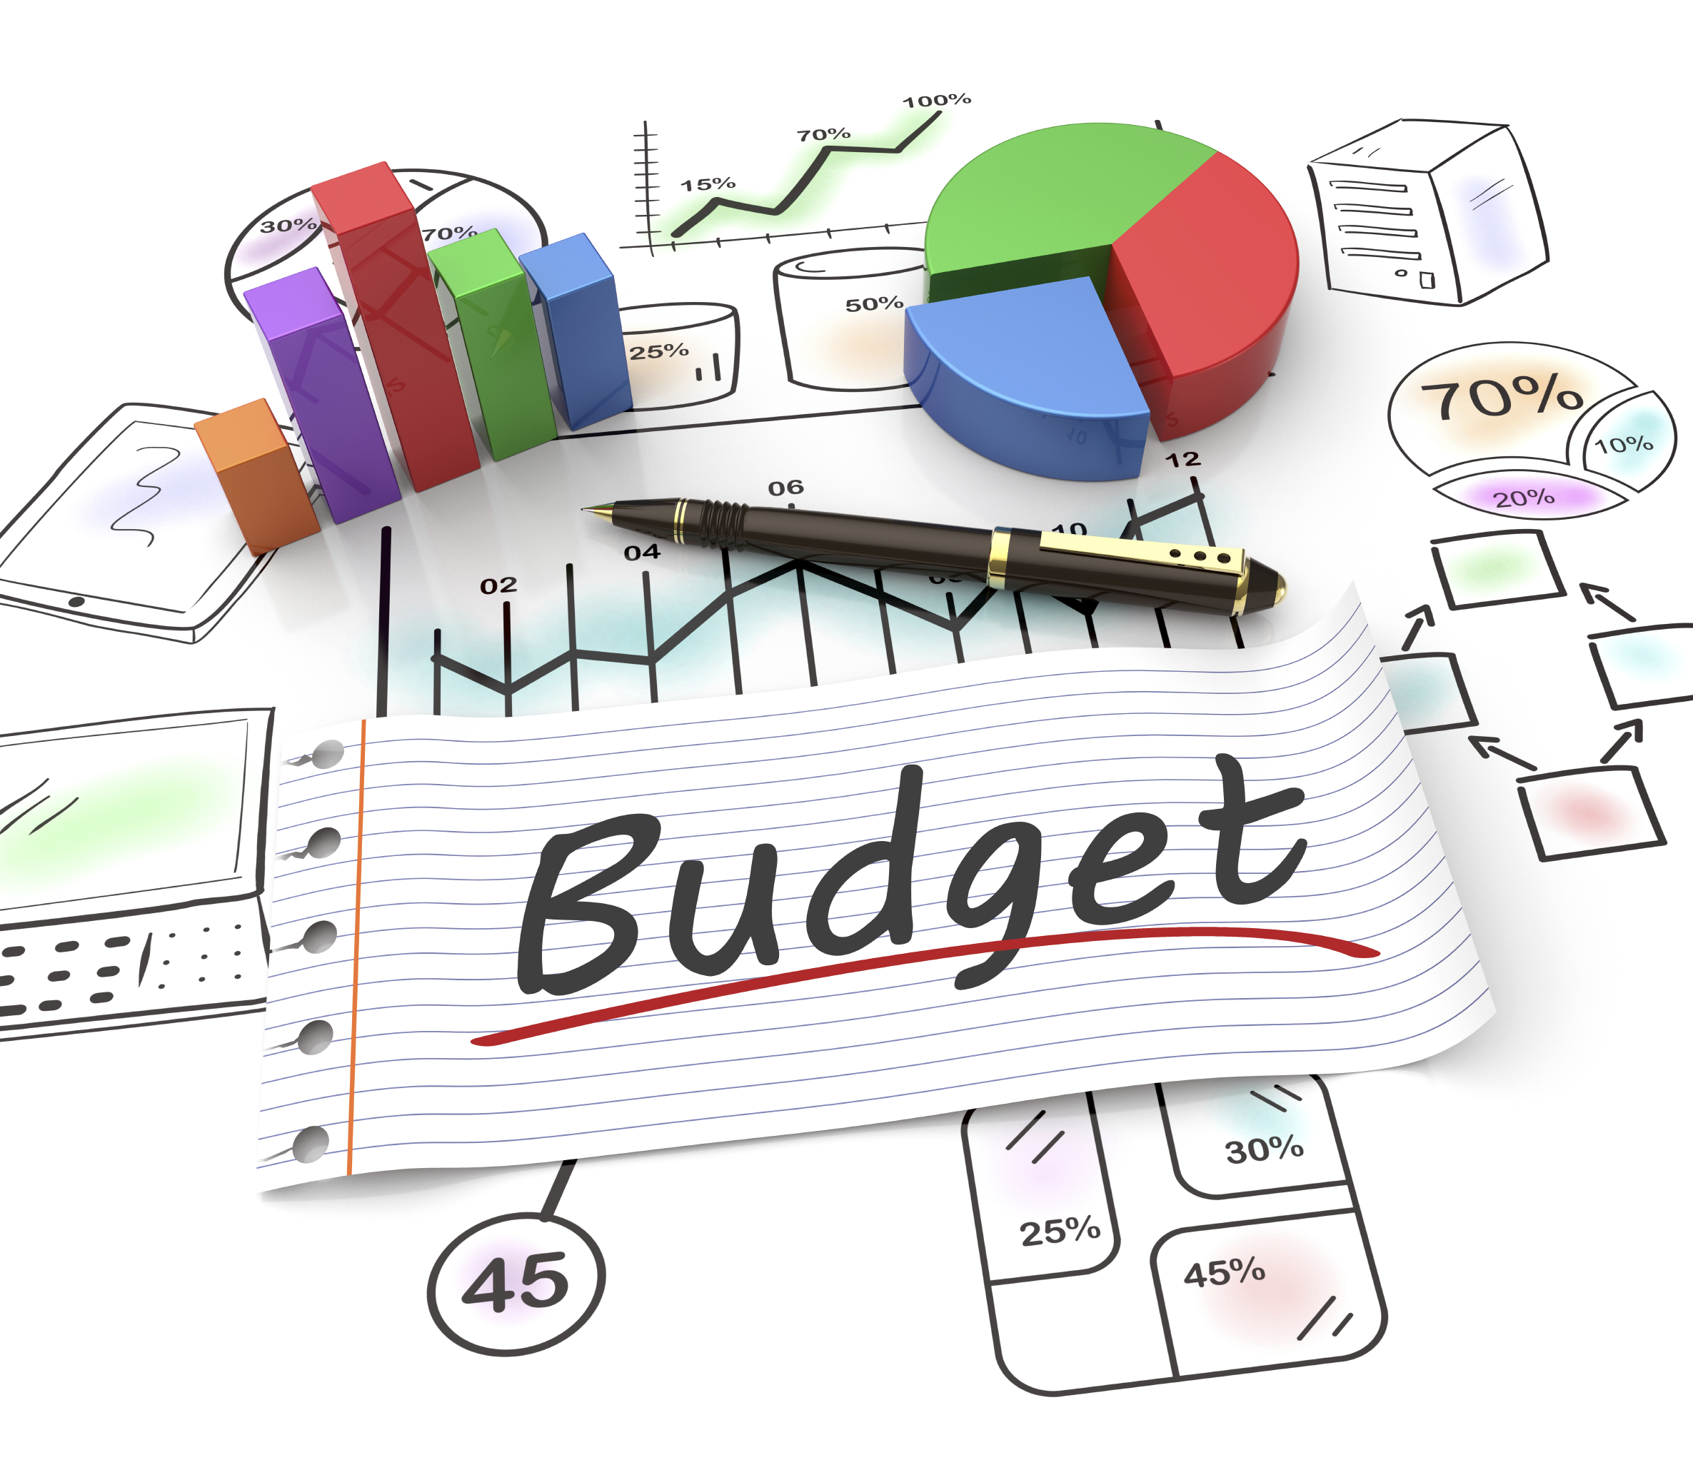
What is a Budget?
Written estimate of future income and expenditures for a set period of time.

Slide 3

Why Budget?
To make a plan and set a direction for your business
To improve current and future performance
To forecast future profitability
To grow your business intentionally

Slide 4

What makes budgeting so difficult?
Time consuming
What do we start with?
Perception of no control

Slide 5

PRE-BUDGET
PROCESS

Slide 6

Forecast Sales
Assign Budget Goals
  Gross Sales
  Profit Margin
  Items per Sale
Track Door Count

Slide 7

Forecast Rentals
Rentals by Instrument Type
Rentals by School
Rentals Per Road Rep.

Slide 8

Forecast Repairs
Total Daily Repairs
Paying vs. Warranty Repairs
Repairs by School
Repairs by Repair Staff

Slide 9

Forecast Lessons
  Total Teachers
  Students (by Type)
  Group Lessons

Slide 10

“Free” Budget Tool at FKCo.com
FKCo Budget Spreadsheet
  http://www.fkco.com/budgeting
Start with…
  Revenues from prior year
  Expenses from last year
  Adjust both for current year plans

Slide 11
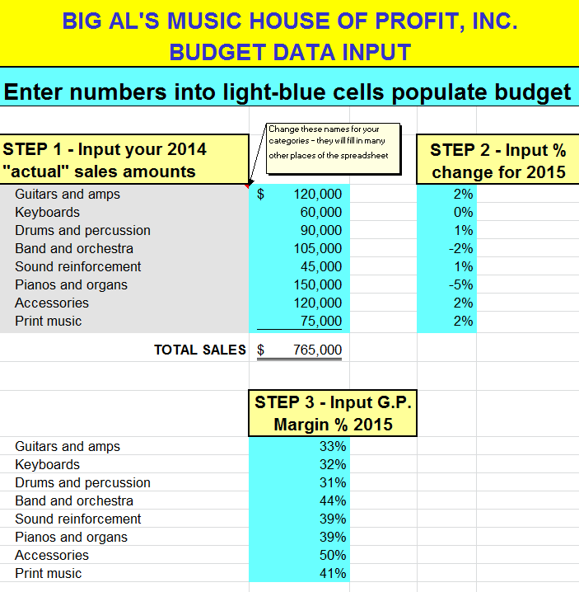
FKCo Budget Spreadsheet
  http://www.fkco.com/budgeting

Slide 12
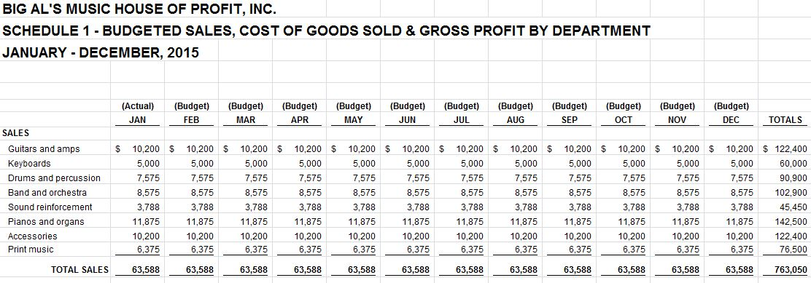
FKCo Budget Spreadsheet
  http://www.fkco.com/budgeting

Slide 13
FKCo Budget Spreadsheet
  http://www.fkco.com/budgeting

Slide 14
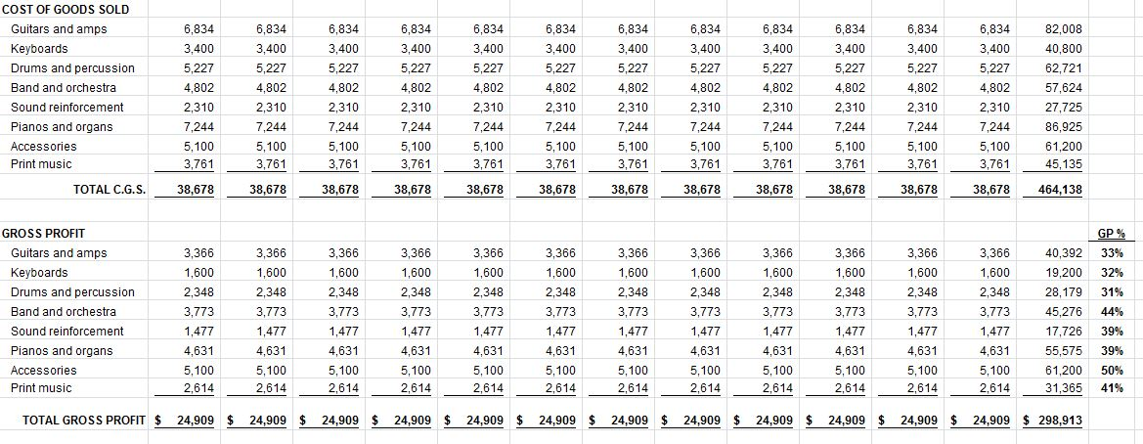
FKCo Budget Spreadsheet
  http://www.fkco.com/budgeting

Slide 15
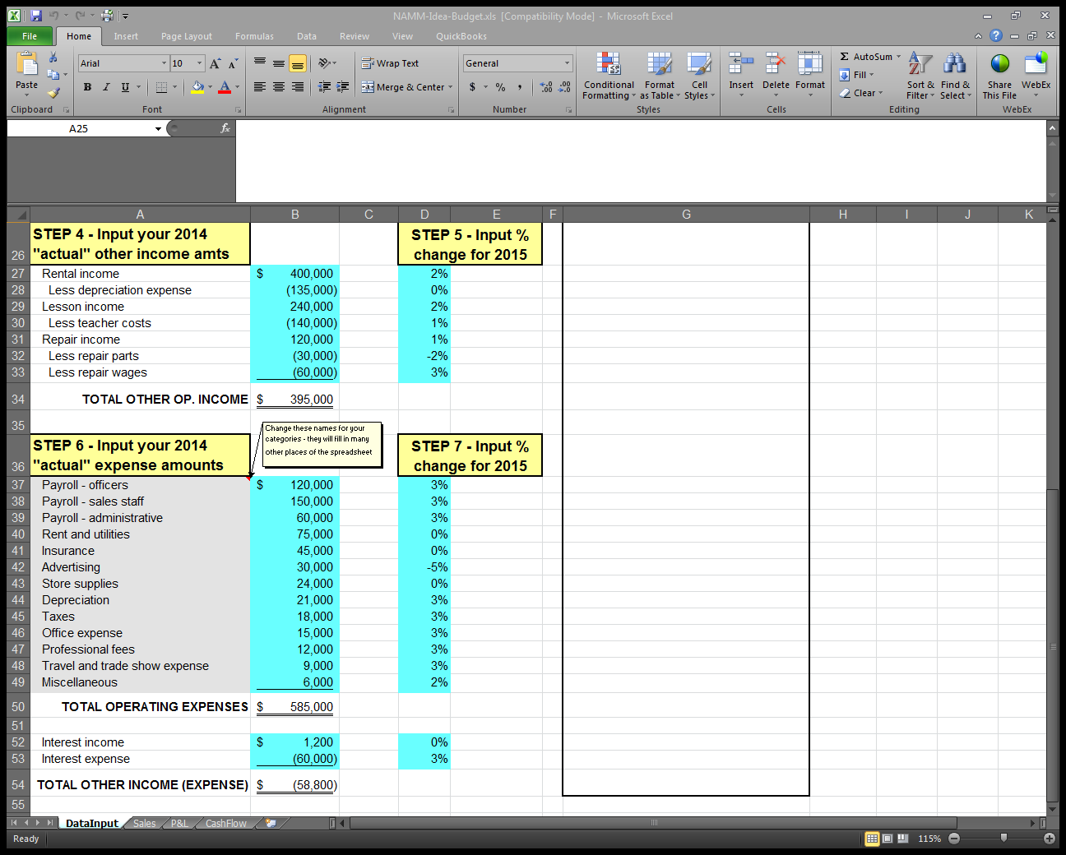
FKCo Budget Spreadsheet
  http://www.fkco.com/budgeting

Slide 16
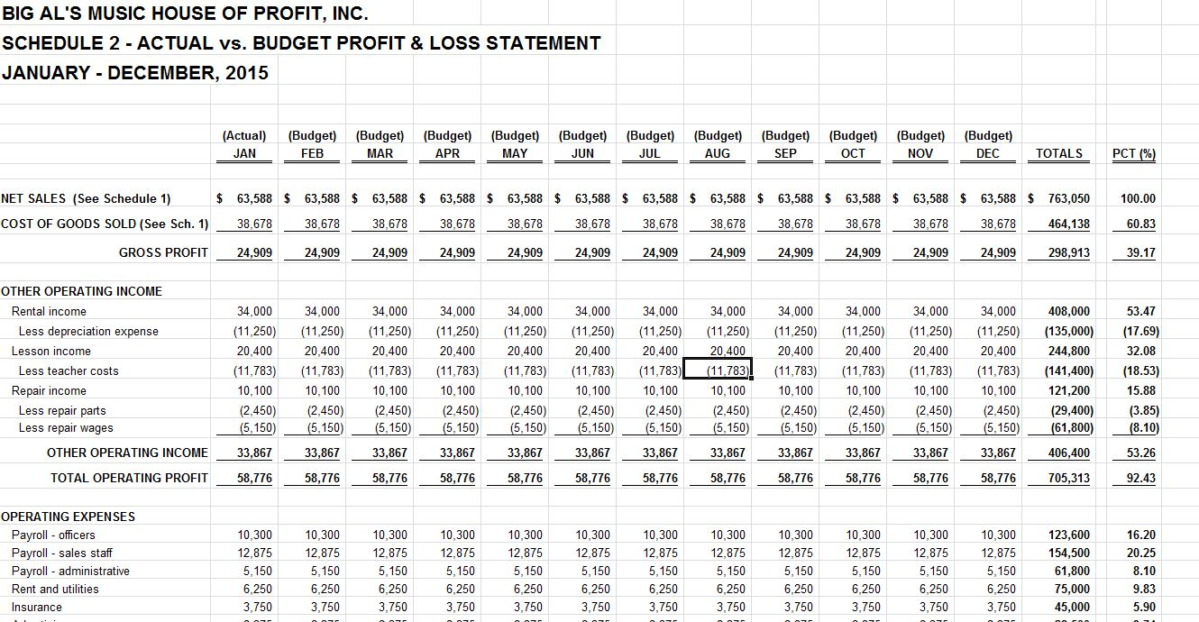

Slide 17
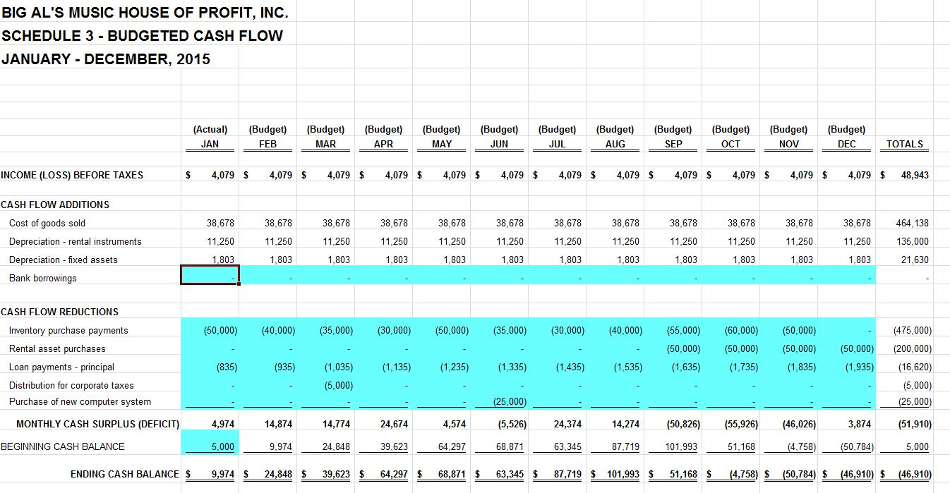

Slide 18

Implement & Follow-Up
Download Budget Spreadsheet
  http://www.fkco.com/budgeting
Involve Others – Sales & Admin
Update Monthly With Actual Data
Review Monthly Performance
Hire Accountants for Tax Planning

Slide 19


Slide 20

Consulting Meetings
Contact us outside the Idea Center entrance
after this session to set up a meeting time

