Slide 1


Slide 2

20 Tips for Riding the
Economic Waves
. . . and unique places you can cut costs
Tracy Leenman
Musical Innovations
July 2012
Notes:
One day we hear that the economy is on its way to recovery. The next day, we hear that things are as bad as ever, and may get even worse before they improve. Just when things finally seem to be leveling out, an earthquake hits, a nuclear plant melts down, gas prices skyrocket, and the ups and downs begin again. Business columnist Rhonda Abrams calls the economy of 2011 “an economy of transition.” Abrams notes that, “Whenever there’s significant change – economically, technologically, sociologically – there are business opportunities and challenges. You want to be in a position to take advantage of those opportunities and prepare yourself for the challenges.” In fact, tougher economic times can be a real blessing . . . if they force us to re-evaluate and make the changes we might not take the time to implement when things are “doing just fine.” Let’s face it, we all have those times when we live the cliché “I’m too busy working in my business to work on my business,” right?

Slide 3


Adopt an
Austerity Mentality
Every penny counts
Leave “no quarter”
Disallow “But we’ve always . . .”
Do the math
Determine to “get it right” –
no matter what the cost
Start TODAY!
Notes:
Regardless of the economic indicators, keeping a fiscal “tight rein” on your business is obviously the wisest approach, both for taking advantage of opportunities, and preparing for challenges. Much has been written of late about “tightening the belt;” clearly, being fiscally conservative will protect us in times of downturn, and help maximize our profitability in more stable economic times.
Michael Gerber, in "The E-Myth Revisied" says that "if your thinking is sloppy, your business will be sloppy . . . You can’t ask too many questions about the numbers.”
cf. Joseph and the Amazing Technicolor Dreamcoat, 7 fat cows and 7 lean cows
Being fiscally responsible regardless of what happens around you protects you for the next downturn
Little things left unattended become big things.
40% of all new small businesses are out of business by the end of the first year; of those who survive the first years, 80% fail in the next 5 years.
Chip Averwater cites the US Economic Census in saying the net profit of a retailer after ALL expenses is typically 1-3% of sales (p. 30). He notes that "profit is the sum of a thousand little improvements (p. 43), and "every missed detail comes directly off the bottom line."
A. Be totally objective - determine in advance there will be no "sacred cows" - disallow "we've always done it that way" as a rationale
Like cleaning out your teenager's closet vs. having him/her do it him/herself. Chip p. 376f – “Abandon your mistakes as if they were someone else’s. Mistakes are sunk costs. We have to forget the history . . . and choose the best option from those in front of us.”
B. Do the math. Focus on real data, not your likes and dislikes, your hopes and dreams.
C. Determine to "get it right no matter what the cost" (Gerber)
D. Don't forget the impact on your customer! Customers are fine with common-sense changes or changes that will bring their prices down or service up, but not a bunch of changes that make no sense to them (e.g. Reorganizing grocery store) - get customers' input (reward in advance for honest input)
Remember the “Zep Tune?” - A victor gives no quarter when the victor shows no clemency or mercy - To show no mercy. Refuse to give an opponent the opportunity to quit or rest. This use of quarter is probably derived from the meaning of quarter which refers to shelter, as in head quarters. Thus, no quarter means that your opponent is offered no retreat to shelter or protection
So, where do you begin? Start by making a commitment to yourself to change whatever needs to be changed, immediately. Evaluate everything, under the proverbial microscope, and be totally objective. Do the math. Which products and services have truly been profitable, and which have not? Get tough about expenses. Focus on real data; not on your hopes and dreams, or your own personal feelings, likes and dislikes. This is the reason some companies hire outside consulting firms - it’s easier for them to look at every single thing objectively. It’s like asking your teenager to clean out her own closet; chances are, very little will change unless an “outsider” (e.g., a parent) steps in. You probably don’t need an outside consultant; you just need to promise yourself you won’t get stuck in the evaluation phase, but will come up with realistic action items and move forward.

Slide 4

Prioritize Your Points of Change
Divide points to be addressed into three groups:
  Q&E (“DUH”s)
  Changes that will take some work
  Changes that will take major
  re-thinking
Keep a notebook, index cards or Google Docs
  Include action strategies
Order from easiest to hardest
Notes:
3. Divide your issues (and their corresponding action strategies) into 3 groups:
- quick and easy changes with immediate impact (the "DUHs") - address these the day you find them
- changes that will take some research, time and/or effort but will have long-term impact
- changes that will require major re-thinking and/or restructuring
Make a loose leaf notebook (or for you technophiles, Google Docs that can be shared) with a page for each - order smallest/easiest to biggest; address in that order so you don't get stuck on a tough one and lose opportunities to save $$ now - remember, every penny counts!
Start TODAY! Chip Averwater says, “execute the plan quickly, boldly and resolutely . . . We have to do the whole job the first time.” (p. 344)
Some changes are easy to implement. Others take more effort, and happen over time. Some changes may require a totally different look at your business and how it operates. But rest assured that there are some steps you can take, today, to get started. From there, as they say, “don’t stare up the stairs, just step up the steps!” Eat the elephant one bite at a time, so to speak.
“Any expense can be reduced or eliminated, usually much faster than we assume.” (Chip p. 346)

Slide 5

Get a 100% Buy-In
Austerity Mentality mindset starts from the top
Every employee needs to understand the need for change
Every employee needs to be engaged in the process
  Every employee contributes to your bottom line
  Each employee should be encouraged to share ideas
  (Their perspective is very different from yours!)
Whose pennies are these, anyway?
Notes:
This mindset must start "from the top," but everyone must understand the need (not necessarily specifics) and be engaged
Like husband on one budget, wife on another
Every employee contributes to your bottom line in one way or another - employees may have great input - brainstorm w/o criticism, all ideas considered (???commercial re: guy in Ohio??). List all ideas to dispel idea that you are not really listening.
Encourage employees to think of each penny as coming from their own pocket (they think we are/company is rich!)

Slide 6
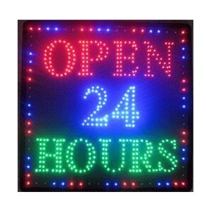
We’re Open!
What are your hours of operation?
Look at the stores around you
  9 to 5 is no longer the cultural norm
Consider changes
  Shorter hours (Saturday hours)
  Smaller staff at certain times of day
  Summer hours, holidays
Offer a 24/7 hotline and/or “by appointment”
for after hours
Notes:
LET’S START WITH QUICK & EASY
Take a long, hard look at your store hours. If your company opens at 9 a.m., six days a week (because it’s always opened at 9 a.m., six days a week) . . . but never does any substantial business until 10 or 11, consider changing your hours. Some years ago, I did a survey and cost analysis for a friend that showed he could save one person’s annual salary (over $20K per year in just one of three stores!) by opening one hour later each day, without losing any appreciable business.
- Look at sales per hour
- When are the stores around you open? Can you have a smaller staff some hours?
- less hours reduces chance of overtime
- use a 24/7 hotline for emergencies, offer hours by appointment outside of normal business hours

Slide 7
Down the Drain . . .
Losing valuable dollars on utilities?
Don’t just turn it off, unplug it! (power strips)
Change from incandescent to fluorescent bulbs
HVAC
  Change those air filters!
  Ceiling fans
  Hot water heaters
  Air locks on doors (weather stripping)
Timers (7-day time clock) vs. light sensors
Notes:
Utilities. While utilities may be only a small percentage of your annual expenditures, if you are going to be truly austerity-minded, every penny counts. Alan Freidman maintains each extra dollar of overhead saved means three to four dollars less revenue you need to stay afloat. And these are some easy-to-implement changes -
Check your keyboards, computers, calculators and other electrical devices every night when you close up. Unplug, don’t just turn off – use power strips and even timers to make this easier.
Change as many incandescent light bulbs as you can to fluorescent (if the government has its way, we may soon not have a choice in this one!). Energy-saving (“compact fluorescent”) bulbs fit into regular incandescent bulb sockets, and are more energy-efficient. For fluorescent fixtures, Glen Ingles recommends using bulbs of 3500K (Kelvins) with a CRI (Color Rendering Index) of 80 or better, to can avoid a “sterile” look in your showroom. Purchasing these from a lighting contractor rather than a home improvement store may get you better prices. Added benefit - 0Chip Averwater’s new books says (p. 79): “Good light, strategically directed and focused, can turn slow sellers into best sellers.”
Check your thermostat – but be aware that raising or lowering the thermostat more than five degrees from your desired daytime temperatures may wear your HVAC units out more quickly, costing you more in the long run. Better yet, use a timer to set your thermostat they way you want it
Change your air filters often, to keep your cooling/heating system working at its best.
Ceiling fans are inexpensive to install, and can substantially lower your HVAC costs (our monthly electric bill dropped more than 20% when we installed fans in our showroom area).
Air locks on your doors will also help with temperature and humidity control.
Check your hot water heater. Setting the temperature too high is not only costly, but can also be unsafe if young children turn on the faucet without supervision. If your goal is to provide a family-friendly environment for your customers and for the students in your studios, then a temperature setting of 120o to 125o F is recommended. Each 10-degree reduction in temperature setting will result in a 3-5% savings in energy costs [A longer-term goal might be to install a point-of-use water heater, which runs only when hot water is used].
Timer versus light sensor – our lease specifies that our outside sign be lit from sunset until 9:30 p.m. each evening. This means it’s on for four hours or less each day, depending on the time of year. Our landlord “generously” offered to install light sensors to turn signs on and off, but this means signs would be on for 10 to 14½ hours each day, or even more if it’s cloudy or foggy. We use a clock timer instead – inexpensive and easy to install – to keep the cost of lighting our sign to a minimum. A seven-day time clock will help adjust your lights, HVAC, and hot water heater while the store is closed as well.

Slide 8
Keep it Cool!
What color is your roof?
  White reflects heat better than dark colors
Reflective glass
  Shade from the afternoon sun, keeps instruments from fading
Canopy
  Lower the “greenhouse effect”
Landscaping
  Use deciduous trees to shield the sun
Notes:
A white roof will reflect heat better than a dark-colored one.
Reflective glass will help shade your store from the afternoon sun.
Deciduous trees will help shield the glass in the summer time; but in the winter, when you want the light to come in, their leaves are usually gone.
Installing a canopy will also lower the “greenhouse effect.”

Slide 9
Negotiate, negotiate, negotiate
If you rent, check your CAM costs
  Who pays for unleased space?
  Excess use of water, etc. by other tenants
Re-negotiate EVERYTHING on a regular basis
  Telephone, insurance, landscaping, printing/duplicating, shipping, cleaning service, trash, merchant fees, etc.
    Use NAMM Member discounts!
    Watch for “new customer” specials
Notes:
5. Do you own? Rent?
If you are renting a space, go over your Common Area Maintenance charges carefully. Usually, these are a percentage of your space versus the total leasable space. But are you being charge a percentage of the entire leasable space, or only a percentage the space actually leased? If there is an empty space in your center, you want the landlord to be paying that part of the CAM, rather than you. We have a chiropractor next door, and he uses a large amount of water for his x-ray machines. So, we negotiated down a good percent of our CAM fee when the landlord agreed to split up the water bill based on usage. Another issue is that your landlord is probably paying “large use rate,” as opposed to “freestanding rate.” But is he charging you according to what would be your freestanding rate, which is probably considerably more? [A long-term solution here might be to ask for your own meter]
AT&T bill coming down $100 per month
Re-negotiate - new custs often get better deals than old so research and bargain
Re-source, compare, and re-negotiate regularly. My father used to tell me “everything’s negotiable.” Check shipping rates (compare shipping costs versus the postal service for smaller packages). Price-shop insurance rates, printing and duplicating charges, employee benefits, office supply companies, phone and internet service. At one point, we called our phone company and said we were thinking of switching to another provider. They lowered our monthly charges nearly 30%, on the spot – and we got a free air card too! We all know that new customers get special “deals” but often your current service provider will gladly match those deals rather than lose a customer.
Look at the cost of an answering machine versus using the phone company’s voice mail. Depending on your telephone service, an inexpensive answering machine may be all you need, and may save money on your monthly phone bill. Check your phone bill for any “added services” that you don’t use, or that may have been added because of a change of service plan. We recently found we were being charged for internet hosting, as part of a package “deal” – but we had never used that company’s internet service, and cancelling it saved us 10% on our monthly bill.
Who cleans your store? Do you have a cleaning service? Do you, or does one of your employees, have high-school age children who would gladly work for a lower hourly wage? Same with cleaning rental returns. College students headed towards careers in music may jump at the chance to learn about your business, and make a little money, cleaning rental returns, updating price tags, and so on.

Slide 10
Credit or Debit?
Bank services
  Account fees/interest rates
  On-site deposits
  Have a business plan ready at all times!
Merchant services
  What cards do you take?
  Debit vs. credit?
  Swiping vs. card not present
  Mobile swiper, Square
Notes:
Bank services
- account fees
- on site deposits saving time and paper-handling fees
Have an up to date business plan so you can negotiate when the time is ripe – be prepared to present to a bank at any time. Know who your customers are and what their needs are. Know what your financial and business goals are, your goals for reaching new customers, implementing new marketing techniques, new technology. Know what’s changing in the industry, in your market, and in your competitive environment. You never know you might be facing a change in your bank’s ownership, or the need for a short-term loan -- an up-to-date business plan is one of the first things your banker will want to see. Shows you are interested in and aware of your business, demonstrates financial acumen
Banks are sitting on money but are afraid to lend because there are fewer well-qualified customers to lend to. Alan Friedman - "the best time to get a banker is when you don't need a banker“
Review your credit card provider’s fees.
Our former card processor charged more for debit transactions under $30 than it did for credit transactions, so we ran all transactions under $30 as credit.
Our current processor charges more if an address is not provided with a credit transaction when the card is not present, so our employees are asked to get billing addresses and zip codes with each phone order.
Each processing company has its own fee structure, so be sure you are familiar with its ins and outs, and be sure your staff is kept informed as well.
Usually based on # of transactions per month as well as size of average transaction, so a change in your number of transactions, gross sales, or average transaction dollars can mean a change in your fee structure, so check your monthly reports carefully.
- New laws in effect Dec 2011 may change your fee structure, so check!
- invest in mobile swiper/Square
Everyone who has AmEx has at least one other card!

Slide 11
Check Every Invoice
Pricing
  Be sure your AP person knows what’s been negotiated
  Discounts negotiated
  Terms, special nets, sales
    Read your e-mails!
Review statements carefully (finance charges, etc.)
Update list prices regularly
  Have someone in charge of re-labeling when new
  catalogs arrive.
Notes:
Invoices – often, your buyer negotiates with the suppliers, but someone else entirely handles your invoices. And your AP staff may or may not know the details of everything your buyer has negotiated. So, take a closer look!
Check every invoice for pricing errors, incorrect terms, questionable freight charges. Check your nets carefully. Many of our suppliers comment that we are one of very few companies that “check up on them,” and make sure we are billed correctly every time . . . and that’s a shame! If a supplier is running a special, or if your discount level changes, the supplier’s computer that generates your invoices may not be aware of your deal. We recently ordered some instruments off a manufacturer’s booth at our MEA Convention, but the invoice did not reflect the extra show discount, and we were erroneously charged freight [Again, a phone call was all that was needed to get credit for erroneous charges – over $300].
Check your statements carefully. You may get automatically-generated finance charges on invoices for a number of reasons – invoices awaiting credits, slower-than-usual post office delivery times, incorrect terms. We generally do not pay for items that were incorrectly shipped (including the applicable freight charges), or that we know will be returned; we normally short-pay and then apply the credit to the invoice balance. While the suppliers probably don’t like this approach, it makes little financial sense for us to pay in full and then wait (sometimes weeks) for credits. This also seems to have a “magical” effect on the length of time it takes to get the credit.
Read your e-mail. We all hate spam; we all get too many e-mails. We hit “delete” almost involuntarily when we see certain e-mail addresses in our inbox. But supplier e-mails that contain B-stock lists and other special promotions – and updated dealer price lists – can be easily overlooked in the e-overload. Last year, Dansr offered a $10 rebate on all VanDoren mouthpieces. We printed out the coupon, and sent an e-mail to all our band directors, sax and clarinet customers, and local universities’ applied faculty. A number of people who had never bought from us before bought mouthpieces because of “our” rebate. Truth is, the rebate wasn’t “ours” exclusively – it was offered to all VanDoren dealers . . . but we were apparently the only ones in our market area who implemented this promotion.
Check your price tags regularly. When you get a new confidential, do you update your prices and price tags? Many vendors change their prices twice a year, and if you don’t update your prices regularly, you may find your margins slipping away. We put price tags on the back of each item, because it’s proven that when customers actually pick something up to look at it, the chances of them keeping it are higher.

Slide 12
Freight – the Hidden Variable
Check for unreasonable shipping charges
  Identical shipments should have identical freight charges
  “Shipping from a different warehouse” - not your problem
  Free freight or freight allowances promised
    Ship to school vs. ship to store
  Everything is negotiable!
    Product brought in for special events, MEA’s
    Negotiate freight on returns
Notes:
We received two UPS shipments from the same manufacturer, one week apart. Each shipment contained two trumpets; all four instruments were exactly the same model. The freight on one shipment was $16.43, and the other was $24.14 – 47% more. Shortly thereafter, we received a UPS shipment (from the same manufacturer) that contained only one trumpet, for which the freight charge was $16.46. A phone call to the manufacturer resulted in almost $20 in credits for excess charges.
One of our publishers sent us catalogs to distribute at our MEA Convention, along with a few items we had ordered. The freight charges were $22.72, even though our actual order could have been sent first class mail (USPS) for only a few dollars. This time, a phone call resulted in a credit for the entire $22.72! [We love our suppliers!]
Last Christmas, we ordered a guitar for a customer from one of our favorite jobbers. This particular item had to be shipped from a different warehouse, and we were charged $50.17 freight on an item with a net of not much more than that. Once we brought this to his attention, our rep was gracious to adjust the freight down to what shipping from our “normal” warehouse would have been.

Slide 13
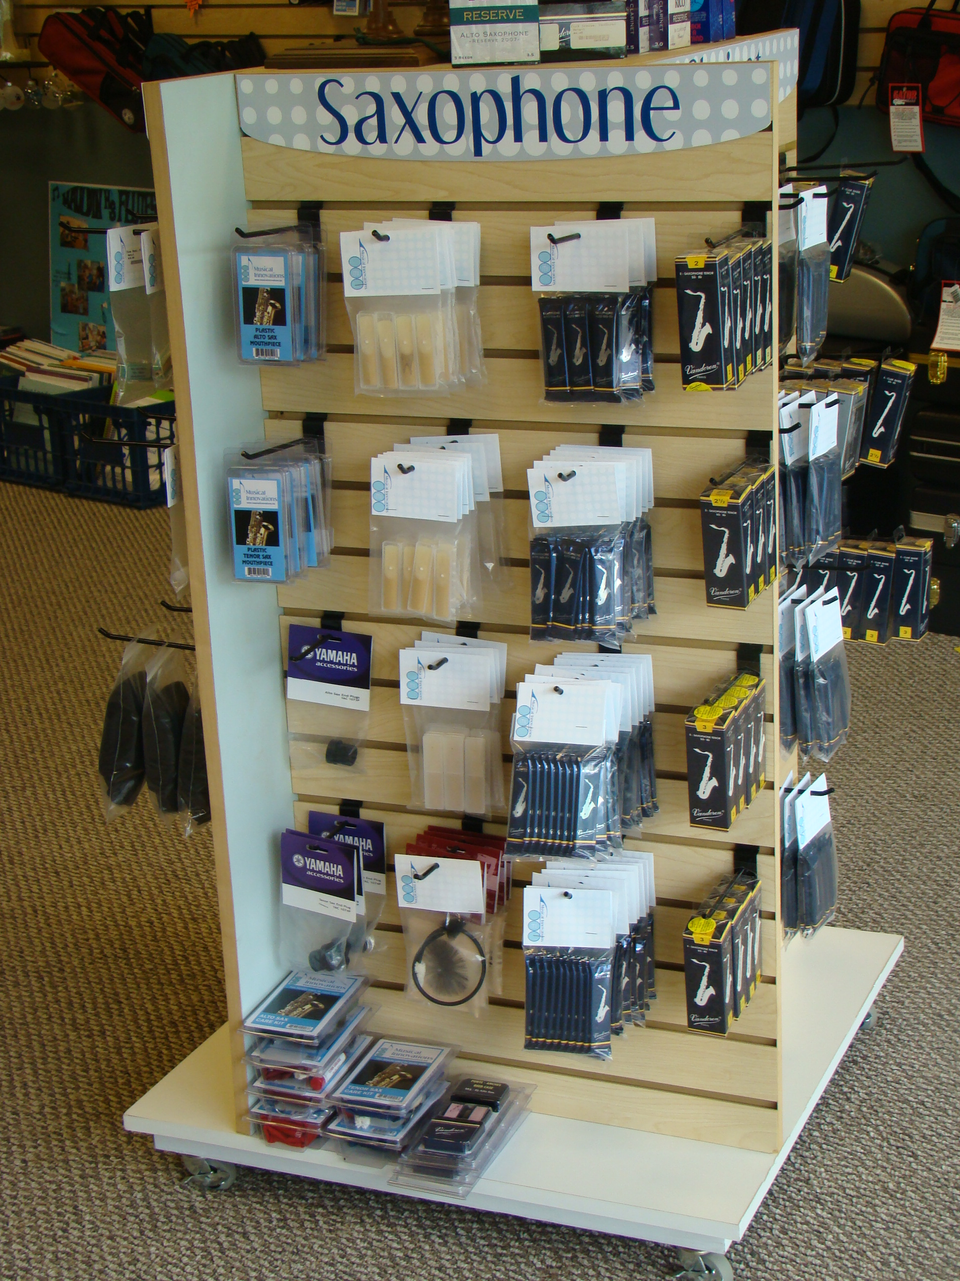
Buying Power
Buy in bulk (but only what you can sell!)
  Reeds, bowed strings, etc. can be repackaged
  Branding opportunity
Buy carefully
  Watch for specials, sales
  Watch for show horns (MEA), “Disney List,” etc.
  Watch for changes in distribution
  Be willing to re-source regularly
  Pay by cards (e.g. Plum) that give discounts
Notes:
More on buying in bulk later – risk is, as with Sam’s Club – buy too much!
Purchase reeds, strings, etc. in bulk and repackage them. Packs of fifty reeds can be re-packaged into tens; purchasing single violin strings by the dozen and making them into sets is much less expensive than buying by the sets And you can use your own personalized headers to reinforce branding. Yes, this takes man hours (your employees can often get this done during “down times” like first thing in the morning), but it saves money, and you get the added benefit of branding.
Re-source
- watch for changes in distribution (last year Pro Mark, Vic Firth)
- watch for sales
- buy in bulk and re-package - also a branding opportunity
look for show booth horns (not just your MEA - ITG, NFA, etc.) and read emails about specials like Disney
Remember the “change whatever needs to be changed” commitment you made at the start of this process? I have a friend whose buyer found out he could purchase bows for $3 to $8 less per bow by switching vendors. However, he refused to change his sourcing, because it was “too much work” [I wonder if he would have been as hesitant if that $3-8 came out of his pocket, rather than his company’s!].
More on inventory control later! ☺

Slide 14
Aim for the Bull's-eye
Core Customers
  Buy on a regular basis, from you
Inner Circle
  Buy regularly, but not exclusively
Fringe
  Infrequent buyers
“Off the Board”
  “No need” for your products
Notes:
You’ve heard it said that it is 6 – 7 times (?7-10X per Danny Rocks) more costly to acquire a new customer than retain an existing one. By rewarding and engaging your current customers, you can draw them from the outer circles towards the bull’s-eye.
Core – your best customers, those who spend money at your store on a regular basis, and would not go anywhere else. They trust you; they even call you when they’re on a band trip to ask what music stores you know in that area, should an emergency arise. They are your loyal advocates.
why should they keep buying? New products, add-ons, upgrades, etc.
Inner Circle – repeat customers, but still not “brand-insistent” --- How can we make our “sometimes” customers in to “exclusively-ours” customers?
why should they buy only from US? – what do we do that’s DIFFERENT?
Fringe – why should they buy more often (regular maintenance, need for step up – EDUCATE). More importantly, why should they be PLAYING MUSIC more often?
Off the Board – educate as to why get involved with music?
Use customers as advertisements – recommend a new rental/lease customer, get a thank you note w/ a free month’s rent
Bring a friend to lessons, get a free lesson
Add-ons, e.g care kit dots and add-on spiffs – took our add ons from 27% to 93% - 27% means that 73% of rental customers leaving without so much as a book or a reed!
Even if “off the board” - Chip Averwater, p. 17 – “Each buyer is a future customer.” Seize each opportunity to win them over!
Make their experience memorable – doesn’t cost a dime! ☺

Slide 15
Marketing
Targeted vs. non-targeted
  Mass media vs. directed advertising
  Track every promotion you do
Social Media – it’s FREE!
  Facebook promotions, events
  “Shares” with friends
  Photos of events
PR – it’s FREE!
  More credible than advertising
Notes:
Marketing. Another area where we tend to over-spend. Non-targeted marketing is very expensive, and can have a surprisingly low return. At the very least, track every promotion you do so that you can see what is really effective. “Print this out and bring it in for . . . ” or “Mention this ad . . .” or “Bring this in for an extra . . .” are no-cost ways of seeing if you are getting a return on your advertising dollar. We do mass-media advertising only during the six weeks of rental season and four weeks at Christmastime; and even then, we use only the local section of the newspaper (which costs about 1/3 of the regular sections). This has actually been quite effective for us, as a new company, in getting new customers into the store. Other than that, we use almost exclusively low-cost guerilla marketing. Social media, direct mail, e-mail, and so on.
Collect contact info at every opportunity.
Facebook for events
Thank you note with coupon
Web site
Marching contest and band programs more than sports or yearbook programs (untargeted)
Business section of paper
Magazines – cut out also take photos
Press releases

Slide 16
Repair Department
Keep track of serial numbers
  Warranty issues that should be covered by manufacturer
  Instruments that should be repossessed
Dare to Compare
  Check what others in your area charge
  Update prices regularly
  Buy parts for your subcontractors
Let your repairmen be repairmen
  Let someone else do the calling
Notes:
Keep track of serial numbers on all repairs. If an instrument comes in for repair and the account is not paid up, you can keep the instrument until you get the account current. If the instrument is still under manufacturer’s warranty, you may be able to get parts at no charge from the manufacturer, and may even get reimbursed for some of your labor costs (this varies by manufacturer, but it’s always worth asking).
If you have subcontractors, buy parts for them – chances are you can get them cheaper than they can. And if they pay more than you would, they are charging you more, too!
If your repairmen are calling customers, they are spending expensive time doing a task almost anyone could do. Let them repair horns (as only they can) and let others do what anyone could do

Slide 17

Rentals
Credit check 100% of your rental customers
  Don’t worry about losing customers, worry about losing horns!
  Bad credit is never a surprise . . . to the customer
Require 100% Auto Pay (Electronic Funds Transfer)
  Eliminates “decision moments,” lowers return rates
  Charge a late fee
  Send out reminders in advance if needed
  Use software that posts automatically
  Run payments only 2 – 3 times per month
Notes:
- do credit checks. Don't be afraid of losing rental #s, be afraid of losing instruments to those who will not pay!
If you are not 100% on some form of electronic funds transfer (automatic payments), change your policy immediately, if not sooner. When a friend of mine began using auto pay, he also gave customers the option of getting a monthly statement and sending in checks. Even with a $3 (and later $5) per month statement fee, a number of customers chose this option . . . but 73% of those who chose the statement option had defaulted within a year. The default rate of those on auto pay was far, far less. Even taking into account those very few customers who left because they objected to auto pay, the overall effect was positive, both in terms of payments received on time, but on employees’ time saved, not having to track down past due customers. An added benefit to auto pay – customers who have to send a payment each month are facing what’s called a “decision moment” each month – should I pay, or should I return the instrument? Should I pay this bill, or is something else more important? Auto pay takes the “decision making” out of the picture, so your return rate may drop significantly.
We send out reminder letters about a week before payment date, to customers whose credit cards are about to expire, or who have been chronically slow to pay. The cost of a stamp is far less than the cost of paying an employee to track down a customer whose card expired, or one who chronically “forgets” to put the money in his account. We also charge a late fee if payments are not made on time.
If you are still paying employees to post rental payment several times each month, consider switching to a POS software (such as AIMsi) that is integrated with a credit card processor, so that this is done automatically. Imagine, hitting one key on your computer, and less than 60 seconds later, all your payments are posted! The hourly wages you will save will pay for the software over time.
Along the same line, if you are running automatic payments (even on AIMsi) more than twice a month, consider consolidating. Even when much of the process is automated, you still may be spending more time and energy than you need to.

Slide 18
Vehicle Expenses
Re-think gas cards
  Paying cash or debit can mean lower prices
Take the time to do routine maintenance
  Regular oil changes, tune-ups
  Tire rotation, replacement
  Prevent down time for unexpected repairs
  Increase the life span of your vehicles
Consolidate trips wherever possible
  Visit more teachers per stop (strings, choral)
Notes:
A company gas card may mean your employees have to buy more expensive gas; paying with cash or debit card usually means lower prices per gallon, and also gives your employees more flexibility to price-shop different brands. And be sure the routine maintenance required on your vehicles is done on time, to keep repair costs down. Regular oil changes, tune-ups and rotation will keep your vehicles running longer, and will help prevent down time for unexpected repairs. Considering the use of smaller vehicles, or flex fuel vehicles, wherever possible may be a long-term goal.
By visiting more teachers on each stop, you can increase your customer base without increasing road miles. Do you see the orchestra and choir teachers too?
One school we visit said the road rep from another company walked right by her room to the band room . . . and missed out on thousands of dollars of sales! ☺

Slide 19
Teaching Studios
Charge a registration fee, payable to your store
  Offsets costs of utilities
  Lowers attrition, fosters “belonging” to your store
Educate teachers in products you sell
  Step up instruments
  Summer fun music
  Add-on sales, accessories, cross-selling
  Teach on and display what you sell
Reward teacher/student longevity
Notes:
If you offer lessons, charge a studio registration fee, payable directly to your company (whether your teachers are independent subcontractors or employees – this is a transaction between the student and the store). This will not only help offset the cost of lights and HVAC, but will also help lower attrition. We charge $35, and discount the fee for the 2nd, 3rd, etc. child in the same family. We run coupons in the fall for a “free lesson with payment of studio registration fee” – and then can use part of that registration fee to reimburse the teacher for the lesson fee.
Give teachers enough info to help encourage step-up sales (spiff?), seasonal music, add-on sales like jewelry
Teach on the instruments you sell, display what you sell (clocks)
Reward teacher & student longevity to minimize turnover
BTW, Have excess room? Build studios. Lesson income does not fluctuate with the economy nearly as much as disposable income sales.

Slide 20
Inventory Control – the Biggie
Alan Friedman’s Rules
  Buy what you can sell before you need to pay for it
  Buy only what you can sell in x-days, where x=360 times %GPM
  M.I. Rule: “One less and you’d lose a sale”
Understand GMROI
  GMROI is a ratio (fraction)
  Balance of turn and profit
  Increase turn by selling more,
  or by lowering inventory
Notes:
Alan Friedman's rule - buy only what you can sell in x number of days, where x = 360 x %GPM (sales $$ - COGS = GPM)
- small goods - buy what you can sell before you need to pay for it
Aim for a GMROI of $1.50 or better -- remember, GMROI is a ratio -- first reaction might be to raise prices to raise margin, but this can have a reverse effect on GMROi if your turn tanks! Aim for a turn of 2.5 to 3 minimum - if this is not happening, you need to research why! Aim for GPM of 30-40% in school B&O, 35-45% in print music (Alan) - again, if this is not happening, research why (exceptions below!!)
fine-tune balance between inventory and GMROI - "one less and we'd lose a sale" (exception - people don't like buying last one of anything, so that rule does not always imply only 1 of an item)
BTW - IRS new rule (2 years) allows you to depreciate up to a certain $$ instruments purchase for lease pool 100% in year purchased. Weigh benefits vs. disadvantage of not taking over 3 years

Slide 21
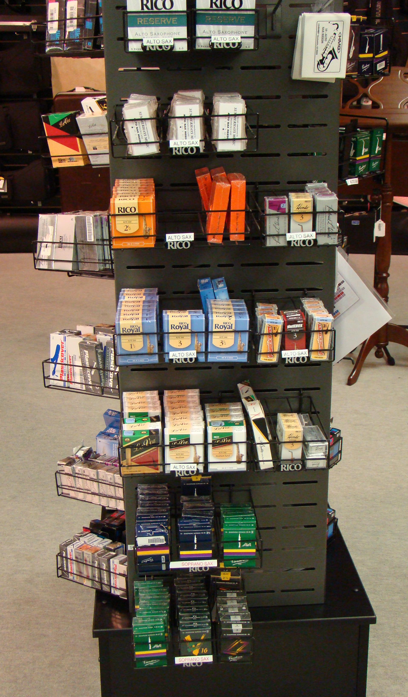
Buried in SKU’s?
Eliminate unnecessary SKUs
  Decreases customer confusion
  (leads to buying cheapest)
  Good signage (FABs) essential - differentiate
  Offer to order what you don’t stock
Blow out old inventory
  Run frequent aging reports, set discounts
  Create a spiff to make up for lost commission
  Surround blow-outs with higher margin add-ons
Notes:
- eliminate skus's - also decreases customer confusion (e.g. reeds) Implement “good-better-best” – lowers inventory costs as you will be buying bigger quantities of fewer things, also encourages “buying up a level”
Guitar strings – if we don’t sell a box in 6 months, it can be special order ☺
Don’t say “we don’t have . . .” unless it’s followed by “but we can order . . .” - DUH
- sell off excess inventory at cost to generate cash flow to purchase stuff that WIlLL sell (and of your commissioned salespeople complain, remind them that they are getting ZERO commission if something does not sell at all!)? Surround blow out inventory with higher-margin add-ons
- think about clothing and seasons - if it does not sell when it's "in season" at that price, it sure won't sell for that once it's out of season). Older inventory costs you money every day it sits in your store. MARK “RETURN BY” dates on a calendar, also events – when to buy for special events to avoid last-minute buying
run frequent reports of inventory aging, over 3-4 months for most items means it's "old" (exception - rental and pro horns)
Consider sales spiffs for salespeople, “end cap sales” as in grocery store – featured items that change regularly

Slide 22
Creating a Model Inventory
Examine each department by price point
  Total up sales, GPM by price point
  Compare % GPM in that price point to total GPM
  Devote the matching % of inventory $$ to that price point
  Set “open to buy” and replace inventory
  only as $$ become open
  Target your marketing to those customers
    Are you a pro shop? student horn shop?
  Expand target market carefully, deliberately
    Broaden “product portfolio”
Notes:
This is a major project!!
NOW, take the cash you earned selling off your junk, and buy stuff you CAN sell! ☺
Alan Friedman: “GMROI tells us if we have a problem; GPM and turn tell you WHERE the problem lies.”
percent of sales should relate to percent of inventory load
- percent of profit from category by price point = percent of $$ invested in inventory in that category by price point
Define your target customer, and identify their most important needs. Then, serve that need.
Broaden your product portfolio WITHIN WHO YOU ARE first – e.g. cross-selling (put books near beginner guitars, etc.)
Chip p. 371: “Doing more of the thing you do best is better bet than doing more things.”
Creatively expand revenue streams without getting outside of who you are – Lori Supinie: “Be yourself, but do it exquisitely.”

Slide 23
A Hypothetical Example
Under $300
37% GPM
$300-499
43% GPM
$500-699
18% GPM
Over $700
2% GPM
Notes:
THIS IS A HYPOTHETICAL EXAMPLE illustrating inventory management and NOT addressing target prices, margins or pricing policies!
Where is the majority of their profit? Why? Lower-priced guitars sold everywhere, and cheaper than you can!
This is NOT a high-end guitar shop, but a middle-of-the-road shop with regard to price. So, they should focus on that . . . Unless they want to change deliberately – change their image, market to a whole different customer (which is NOT cheap!).

Slide 24
A Hypothetical Conundrum
Acoustic Guitars on Hand
Compare to GPM %s:
Under $300 - 37% GPM
$300-499 - 43% GPM
$500-699 - 18% GPM
Over $700 - 2% GPM
Why was this company having trouble selling guitars?
Notes:
Again, THIS IS A HYPOTHETICAL EXAMPLE illustrating inventory management and NOT addressing target prices, margins or pricing policies!
Note that the largest percentage of inventory dollars (42%) were spent in a price point that was only 18% of their sales.
The price point that gave them the most profit dollars (red) had only ½ that many dollars in inventory load
Pro guitars – just not this company’s “thing” at that time – if he wanted to change it, SAF, marketing, merchandising would all have to be re-thought
Also look at % of floor space devoted to a department or price point (e.g. I have a friend - 20% of his store’s sales is print music and he has 67% of his sales floor space devoted to print!
Balance by department, by price point
This is one of those things that takes a LOT of time & re-thinking ☺

Slide 25
Additional Resources
Averwater, Chip. Retail Truths: The Unconventional Wisdom of Retailing. Cary, NC, ABB Press, 2012
Gerber, Michael F. The E Myth Revisited. NY: Harper Collins Publishers, 1995.
Lewis, Robin and Dart, Michael. The New Rules of Retail. NY: Palgrave Macmillan, 2010.
Warner, Ralph and Laurence, Bethany. Save Your Small Business. Berkeley, CA: Nolo, 2009.

Slide 26

Thank you!
Tracy E. Leenman
Musical Innovations
150-G Tanner Rd. at Butler
Greenville, SC 29607
(864) 286-8742
tracy@musicalinnovations.biz

