Slide 1

Fan Your Success
Notes:
Thank You for taking the time to join us.

Slide 2



Jen Lowe
BoomBoom Percussion
&
Tony Caporale
TwinBear Management
Notes:
A little bit about who we are and why we’re here…
Jen does a mini interview with Tony and he mentions all the items that qualify him to be a social media expert
Make sure you mention Collective Soul/Myspace story

Slide 3

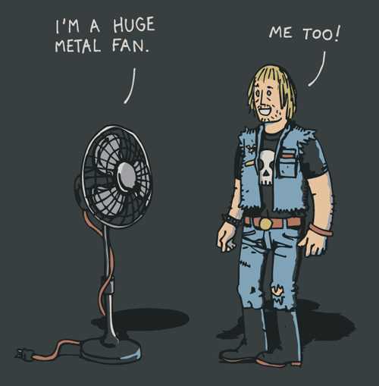
Fan Your Success
Identify your FANS!
Critical first step to inspire social media engagement.
Notes:
Jen Shares story about guy who bought udu on BBP – customer turn into a fan
You Never know who will be your greatest fan.
They share your story and you will don’t even know it.
Ask, who can share a “greatest fan moment?”
How many know who your biggest fan is? By Name?
How do you engage with them?

Slide 4

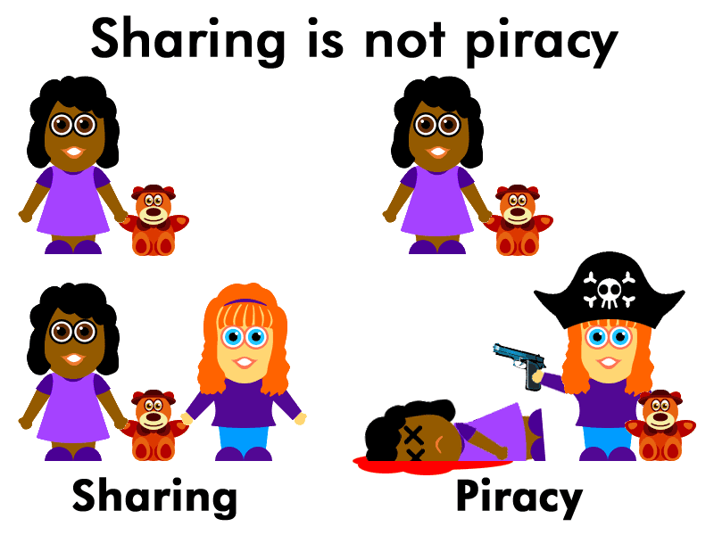
The internet is faster than any other method.
Sharing is not Piracy…
Notes:
A lot of our artist friends were concerned about sharing their art online, because of the piracy issues… Sharing is not piracy. Sharing is Caring ☺ Sharing is the fundamental essence of social media success.

Slide 5
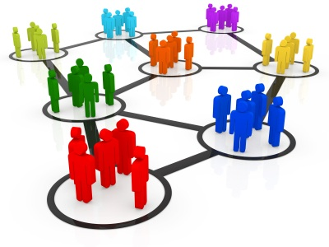
You need a social media plan
What is Social Media?
Social Media is a fundamental shift in the way we communicate
Notes:
After build ask: Does this not make sense to everyone? Take a moment to grasp what this means!
How many have kids? Teenage Kids?
It’s all ages right?
Share Mom’s retirement story: How she now communicates with more people than she ever did via facebook. She loves it! And if you read her comments, all she talks about are experiences. Opinion.
We’ll get to that a little later.

Slide 6
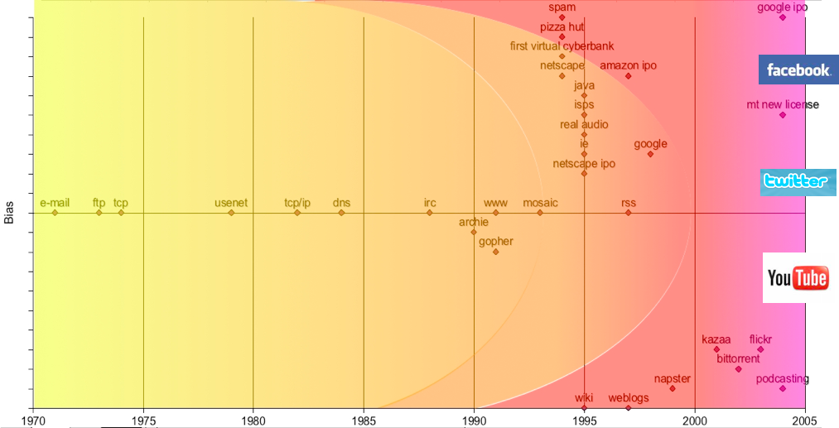
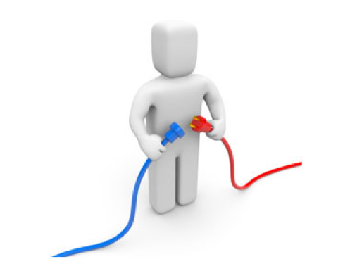
Conclusion
Annual Internet Growth
The Web Goes Social
Research Phase
Humanization Phase
Commercial Phase
Notes:
Let’s take a look at the life span of the internet.
In the 80’s the internet was used primarily as research for companies
Through the 90’s – Websites were in high demand. Remember when you searched for company websites on line and you had to actually type in WWW
Later in the 90’s and into the new millennium, the internet did something special, it began to be more human. By human I mean, people were using it to socialize and be interactive with each other in real time. Who remembers the MySpace explosion from 2004 – 2008? Then of course Facebook took over the world and is now head an shoulder above any competition.
Going back to our earlier slide, it is a fundamental shift in the way people are communicating.
OK, so we can communicate better with our friends and families? What does this mean for businesses?

Slide 7
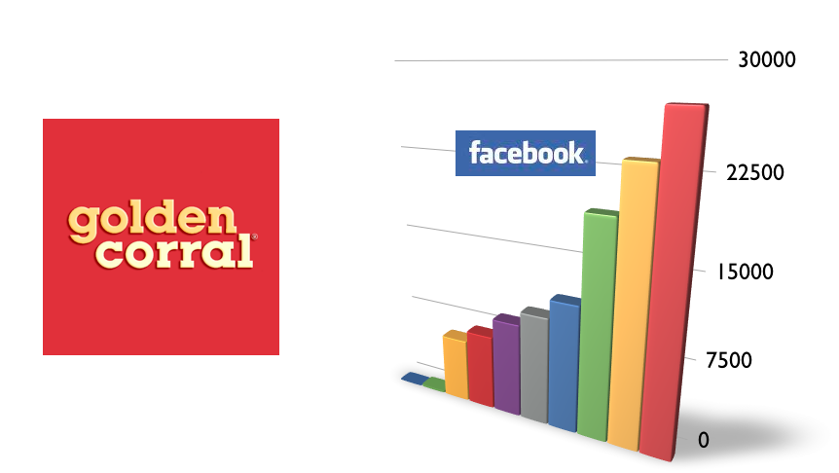
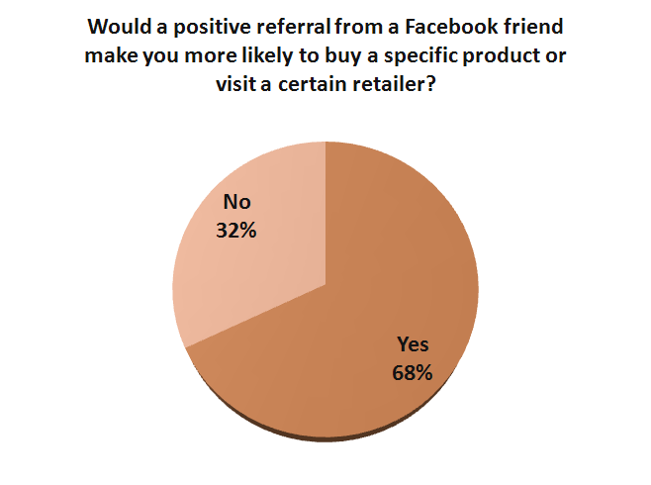
TwinBear Results
Social Media Impacts Purchases
Notes:
It means that social media impacts purchase decisions
When Asked: “would a positive referral from a friend sway your decision to buy a specific product over another?
68% said yes
This number will undoubtedly increase over the years to come
We all know that word of mouth advertising is priceless and by far the most affective when it relates to ROI

Slide 8
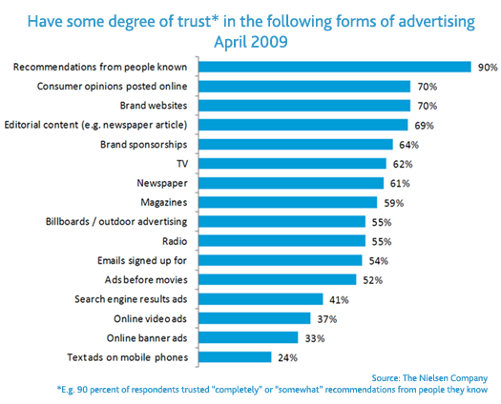
TwinBear Results
People Trust Their Friends
Notes:
Nielson shows us here that 90% of consumers TRUST recommendations from people the know. That seems, like Duh… but when these people are fans of yours and they are talking to people about purchase decisions that could drive them into your store…well you get the picture.

Slide 9
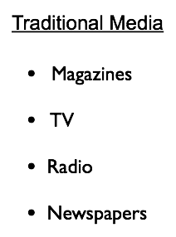
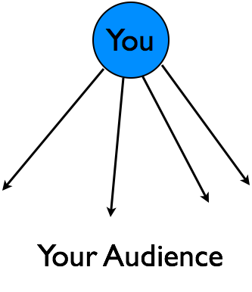
TwinBear Results
Social Media is Not the Following:
Notes:
Not long ago, Traditional media was the only option you had… meaning
If you had enough money and resources, you could reach the largest audience.
When you did, you just hoped that your message was inspiring enough to provoke interest and drive them to an actual purchase.
Before Social media, your brand message was what you said it was… for example, If you said, “We are the best!” People would have to believe you because you had the biggest voice.
With Social Media, Your Brand is so longer what you say it is, however it is the sum of what people saying about it…
Now the people decide who is the best, and they’re telling there friends about it too. So companies more and more every day are shifting their marketing budgets to include social media management into their overall plan.

Slide 10
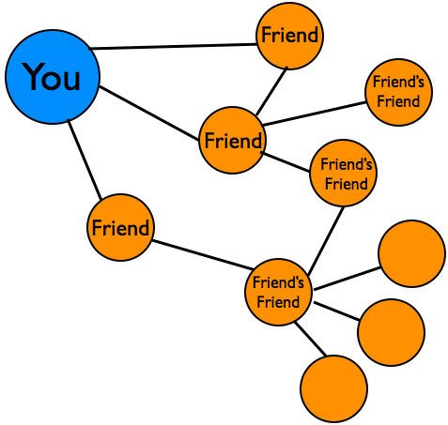
TwinBear Results
What Makes Social Media Different?
Friends Sharing Content
Notes:
This illustration shows why it is a reality
Just to get an idea about how this happens… next slide

Slide 11
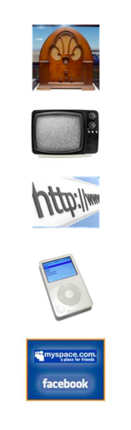
TwinBear Results
How Much Time Does It Take To Reach 50 Million People?
Radio - 38 Years
TV - 13 Years
Internet - 4 Years
iPod - 3 Years
Facebook – 9 Months
Notes:
I love this slide because it’s fun ☺ But it also paints a very vivid picture.

Slide 12
Currently, Facebook reaches more than 175 million people per day

Slide 13
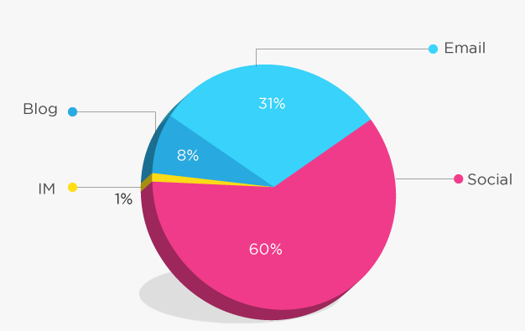
Social Media Stats
The Fastest Growing Segment on Facebook are Females 55 + years old
200 Million comments are posted per day on Facebook
Nearly 80% of all comments are opinions about product and service experiences.
80% of all Twitter comments are made from a mobile device. What might this mean for a good or bad customer experience?
Engaging on Social Media Sites is Now the Most Popular Activity Online - Ahead of Personal Email
Notes:
Show videos

Slide 14
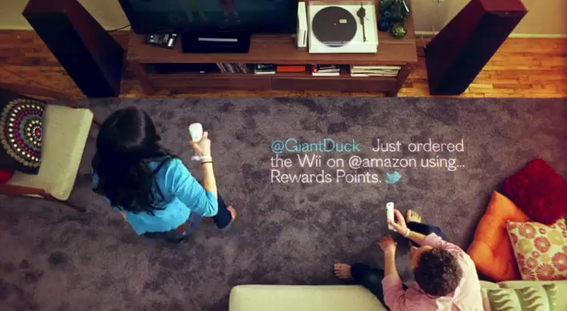

Slide 15
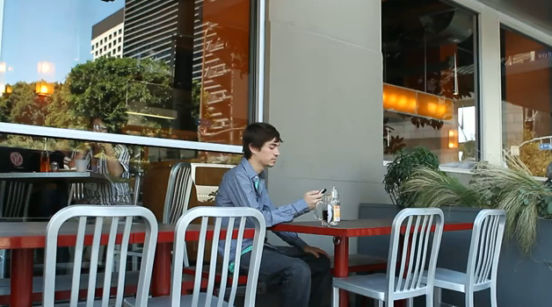

Slide 16


Slide 17
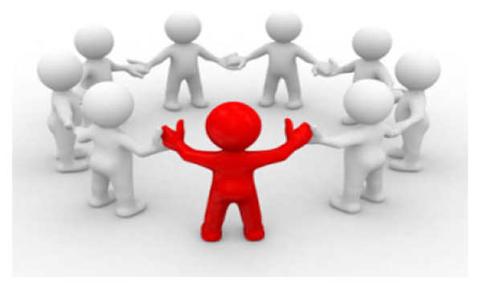
Connect Fans To Each Other
Notes:
Provide a space for this to occur
You can do this on facebook, twitter, or any number of social media channels
We know that when this can occur more often, sales go up as a result.

Slide 18

Build A Community Centered Around Your Brand
Notes:
Build the community around your brand.
be a leader in your community.
Let your customers know that you will be present online to respond and engage.
Best Buy has a great way to do this… They simply say, “if you need us, Tweet us”
Start online social groups around interests that support your business.
In school music program – status
Lessons offered – free clinics
Every different instrument can have their own group online to discuss tips and new technology
Music events calendar…etc.

Slide 19
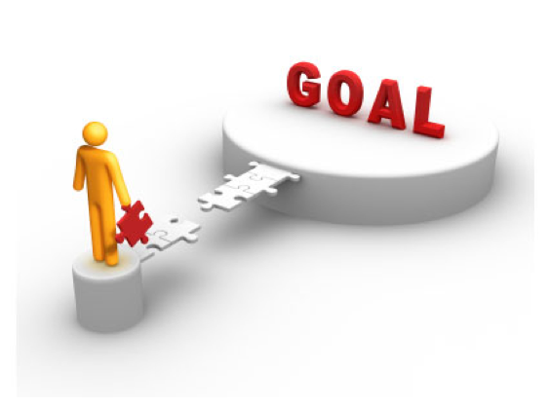
Establish Goals and Objectives
Strengthen Fan Loyalty
Communicate More Effectively
Organize Social Clubs
Notes:
To do all of this, you must first establish what you want social media to do for you and your brand.
These are a few we have found from the research we have done…but everyone’s objectives will be different.
Loyalty = means word of mouth
When we communicate in a space that has the largest amount of traffic, we stand a better chance of reaching someone interested.
Isn’t that we are all here? This same experience can happen in a virtual world.
Organizing social clubs can be a variety of things.
Drum Club – Jen has done a fabulous job building a following via her drum demo videos. TELL TONIC DRUMMER STORY of how he knows Jen Lowe.

Slide 20

Build The Community
Host & Manage Content
Provide Online Share Tools
Invite Fan Participation
Notes:
Now that you have become an online community leader you’ll be able to Host and manage your content affectively.
Each and everything you post have share features built in so that when the content is remarkable, your fans will share it to their own networks.
Show of hands, how many people have shared content online? Why did you do it?
By doing all of this you are inviting other fans to participate. Make enough noise and see what happens.

Slide 21

Monitor the Message
Reputation Management
Listen and Respond
Control the Message
Notes:
A big concern I run into is how much can we control the message.
Global steel company – scrap metal. Ex employee sabotage became viral – lack of strategy and tools made them vulnerable
Reputation Management: ? How will I be able to deal with a negative post about my products or services? My answer is always the same… People are talking about you right now, whether you know it or not. The important thing realize is to know what they’re saying
You’ll be able to listen and respond: There are free tools to use that work very well and there are technology companies that can provide a virtual web of coverage about your brand.
By doing so, you will be controlling your message the best way possible.

Slide 22

Metrics: Measuring Impact In Real Time
Track Fan Activity
Use Site Analytics
Refer to Monthly Reports
Notes:
One of the best things about having a solid social media plan in place is the accurate measurement it provides. With analytics built into your sites and social media channels, you be able to
Track activity. By understanding how people got to your sites, what they did when they got there and how long they stayed, you’ll be able to fine tune the delivery of your message and content.
Use these analytics to modify your strategy moving forward – that’s another cool thing about social media, unlike websites that sometimes take a rocket scientist to modify, social media can be changed on the fly very easily.
Refer to the monthly reports to measure success. Know how you got there and how you can continue to grow your fans.

Slide 23

Educate & Support
Notes:
There are a lot of so-called social media experts out there. Some of them really have great ideas and understand the essence of social media for business.
Educate Yourself: If you wanna know more how all of this this works… Read books, subscribe to social media trade websites like social media today, mashable or any others. They’re filled with knowledge that may or may not apply to your business.
Hire a social media management company: This usually winds up costing less than you can hire someone to do it internally. They have the tools and a plan that you can measure and manage affectively.
However, whatever you choose… the single most important thing you want to accomplish is building your “permission asset”

Slide 24
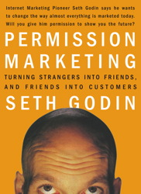
Permission Asset: Most Valuable
Permission is like dating. You don't start by asking for the sale at first impression. You earn the right, over time, bit by bit. – Seth Godin
Notes:
Permission Asset: What separates a permission asset from a standard asset is that your audience appreciates being a part of your business success. You have their permission to market to them, they expect it and they’re very happy when they get it.
In return, you’ll have a large group of fans that aren’t just open to trying your products or services – they’re eager to try them, they talk about them and independently promote them for you.

Slide 25

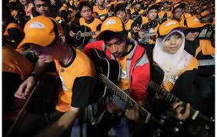
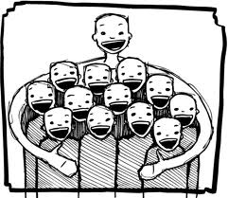
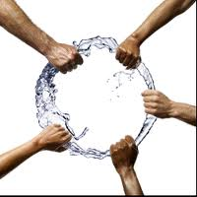

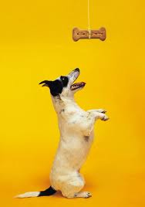

Identify
Gather
Include
Reward
Empower
Appreciate
Inspire
Notes:
To recap a social media strategy for you to employ. You need to:
Indentify who your fans are
Gather them is a space that you are present in on a regular basis
Include them in your process
Inspire them by providing meaningful information – Content is King
Appreciate them – If nothing else say thank you for being there.
Reward them – However you choose is good
Empower them – Because when you do all of these things on a consistent basis, no one wants to share your message more than them!

Slide 26
No one wants to spread your message more than your fans!

Slide 27
Jen Lowe
BoomBoom Percussion
&
Tony Caporale
TwinBear Management
Notes:
Thank you for taking time out of your schedules to be here today. It means a lot to both of us.

Slide 28
Fan Your Success

