Slide 1
NAMM Antitrust Statement
NAMM is committed to strict compliance with the antitrust laws and its obligations under a recent settlement agreement with the FTC. To this end, NAMM has put in place an Antitrust Policy governing all activity during NAMM-sponsored events. NAMM’s Antitrust Policy covers all participants, including speakers, exhibitors and audience members at NAMM Events. The antitrust laws prohibit certain conduct, including:
  Agreements between or among competitors on price or output.
  Agreements between or among competitors to divide markets or allocate customers, territories, products, or services; and
  Boycotts or refusals to deal with any suppliers, customers or competitors.
It is important to remember that all of these activities are prohibited regardless of intent. Additionally, it is not necessary to have an explicit agreement to violate the antitrust laws. Circumstantial evidence can suffice. Remember, all NAMM members must make competitive decisions independently of any agreement or understanding with competitors.
NAMM Show participants must not exchange competitively sensitive information, including information regarding: wholesale and retail prices, discounts, credit terms, margins or profits, proposed price increases or decreases, price ranges, price formulas, MAP policies and RPM policies.
Of course, these prohibitions do not apply to legitimate business discussions between manufacturers and retailers. NAMM and its members could be subject to fines and other serious consequences for failure to comply with NAMM’s obligations under the antitrust laws.
Anyone that violates NAMM’s Antitrust Policy may be subject to discipline, including removal from this Event and possible expulsion from the organization.
This reminder is not a complete list of activities that could raise antitrust concerns. NAMM’s full Antitrust Policy can be found in your Show Directory and on NAMM’s website. Specific details regarding NAMM’s obligations under the FTC Order are also available on NAMM’s website. Just click on the “Antitrust Compliance” tab on NAMM’s homepage. Please direct questions on antitrust compliance to NAMM’s Antitrust Compliance Officer, Paul Cuomo of Baker Botts, or to your company’s legal counsel. If you have any questions about antitrust compliance, you should seek legal advice before acting.
Thank you for your attention and cooperation with this very important matter.

Slide 2


Slide 3

Top 10 Internet Marketing Trends
Introduction

Slide 4


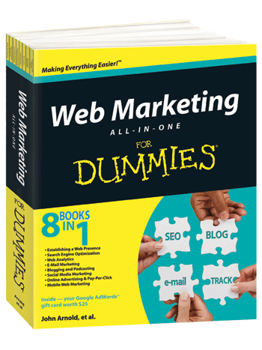
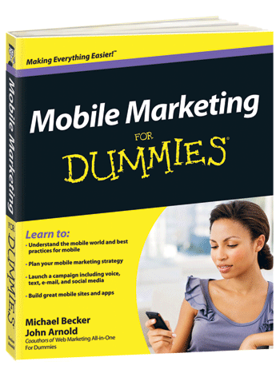
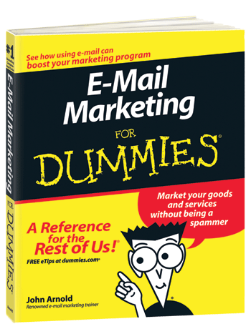
About Your Speaker
John Arnold
O: +1.303.532.1062
M: +1.303.669.0958
E: john@johnarnold.com
T: @ArnoldMarketing
W: JohnArnold.com

Slide 5

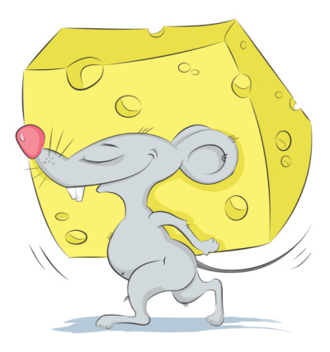
Bird or Mouse?
  “The early bird gets the worm.”
  “The second mouse gets the cheese.”

Slide 6

Trend #1: Location-Based Marketing
  Location is important, just ask Google
  Local places pages and search listings
  Local coupons and group deals
  Localized web content and mobile strategy more important than ever

Slide 7
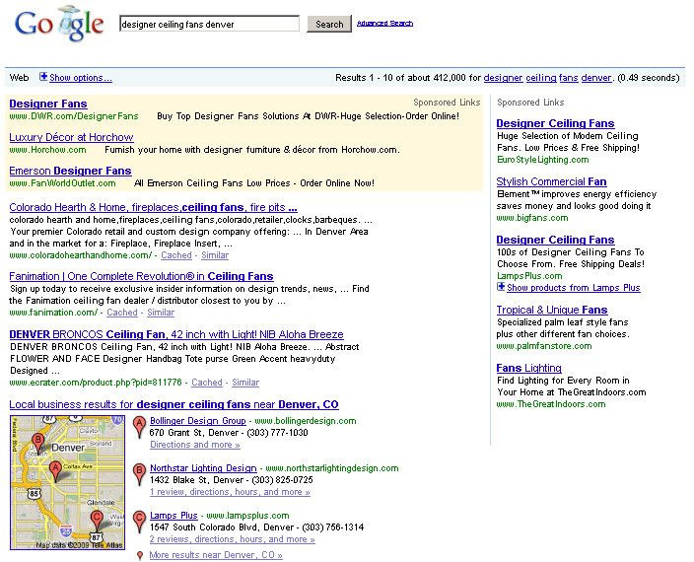
Trend #2: Instant Search
  Longer search phrases now being suggested
  Watch search volume on long-tail phrases
  Make adjustments to optimize content for trending search terms

Slide 8

Trend #3: Social Media Monitoring
  Evaluate your involvement in conversations
  Why do people share?
  Use your budget to focus on a great customer experience
  Run real marketing campaigns (see next trend)

Slide 9


Enter Vote Share
Answer Redeem
Choose Buy
Trend #4: Social Media Marketing
  Abandon ‘chatter’ and ‘re-gifting’
  Run real marketing campaigns and promotions
  Display advertising
  ‘Engaging’ campaigns

Slide 10
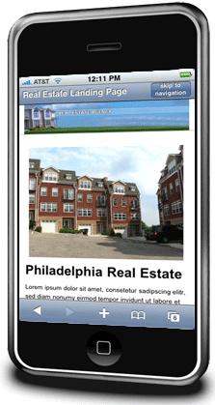
Trend #5: Mobile Marketing
  Smartphones still ‘outsmarting’ consumers
  Mobile is coming fast
  Start with simple campaigns such as SMS, mobile apps, and mobile micro-sites
  Leverage location and other media for best results

Slide 11

Trend #6: Online Display Advertising
  More than ‘banner-ads’
  Good access and targeting options
  Flexible budgeting (CPM, CPC, CPA)
  Do-it-yourself tools available

Slide 12


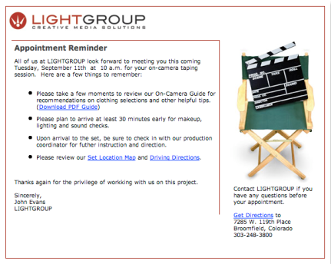
Trend #7: Email Marketing
  Why is Email Marketing a Trend?
  Integration with social media
  Integration with mobile
  Email automation options growing

Slide 13

Trend #8: Social Shopping
  New tools for sharing purchases and shopping together
  Best products for sharing evoke vanity
  Discounts also highly sharable

Slide 14
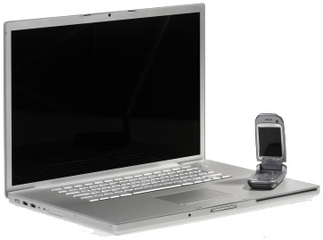

Trend #9: Instant Messaging
  Chat becoming more familiar due to social media
  The value of instant information is high
  Chat tools converging and mobile friendly

Slide 15
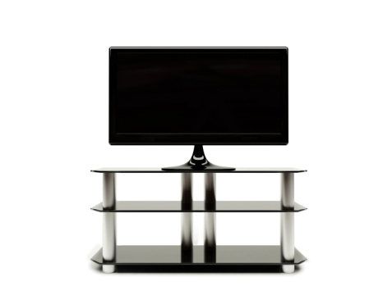

Trend #10: Online Television
  Three screens
  New targeting and budgeting options for advertisers
  Interactive experiences
  Big companies involved, slow movement

Slide 16





Slide 17


