Slide 1


Slide 2
Apps to Live By
CJ Averwater

Slide 3

TurboScan
Quickly scan multi-page documents into high-quality PDFs
iOS & Android
Notes:
Eliminates the need for a physical scanner.
Spy Stuff
Multiple pages – high quality
Automatically detects edges
Send as a PDF, JPG, or PNG

Slide 4
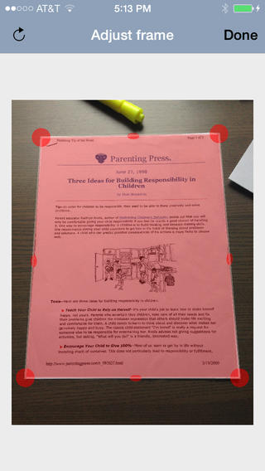
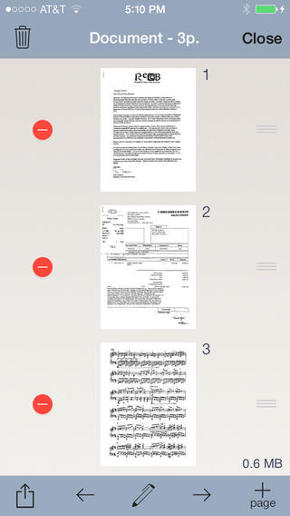
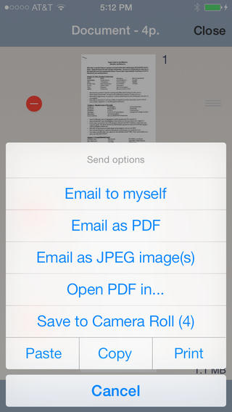
TurboScan
Notes:
Eliminates the need for a physical scanner.
Spy Stuff
Multiple pages – high quality
Automatically detects edges
Send as a PDF, JPG, or PNG

Slide 5

Expensify
Simplified expense reporting where you use it most.
iOS, Android, Blackberry, and Windows Phone
Scan receipts, email reports, track mileage
Notes:
Travel – wallet full of receipts
Organize & match to reports
Reps who travel & entertain – receipts & mileage
Expensify uses camera to take pictures of reciepts
Organize & submit reports

Slide 6
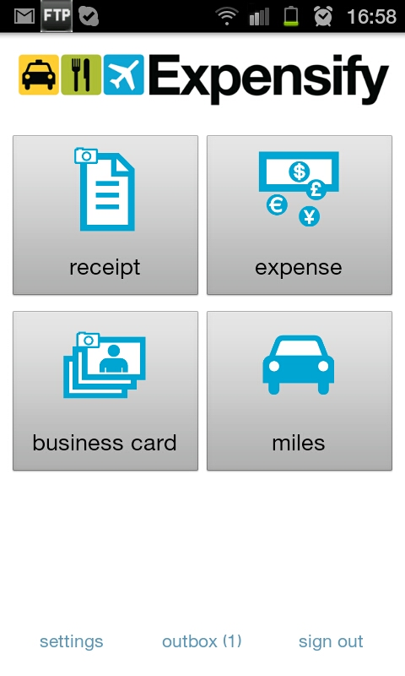
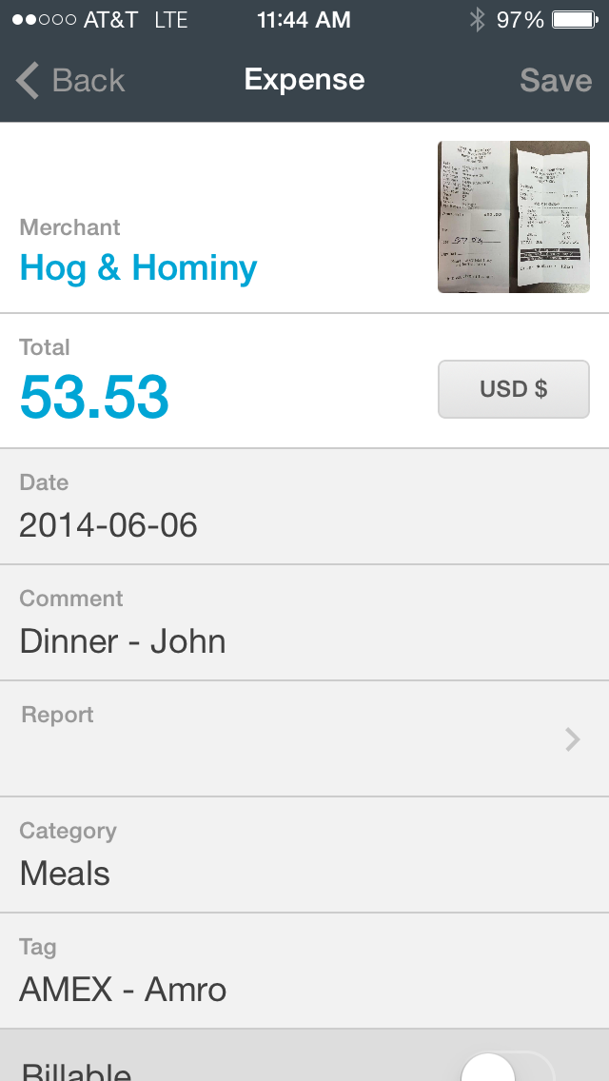
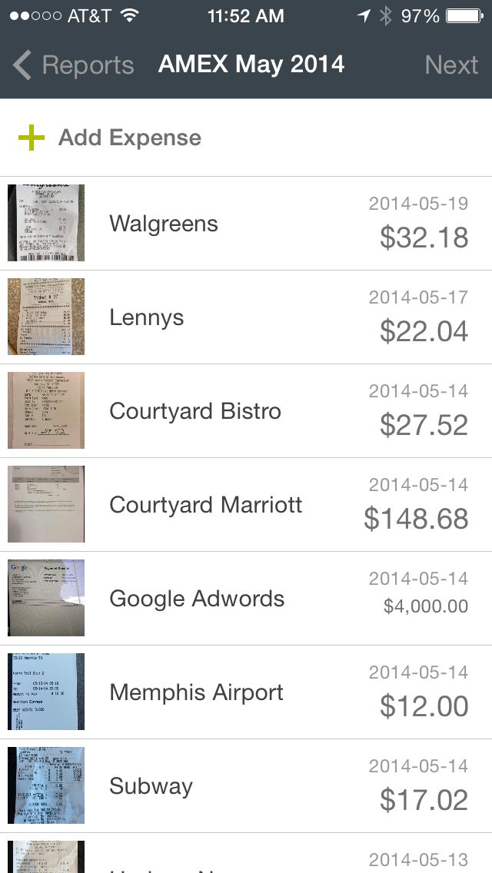
Expensify

Slide 7
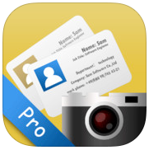
SamCard
Business card scanner – scan cards & add to contacts
iOS
Pretty accurate – manually update sometimes
Notes:
Travel – wallet full of receipts
Organize & match to reports
Reps who travel & entertain – receipts & mileage
Expensify uses camera to take pictures of reciepts
Organize & submit reports

Slide 8
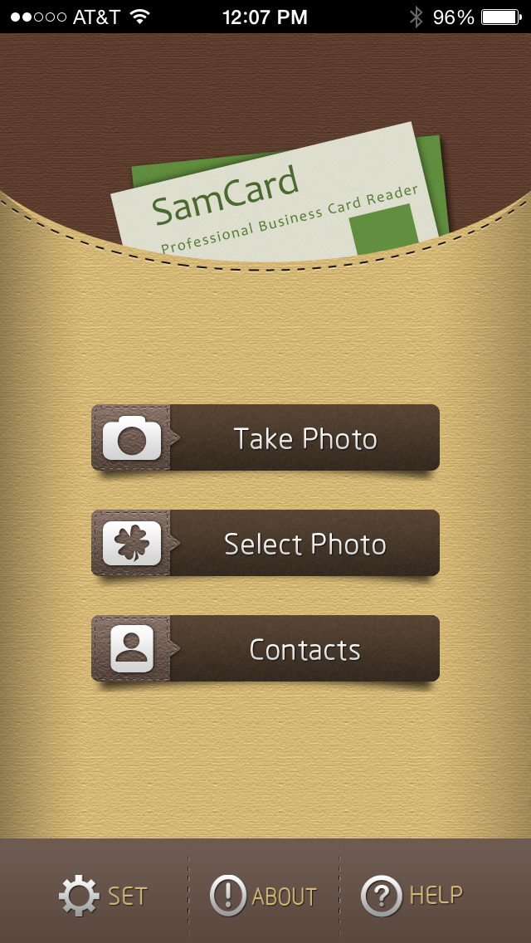
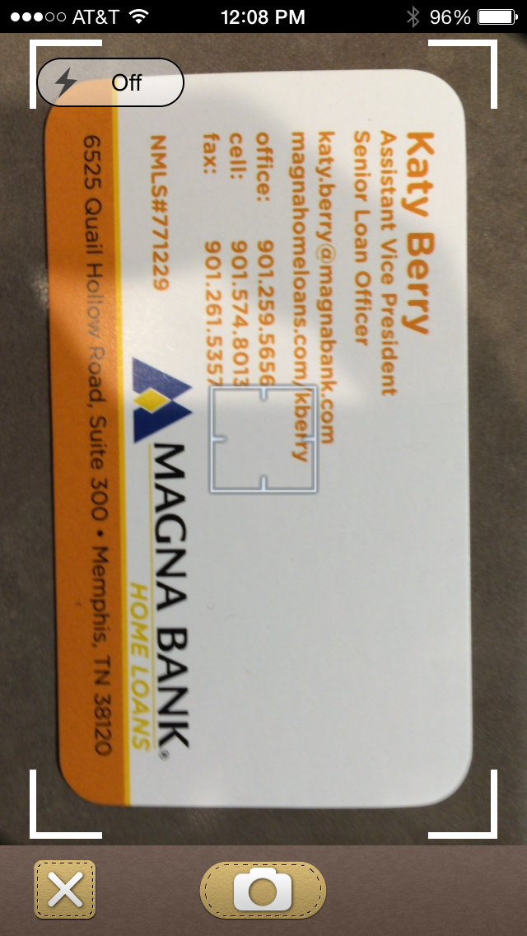
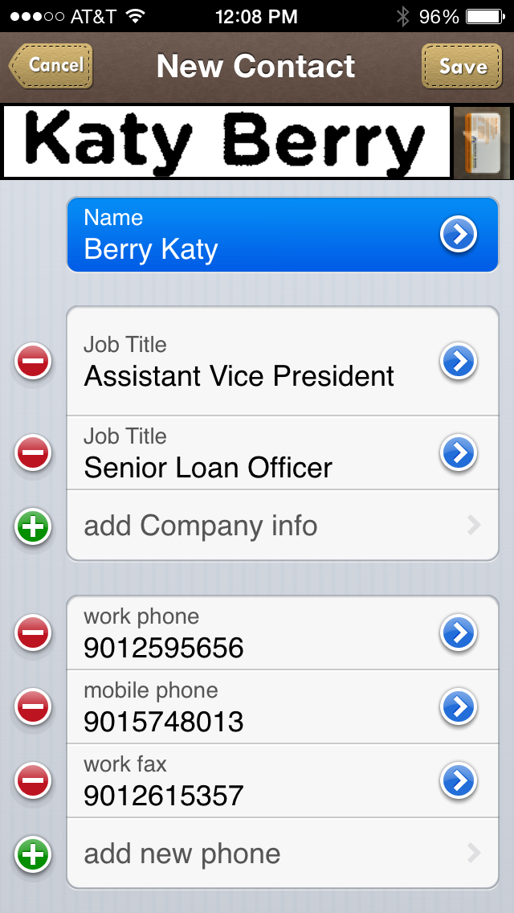
SamCard

Slide 9

Any.Do
To-Do List
iOS, Android, Chrome, Web
Sync across platforms
Reminders by date, time, location
Notes:
Travel – wallet full of receipts
Organize & match to reports
Reps who travel & entertain – receipts & mileage
Expensify uses camera to take pictures of reciepts
Organize & submit reports

Slide 10
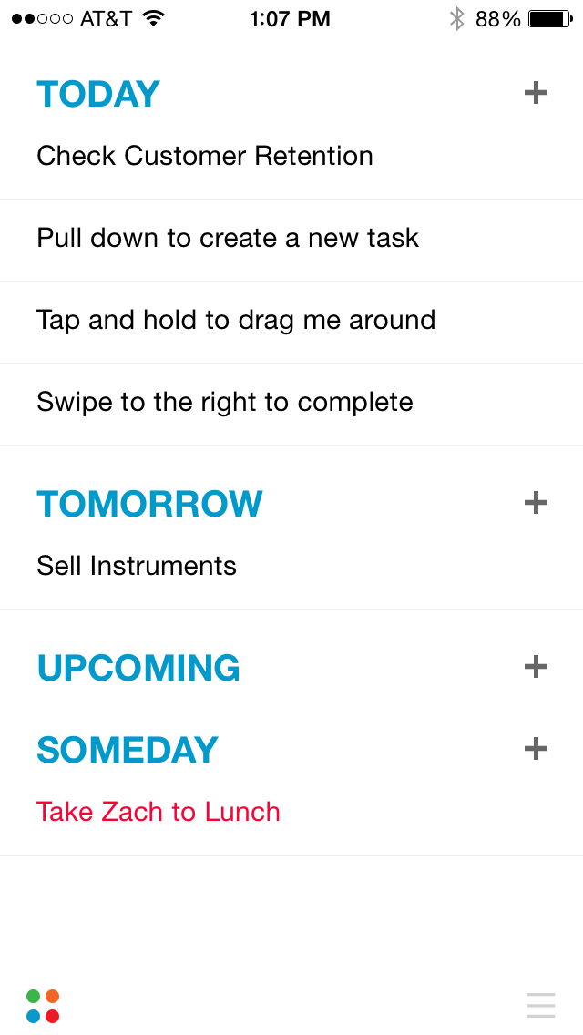
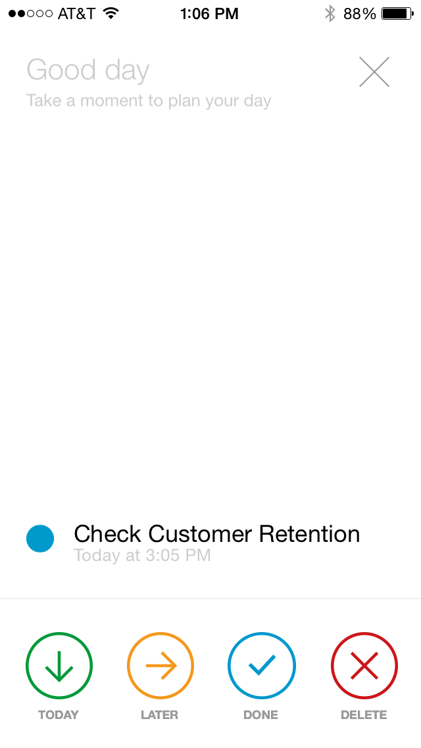
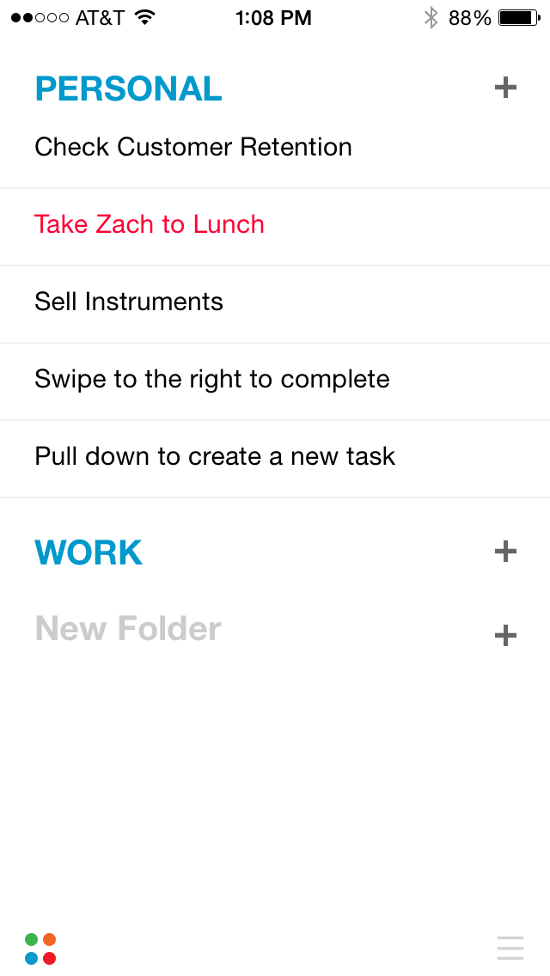
Any.Do

Slide 11

Uberconference
Free Conference Calling
iOS, Android
Notes:
Travel – wallet full of receipts
Organize & match to reports
Reps who travel & entertain – receipts & mileage
Expensify uses camera to take pictures of reciepts
Organize & submit reports

Slide 12
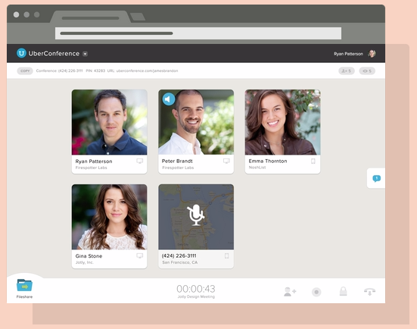
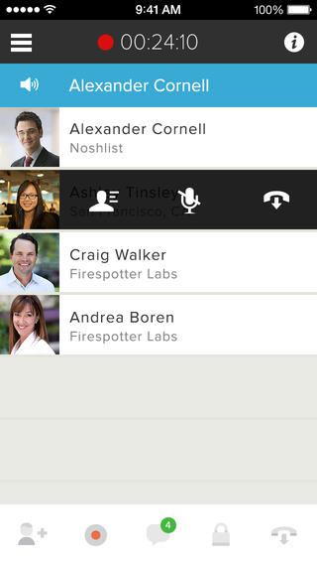
Uberconference

Slide 13

Google Hangouts
Conference calling over Internet
iOS, Android, Web
Audio/Video calling
Up to 10 people
LiveStream

Slide 14
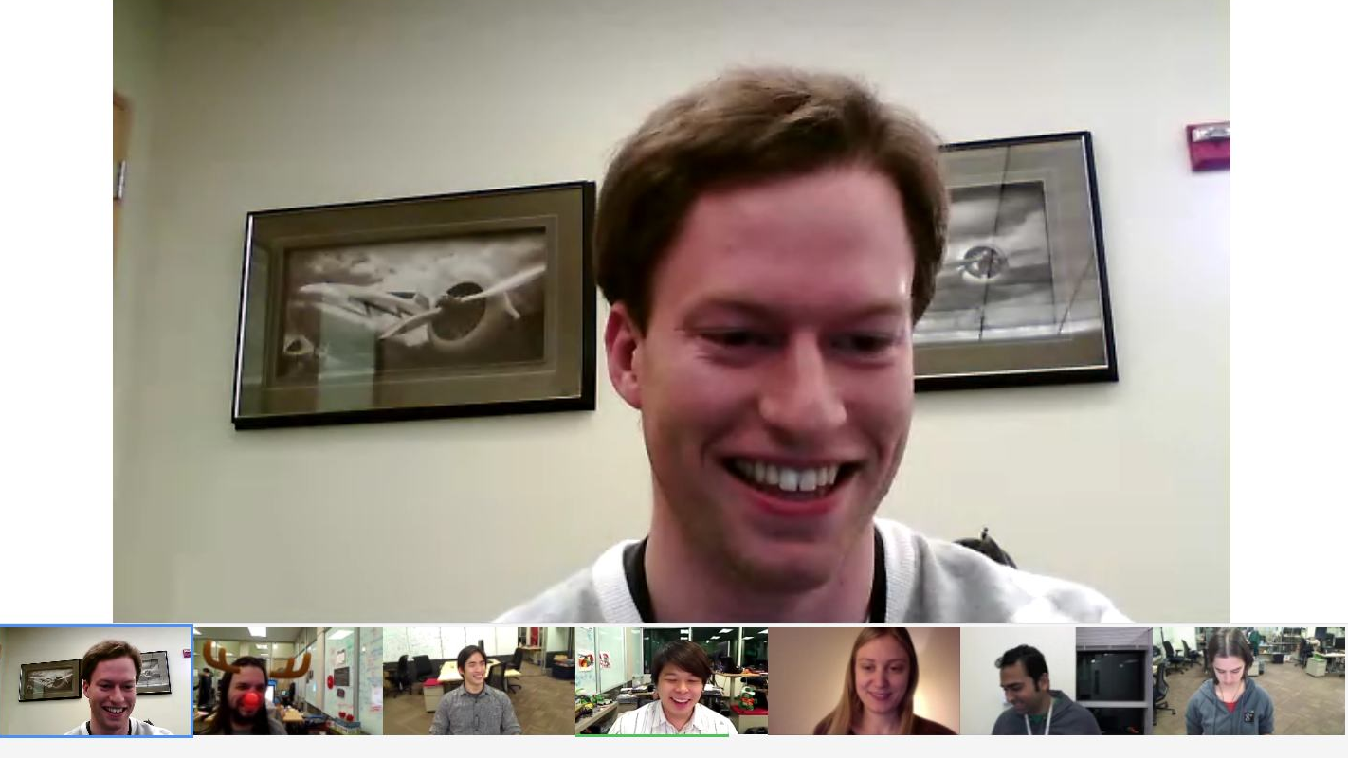

Google
Hangouts

Slide 15

LastPass
Password Manager
iOS, Android, Blackberry, Windows Phone, Windows, Mac
Sync passwords across platforms
Share passwords
Automatically fill-in passwords & other info

Slide 16
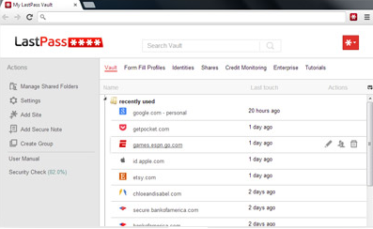
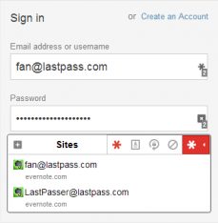
LastPass

Slide 17

NAMM App
Why have you NOT downloaded this?

Slide 18
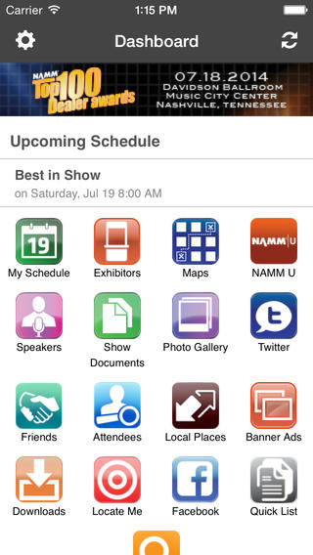
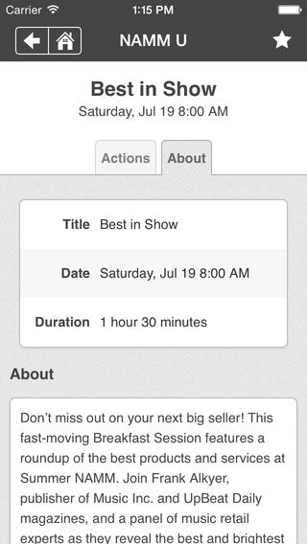
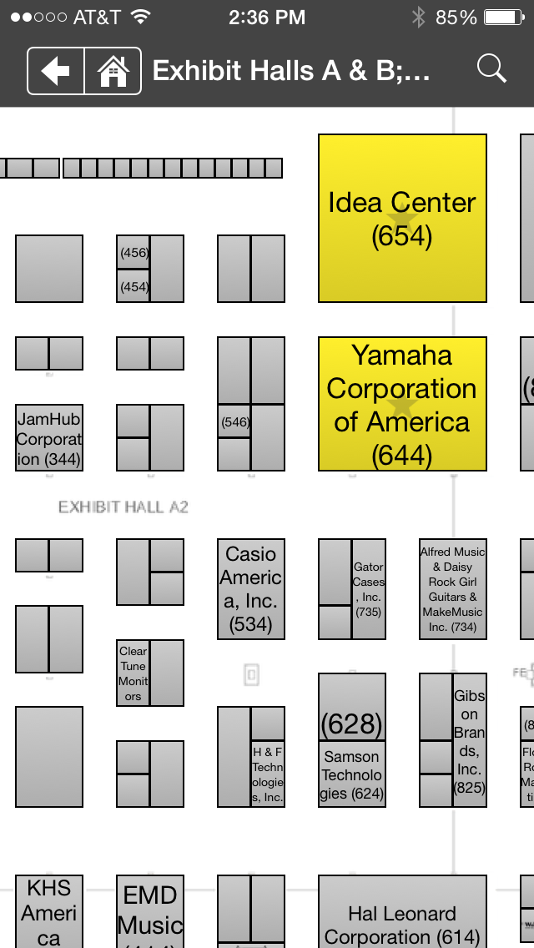
NAMM
App

Slide 19

PDFpen
Sign and annotate PDFs
iOS

Slide 20
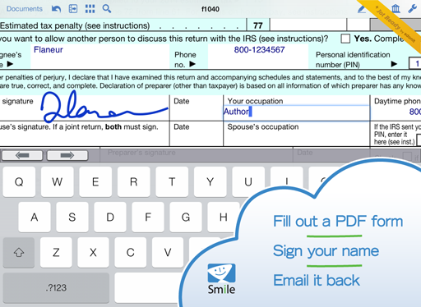
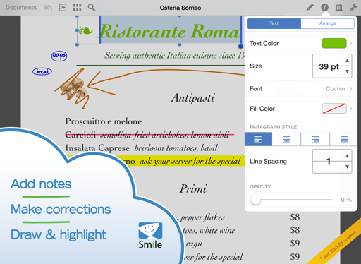
PDFpen

Slide 21

Videolicious
Creating product videos in a flash.

Slide 22
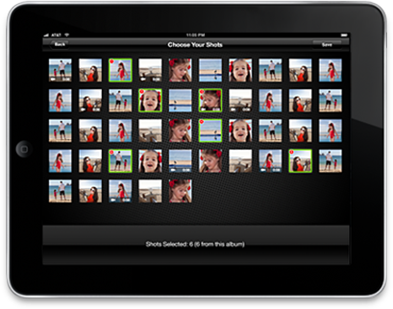
Videolicious

