Slide 1


Slide 2

Simple Ways to Get Found on Google
Gabriel O’Brien
Sales Manager, Larry’s Music Center

Slide 3
Simple ways to get found on Google
Optimizing your website using keywords
Getting customers for brands you carry
Managing your Google Places listing
Using social media to improve your ranking
Making the most impact in 15 minutes a day
Notes:
Google uses search bots to find and analyze information.
Google Ad Words shouldn’t be overlooked, but not everyone has the budget for those things and even if you do, you should still be doing all these.

Slide 4
Google
Your store name

Slide 5
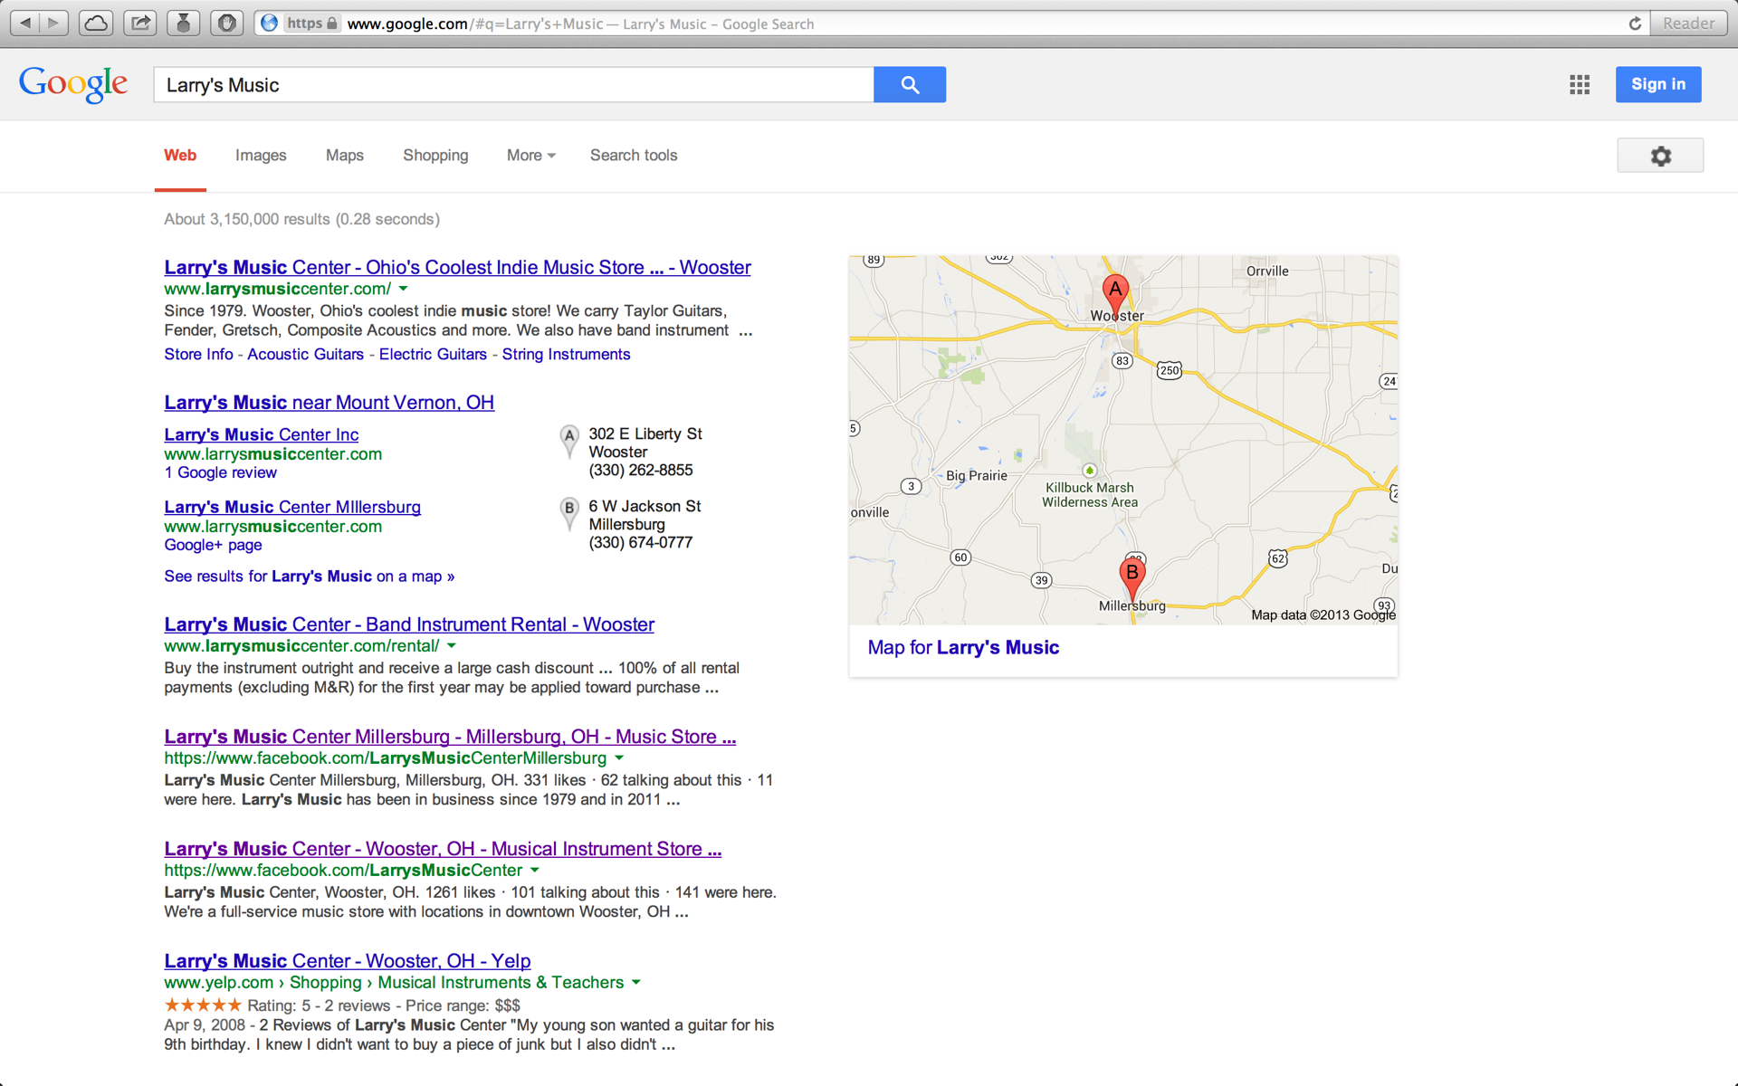
Notes:
Customers who want hours, phone #, stock. Look here not Yellow Pages.

Slide 6
Google
Your store name
Music store (your town or city)
Notes:
Search like the people who are looking for you.

Slide 7
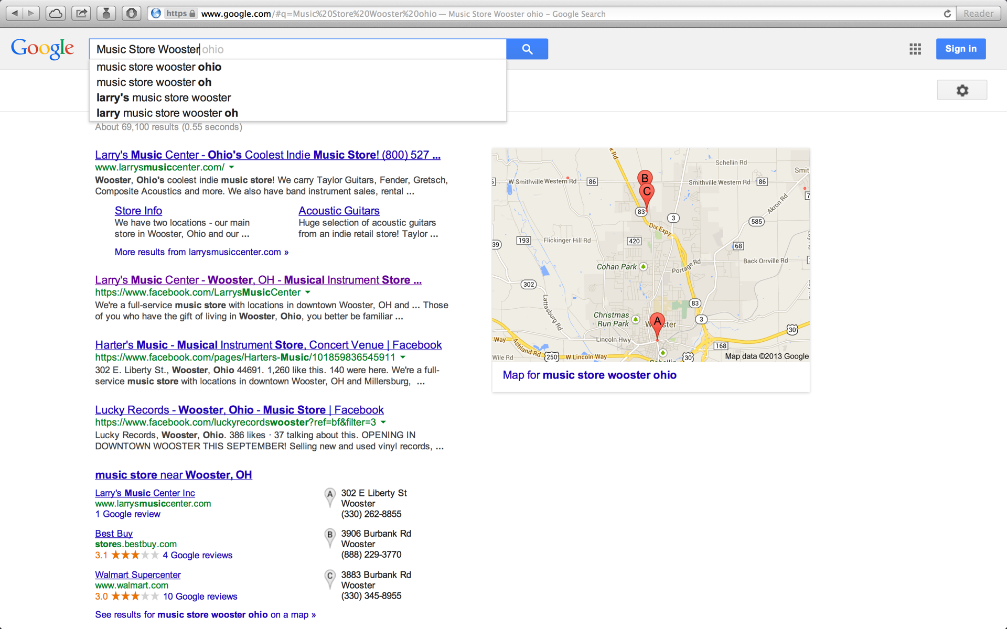
Notes:
New customer, just moved here, or vacationing and heard about you.

Slide 8
Google
Your store name
Music store (your town or city)
Your marquee brand names and state
Notes:
Wider reach search. Destination brands.
People do this before going to a manufacturer’s website, assume Google will give them a quicker answer.

Slide 9
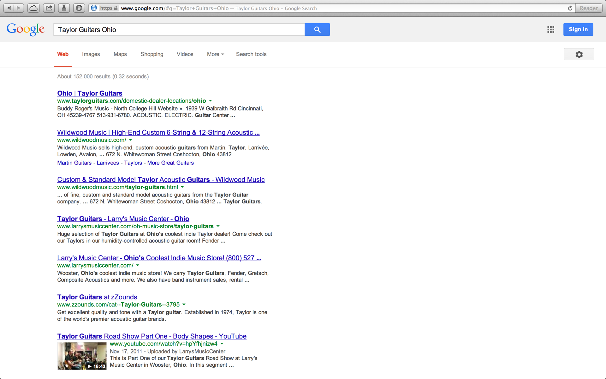
Notes:
Where can I play a Taylor guitar in Ohio? Product many people still want to hold and play before they buy.

Slide 10
Google
Your store name
Music store (your town or city)
Your marquee brand names and state
Your services - lessons, band instrument rentals, repairs
Notes:
“ Band instrument rental Wooster.”

Slide 11
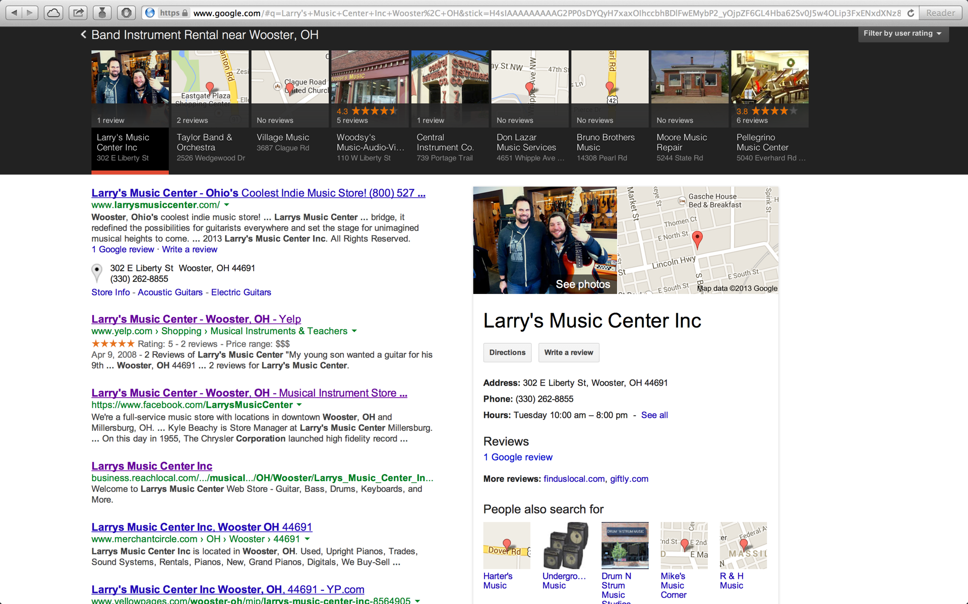
Notes:
All important ways to think about SEO and the ways your customers are trying to find you. How do we improve our rankings?

Slide 12
Keywords
Number One
Notes:
Number one. Keywords.
Words or phrases that people will commonly search for to find a product or service.

Slide 13
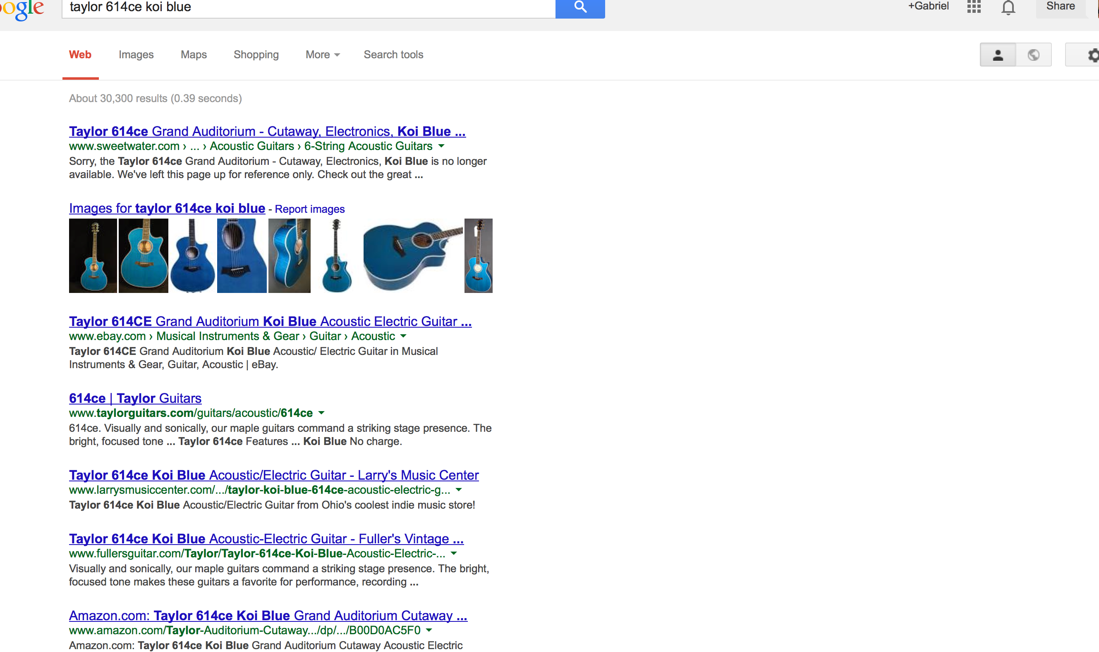
Notes:
The message is simple: Taylor 614ce Koi Blue at Ohio’s Coolest indie music store. Damn right.

Slide 14
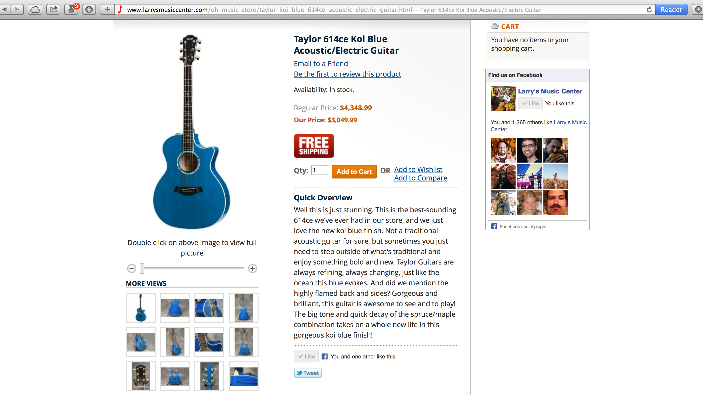
Notes:
614ce and koi blue mentioned in description. Don’t just say “guitar” when you can say which guitar.

Slide 15
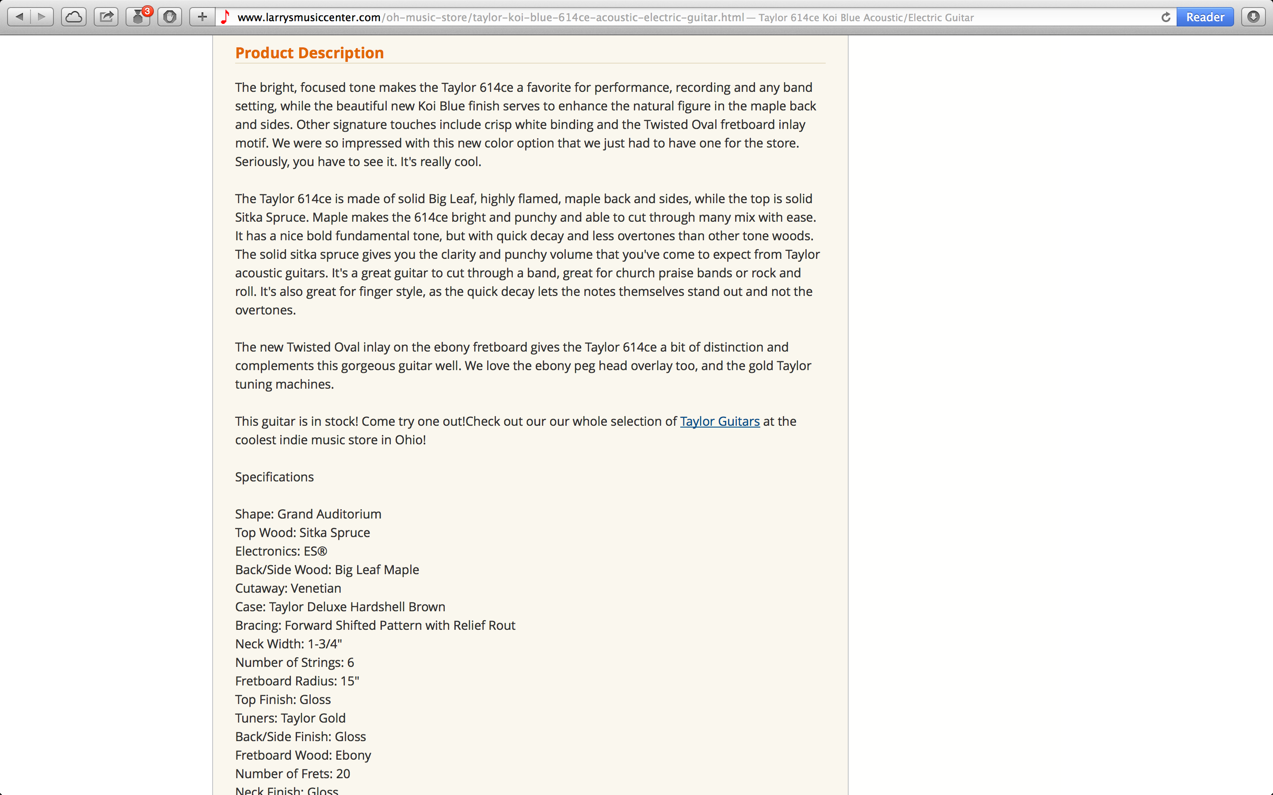
Notes:
Content is king. Google analyzes the quality of content on your site.

Slide 16
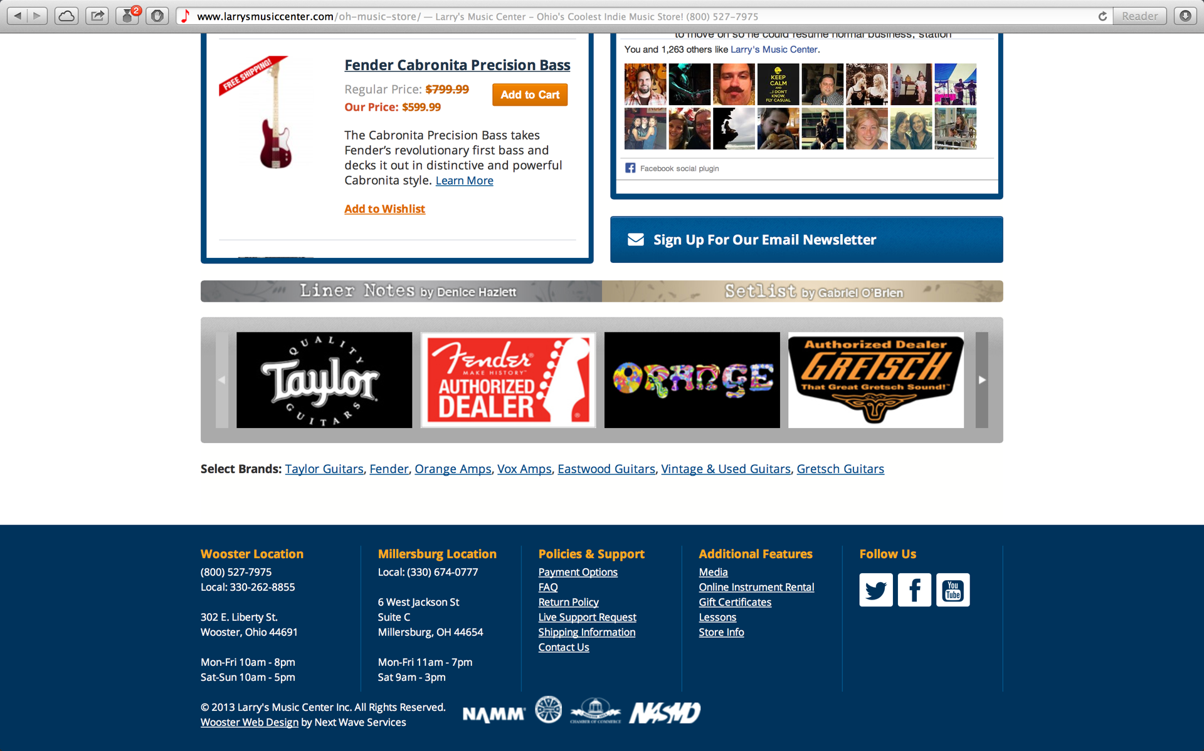
Notes:
Brand links right on main page.

Slide 17
Keywords
Target the things you want to be found for
Use the item and brand name in listing descriptions
Mention key brands and services
Mention your store by name
Highlight unique things that set you apart
Notes:
Mexi Strat or Koi Blue 614ce?

Slide 18
Brands
Number Two
Landing Pages
Notes:
Number 2. Brands.
Getting customers who don’t know about you based on the brands you carry.
Landing Pages.

Slide 19
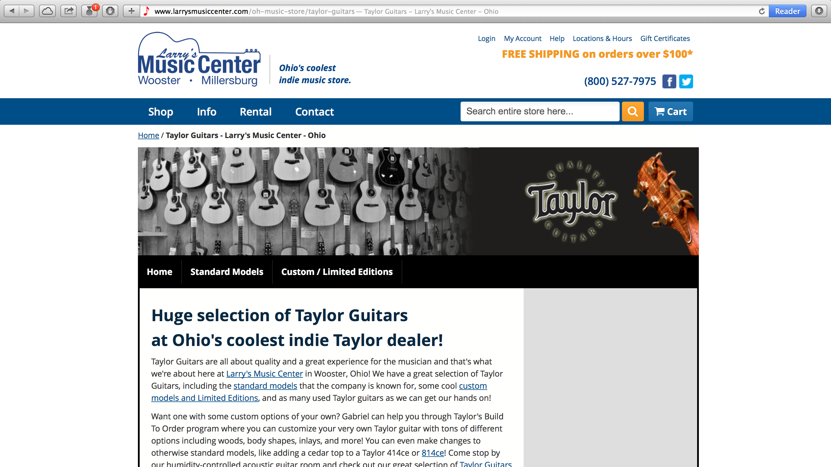
Notes:
Text link on home page goes here. Taylor guitars and Wooster, Ohio right in body. TAYLOR GUITARS OHIO Google gets this + home page

Slide 20
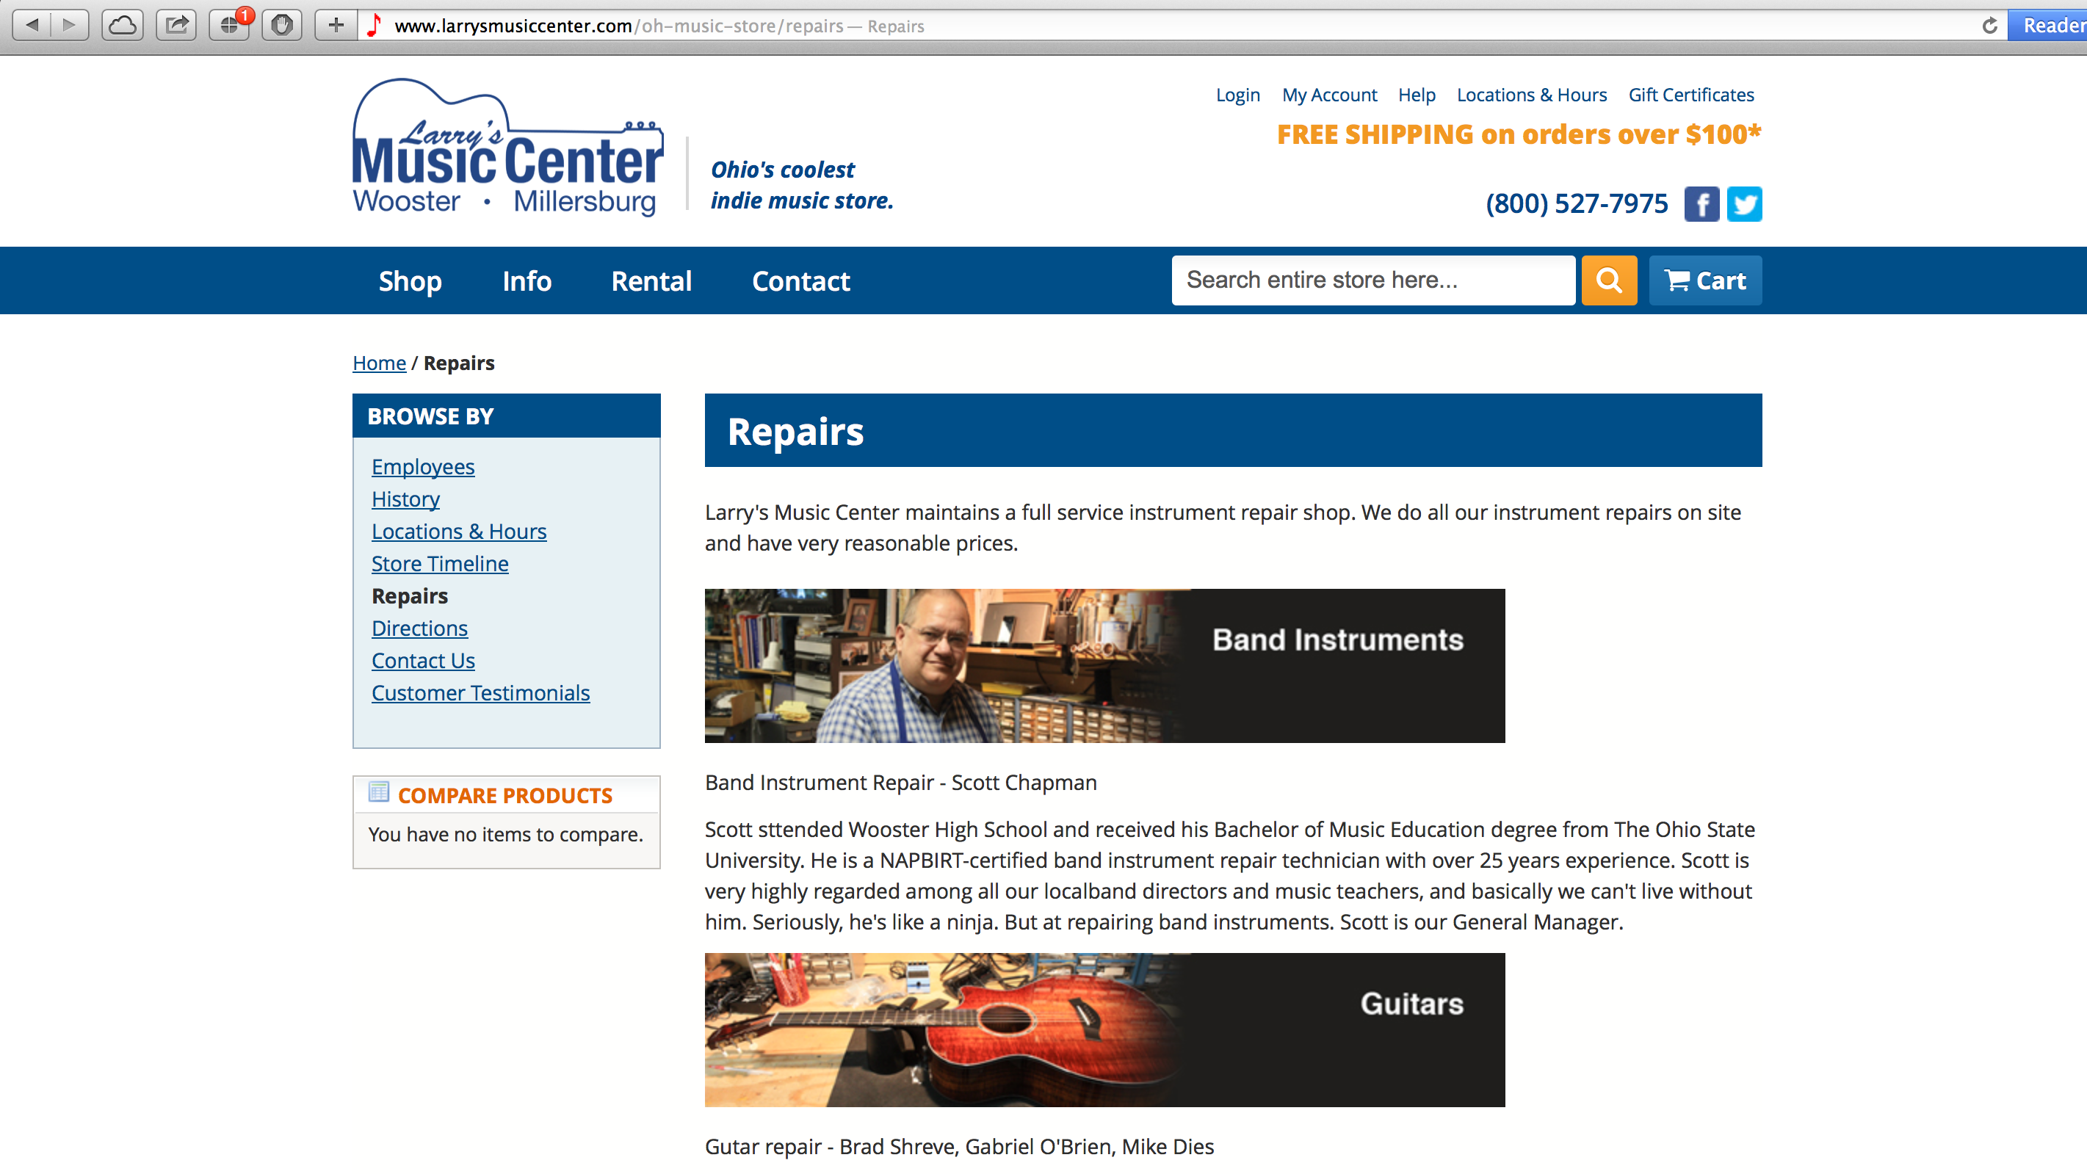
Notes:
Landing pages important for services. Repairs.

Slide 21
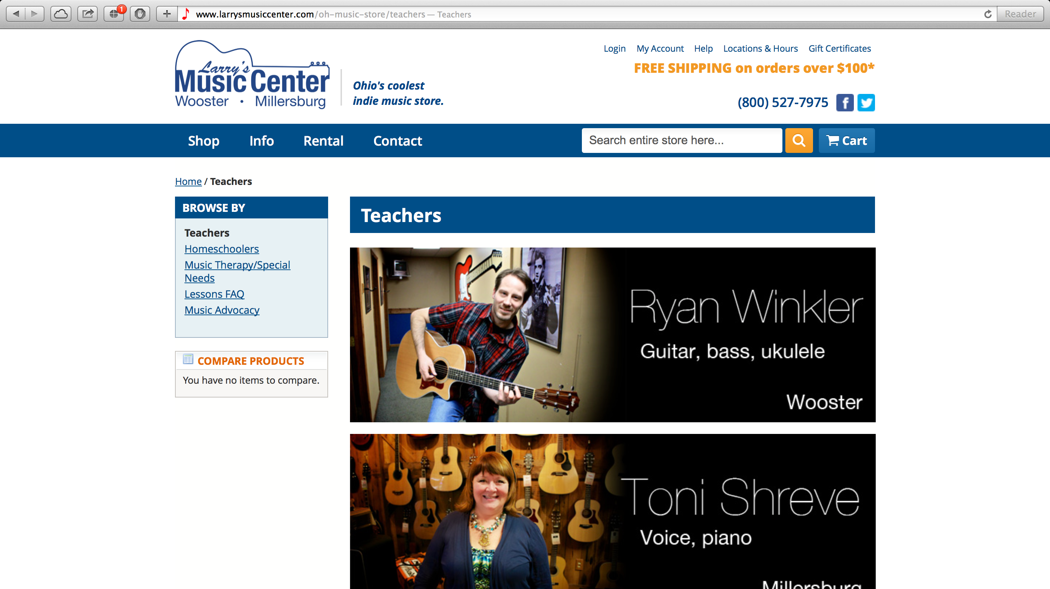
Notes:
Lessons. Teachers. Sometimes people search for “teachers” instead. Make sub pages for things people will search for.

Slide 22
Landing Pages
Create landing pages for marquee brands and services
Use key product names and information in descriptions
Create home page links to your landing pages
Point search results within your site to landing pages

Slide 23
Google Places
Number Three
Notes:
Number 3. Google Places.

Slide 24
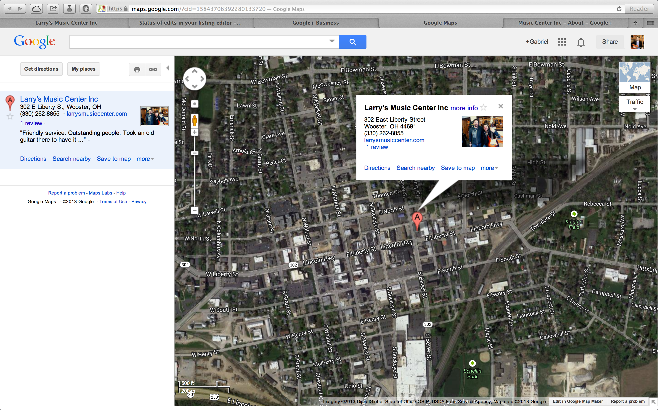

Slide 25
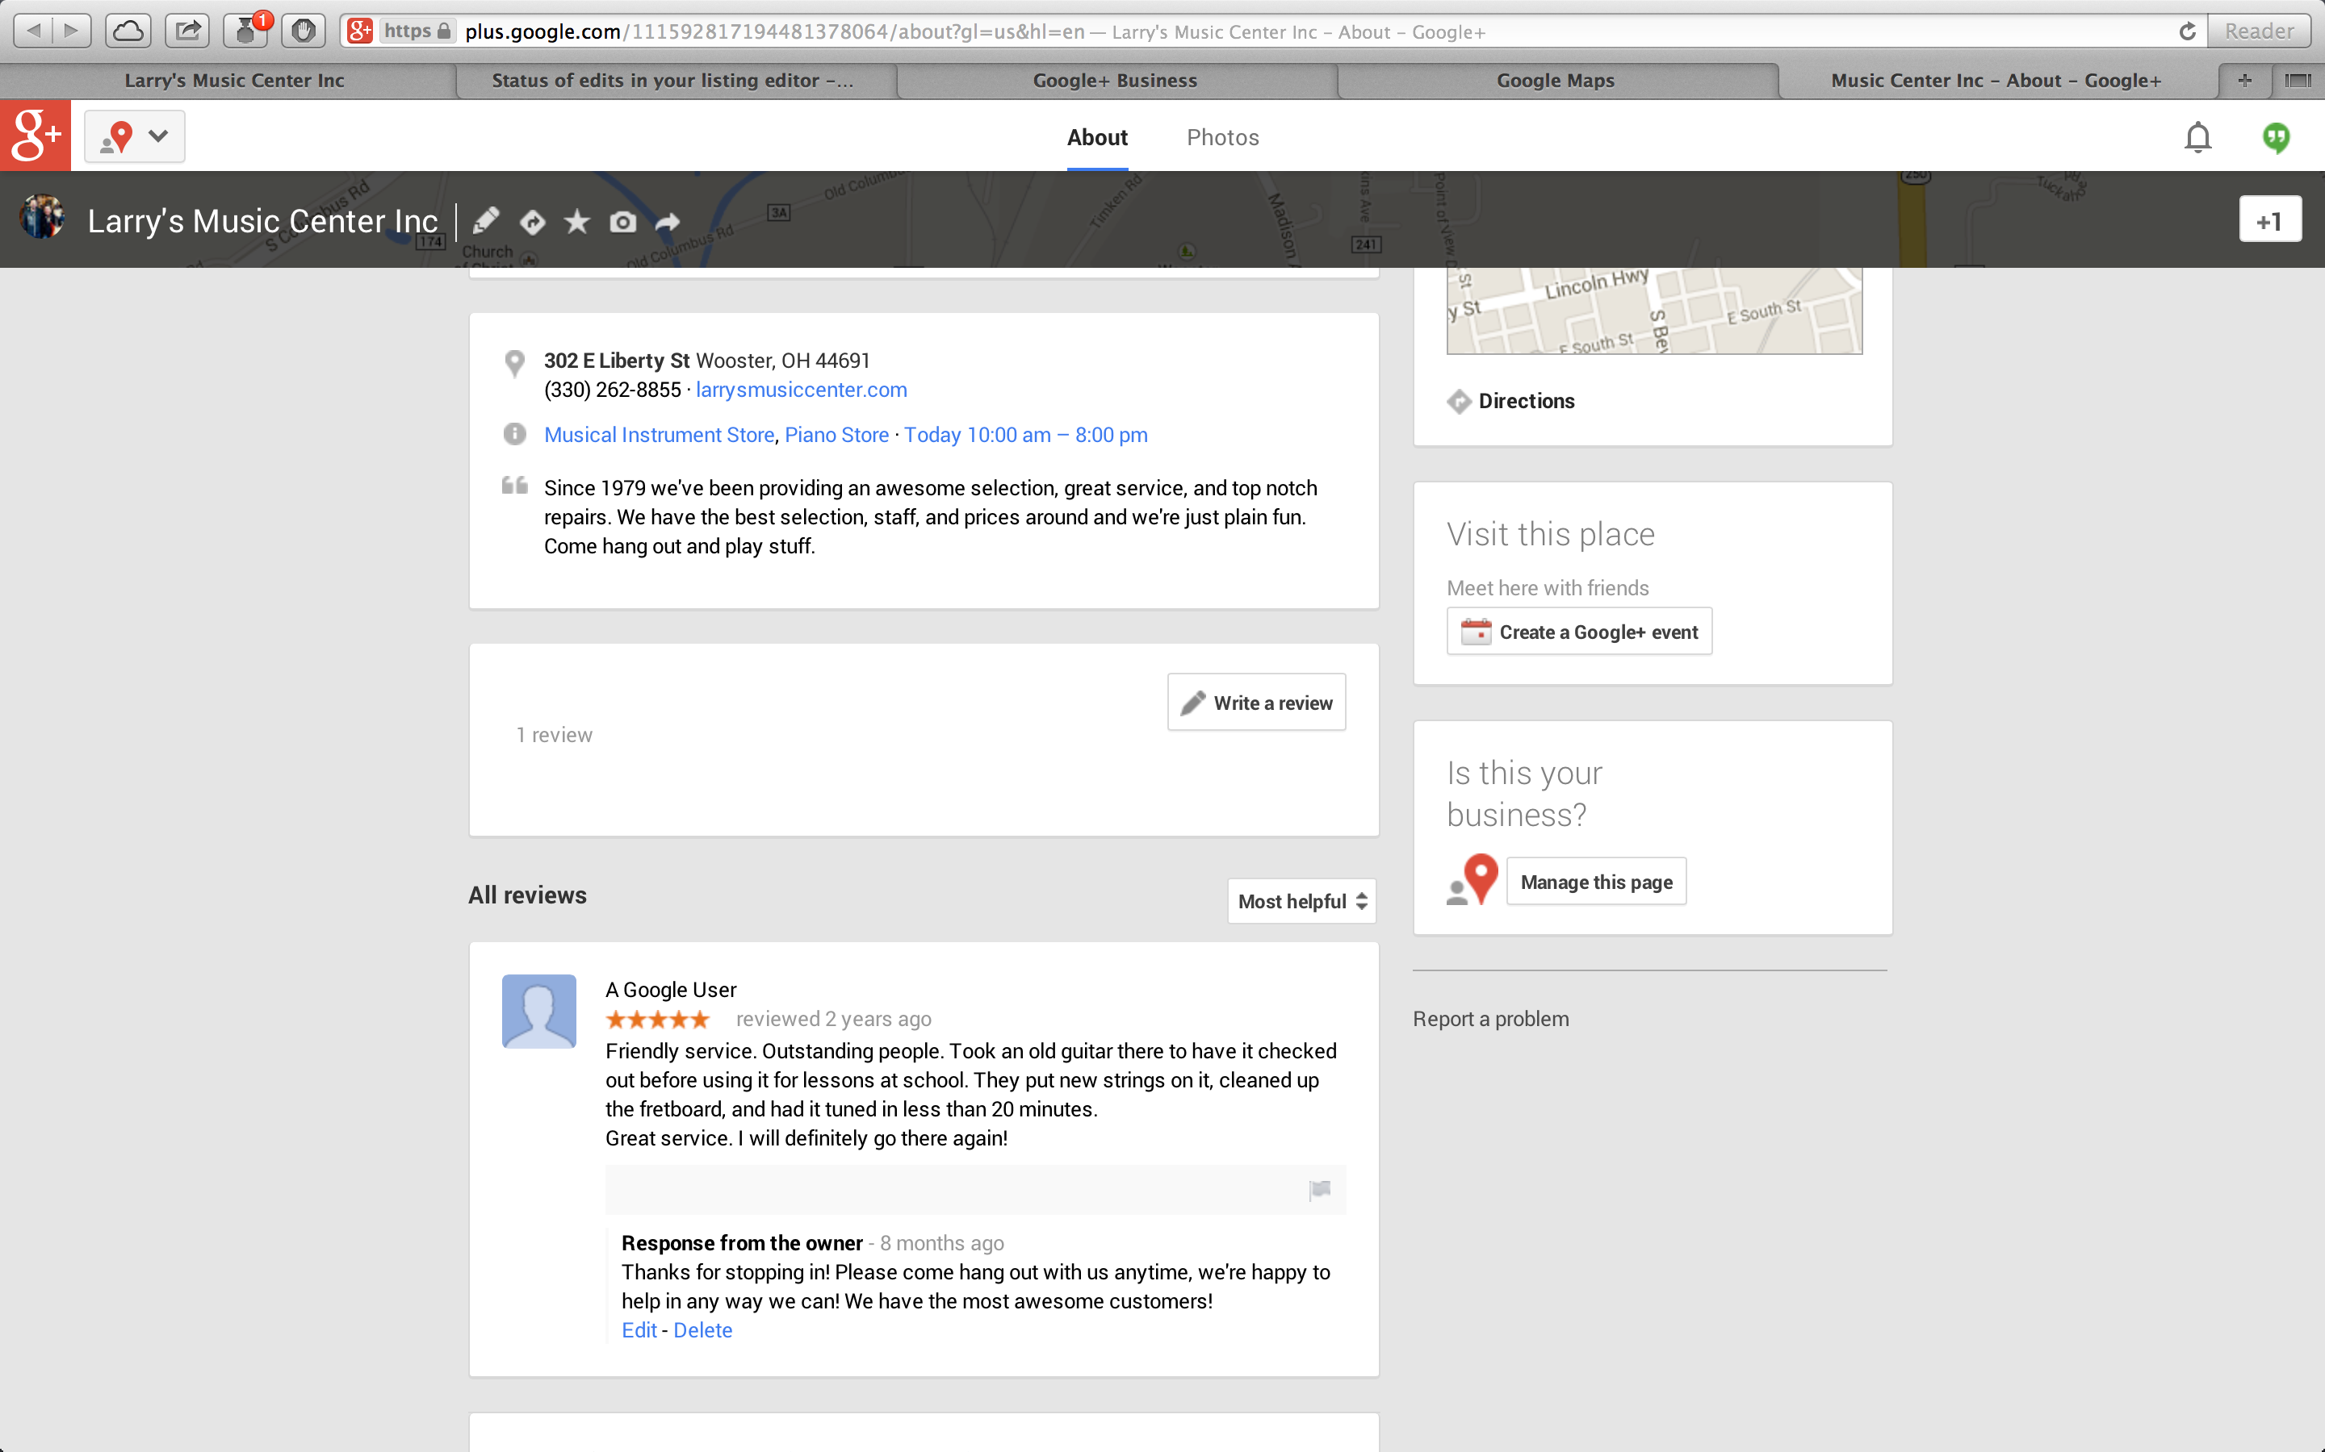

Slide 26
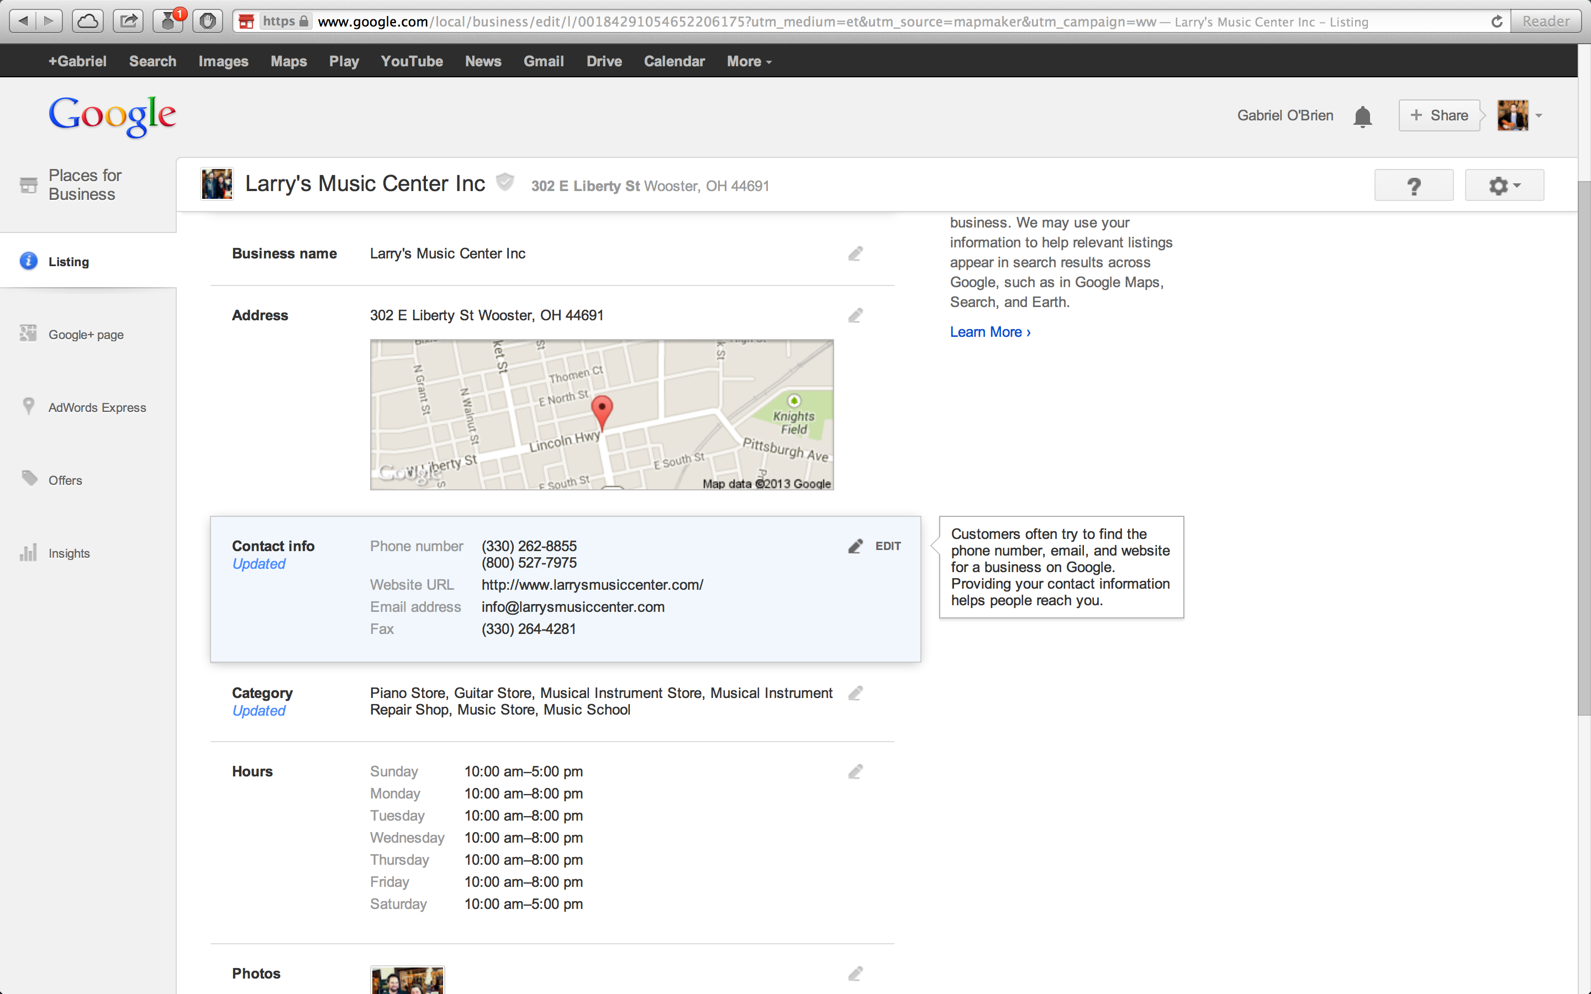
Notes:
Takes you through steps to claim page, phone code.

Slide 27
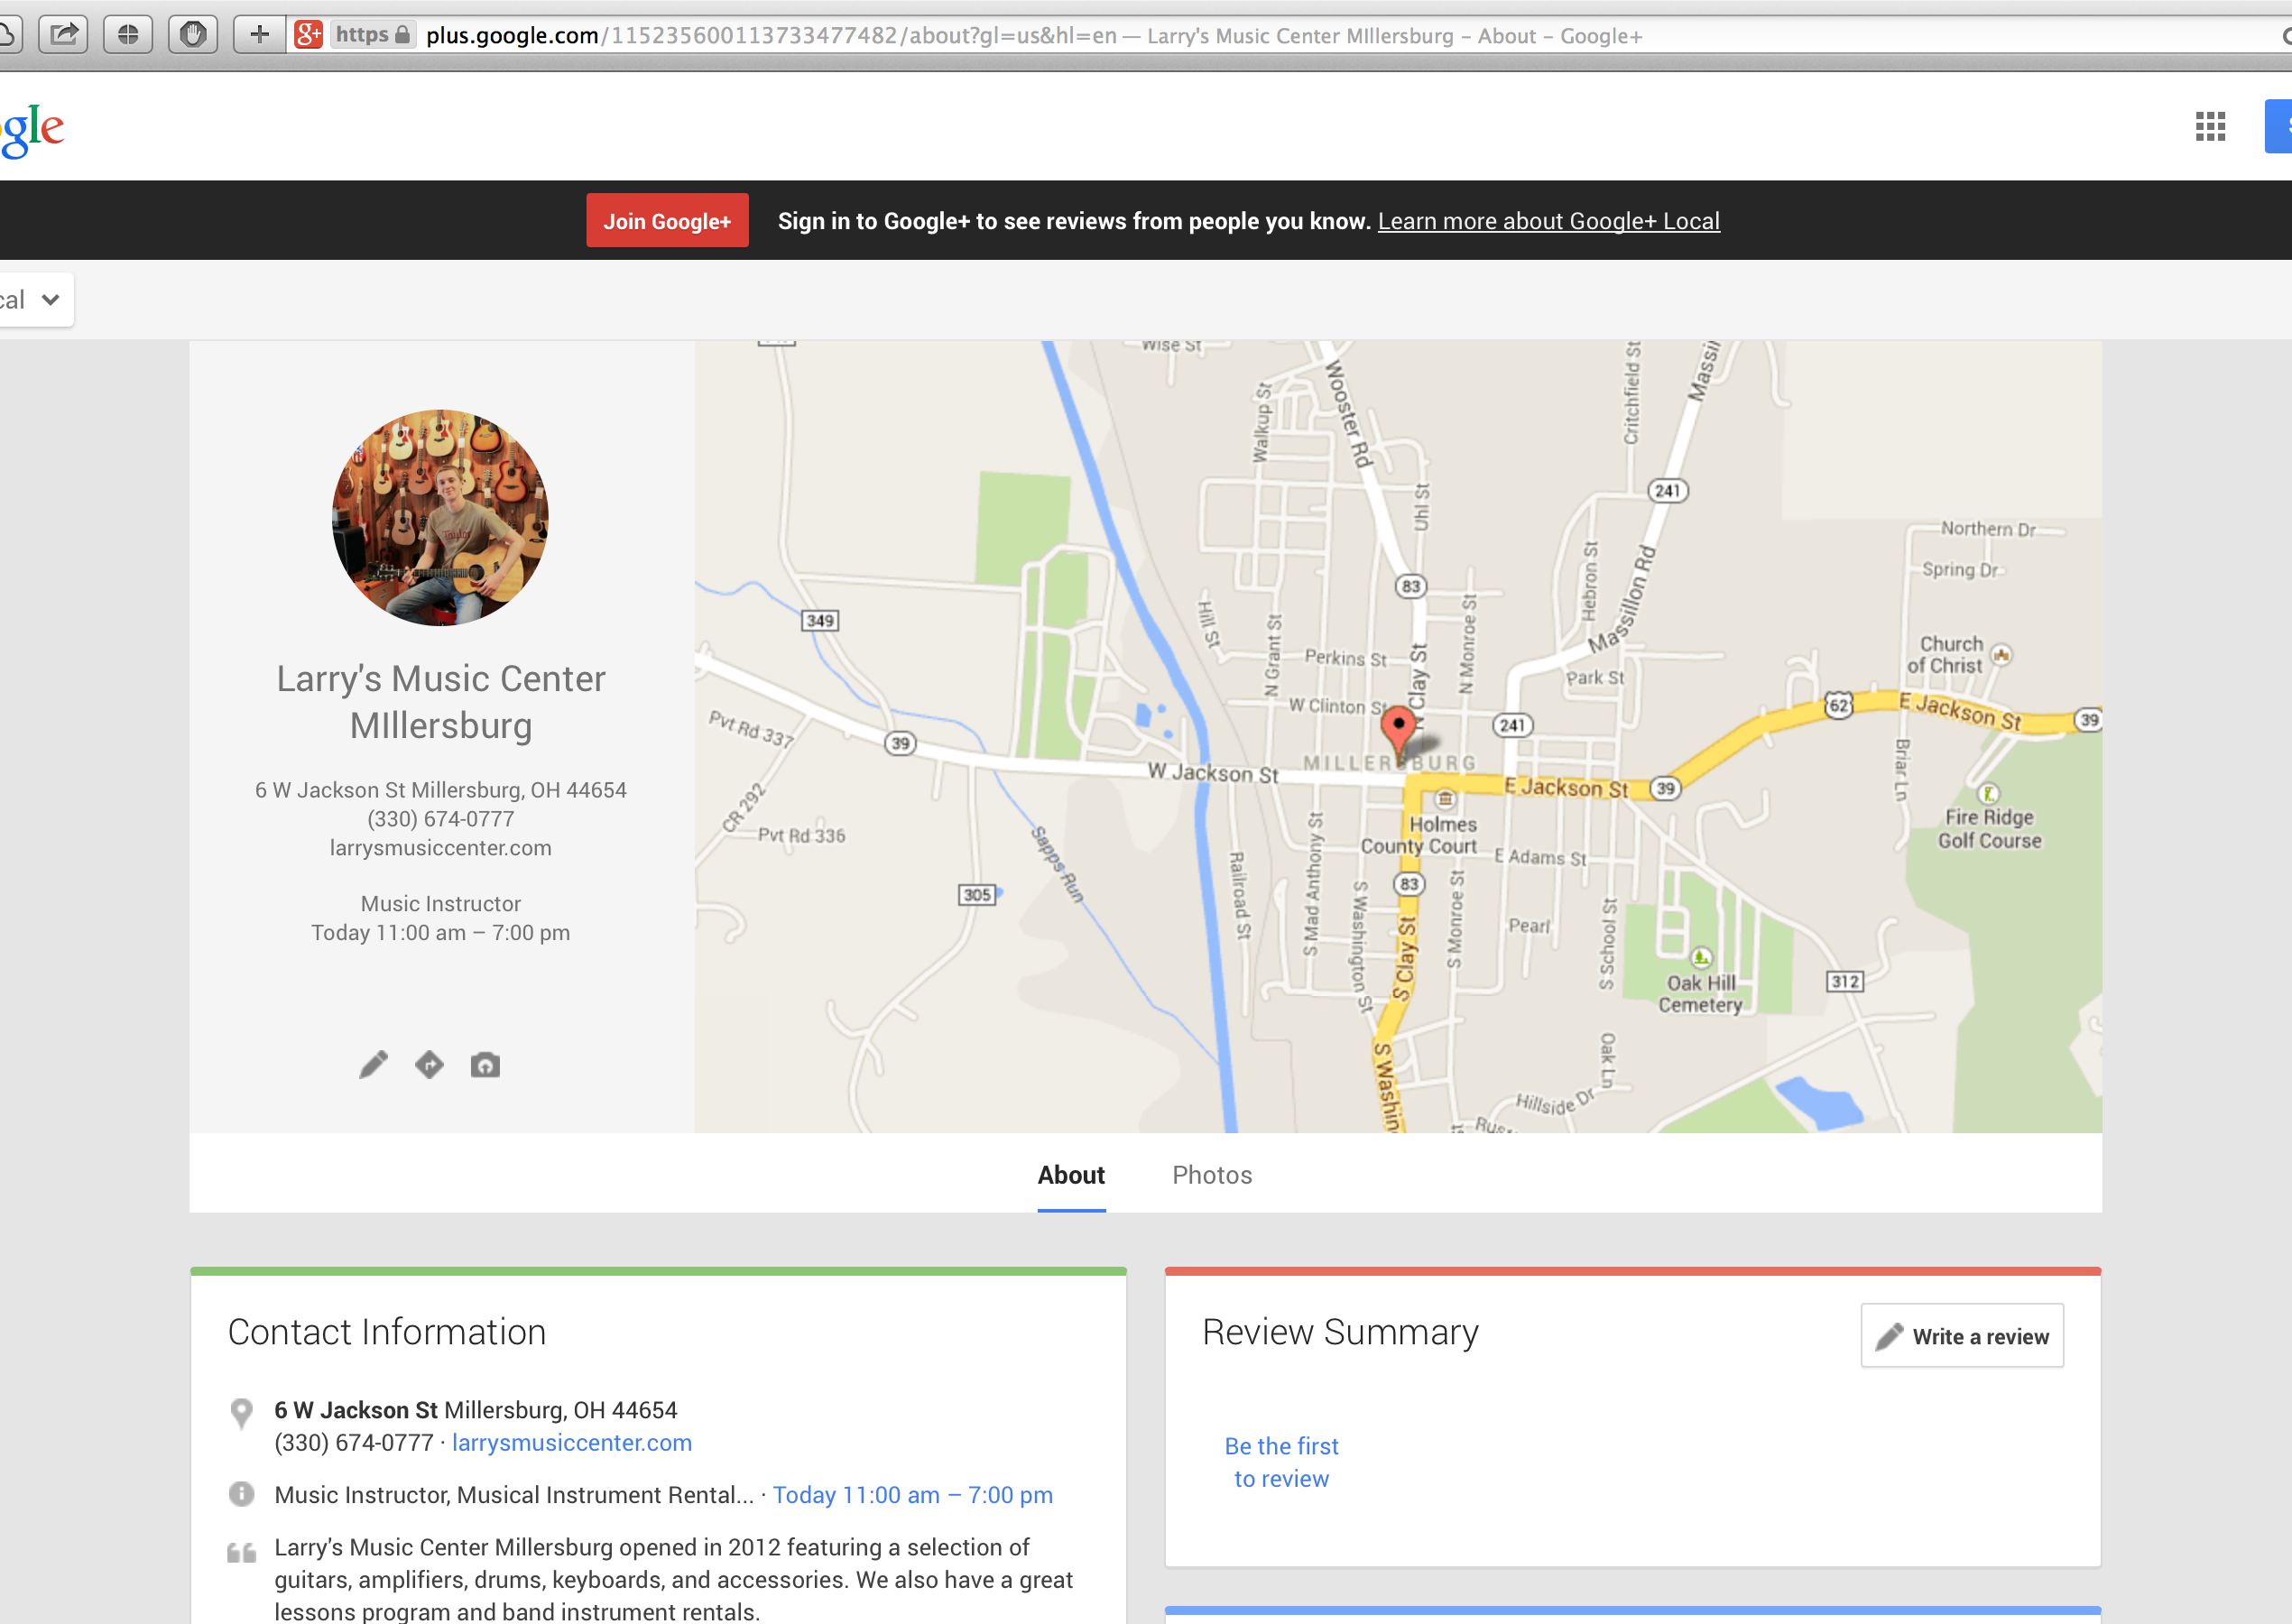
Notes:
Separate page for Millersburg store.

Slide 28
Google Places
Make sure your basic information is accurate
Link your Google Places listing to your website
Mention key brands and services in your listing
Claim your business listing for each location

Slide 29
Social Media
Number Four
Notes:
Number 4. Social Media.

Slide 31
Notes:
Claim Yelp and other review site listings. Merchantcircle, Reach Local come up high. Ignore yellow pages and things people want to sell you.

Slide 32
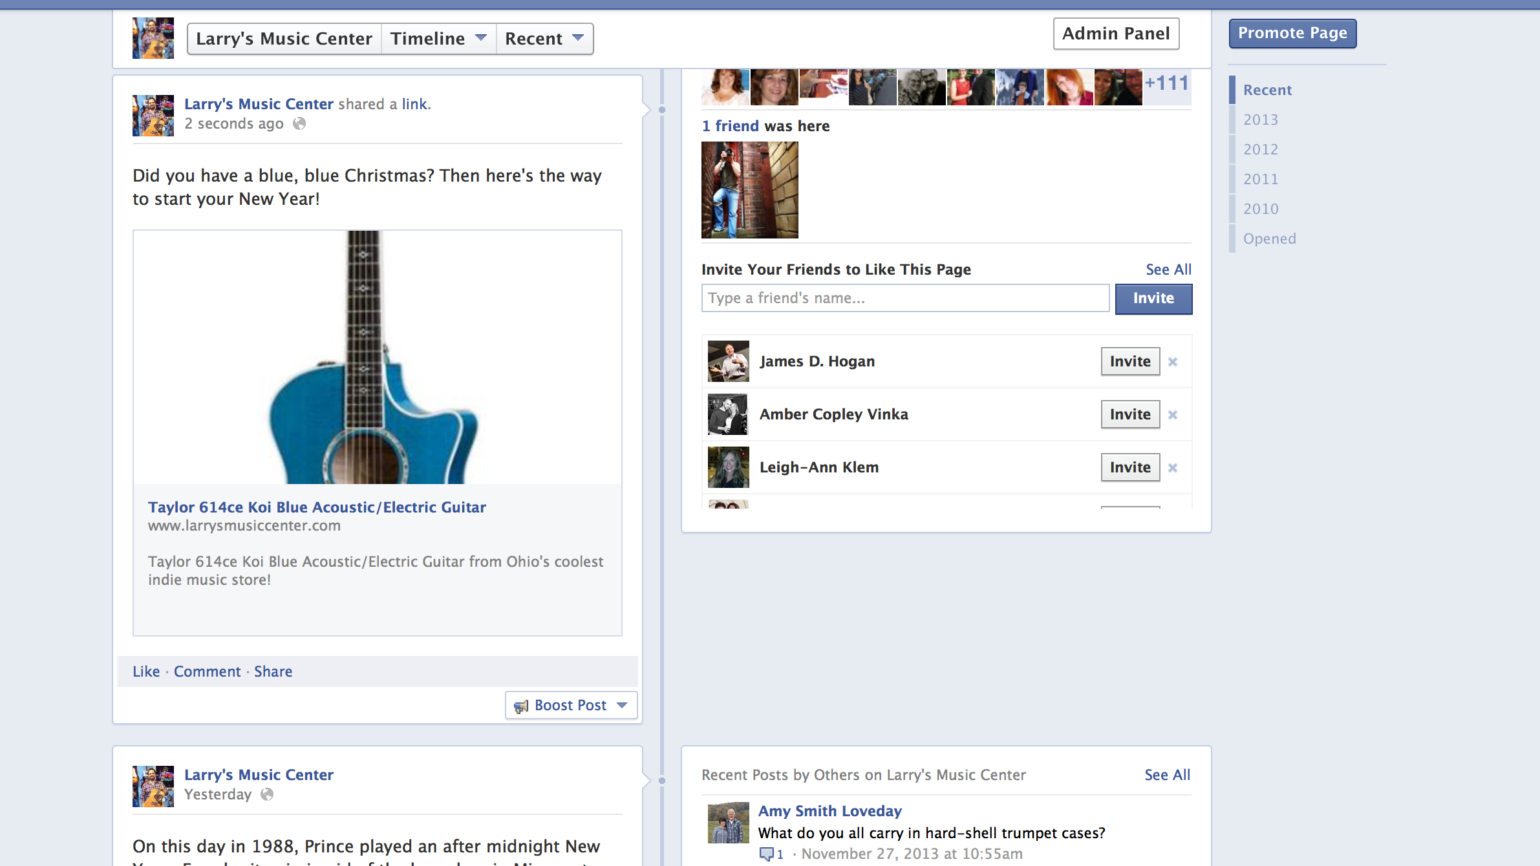
Notes:
Use Facebook to drive traffic back to your site, helps that item come up higher.

Slide 33
Social Media
Claim your business listings on Yelp and Foursquare
Make sure your basic information is accurate
Link your social media pages to your website
Use links within Facebook and YouTube posts to create traffic
Highlight unusual and hard-to-find items

Slide 34
15 Minutes a Day
Get your entire staff involved
Start with the basics, then get more specific
Only work on one thing at a time
“Once you pick it up, don’t put it down ’’til it’s done”
Make a list of search terms that apply to your store

Slide 35
Brands
Services
Taylor Guitars
Orange Amps
Reverend Guitars
Band Instrument Rental
Lessons
Repairs
Keywords
Wooster, Ohio, Vintage Guitars, Music Store, Larry’s Music Center

Slide 36

Gabriel O’Brien
gabriel@larrysmusiccenter.com
(800) 527-7975
@gabrielobrien

