Slide 1
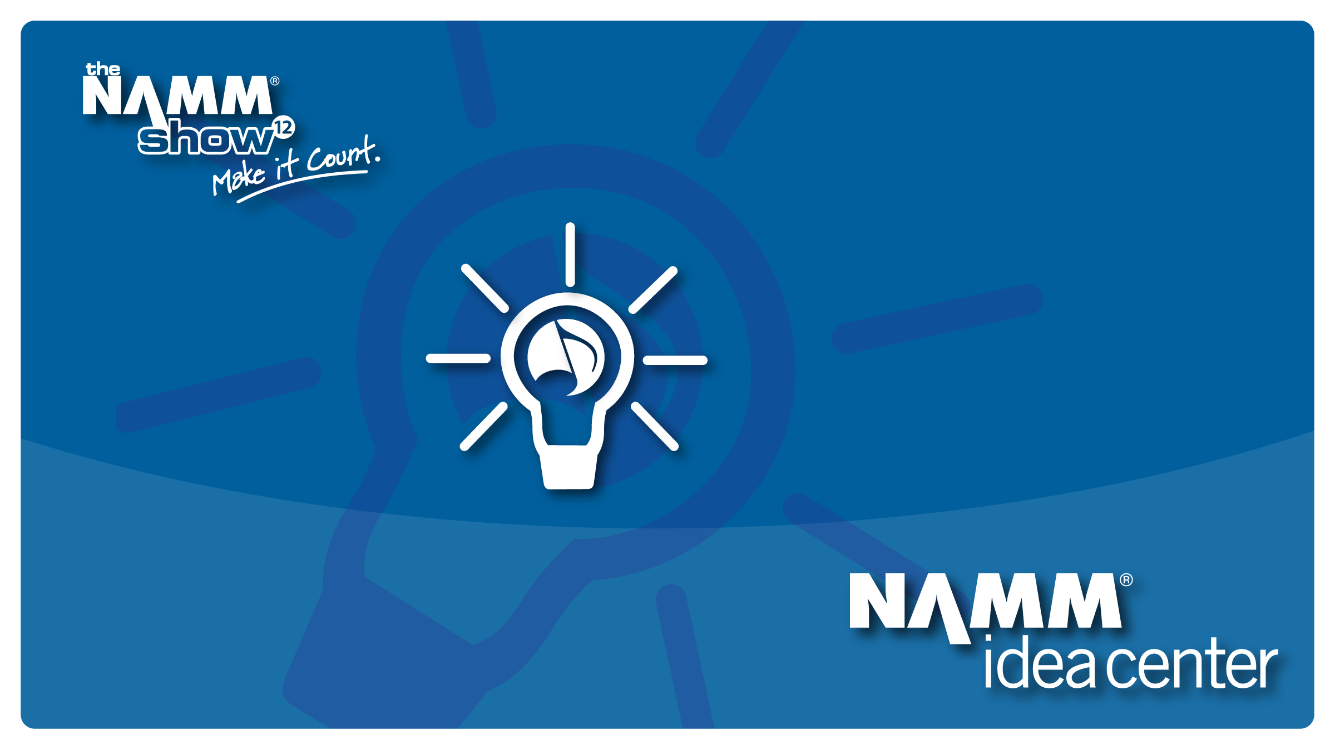
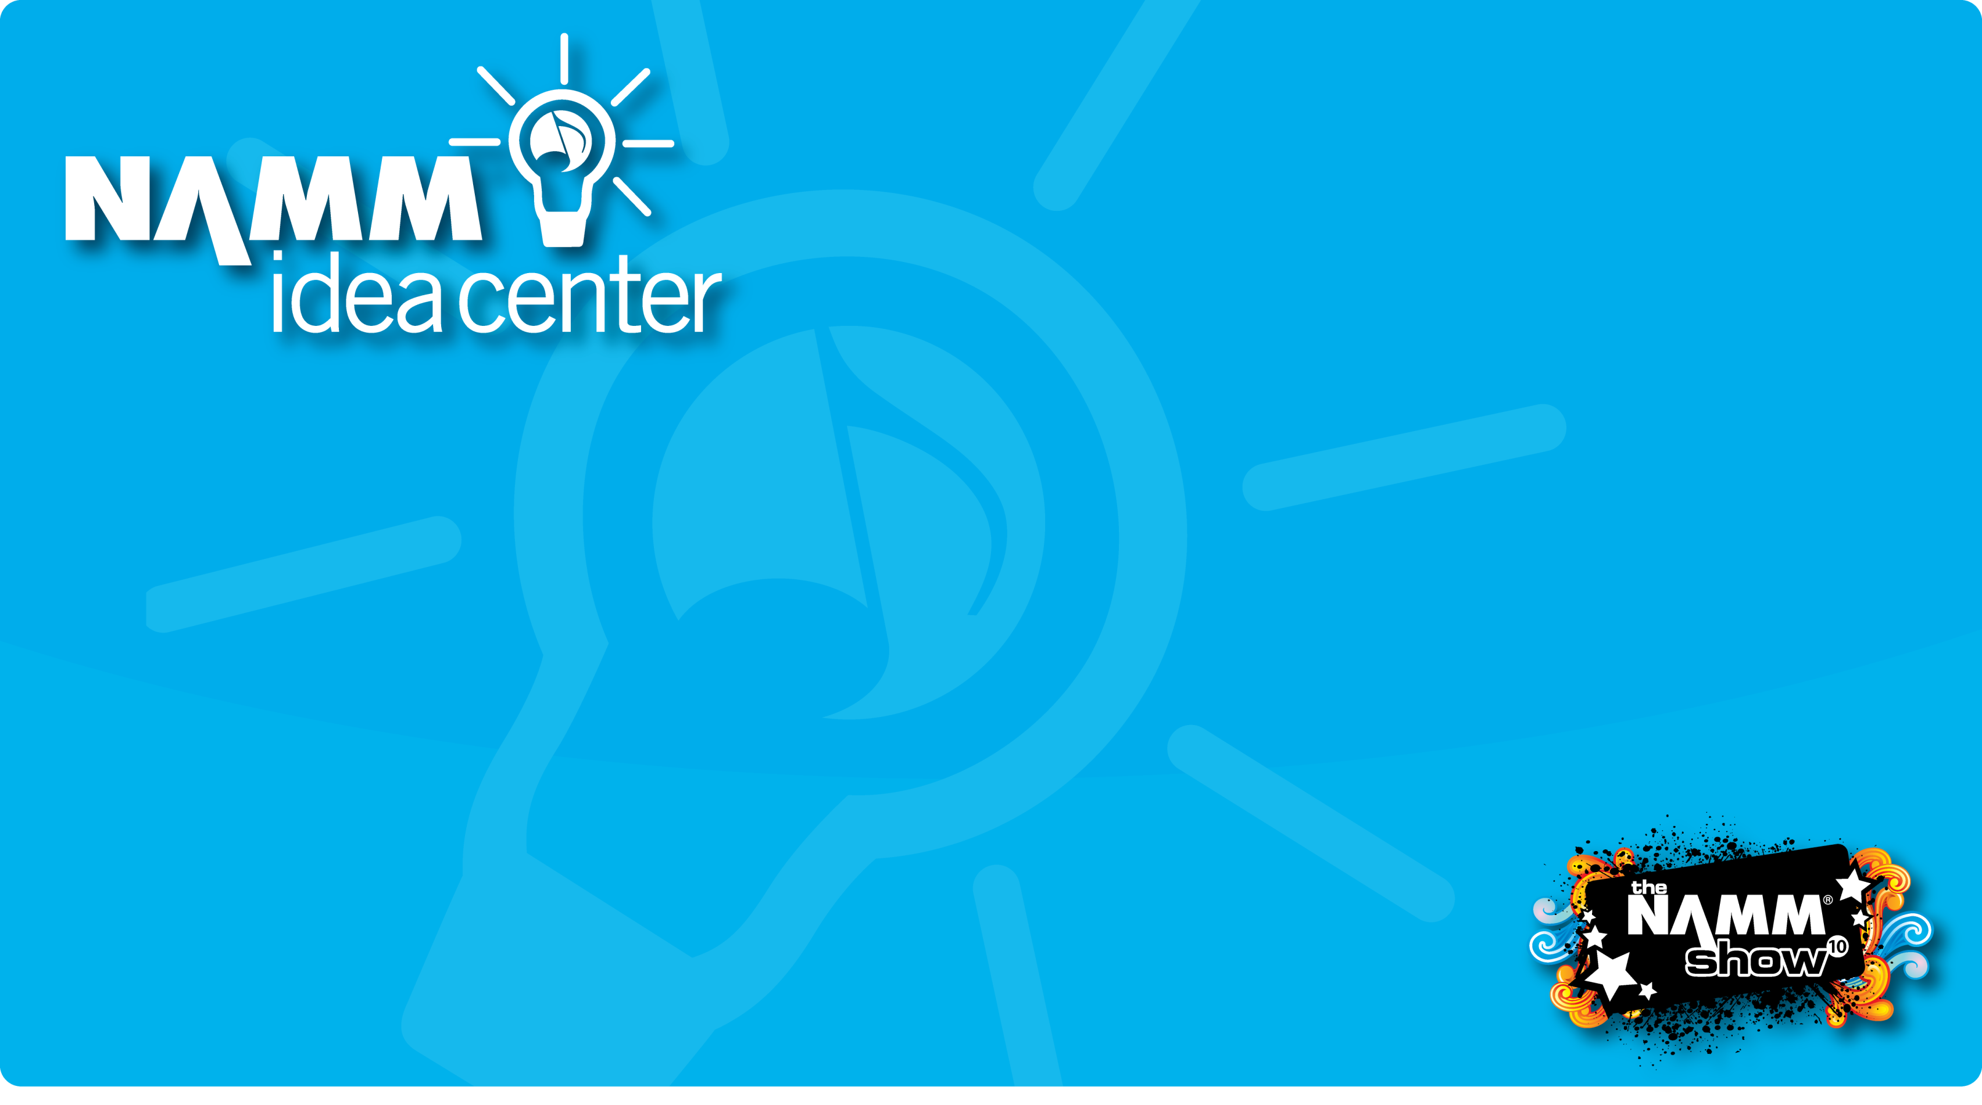
Course Title
Notes:
1

Slide 2

Design on a Dime
Lisa Paul-Kirkwood
Co-Owner
Discount Music of Jacksonville

Slide 3
Design on a Dime
Store Improvements on a Dime
You found WHAT on Craig's List?
Making improvements that fit your budget

Slide 4

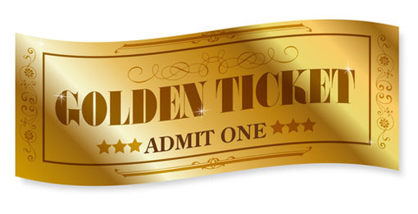
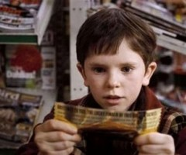
“ A golden ticket for a
NAMM Idea Center”

Slide 5
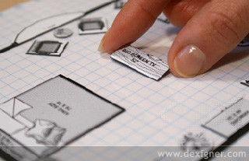
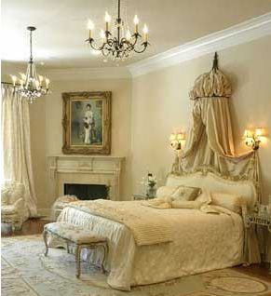
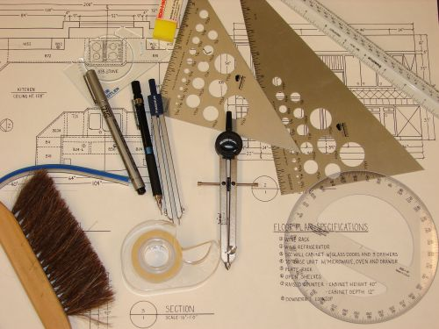
Life before becoming a
Music Store Owner

Slide 6
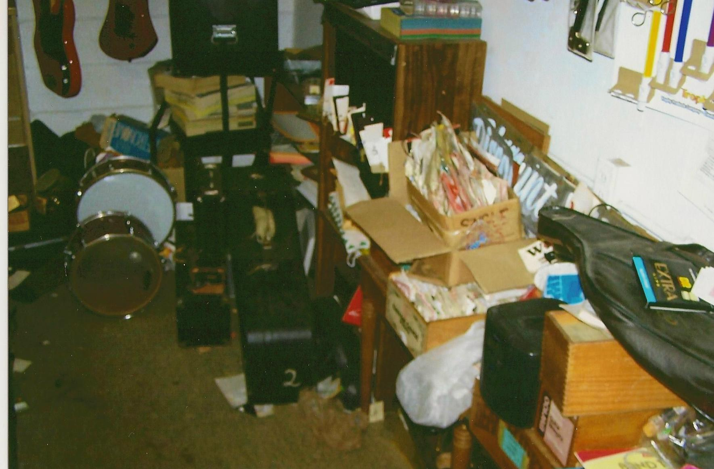
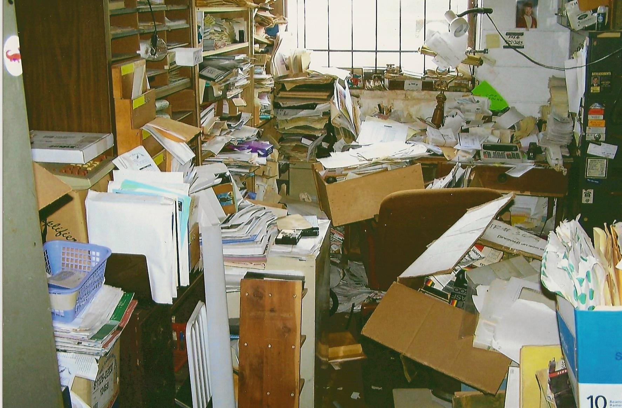
Be Happy this is not a Scratch & Sniff !

Slide 7
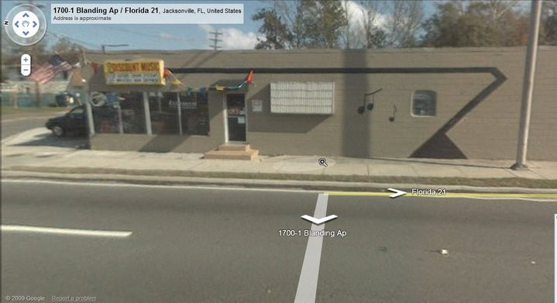
October 2007

Slide 8
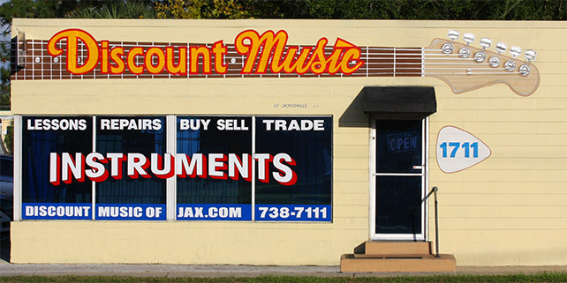

Slide 9
Now, the point of this session isn’t to compare ‘store to store’
re-using, re-purposing and recycling can save you money
and set you apart from other stores

Slide 10
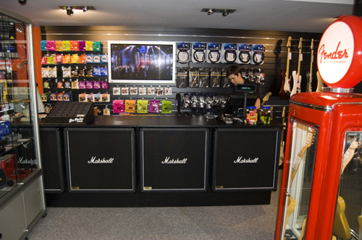
Most people have a hard time seeing
behind the counter to read string
information

Slide 11
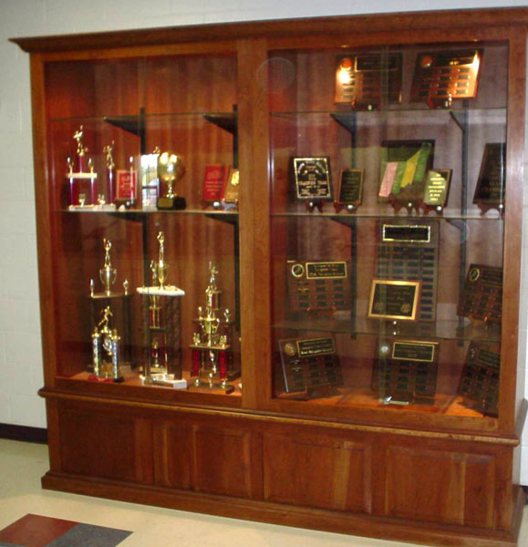
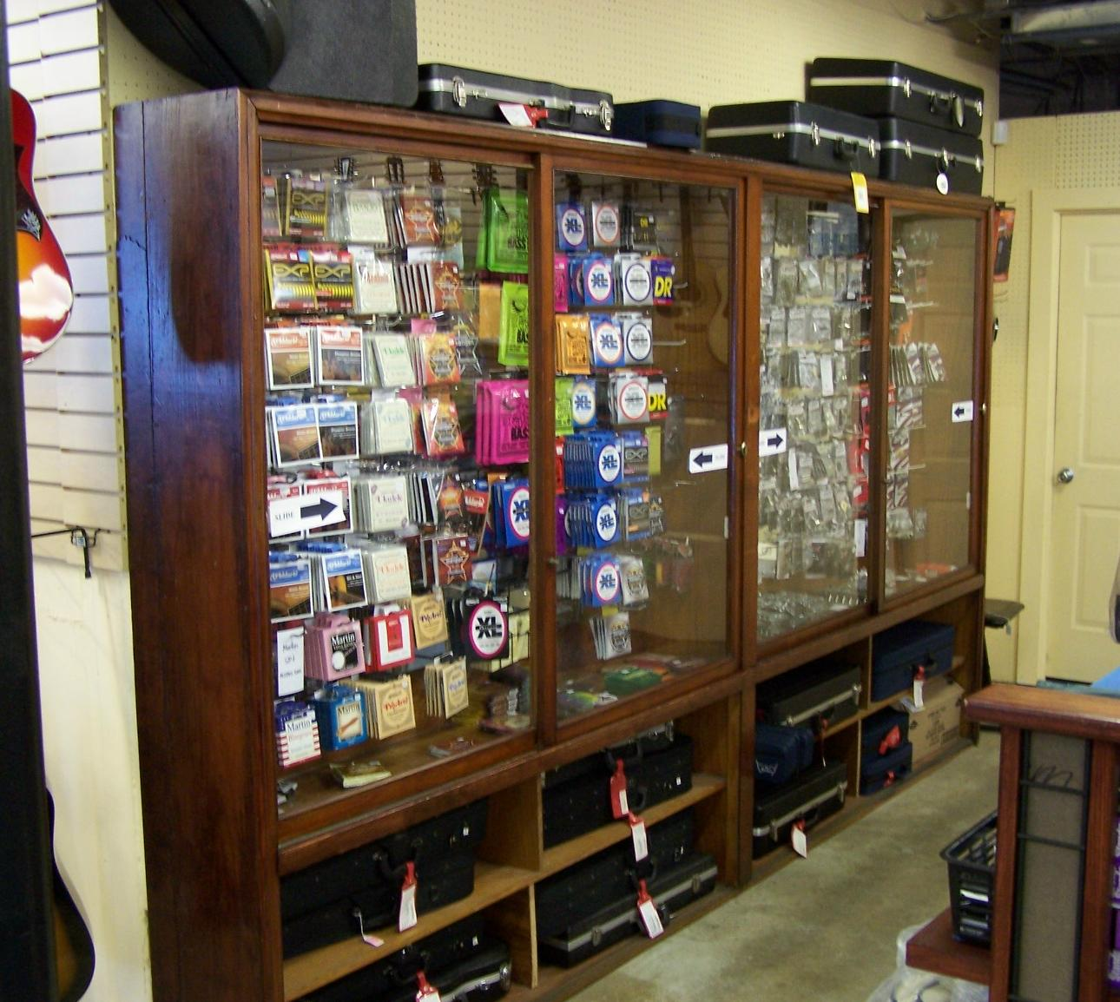
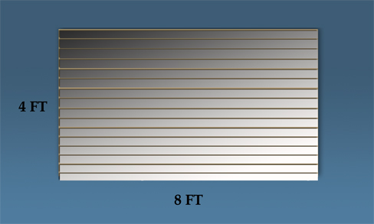
Habitat Re-Store
Craig's List

Slide 12
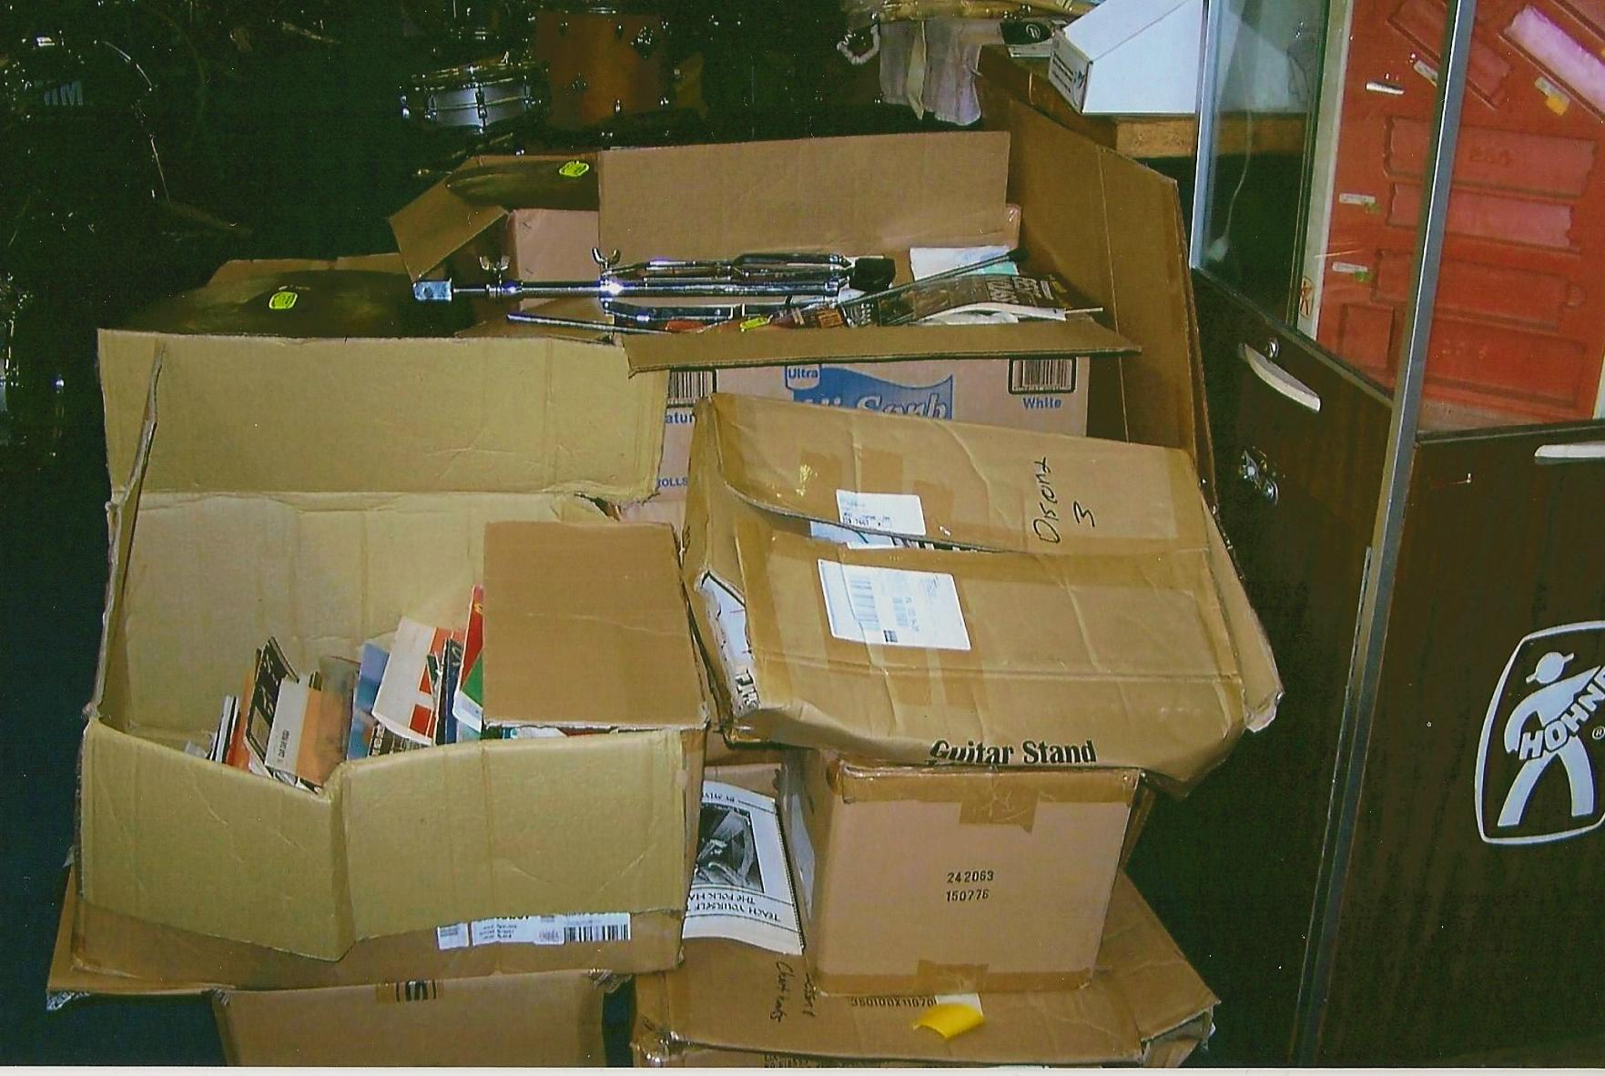
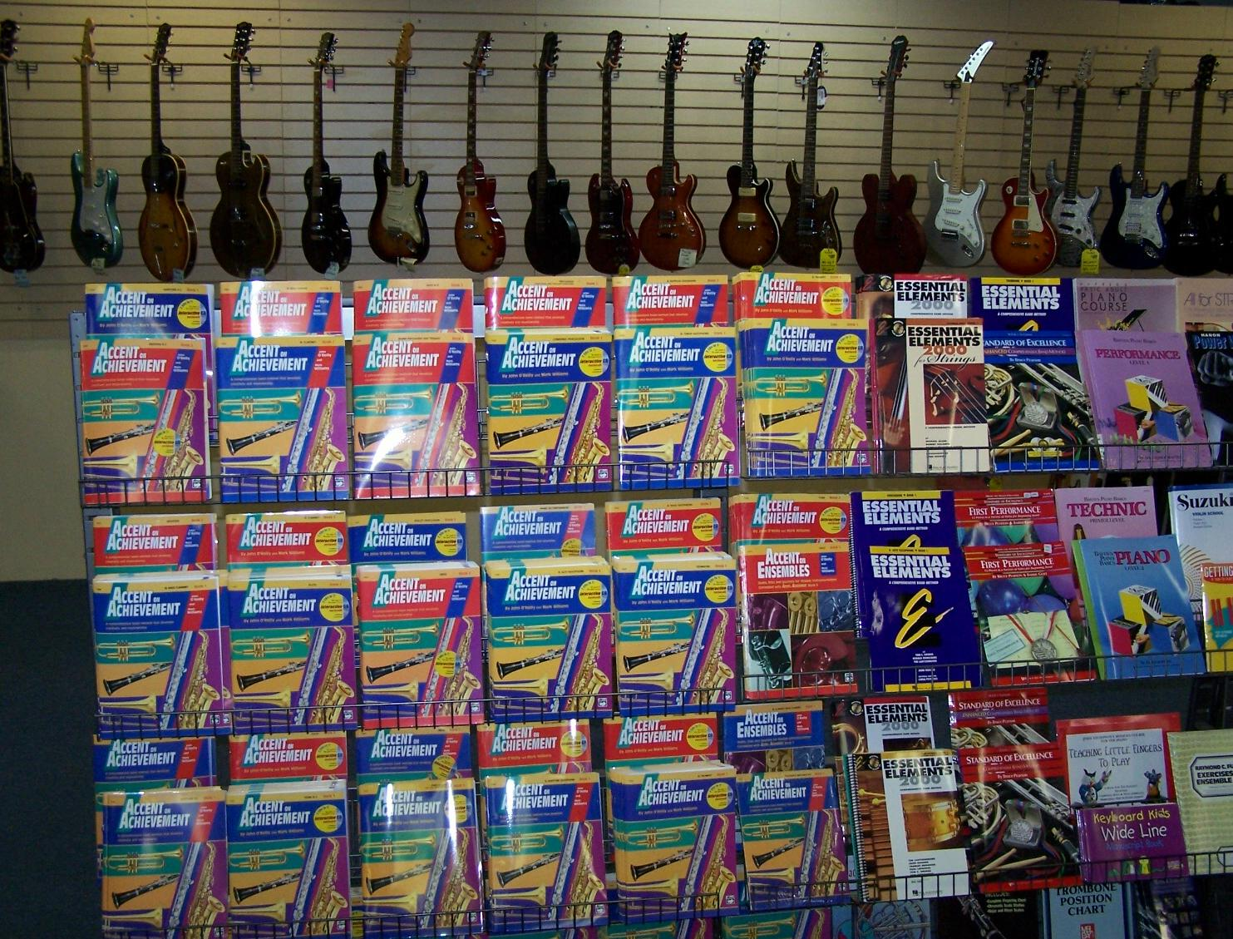
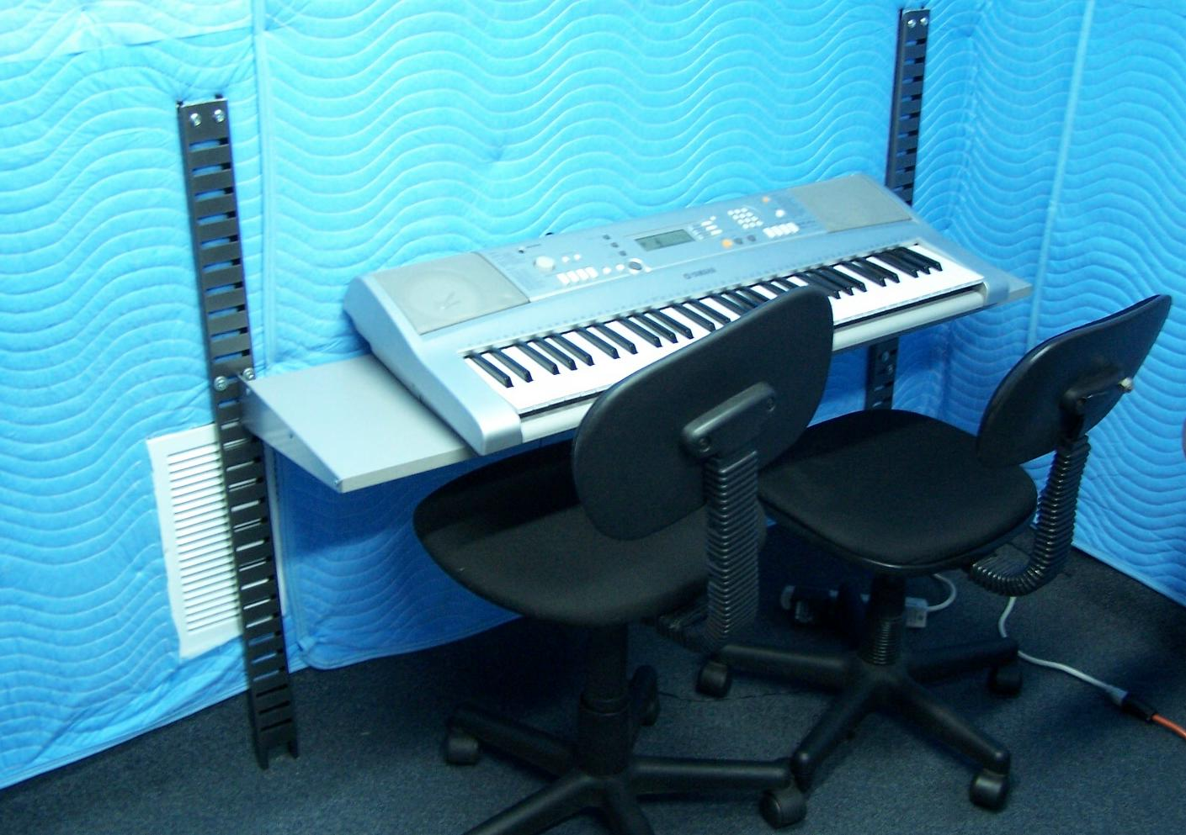
While others looked for videos, We Looked
at fixtures. Then we thought of other ways
to use those fixtures

Slide 13
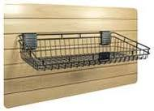
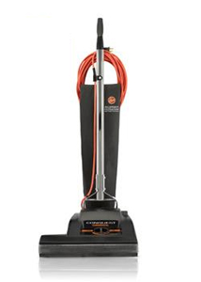
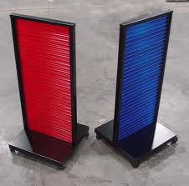
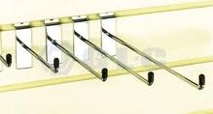
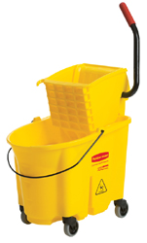
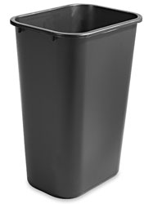
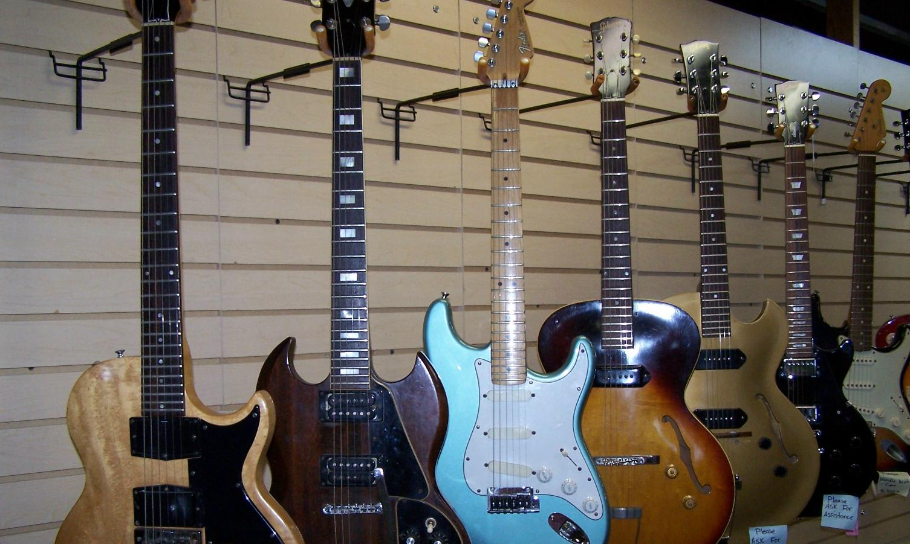
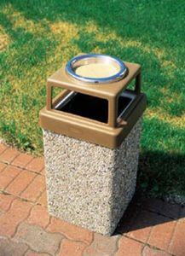
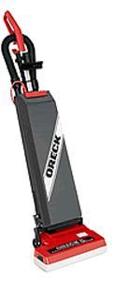
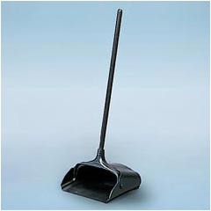
Pictured are some of the items
We bought from the video store
If bought new- the total cost would
Have been over $6000.00

Slide 14
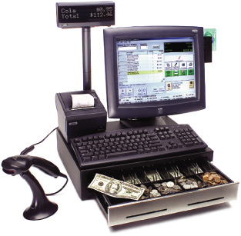
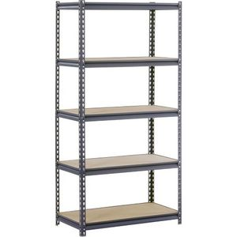

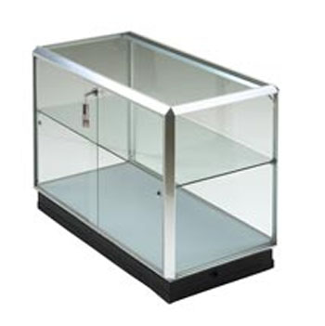
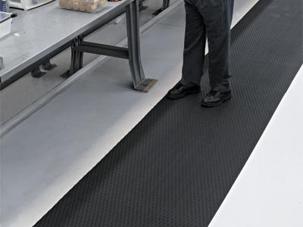
A large leather bench
2 organ benches
Heavy duty commercial shelving
Track lighting
Drop ceiling lights
Entire point of sale with flat screen
scanner & printer
Carpet squares
2000 Shopping bags- FREE
Office Supplies
Sound proofing material (class-rooms)

Slide 15
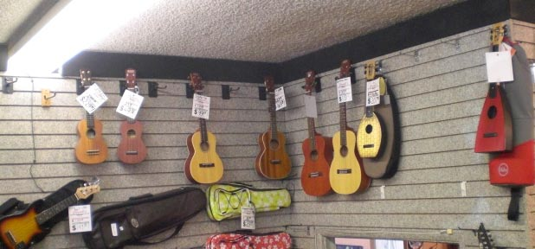
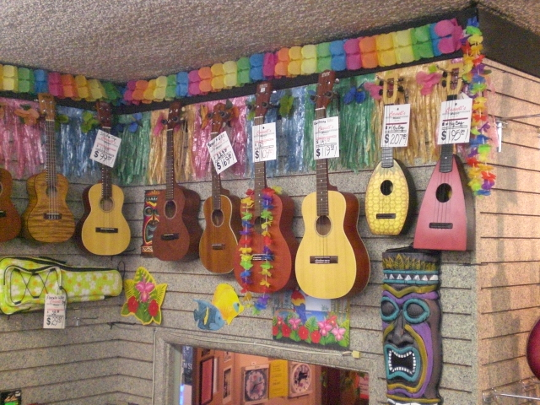
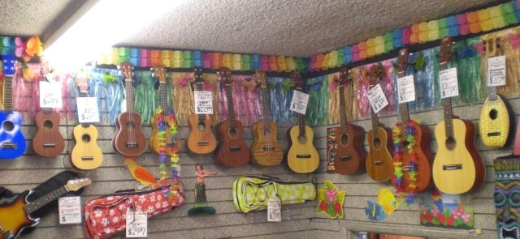
Less then $40.00 from the party
Store can go a long way!

Slide 16
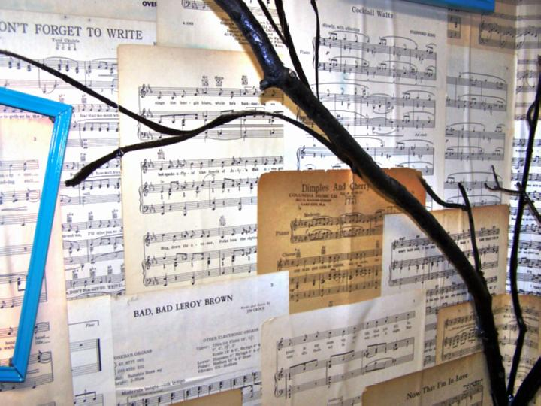
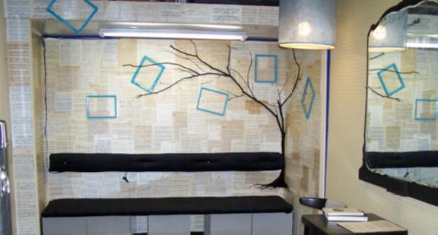
Waiting room

Slide 17
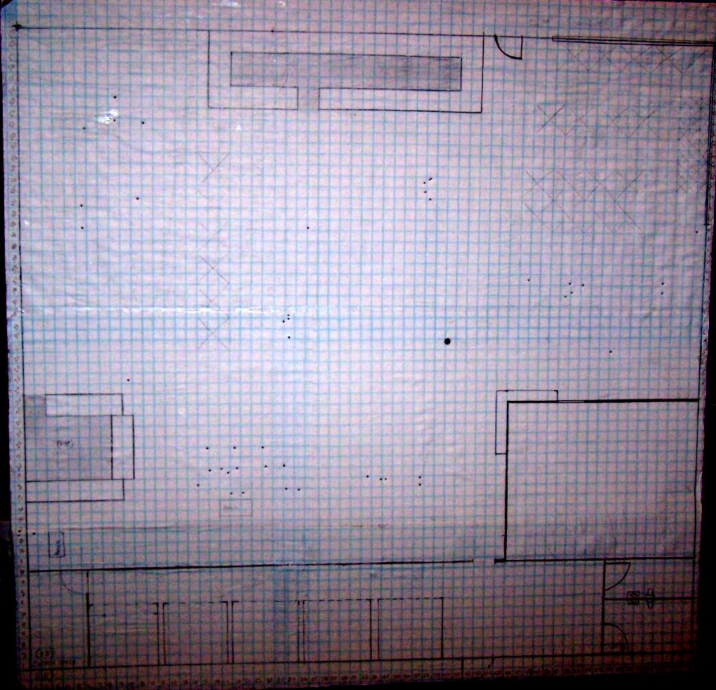
Free Square Footage
Remember to plan for the future

Slide 18
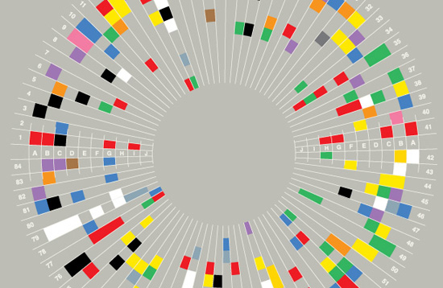
COLOR
WHY THIS
OR THAT

Slide 19
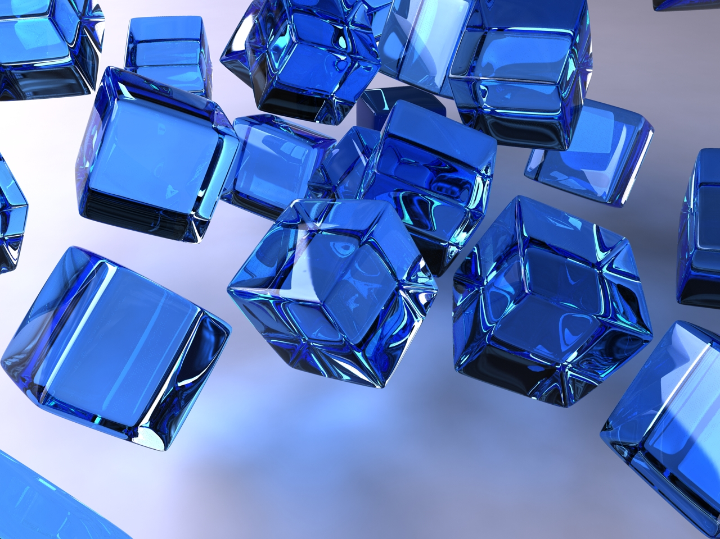
BLUE
Favorite color of most men
Research shows people are more productive in blue rooms. Weight lifters can lift more weight in blue gyms. Warehouses are often painted blue in order to have more productive workers.
Blue is also the least appetizing color. People who eat off of blue plates, eat less.
Blue is the color of Loyalty. It's recommended that people wear blue to interviews or sales staff who wear blue shirts are seen as loyal to customers.

Slide 20
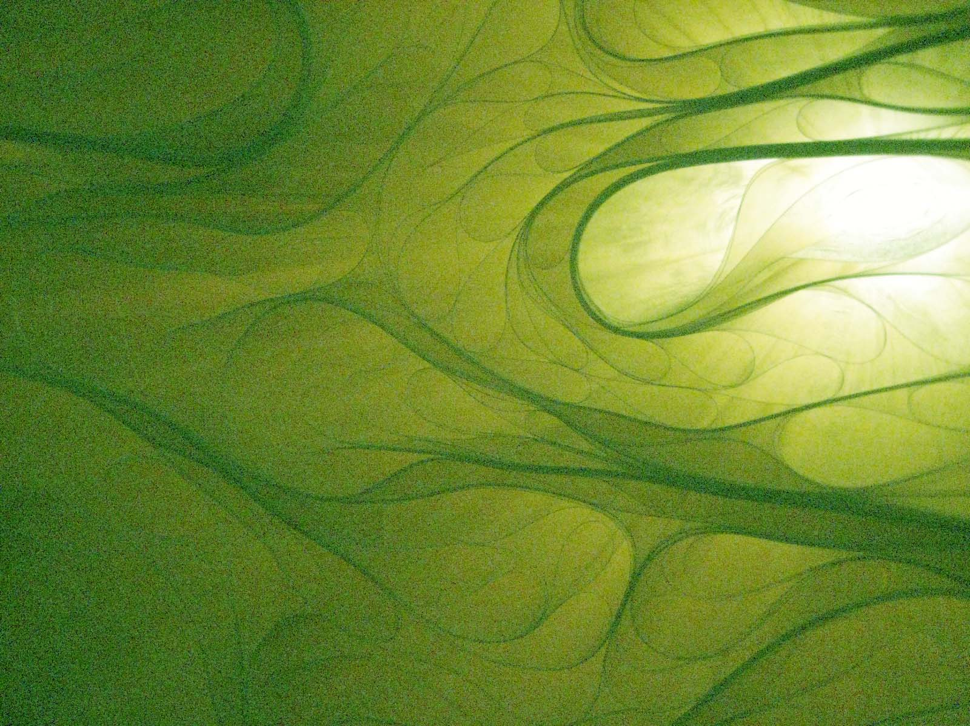
GREEN
Green is easiest on the eye
Improves vision and reading ability
Laying a green transparency over reading material improves reading speed and comprehension
Green is calming ( The Green Room of television shows)
Green relieves stress.

Slide 21
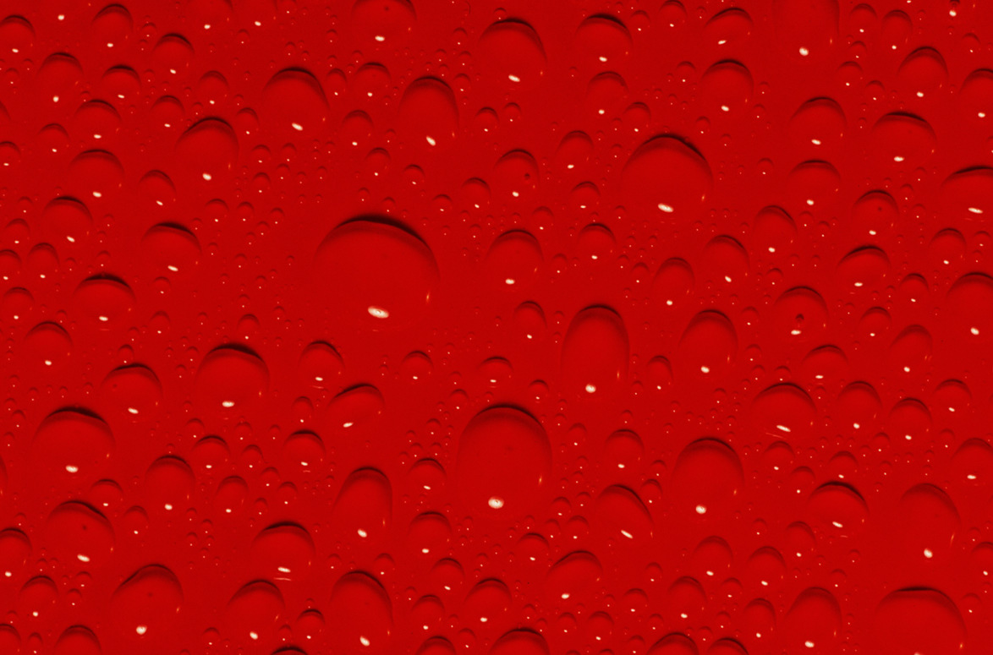
RED
Strong emotions, excitement or intensity.
Studies show people eat more and leave bigger tips (spend more money) when eating on red table cloths
Stimulates both body and mind
Increases circulation
Increases appetites.

Slide 22
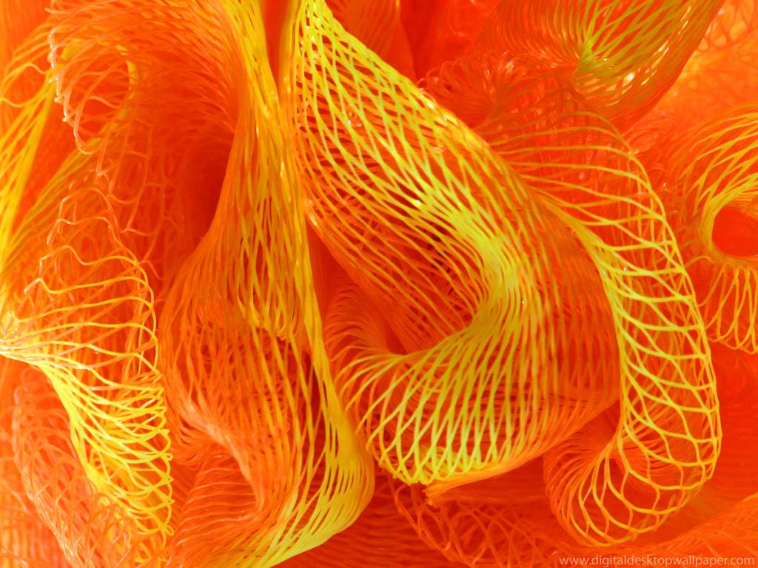
ORANGE
Increases Energy Levels
Used to quickly get attention (traffic signs) but doesn't hold attention
Studies shows it causes people to become thirsty

Slide 23

YELLOW
Yellow stimulates Nerves.
It's most fatiguing to the eyes
Causes feelings of frustration & anger
Used for fast quick task (post it notes)
A great color for public restrooms-people don't like to linger in yellow rooms.

Slide 24
Never be too busy trying to make the sale – that you forget to be friendly!
People will look past your store not being the
‘best' in design and floor plan.
People will forget the color of your walls.
How you make them feel when they come into your store,
that they'll remember.

Slide 25

Come Join
Independent Music Store Owners
Friday 5:00pm
Hilton Hotel 4th Floor
Palos Verdes Room

