Slide 1
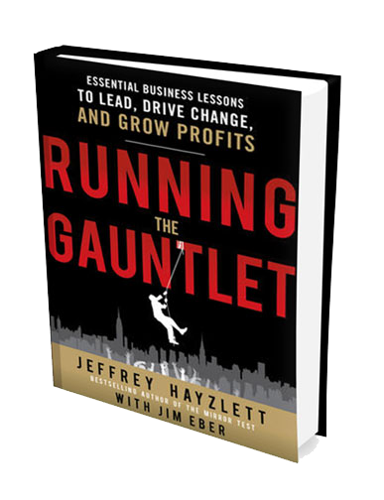

The Mirror Test

Slide 2
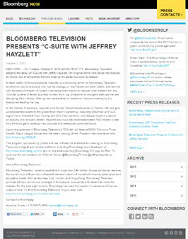


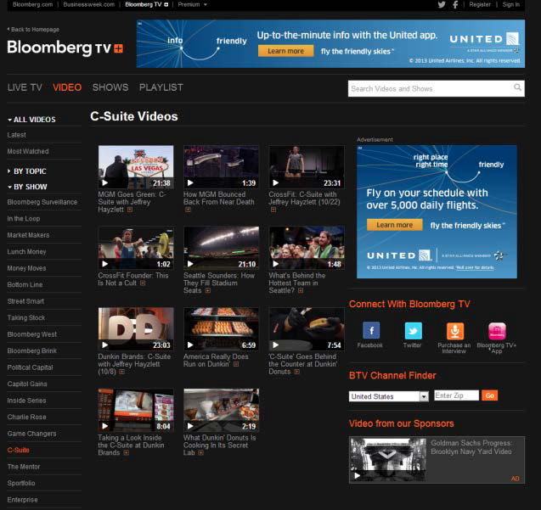

Prime Time

Slide 3
WARNING:
To the naysayers, opportunists, and obstructionists who stand in the way
of driving change and progress
in any organization
Note:
WE WILL BEAT YOU

Slide 4
Adapt, Change or Die

Slide 5
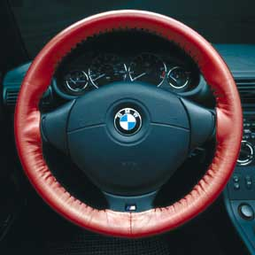
Driving Change
Change for Change Sake
is bad
“There is nothing wrong with change, if it is in the right direction.” – Winston Churchill

Slide 6
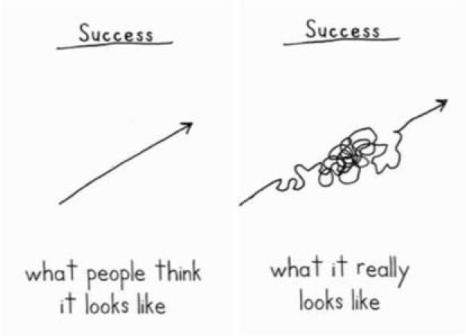
Never One Way

Slide 7
Agents of Change
Leaders

Slide 8

Clock Changers

Slide 9
Clock Changers
Find leaders

Slide 10
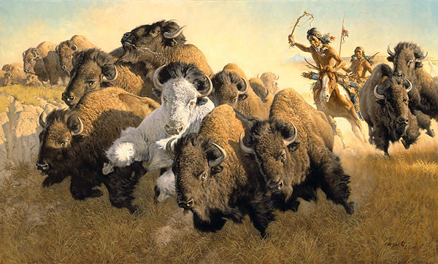
Noticeable Assets
Problem Solvers, not problem seekers
Change agents for the process
Cheerleaders who reinforce goals
Seam operators
Notes:
Build the slide – one bullet point at a time

Slide 11
Why People & Companies Fail to Drive Change Needed to Win
The BIG Five

Slide 12

Reasons We Fail
Fear
Be a beginner

Slide 13

Reasons We Fail
Tension
Healthy debate is good

Slide 14
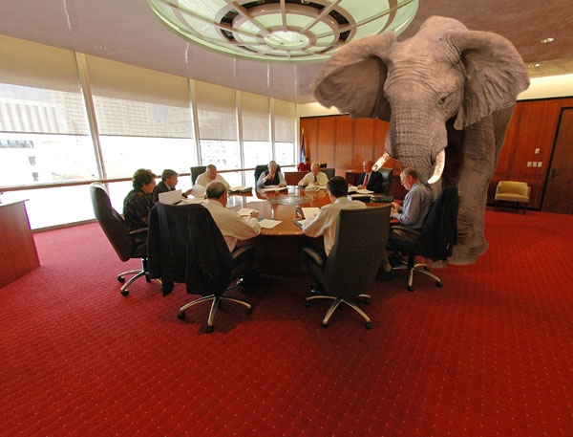
Reasons We Fail
Radical
Transparency
Biz Elephants are fun to kill

Slide 15
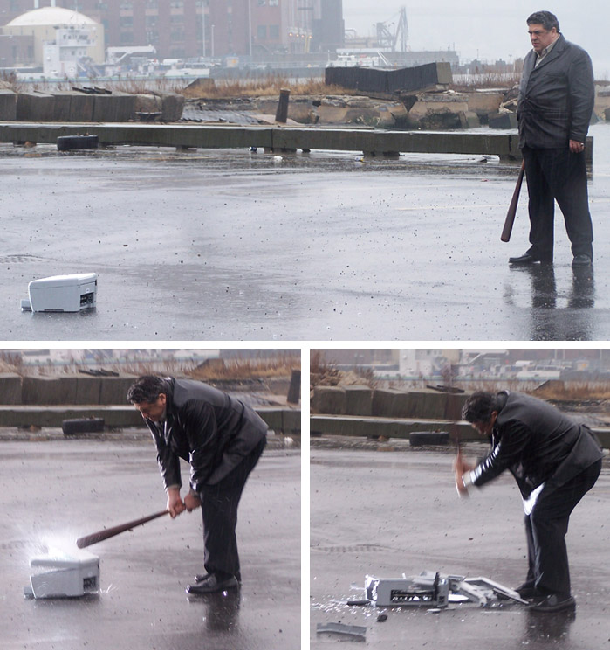
Reasons We Fail
Risk
No one is going to die

Slide 16
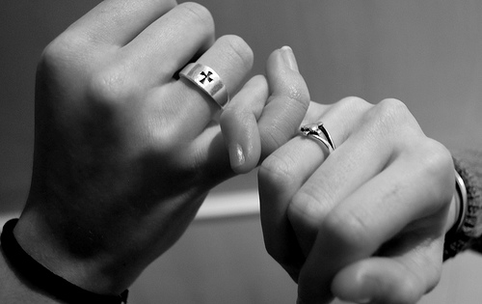
Reasons We Fail
Promises
Mutual Conditions of Satisfaction

Slide 17
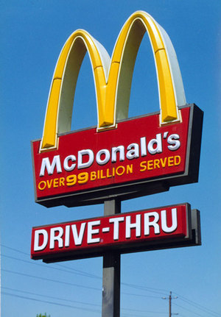
How it Should Work

Slide 18
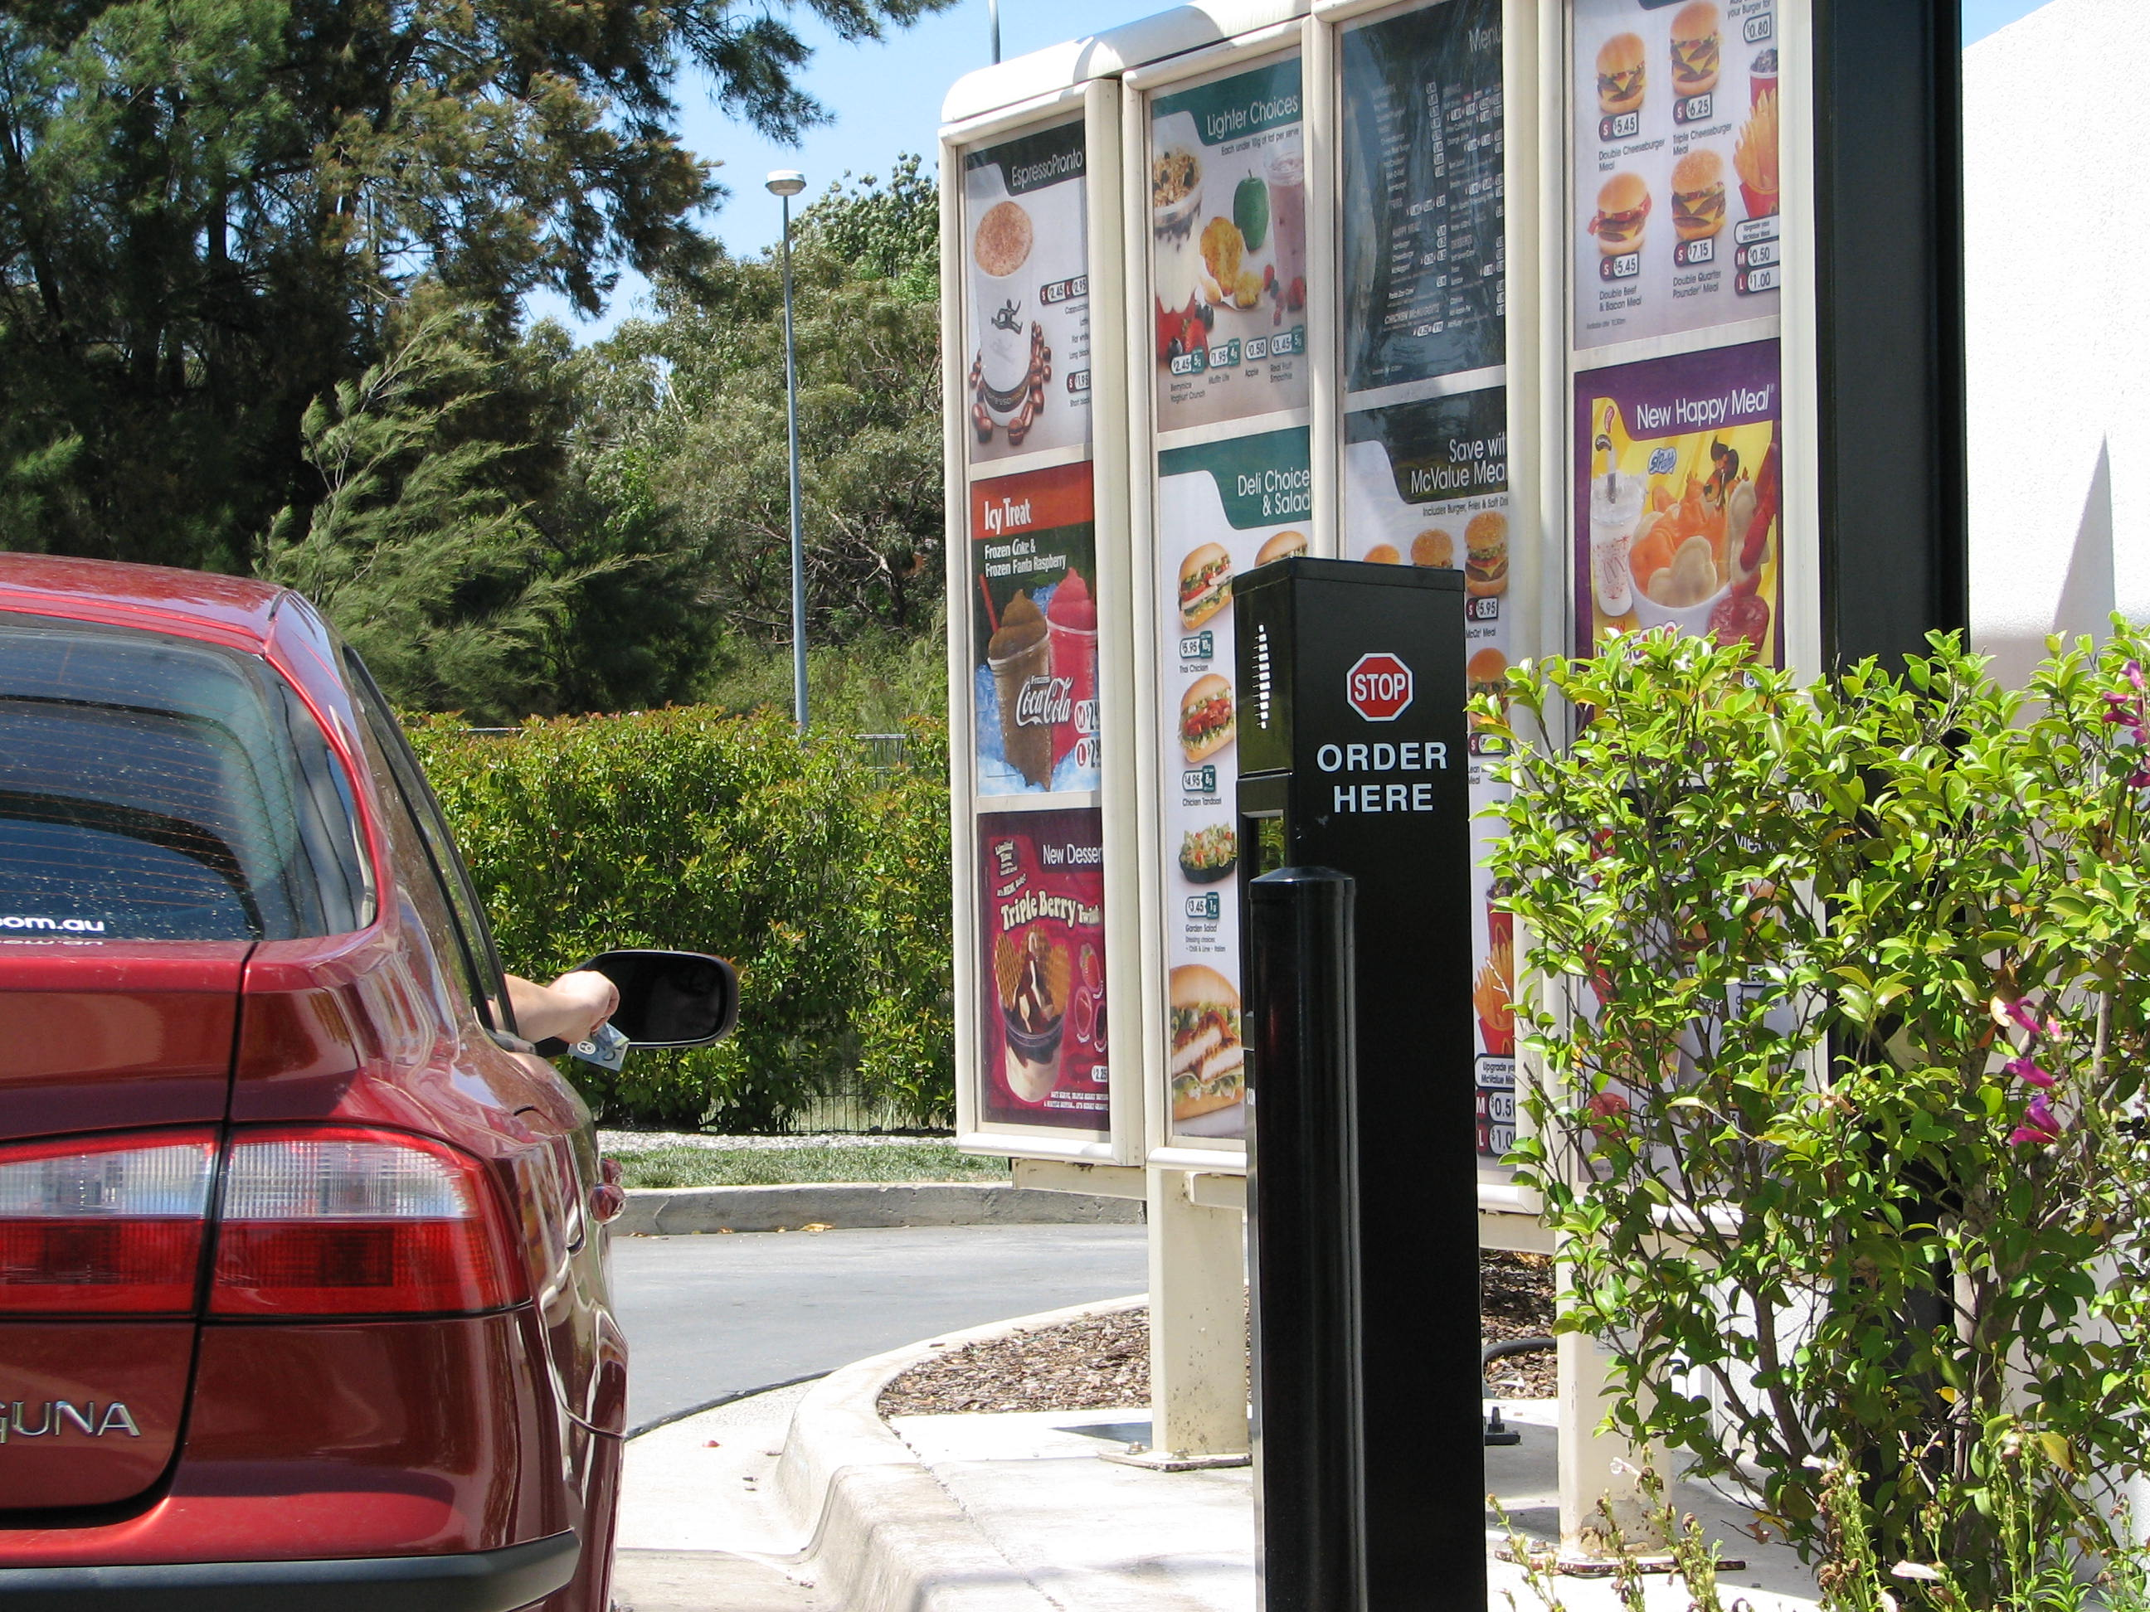
Take my Order

Slide 19
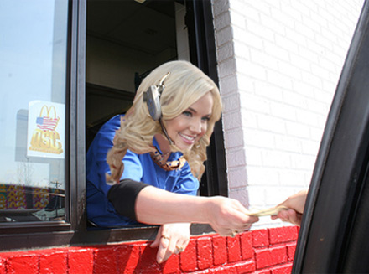
Give Up Some Cash

Slide 20
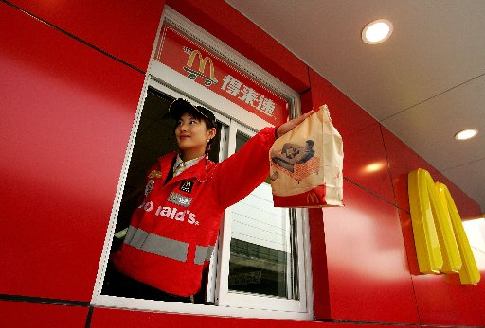
Delivered Fast

Slide 21

Not Lovin’ it!

Slide 22
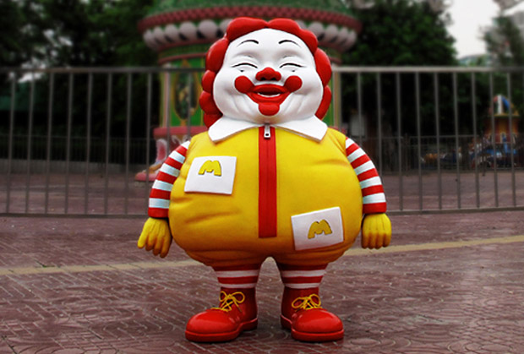
Clowns Lie

Slide 23
A Promise?
Mutual Conditions
of
Satisfaction

Slide 24
Ask Yourself
Why are you in this game?
Who are you?
-Your 118-
A Passion for Pheasants
What should you look like?

Slide 25
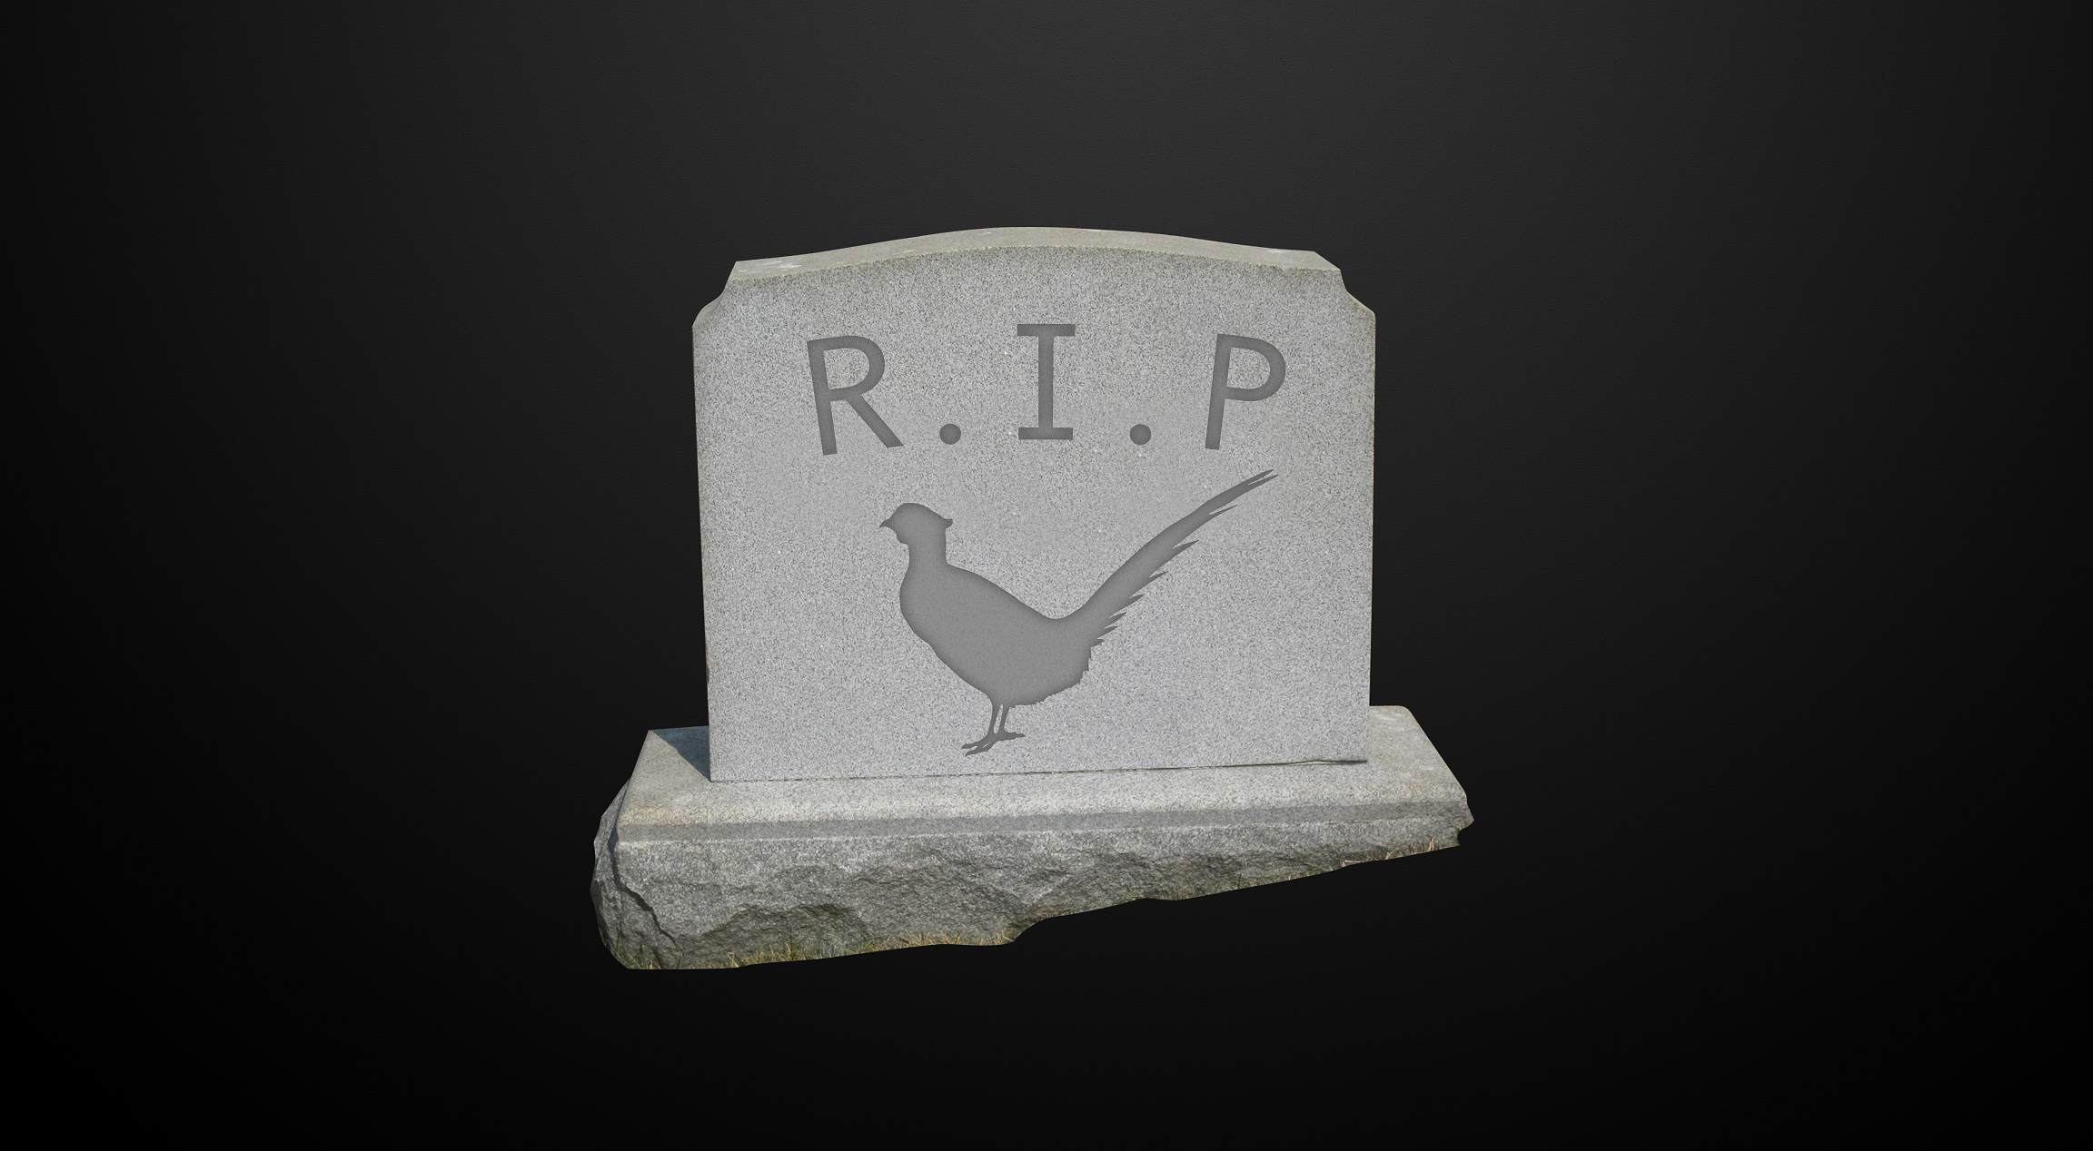
More than Passion

Slide 26
Ask Yourself
Why are you in this game?
Who are you?
-Your 118-
A Passion for Pheasants
What should you look like?

Slide 27
You & Your Brand
Horses. . . cows
and
promises delivered

Slide 28
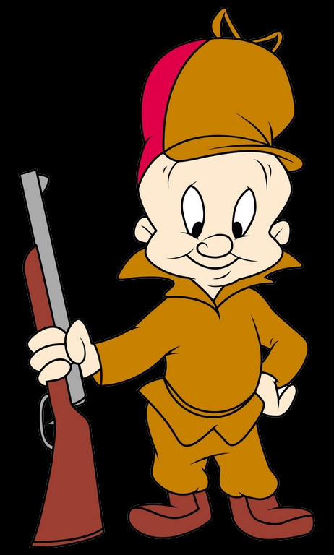

Do it Right
Stand for something
Online or offline
Principles only mean something
when they are
inconvenient

Slide 29
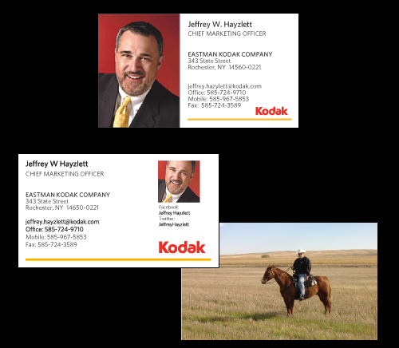
Cause Tension
Don’t settle
Create competition
Stir it up
Why?

Slide 30
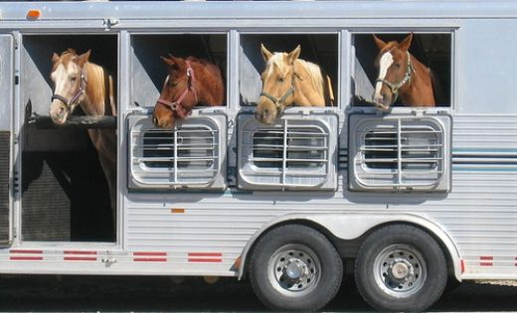
Rules to Remember
Mood
Rule of thirds
Change the questions
Make it better in the new place

Slide 31
In Good Company

Slide 32
In Good Company

