Slide 1

Course Title
How to Plan
Holiday Promotions
That Work
Panel Discussion
Moderated by Danny Rocks
The Company Rocks

Slide 2

Meet Our Panelists
Joy Jazz Armento

Slide 3

Meet Our Panelists
Mitch Brashers

Slide 4
Question #1
How do you define a successful Holiday Promotion?

Slide 5
Question #2
When do you start planning
for your Holiday Promotions?

Slide 6
Specific Holiday Promotions
Black Friday Promotion
Moms Rock
“Twelve Days of Christmas” Promotion
Cinco de Mayo

Slide 7
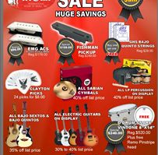
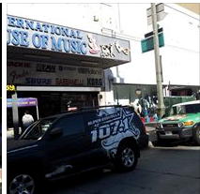
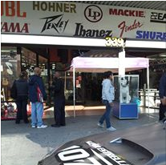
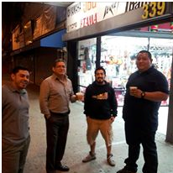
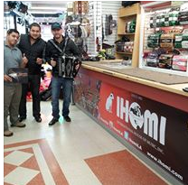
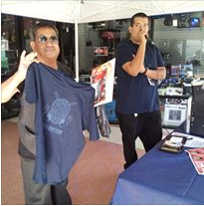
Black Friday Promotions

Slide 8

Moms Rock
http://www.springfield-music.com/new-at-springfield-music/press/springfield-music-celebrates-mothers-day-with-instrument-fitting-and-free-flower/

Slide 9
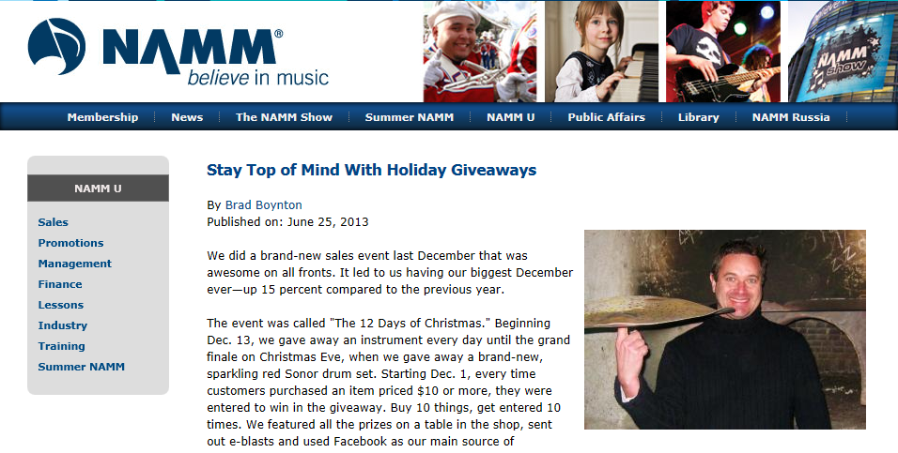
The 12 Days of Christmas
http://www.namm.org/nammu/promotions/stay-top-mind-holiday-giveaways

Slide 10

The 12 Days of Christmas

Slide 11
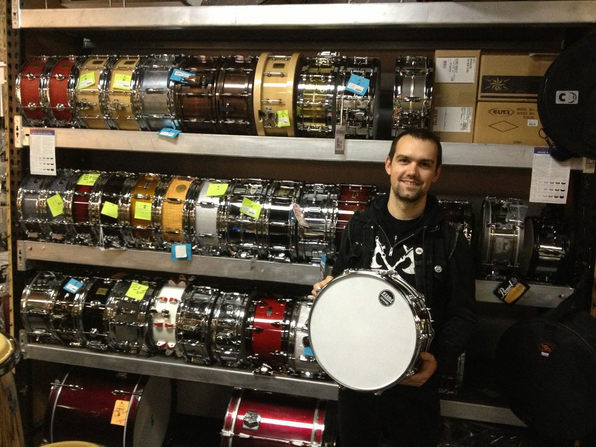
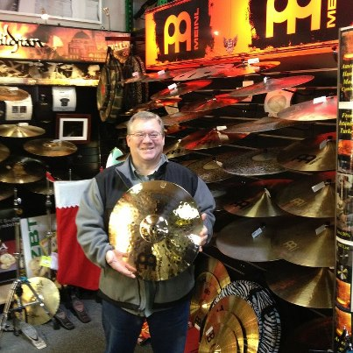
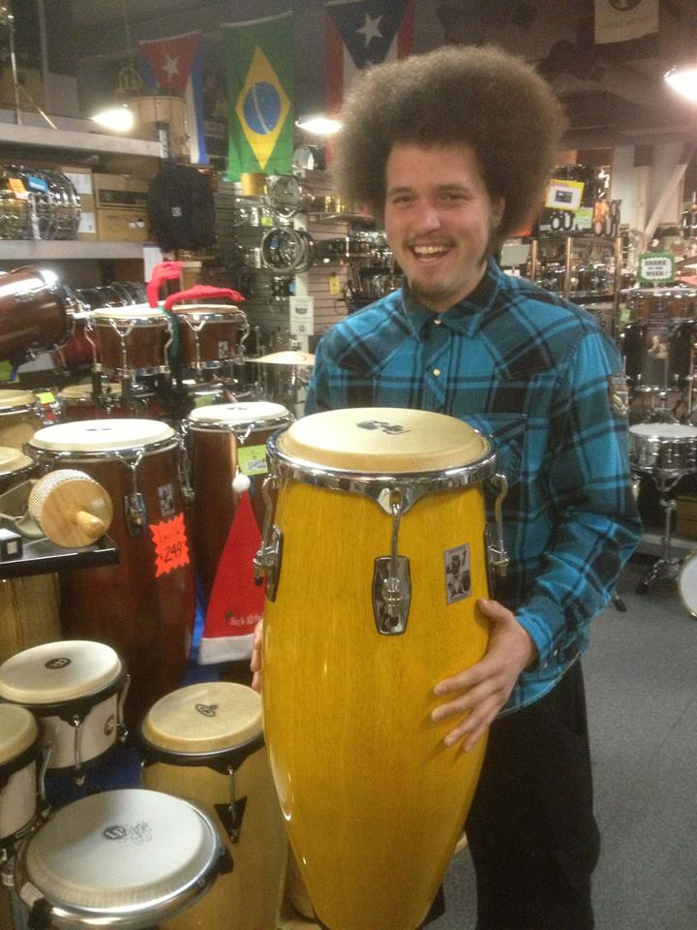
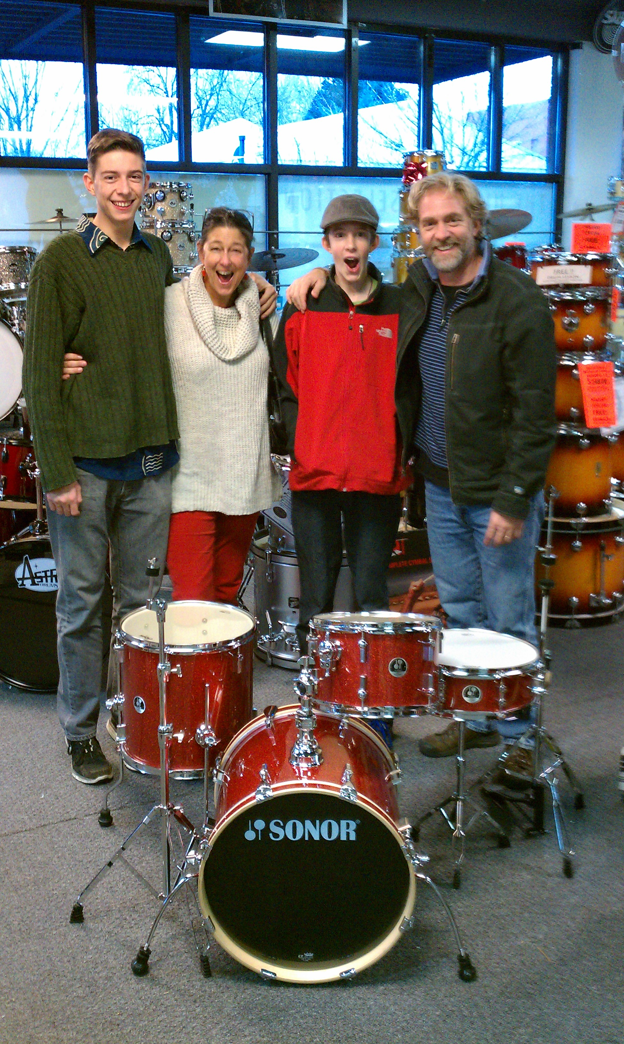
And the Winners are …

Slide 12
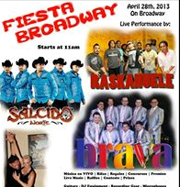
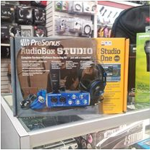
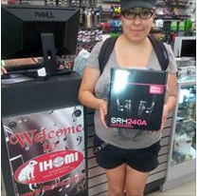
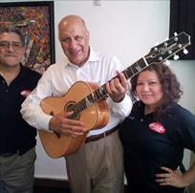
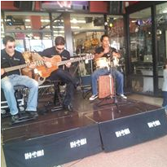
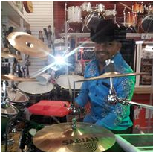
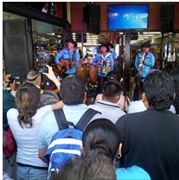
Cinco de Mayo

Slide 13
Final Thoughts
What is the one “Take-away” point you want to share with our audience?

Slide 14
Thank You Panelists!

