Slide 1



Course Title
“Inventory: How to Manage Your Biggest Investment”
presented by
Alan M. Friedman, CPA
Friedman, Kannenberg & Company, P.C.

Slide 2
Objectives
Demonstrate how to make a “sound investment” in inventory
Remove the “gut approach” and instead use an objective reporting tool to manage your inventory
Q&A along the way

Slide 3
4 Buying Factors
Can I sell this product ?
Will I make a profit ?
How quick can I sell it ?
How fast will I have to pay my vendor for it ?

Slide 4

Solution
Alan’s
Rule of Thumb
for buying inventory

Slide 5
Alan’s Rule of Thumb?
“ Buy the product ONLY If you know you can sell it in “X” days or less, where “X” is equal to 360 days times your gross profit percent. ”

Slide 6
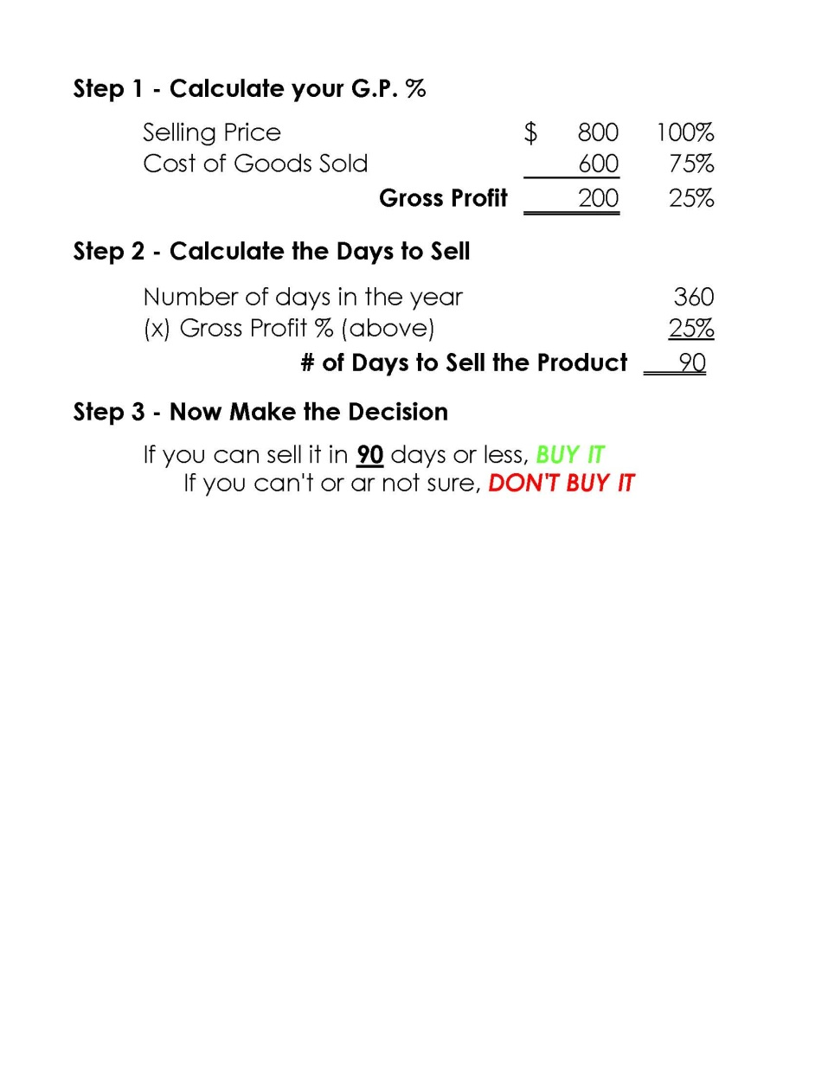
Alan’s Rule of Thumb?

Slide 7

Managing Inventory
Gross Profit
Inventory Turns
Gross Margin Return on Investment (GMROI)

Slide 8
Gross Profit
Sales $ 1,000,000 100%
Cost goods sold ( 600,000) 60%
--------------- -------
Gross Profit $ 400,000 40%
========= ====

Slide 9
Inventory Turns
Cost of goods sold ($ 600,000)
------------------------
Avg Inventory cost
on hand ($ 300,000)
  = Inventory turned “2 Times”
…or, it took you 6 months to turn over your entire inventory (in $$$)

Slide 10
GMROI
Gross Profit ($ 400,000)
--------------------
Avg Inventory cost
on hand ($ 300,000)
= GMROI of $1.33
…or, your earned $1.33 for every $1.00 you invested in inventory

Slide 11
GMROI Goal
Most retailing experts (across industries) suggest a GMROI target of
$1.50 or better

Slide 12
The Secret Weapon: a “1-Page Solution” to Managing Your Inventory

Slide 13
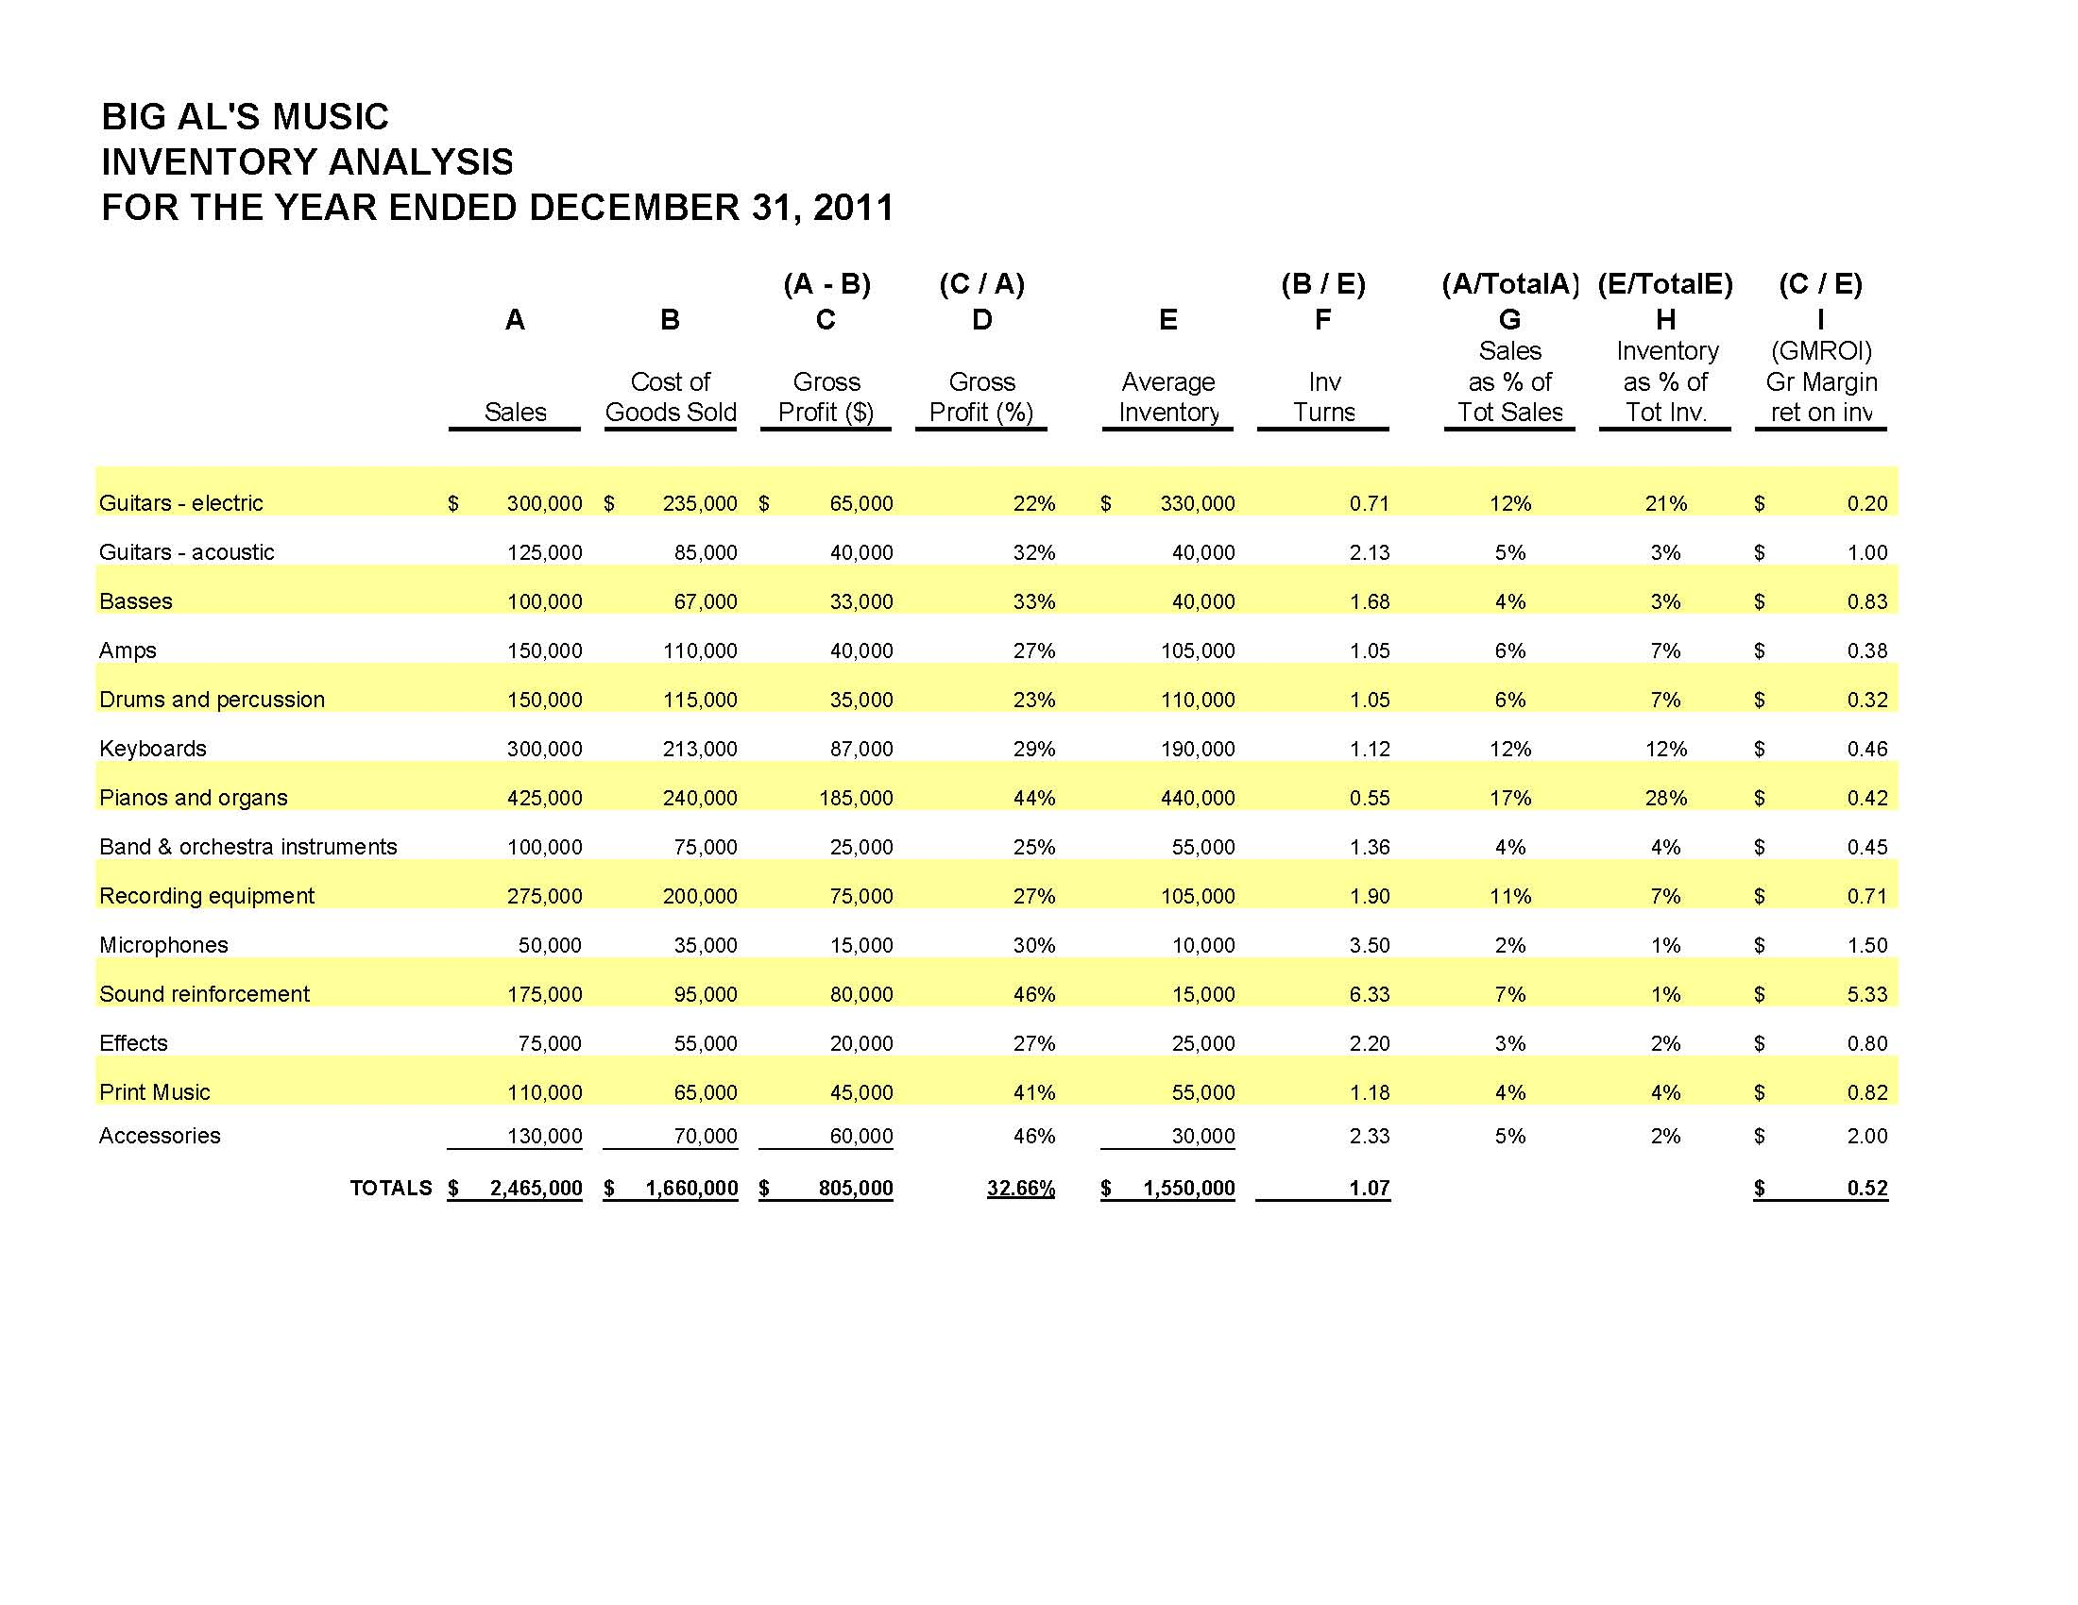
GMROI Goal

Slide 14

Need more help?
Contact Jen Lowe after this seminar
to set up a meeting time

Slide 15

Thanks RPMDA! Any questions?
Any Questions?

