Slide 1


Course Title

Slide 2
Website Usability Testing
Is Your Website Leaving Money on the Table?
How to Find & Fix Problems with Your Website
Michael Newman
Michael Newman Consulting
www.michaelnewmanconsulting.com
Stan Werbin
Elderly Instruments
http://www.elderly.com
Notes:
Introduce Stan and background on Elderly Music and give my background info

Slide 3
Website Usability Testing
This session will cover…
  Why you need to test your website
  Why testing works
  How you can do your own testing with several hours of planning and an investment of several hundred dollars

Slide 4

Website Usability Testing
Where Am I?
What do I do?
Notes:
How many times have you felt like this while using a website? What if people experience this while using YOUR website? As a marketer your goal is to reduce this feeling in your site visitors so they can achieve your intended website goals.

Slide 5
Website Usability Testing
Why do websites have problems?
  We design sites for people to read them
  Instant access has made us impatient
  People don’t read, they scan¹
  80% of web users give you several seconds to get their attention
¹Jacob Nielson October 1997 “How Users Read on the Web”

Slide 6

Website Usability Testing
Usability testing provides a clear path for your website users

Slide 7
Website Usability Testing
What is usability test?
  Usability testing is described as watching people use the thing you are designing or interested in improving
  You simply observe and gather data
  This is NOT quantitative testing (focus group)

Slide 8
Website Usability Testing
Background on Usability Testing

Slide 9
Website Usability Testing
Testing up to the 90’s was expensive & laborious
Cognitive experts conducted the testing
Test groups ranged from 30 – 50 people
Few companies could afford this

Slide 10
Website Usability Testing
In the early 90’s Jacob Nielson (the “guru” of web testing) noticed the max cost to benefit ratio: 3 – 5 participants!
85% of problems uncovered this way
Novice to savvy web users encounter similar problems
Many other researchers showed similar results
Notes:
In the early 90’s Jacob Nielson and Tom Landauer who were both experts in usability testing were noticing that after testing with several subjects, the rest of the subjects would uncover the same issues as the first few.
They determined that the maximum cost to benefit ratio was achieved after testing with only 3 – 5 people. “The most striking truth of the curve is that zero users gives zero insights. As soon as you collect data from a single user, your insights shoot up and you have already learned almost a third of all there is to know about the usability of the design. The dfference between zero and a little bit of data is astounding.”

Slide 11
Website Usability Testing
The simple formula for website testing
  Test with representative customers
  Ask them to perform realistic tasks
  Shut up and let them do the talking
  Test frequently with a few users
²Interview with Jacob Neilson September 2009

Slide 12
Website Usability Testing
Sample video clip from Elderly Music testing
  The user could not find guitar pickups
  Links were visible in the middle of the page
  All 3 test participants experienced similar confusion
  Example of how a minor website change can have major impact

Slide 13
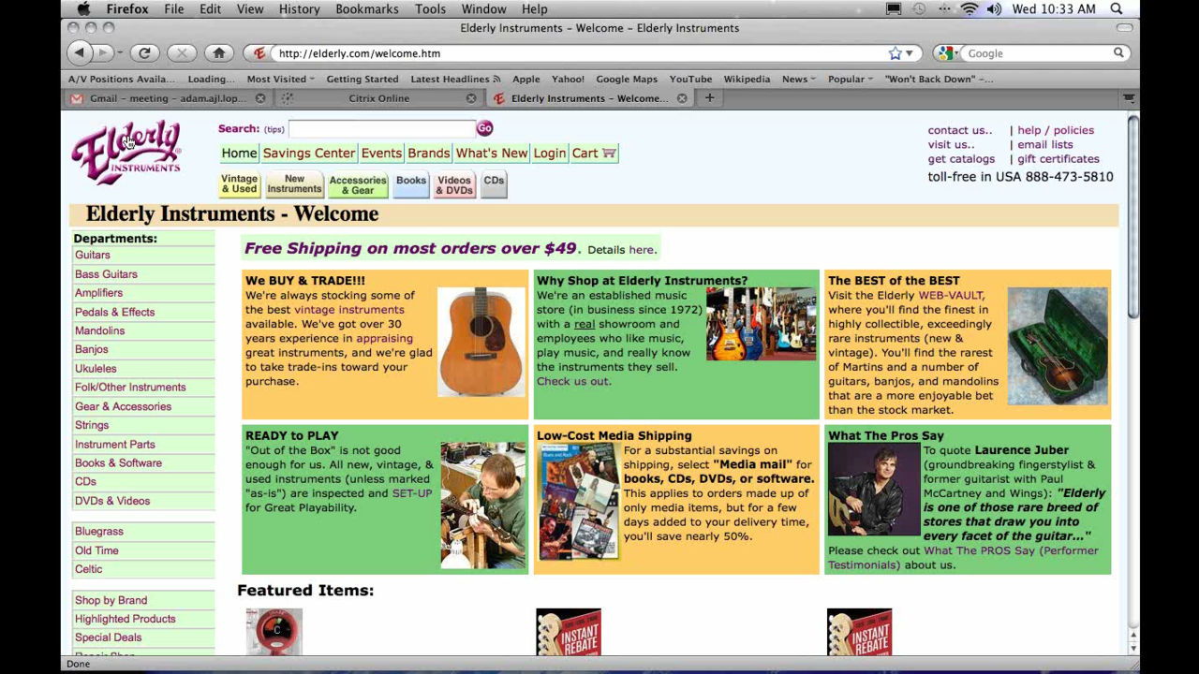
Website Usability Testing

Slide 14
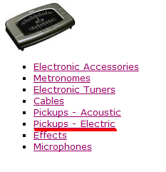
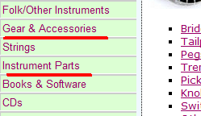
Website Usability Testing
Test subject could not find guitar pickups
  Re-categorize groups logically
  Put link under Instrument Parts Heading
Notes:
Categorize by similar items for more logical groupings.

Slide 15
Website Usability Testing
Preparation for Testing

Slide 16
Website Usability Testing
Document important goals people need to do on your site
  Reseller Examples
    Locate, research and purchase products
    Book a lesson appointment or research lessons
    Review your shipping policy
  Manufacturer Examples
    Communicate brand positioning & unique offerings
    Find a product then choose a dealer
    Sign up for company newsletter
Notes:
Document 5 – 10 most important tasks for your site. Amazingly many have never actually documented the goals for their website.

Slide 17
Website Usability Testing
Turn those goals into specific tasks for testing
Don’t over analyze your initial tasks – you can adjust in your next testing session
Pick tasks for 60 minute sessions or less
Notes:
The more interesting your scripts are the more motivated your subjects will be to complete the tasks.
You will want to dish out each scenario one at a time and allow them to review them as they work through them.

Slide 18
Website Usability Testing
Example Task for Dealer Site:
  “You have saved $1,000 and now you are ready to buy a Fender Telecaster. You haven’t made up your mind on the body color & other options so you want to do a little browsing first. Try to find all of the NEW Fender Telecasters on the site for $1,000 or less. Pick one and put it in the shopping cart.”
Notes:
The more interesting your scripts are the more motivated your subjects will be to complete the tasks.
You will want to dish out each scenario one at a time and allow them to review them as they work through them.

Slide 19
Website Usability Testing
Example brand positioning task:
  “The guitar player in your band is looking for some new guitar pickups. You come across this site and want to tell him about the company. Navigate this site, find the section that explains the company story and what makes the products special and explain what you found.”
Notes:
The more interesting your scripts are the more motivated your subjects will be to complete the tasks.
You will want to dish out each scenario one at a time and allow them to review them as they work through them.

Slide 20
Website Usability Testing
When do you test?
  Test anywhere in the site development cycle
  From napkin drawing to completed website
  Testing early saves time, money and resources
Test often with 3 subjects
  Ideally test every few months if you can
  Focus on different tasks for each test
Notes:
Recording your sessions allows you to focus on keeping your test on task instead of taking notes and allows you and others to review the tests later.
Camstudio is free. Camtasia allows editing and other features for $300.

Slide 21
Website Usability Testing
Create a computer setup in a quiet environment
Install desktop recording software
  You can focus on the user instead of taking notes
  Eliminates a “huddle” of viewers around test
  Stakeholders can review the sessions later
  Prices range from free to $300
  USB microphones $17 to $30
Notes:
Recording your sessions allows you to focus on keeping your test on task instead of taking notes and allows you and others to review the tests later.
Camstudio is free. Camtasia allows editing and other features for $300.

Slide 22
Website Usability Testing
Recruiting participants:
  Use people similar to your target market
  Create incentive (gift certificate or discount)
  Qualify them in a phone interview
    Can they stay focused for an hour session?
    Do they have good communication skills?
  Recruit from customers, friends, social sites, blog, Craig’s List
Notes:
The more interesting your scripts are the more motivated your subjects will be to complete the tasks.
You will want to dish out each scenario one at a time and allow them to review them as they work through them.

Slide 23
Website Usability Testing
Conducting your sessions
  Make them feel at ease: “you can’t do anything wrong”
  Encourage honesty and no “sugar coating”
  Explain they will be using a website and you will attempt to answer their questions after the test
  Encourage them to continuously verbalize what they are thinking (remind when needed)

Slide 24
Website Usability Testing
Remote Testing Advantages
  Eliminates local computer setup
  GoTo Meeting can record ($50 per month)
    Also provides instant chat to send site links and tasks
  Can use Skype + screen recording software
  Thoroughly test your set up in a trial run!

Slide 25
Website Usability Testing
Summary
  Create real world tasks from site goals
  Recruit from target market(s)
  Use 3 subjects per test period
  Test early and often
  Encourage out loud thinking from test subjects
  Don’t over analyze – just start doing it!

Slide 26
Website Usability Testing
  Thank you!
  Questions?

