Slide 1

Notes:
1

Slide 2

James Hill
Ukulele Virtuoso

Slide 3
Scott Robertson
APR, Director of Marketing & Communications, NAMM

Slide 4
The Panel:
Gayle Beacock …
Greg Billings …
Brad Boynton …
Alan Friedman …
John Grabowski …
Brian Reardon …
Gordy Wilcher …
Beacock Music
Steinway Piano Gallery
Rhythm Traders
Friedman Kannenberg & Co
Sweetwater Sound
Monster Music
Owensboro Music
Moderated by Frank Alkyer, Music Inc.

Slide 5
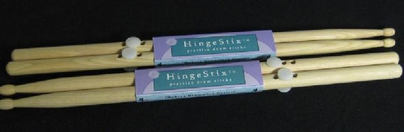
Round 1: Something Small
Hinge Stixs - Big Bang Distributors
Booth # 3564

Slide 6

Round 1: Something Small
The iKlip - IK Multimedia - distributed by Hal Leonard
Booth # 4318

Slide 7
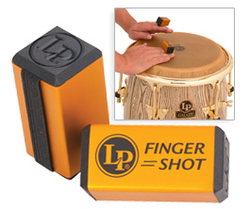
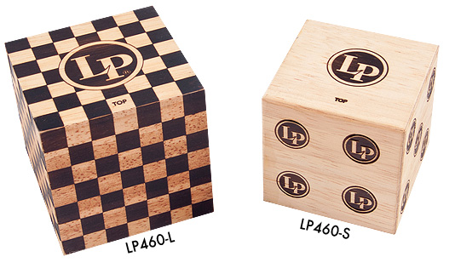
Round 1: Something Small
LP Finger Shot and the Qube
Booth # 5720

Slide 8
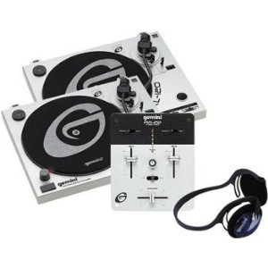
Round 1: Something Small
Gemini – Little Mini DJ Mixer – First Mix
Booth # 5700

Slide 9
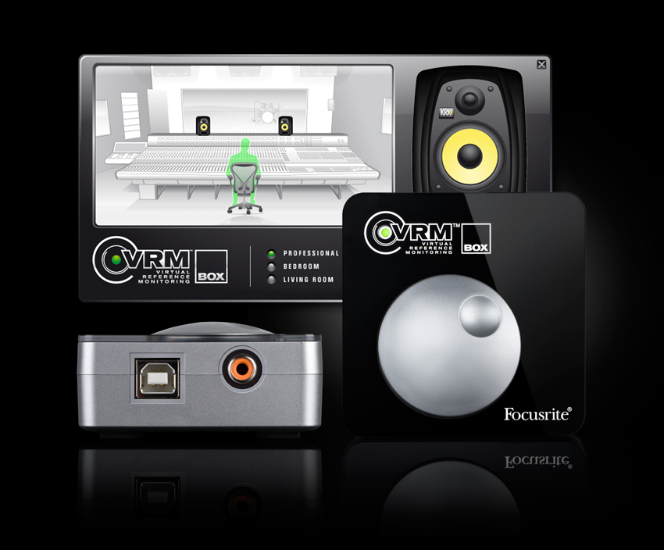
Round 1: Something Small
Focusrite VRM Box
Booth # 6464

Slide 10
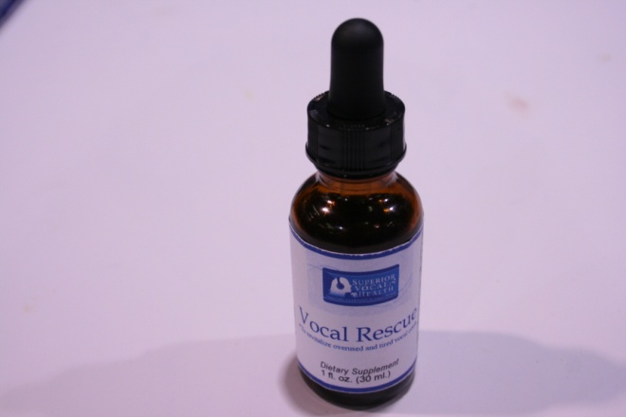
Round 1: Something Small
Superior Vocal Health
Booth # 2593

Slide 11
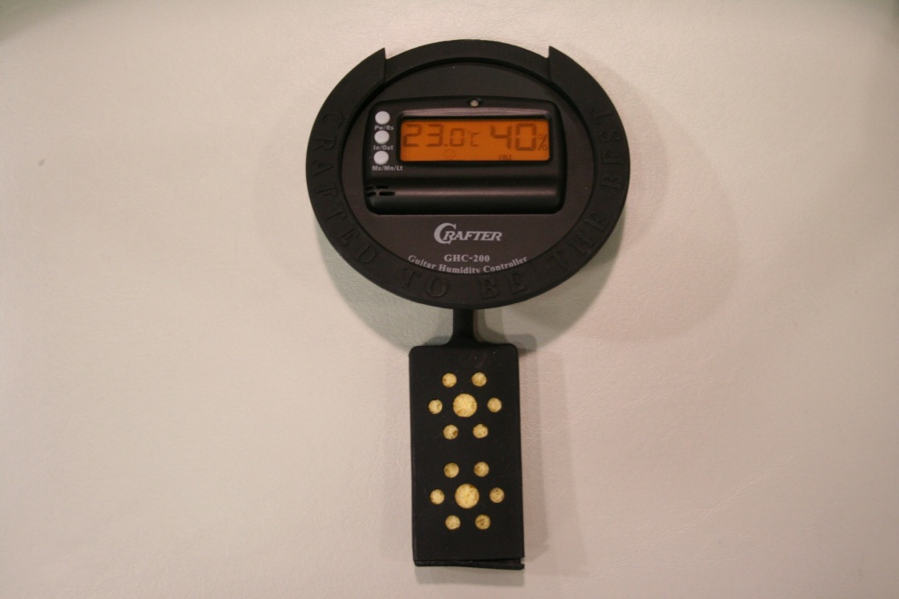
Round 1: Something Small
Crafter GHC-200 Guitar Humidifier Controller
Booth # 1324

Slide 13

Round 2: Gotta Stock It
What Music Means To Me - Book & CD by Richard Rehino
Hal Leonard
Booth # 4618

Slide 14

Round 2: Gotta Stock It
Rollicking Piano Bar - Hal Leonard
Booth # 4618

Slide 15
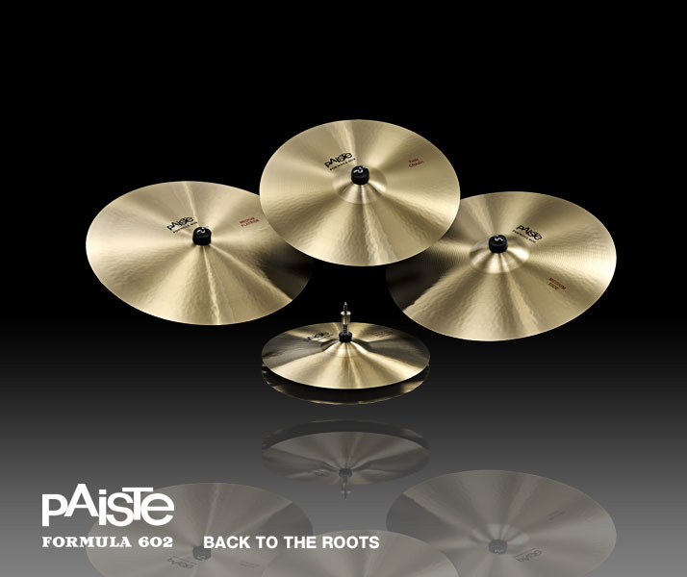
Round 2: Gotta Stock It
Paiste Formula 602
Booth # 3720

Slide 16

Round 2: Gotta Stock It
Led Zeppelin Complete Lyric & Chord Songbook
Alfred Publishing
Booth # 4822

Slide 17
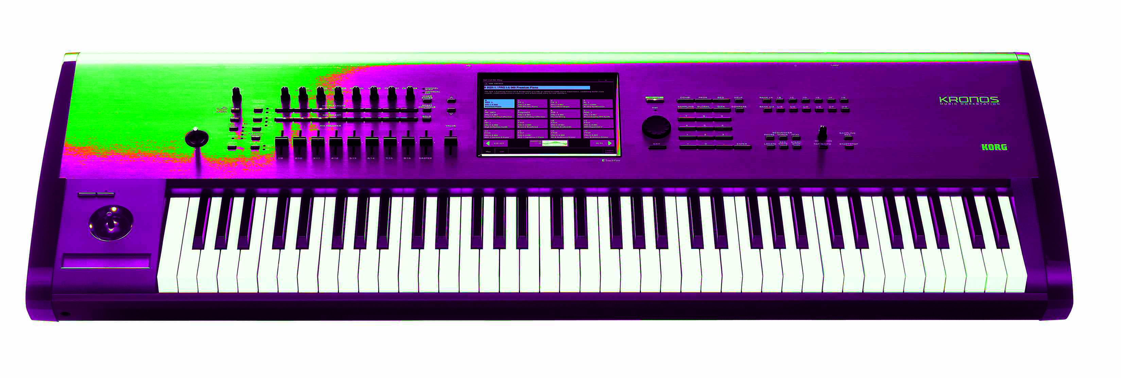
Round 2: Gotta Stock It
Korg Kronos
Booth # 6440

Slide 18
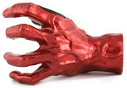
Round 2: Gotta Stock It
Grip Studios
Booth # 3082

Slide 19
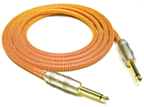
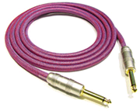
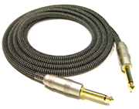
Round 2: Gotta Stock It
Kirlin Industries - Kirlin Cable
Booth # 1770

Slide 21
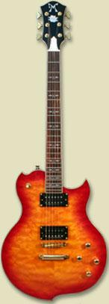

Round 3: Companies to Watch
Minarik Guitars
Booth # 1022

Slide 22
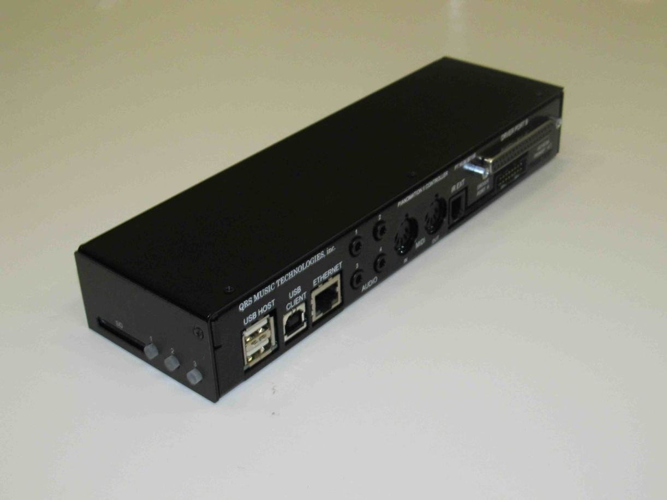

Round 3: Companies to Watch
QRS – PNOmation II
Booth # 2088

Slide 23
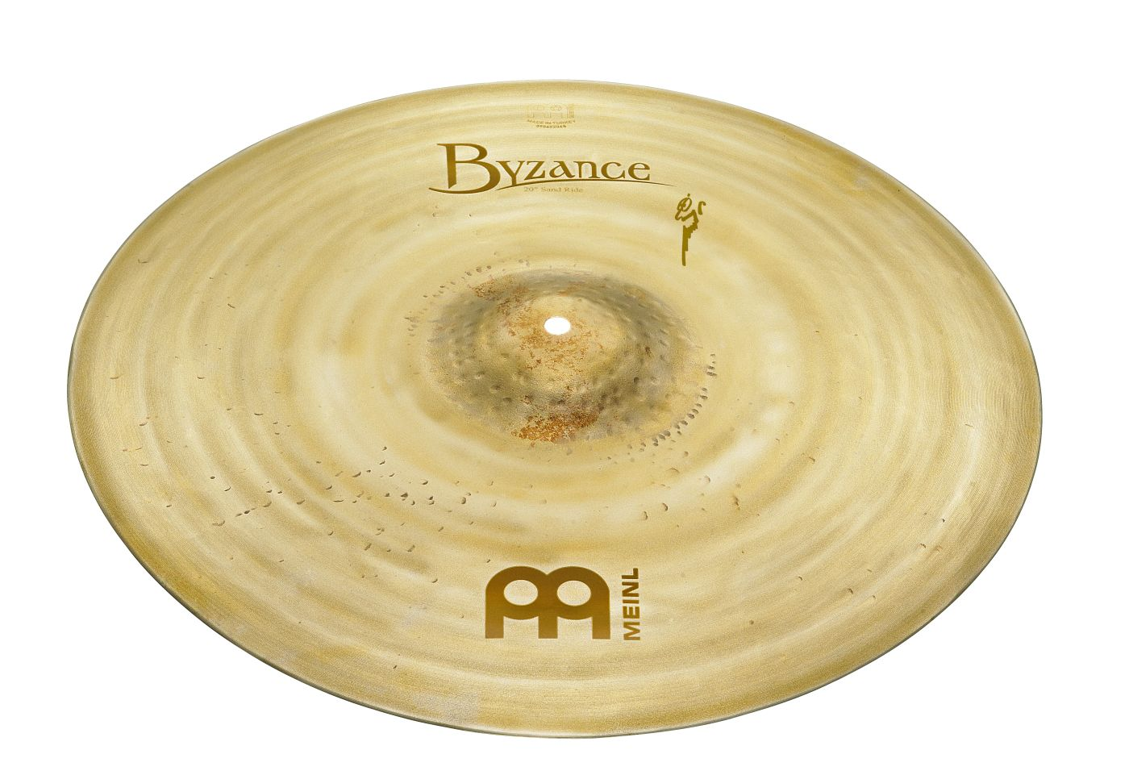
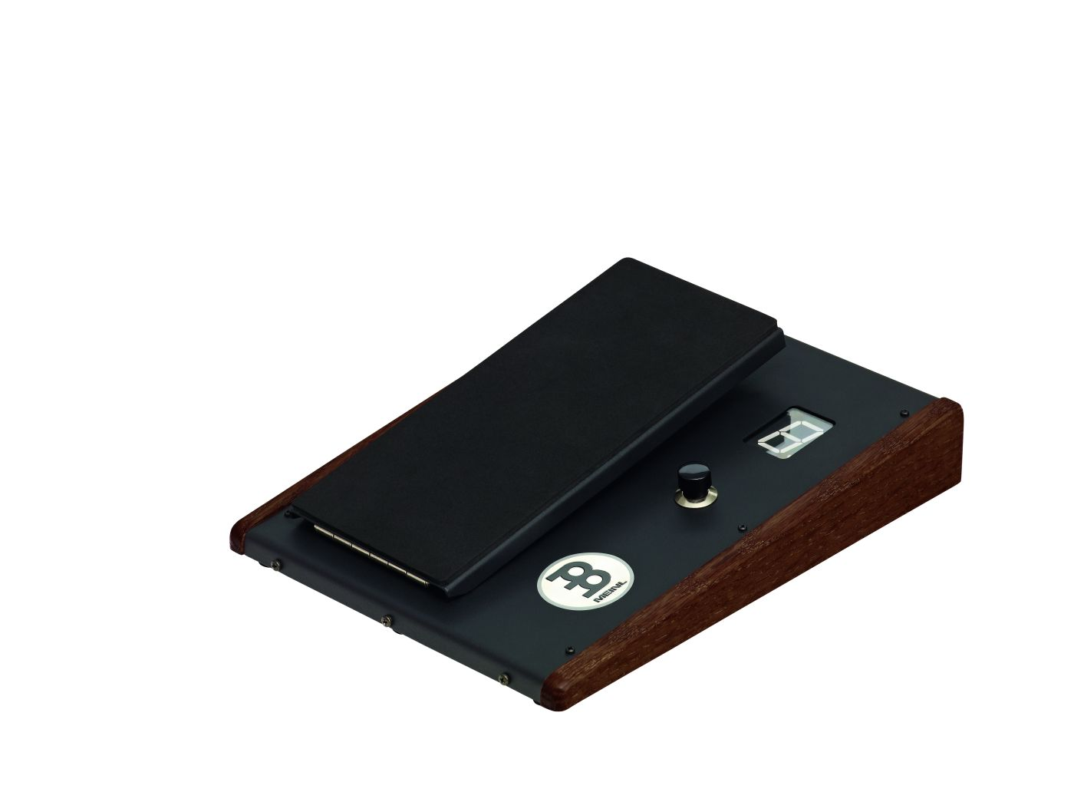

Round 3: Companies to Watch
Meinl
Booth # 3454

Slide 24
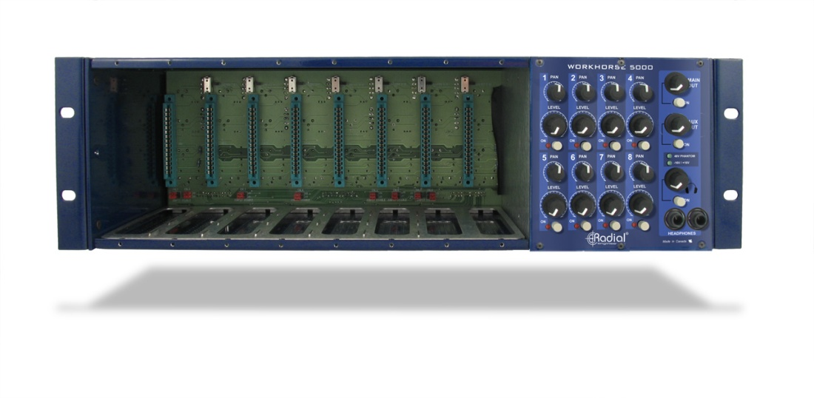
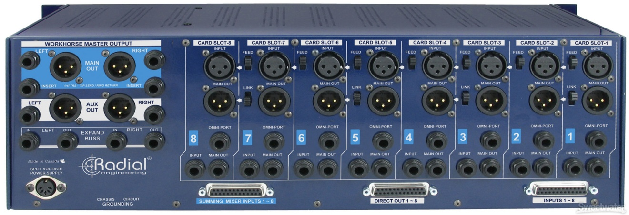
Round 3: Companies to Watch
Radial Engineering – Workhorse 500 Studio Rack
Booth # 6959

Slide 25
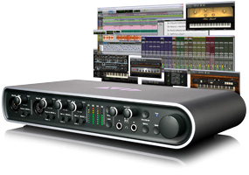

Round 3: Companies to Watch
Avid
Booth # 6700

Slide 26

Round 3: Companies to Watch
Tycoon Percussion
Booth # 3570

Slide 27

Round 3: Companies to Watch
Two Old Hippies
Booth # 4840

Slide 29
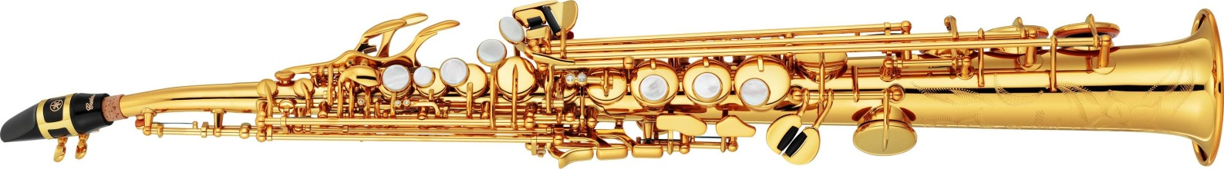
Round 4: Best in Show
Yamaha – YSS-82Z Soprano Sax
Booth # 6528

Slide 30
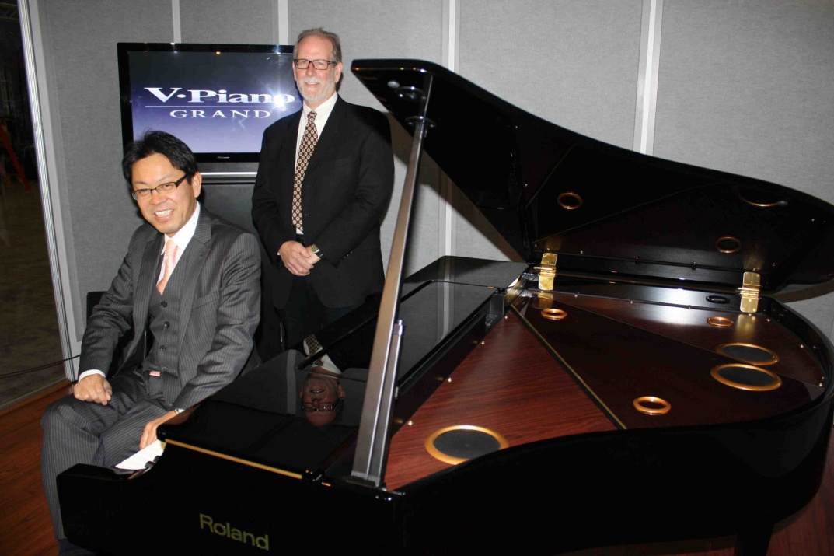
Round 4: Best in Show
Roland V-Piano Grand
Booth # 7400

Slide 31
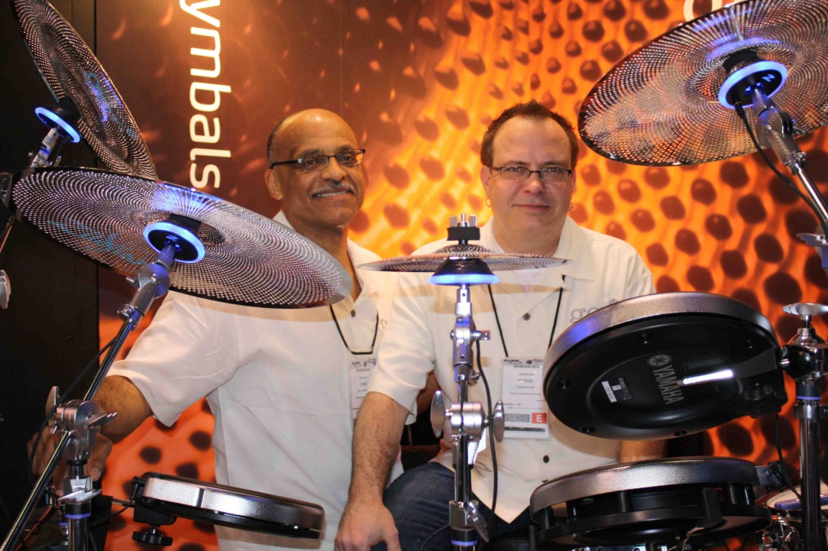
Round 4: Best in Show
Zildjian - Gen 16
Booth # 3050

Slide 32

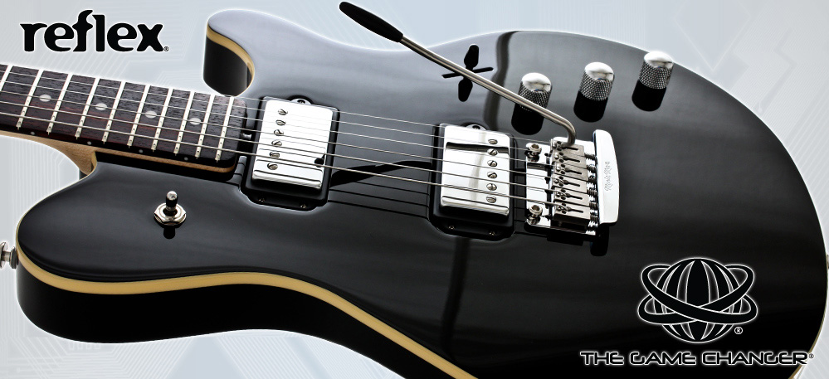
Round 4: Best in Show
Ernie Ball - Game Changer
Booth # 5440

Slide 33

Round 4: Best in Show
David Smith Instruments/Roger Linn Designs - Tempest
Booth # 5900

Slide 34
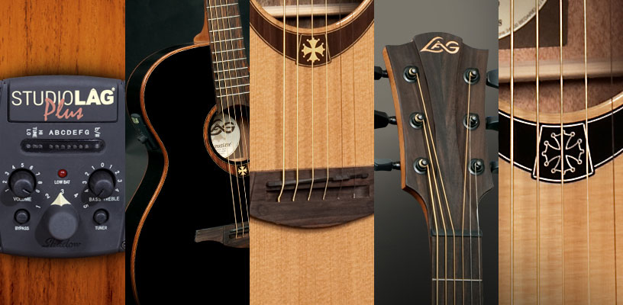
Round 4: Best in Show
Lâg Guitars
Booth # 6440

Slide 35

Round 4: Best in Show
NAMM U – Idea Center
Booth # 5501

