Slide 1


Slide 2

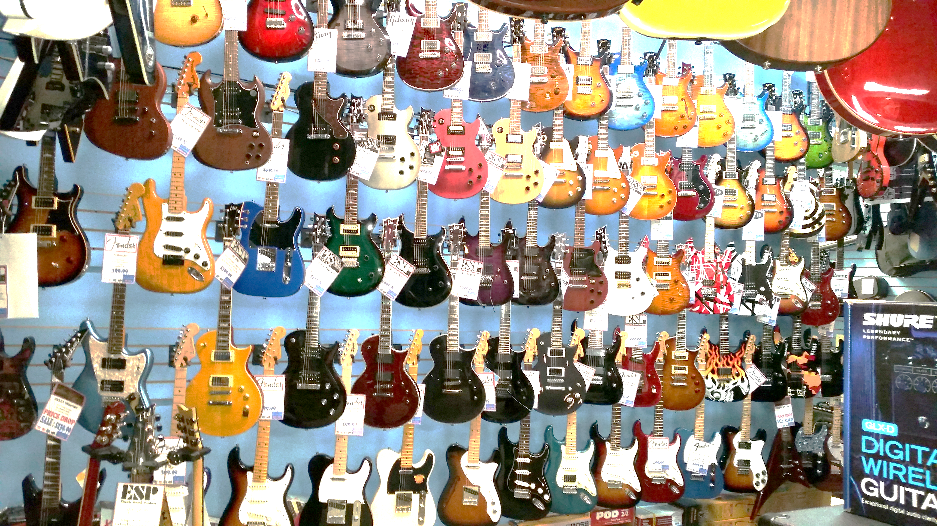
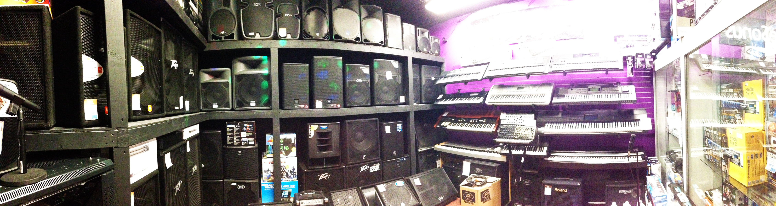
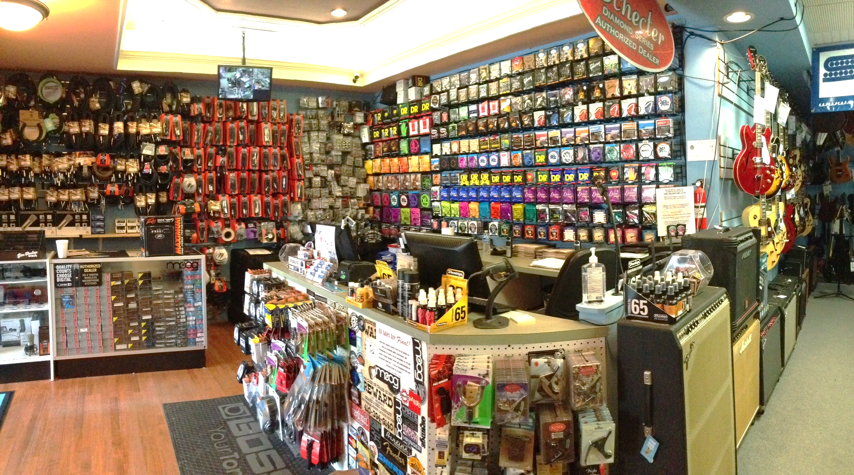
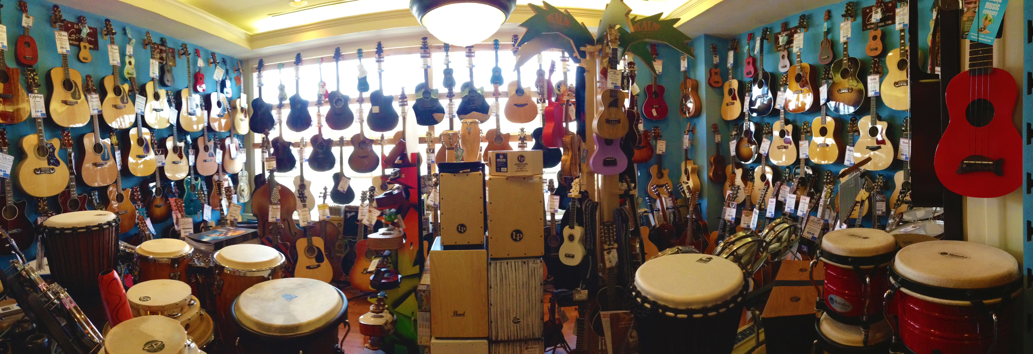
Keith Grasso
Island Music Company
La Plata, Maryland

Slide 3

How to Take Advantage of Reverb.com

Slide 4

How to Take Advantage of Reverb.com
Increase online presence with local customers: Local customers in the surrounding area search for good deals, and once they find them, they’re likely to return to where they bought from.
One man’s trash is another man’s treasure (sell your stock that hangs around): Older gear can sell better online than behind the walls of your store.

Slide 5
How to Take Advantage of Reverb.com (cont.)
Increase your visibility in the global market: With technology being so readily available, who wouldn’t want their store to gain extra attention?
Turn products that you couldn’t sell in your local market: That bass you’ve been trying to sell in Montana could soar off the shelves in London! Don’t think that what you have won’t ever sell.

Slide 6
6 Ways to Profit From Reverb.com
-Best Offers: Start a conversation! Reverb gives the customer the opportunity to make offers (just like on the sales floor). This a great way to begin a dialogue and build relationships.
-Add on Accessories: If a customer on Reverb buys a guitar, offer a case, strings or cables to go with it. If you’re shipping them a new guitar across the country, they’ll want the added protection that comes with a case.

Slide 7
6 Ways to Profit From Reverb.com (cont.)
-Shipping Profit: Shipping costs vary around the world. Make up the difference when you ship! Shipping should be thought of as a profit center for your business.
-Maintaining a business relationship: Add business cards to your boxes when you ship them, and keep a log of e-mail addresses for future business.

Slide 8
6 Ways to Profit From Reverb.com (cont.)
-Bundling Accessories: If any guitar or expensive product we sell on Reverb is over a certain price, we do an accessory pack with it. That includes a polish cloth, assorted picks, a strap, and either strings or a capo.
-Price Drop: Reverb offers a “Price Drop” feature. This lets you mark down your older listings every so often and boost their visibility to the Reverb Community. They are then put on the “Deals and Steals” page along with all other on-sale items from every storefront.

Slide 9
Reverb.com Do’s & Don'ts!
-DO compare online listings with store stock: Make sure to cross check what you have in your store with what is listed online every day.
-DO make sure to include accurate specifications: Accurate serial numbers, nut width, model, with/without a case — all of these are extremely important. Since it’s an online storefront, picture quality and proper descriptions are a must to reel the customer in.

Slide 10
Reverb.com Do’s & Don'ts! (cont.)
-DO have one person in charge of Reverb: “Too many cooks can ruin a stew.” If there is more than one person handling the website, customers could get confused and orders can get caught up in the mix.
-DON’T ship products without testing them: Gear needs to arrive to the customer in the condition it was listed in. Testing products before you pack them is one way to make this happen.

Slide 11
Reverb.com Do’s & Don’t’s (cont.)
-DON’T take your shipping companies for granted: Be sure to pack items as securely as possible! Purchase insurance for the full value when making your shipping labels, and always check your packaging before it goes out your door.
-DON’T leave room for interpretation: All serial numbers should match your pictures, and all descriptions should be identical to the product you’re selling.

Slide 12
Thank you!

