Slide 1


Slide 2
5 Proven Tactics for Indie Retail Growth
Amy Ball Braswell
Director of Business Operations/Co-owner
Capo’s Music Store
Abingdon, VA

Slide 3

General Overview
Capo’s Music Store
Founded in Dec. 2009
Specializing in Bluegrass & Old Time Music (All Acoustic)
Located in a town of 8,200
Full-line music store in same town, multiple other full-line stores in surrounding localities
Named NAMM Top 100
  2013 & 2014

Slide 4
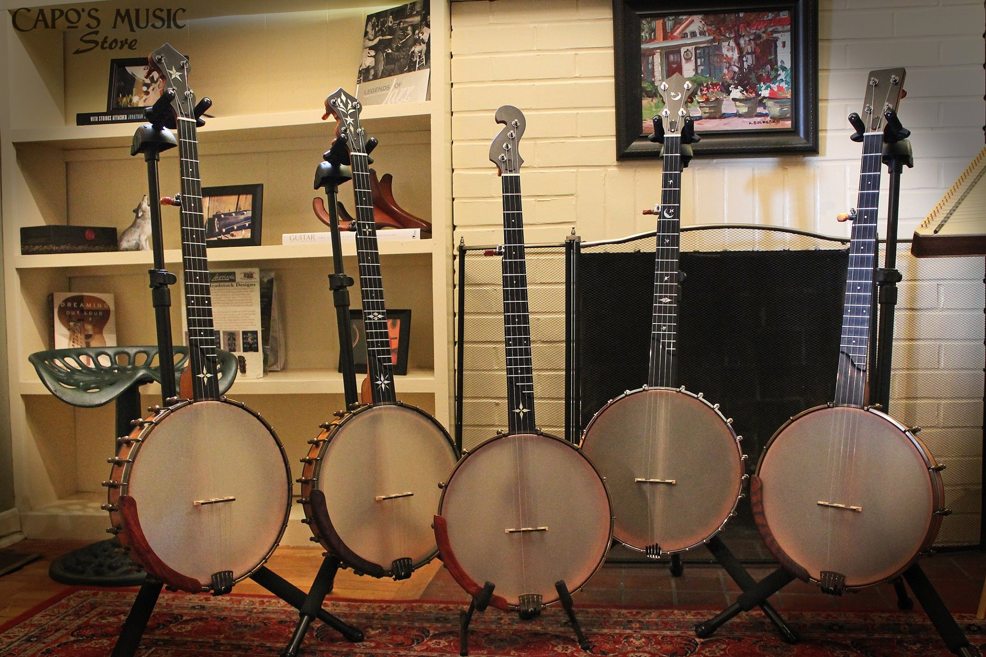
Know Your Niche
Finding our niche!
  Every store should have a specialty
  How niche do you wanna get?
  Are there riches in niches?

Slide 5
Why it was important to know our niche:
  Knowing your niche helps you develop your identity.
  Plan your strategic plan and marketing around your identity. All this is framed within our store identity.
  Select products and services you offer that only fit you niche.
  Identify your ideal customers, not individual people, but types, and look at ways to market to them.
  Design your store inside and out around your identity.

Slide 6

Know Your Numbers!
  If you are not a numbers person, hire someone who is and have a good POS and accounting system. They may be expensive on the front end but they pay for themselves in the long run.
  Beware of perceived success! It is easy to think things are going well, but then you don’t have money for new orders or you start falling behind with vendors.
  Just because you have a little cash in the bank today doesn’t mean you are successful, and just because you have fallen behind doesn’t make you a failure.

Slide 7
Know Your Numbers!
  Learn how to read financial statements and essential reports.
  Listen to the experts and your peers who have lived and learned.
  Manage your overhead dollars! Don’t throw money away on lots of things that won’t put dollars back in the bank.

Slide 8






Marketing
  Marketing and public relations can be expensive, and many new stores will put that last on the list of where to spend money — DON’T.
  Don’t just strive to get customers; get the ones you want. Market to your ideal customer and spend your dollars there.
  Be Social — Go beyond Facebook to the other social media outlets that fit your customer base.

Slide 9
Marketing
  If you have no clue about social media or marketing, hire someone who does. This position should receive the same amount of attention as your sales force.
  Develop a Marketing and Promotions plan for the year, and review it each quarter to see if it needs to be adjusted.
  Look at best practices and what other stores are doing, but tailor those things to fit your business. Don’t just carbon copy other stores’ promotions and sales.
  Learn to say no to advertisers that don’t get your store.
  If a marketing outlet isn’t working, cut your losses and move on to something else. There is very little loyalty in the marketing world. Don’t be afraid to let go.

Slide 10

Never Stop Learning
  To succeed in business, to reach the top, an individual must know all it is possible to know about that business. – J. Paul Getty

Slide 11
Never Stop Learning
  None of us come into this as experts in all areas of the business.
  Identify your weaknesses and find ways to educate yourself.
  Attend NAMM U sessions like this, Retail Boot Camps, chamber classes and more.
  No matter how much you think you might know about something, there might be something you have never thought of or considered trying that could make a big impact.
  Music store owners, especially those I have met through NAMM or IMSO and other organizations, can be on of your best resources for information, and it amazes me how giving this industry is.

Slide 12

Be Willing to Make the Tough Choices
  Hire the right people.
  Fire the wrong people. Be willing to let the wrong people go. Look at ROI for employees like products.
  Don’t fall in love with your products. Use the numbers to tell the winners from the losers, not just your personal opinion.
  Listen to your customers, even when they are wrong.
  Pay attention to cash flow, not just gross margin.
  Understand that reps are not your friend but can be a valuable ally.
  Don’t be so nice. You may be giving money away.
  Learn GOMO: get over it and move on.

Slide 13
Top Takeaways:
1) Be willing to make the tough decisions.
2) Know your niche or what makes your store unique, and use that in all areas of your business: marketing, merchandising, sales, personnel decisions, location and inventory.
3) Reports can be your best friend. Don't just think you know what is going on — work with your numbers.
4) Manage your marketing as closely as you manage your sales. Know your target audience and how to go after them, thus managing your marketing dollars more effectively.
5) Educate yourself. Attend NAMM Idea Center sessions. Use NAMM U Online and all other free educational opportunities from your local Chamber to the Retail Boot Camps.

Slide 14
Parting Thoughts
  Let’s be honest. There’s not a business anywhere that is without problems. Business is complicated and imperfect. Every business everywhere is staffed with imperfect human beings and exists by providing a product or service to other imperfect human beings.
  – Bob Parsons
  Contact Information:
  Amy Ball Braswell and Gill Braswell
  Capo’s Music Store
  caposmusicstore@gmail.com
  www.caposmusicstore.com
  276-525-1880

