Slide 1
Modernize Your Lesson Program Today
Working Together to Build Our Musical Future

Slide 2

Overcoming Inertia

Slide 3
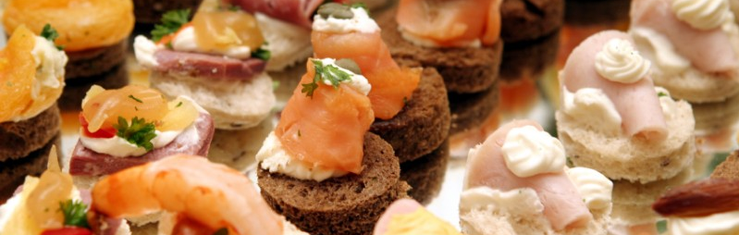
Appetizers

Slide 4
Interest in Music Lessons
Recent Gallup Poll said that 49% of Americans say they have tried music lessons at some point in their lives.

Slide 5
Interest in Music Lessons
Recent Gallop Poll said that 49% of Americans say they have tried music lessons at some point in their lives.
A recent NAMM Poll found that only 7% of Americans today consider themselves to be “Active Music Makers.”

Slide 6
Interest in Music Lessons
Recent Gallop Poll said that 49% of Americans say they have tried music lessons at some point in their lives.
A recent NAMM Poll found that only 7% of Americans today consider themselves to be “Active Music Makers.”
We have massive growth potential.

Slide 7

Families – Our Primary Clients

Slide 8

“Mom and Dad”

Slide 9
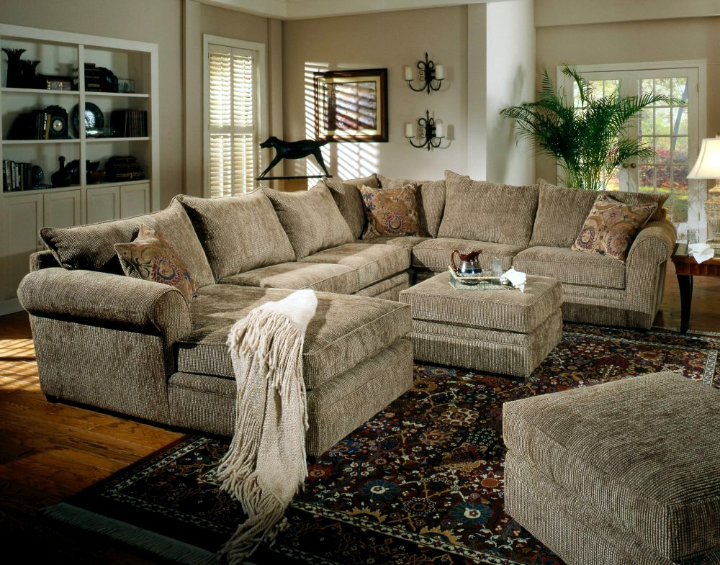
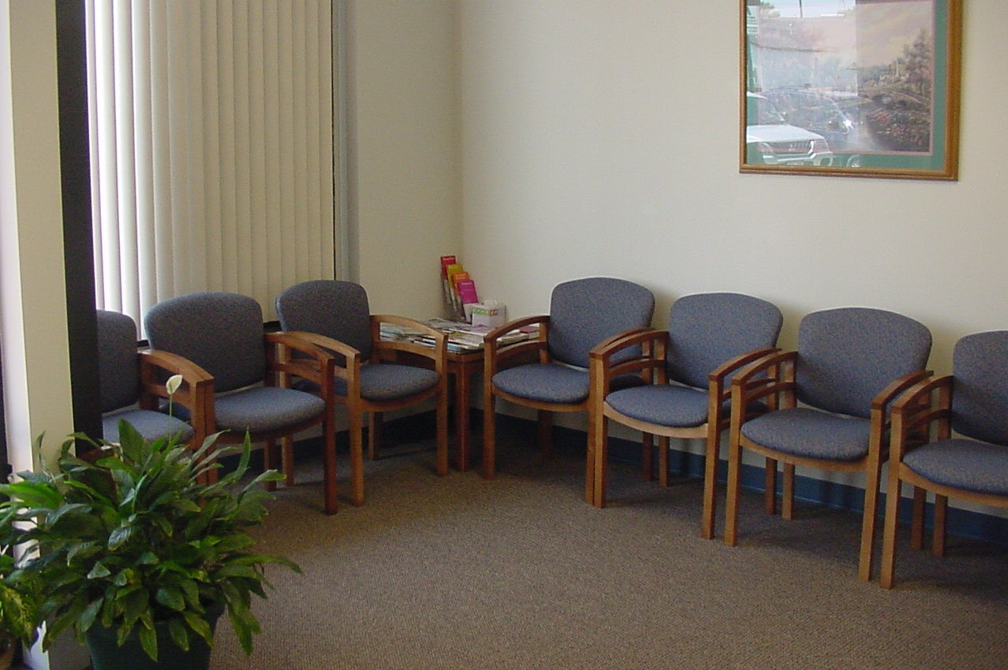
Creating Comfort
“Comfy Living Room”
“Hospital Waiting Room”

Slide 10

Creating Comfort
Wireless Internet
(FREE WIFI)

Slide 11

Creating Comfort
A fun, friendly
Atmosphere.

Slide 12

The Main Course

Slide 13

Reducing My Expenses

Slide 14
Reducing My Expenses
I stopped offering lessons.

Slide 15
Reducing My Expenses
I stopped offering lessons.
I started offering studio memberships.

Slide 16
Reducing My Expenses
I stopped offering lessons.
I started offering studio memberships.
Just like a gym membership – our studio members get all the benefits for one monthly fee. No credits or refunds. The focus is on consistent value and a musical lifestyle.

Slide 17
Reducing My Expenses
I built a solid studio policy for students and another one for my teachers.

Slide 18
Reducing My Expenses
I built a solid studio policy for students and another one for my teachers.
I asked them to sign a copy of our policy for my records, and I gave them one to take home. We now update this annually.

Slide 19
Reducing My Expenses
I built a solid studio policy for students and another one for my teachers.
I asked them to sign a copy of our policy for my records and I gave them one to take home. We now update this annually.
I don’t deviate from my policies.

Slide 20
Reducing My Expenses
I decided to hire my teachers. Independent contractors are less reliable and have less emotional investment in my studio’s success.

Slide 21
Reducing My Expenses
I decided to hire my teachers. Independent contractors are less reliable and have less emotional investment in my studio’s success.
I made every teacher a recruiter for my business. I even provide them with growth incentives.

Slide 22
Reducing My Expenses
I decided to hire my teachers. Independent contractors are less reliable and have less emotional investment in my studio’s success.
I made every teacher a recruiter for my business. I even provide them with growth incentives.
I now conduct regular meetings with my teachers, so they will feel more involved.

Slide 23

Streamlining My Operations

Slide 24
Streamlining My Operations
I now require all of my students to sign up for monthly recurring billing. They can choose to link a credit card, debit card or checking account.

Slide 25
Streamlining My Operations
I now require all of my students to sign up for monthly recurring billing. They can choose to link a credit card, debit card or checking account.
Recurring billing prevents “forgotten” payments, reduces bad debt and dramatically reduces time spent collecting studio payments.

Slide 26
Streamlining My Operations
Use a payroll company.
  Less time spent working on payroll (especially at year-end with W2s, etc.).

Slide 27
Streamlining My Operations
Use a payroll company.
  Less time spent working on payroll (especially at year-end with W2s, etc.).
  Reduced costs for things like direct deposit.

Slide 28
Streamlining My Operations
Use a payroll company.
  Less time spent working on payroll (especially at year-end with W2s, etc.).
  Reduced costs for things like direct deposit.
  Quarterly payroll taxes done on time/correctly.

Slide 29
Streamlining My Operations
Use a payroll company.
  Less time spent working on payroll (especially at year-end with W2s, etc.).
  Reduced costs for things like direct deposit.
  Quarterly payroll taxes done on time/correctly.
  Intimate familiarity with local laws/requirements prevent costly mistakes.

Slide 30
Streamlining My Operations
Use a payroll company.
  Less time spent working on payroll (especially at year-end with W2s, etc.).
  Reduced costs for things like direct deposit.
  Quarterly payroll taxes done on time/correctly.
  Intimate familiarity with local laws/requirements prevent costly mistakes.
  Everything is always on time. I never have to worry about late payments or penalties.

Slide 31
Streamlining My Operations
We communicate electronically to reduce paper use.

Slide 32
Streamlining My Operations
We communicate electronically to reduce paper use.
We set our teachers up with email addresses and made them responsible for keeping their lessons registers (via spreadsheet) and submitting them to the Studio Coordinator on time for payroll.

Slide 33
Streamlining My Operations
Communicate electronically. Reduce paper use.
We set our teachers up with email addresses and made them responsible for keeping their lessons registers (via spreadsheet) and submitting them to the Studio Coordinator on time for payroll.
If they are late, they get paid late. It’s up to them!

Slide 34

Build “Word of Mouth” Advertising

Slide 35
Build “Word of Mouth” Advertising
I made Facebook work for me.

Slide 36
Build “Word of Mouth” Advertising
I made Facebook work for me.
  I asked everyone to check-in on Facebook before each in-store recital. I regularly give a prize to one lucky Facebooker who checked in.

Slide 37
Build “Word of Mouth” Advertising
I made Facebook work for me.
  I asked everyone to check-in on Facebook before each in-store recital. I regularly give a prize to one lucky Facebooker who checked in.
  I often host photo contests on my Facebook page – whoever gets the most “likes” on his/her photo wins. This turns my students into advocates for my page!

Slide 38
Build “Word of Mouth” Advertising
I made Facebook work for me.
  I asked everyone to check-in on Facebook before each in-store recital. I regularly give a prize to one lucky Facebooker who checked in.
  I often host photo contests on my Facebook page – whoever gets the most “likes” on his/her photo wins. This turns my students into advocates for my page!
  I created a hashtag for my store and I use it A LOT. Hashtags are free. Just decide on one and use it. #GistPianoAcademy #PianoLessons #GistPiano

Slide 39
Build “Word of Mouth” Advertising
I made Facebook work for me.
  I linked my Twitter account to Facebook so everything I post is automatically “tweeted” on Twitter. Hashtags will work in both!

Slide 40
Build “Word of Mouth” Advertising
I made Facebook work for me.
  I linked my Twitter account to Facebook so everything I post is automatically “tweeted” on Twitter. Hashtags will work in both!
  I encourage my students to leave reviews for me on Facebook and Google. The more reviews I can get – the better!

Slide 41
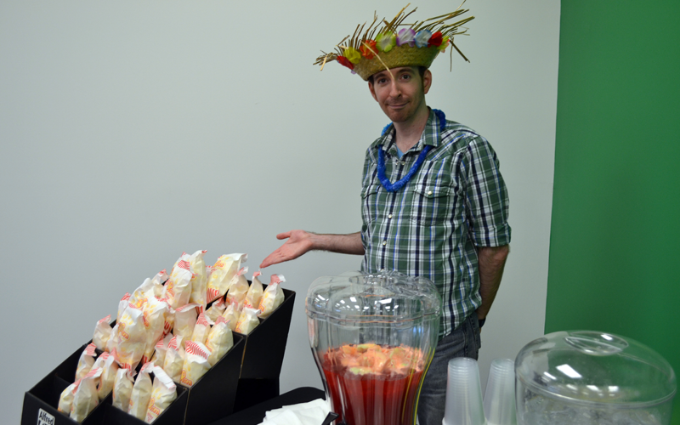
Build “Word of Mouth” Advertising
I made my recitals fun!
  Theme Recitals
  Student Band Concerts
  Fun Venues

Slide 42
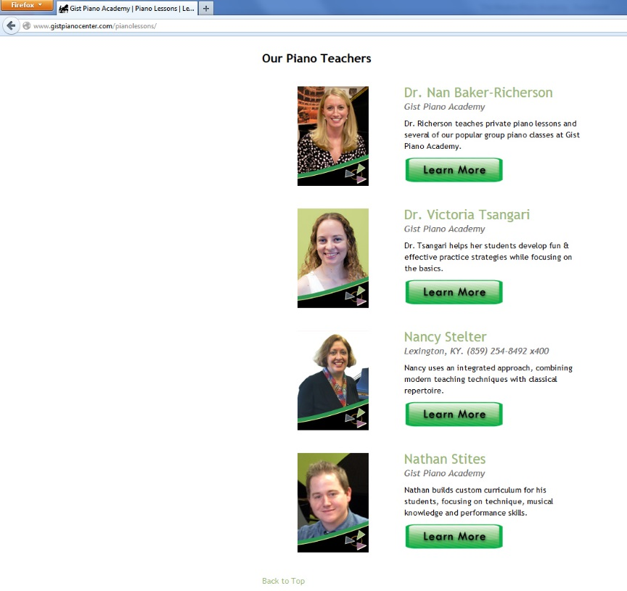
Build “Word of Mouth” Advertising
I made my recitals fun!
  Theme Recitals
  Student Band Concerts
  Fun Venues
I. Use. YouTube.
  I post videos of my teachers and embed them on my website. YouTube makes this easy and prospective students love it!
  I even post clips of my events/recitals online!

Slide 43
Build “Word of Mouth” Advertising
I regularly post my YouTube videos on Facebook so everyone can see how much fun my studio is!

Slide 44
Build “Word of Mouth” Advertising
I regularly post my YouTube videos on Facebook so everyone can see how much fun my studio is!
I also write a TON of press releases and submit them to the local news. You never know when they will decide to do a story. That’s FREE advertising!

Slide 45
Build “Word of Mouth” Advertising
In short, I build incentives designed to make everyone on my team enthusiastic advocates for studio growth.

Slide 46
Build “Word of Mouth” Advertising
In short, I build incentives designed to make everyone on my team enthusiastic advocates for studio growth.
Finally, I work to build friendships with teachers outside my studio. They even send me students!

Slide 47
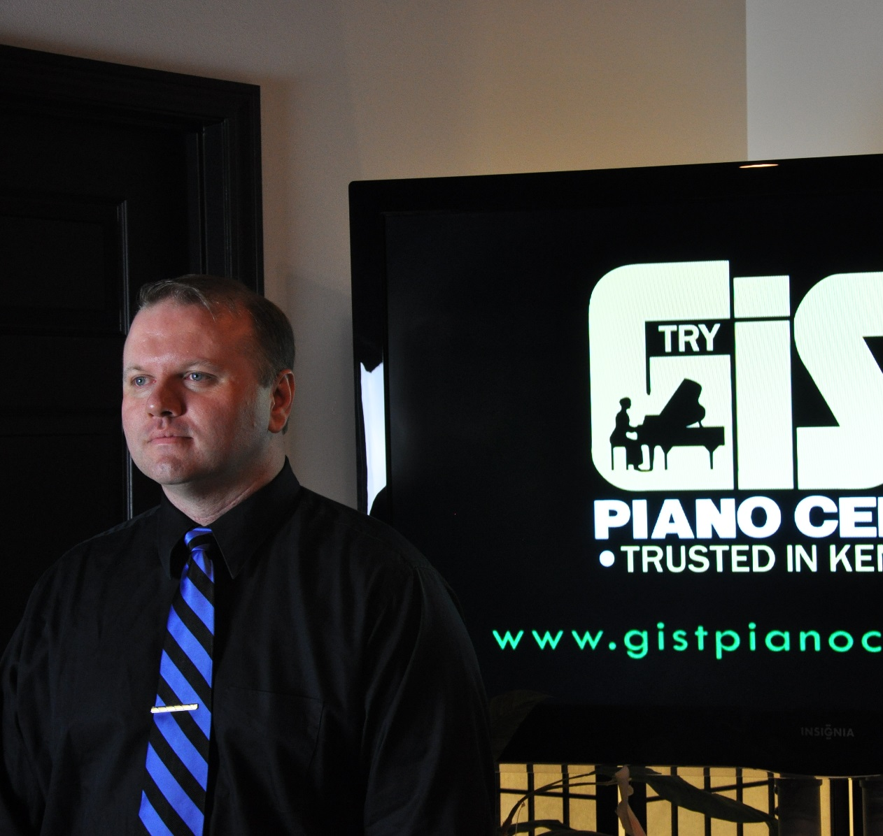
Thank you for attending!
James L. Harding
President
Gist Piano Center
(502) 451-1831 x200
jharding@gistpianocenter.com
www.gistpianocenter.com

