Slide 1

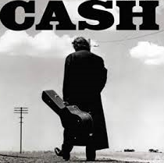

How to Turn Your Aging Inventory Into…
Presented by…
Bob Popyk & Alan Friedman

Slide 2




Friedman has 35+ years experience providing accounting, tax compliance, business valuation & consulting services to the music retailing industry
Speaks at NAMM, RPMDA, NASMD and other industry events
Premier writer for Music Inc. magazine
Plays guitar in the all-CPA rock band The Accounting Crows
Popyk has 50+ years experience providing sales, marketing, advertising and event promotion consulting services to the music retailing industry
Speaks at NAMM, RPMDA, NASMD and other industry events
Premier writer for Music Trades Magazine
Plays the accordion to adoring fans at senior centers
Why Friedman & Popyk ?

Slide 3
What, When & Why...
How to...
…turn aging inventory into cash

Slide 4

Part 1 – Why move aging inventory?

Slide 5
“I’m moving my inventory…I think?”
$40,000 (10%)
$80,000 (20%)

Slide 6
$50,000 (14%)

Slide 7
“What’s the big deal if my inventory has been sitting around for a while?”
Consider the costs…
Purchase & shipping
Merchandising & retail-ready
Rent for retail space & warehousing
Data tracking & pricing
Physical inventory taking & security
Financing & floor planning
Property tax
Shrinkage, pilfering & breakage
Labor costs to do many of the above
The analysts say… “Any item that’s been sitting around for one year has now cost you 30% more.”
$1,000 + 30% = $1,300

Slide 8
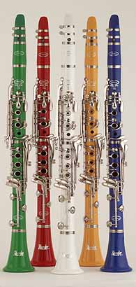
“Can I really benefit from blowing out old stuff?”
• You’ve been sitting on ten (10) very colorful clarinets for over 5 years now
• You paid $400 for each of these clarinets, hoping to sell them for $700 each
• You desperately need B&O accessories
• A band director calls you; he’s willing to pay $3,000 for all 10 clarinets…do you take the deal?

Slide 10
“Is there an easy “rule-of-thumb” for how long I should allow goods to remain unsold?”
Buy any product ONLY IF you know you can sell it in “X” days or less, where “X” is equal to 360 days times your gross profit percent

Slide 11
If you can sell it in 90 days or less, BUY IT.
If you can’t or aren’t sure, DON’T BUY IT.

Slide 12

Part 2 – Okay, but how do I do it?”

Slide 13

1. Put a serious spiff on it

Slide 14

2. Ask your supplier(s) for help

Slide 15

3. Be creative with eBay / Craigslist

Slide 16
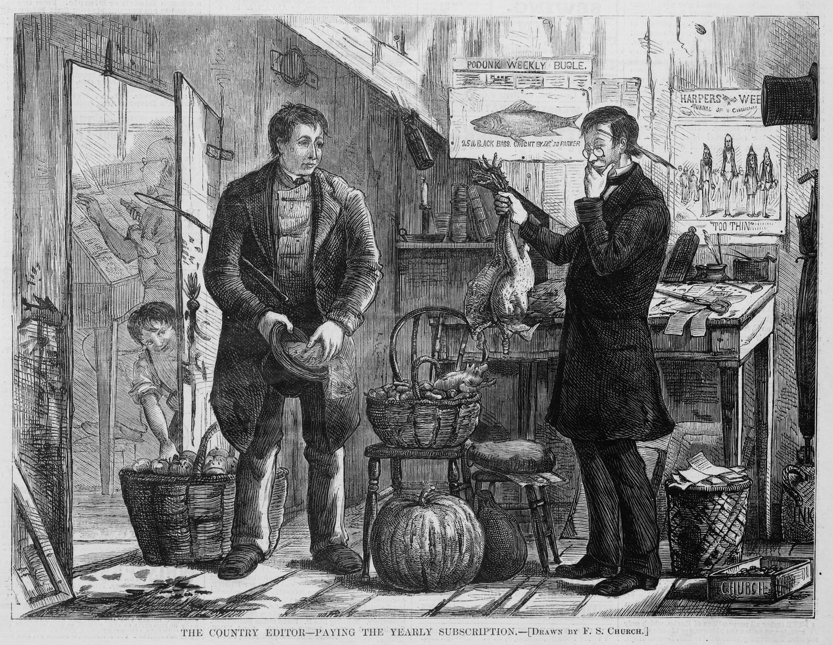
4. Barter for goods or services

Slide 17

5. Ask your customers for help

Slide 18

6. Make it easier to buy

Slide 19

7. Have a drawing in your store

Slide 20
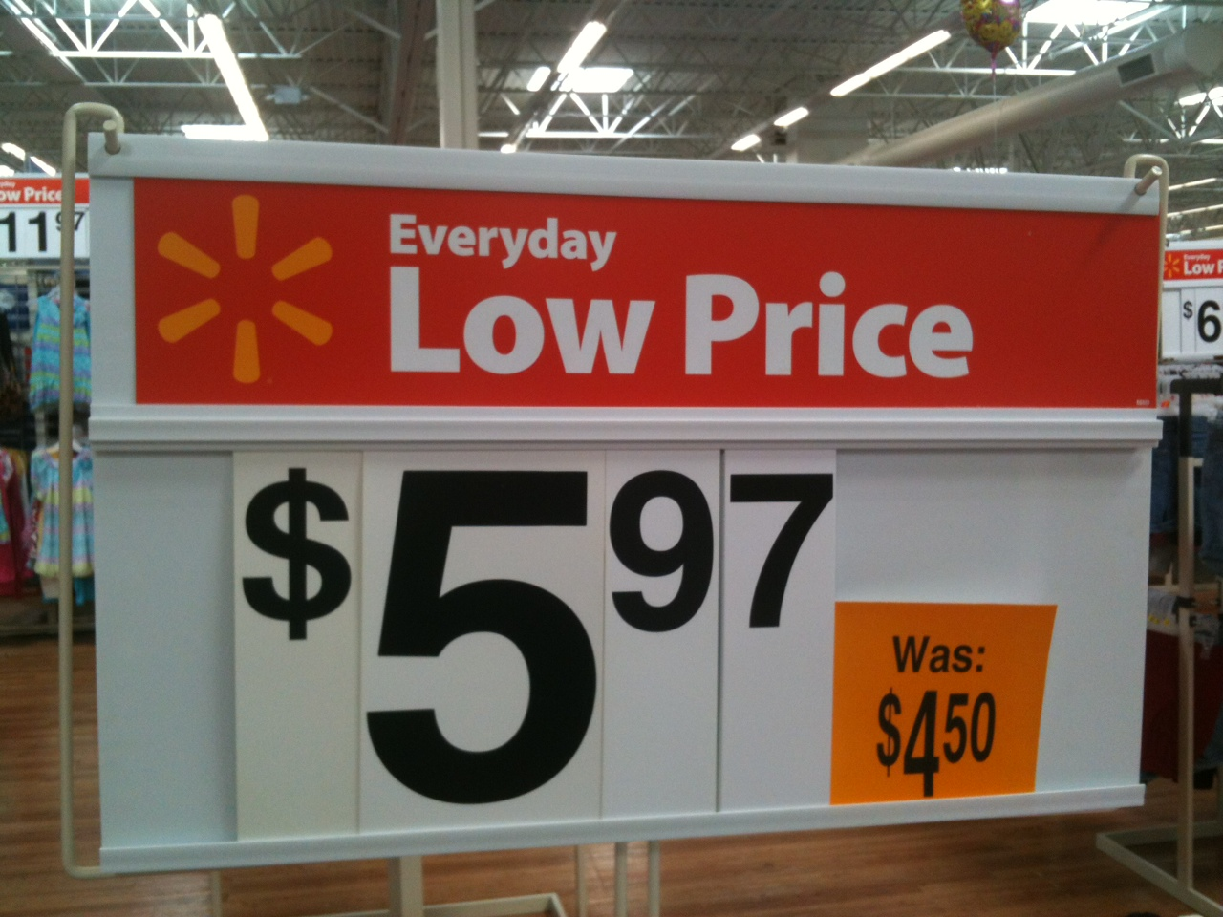
8. Adjust the price!!

Slide 21
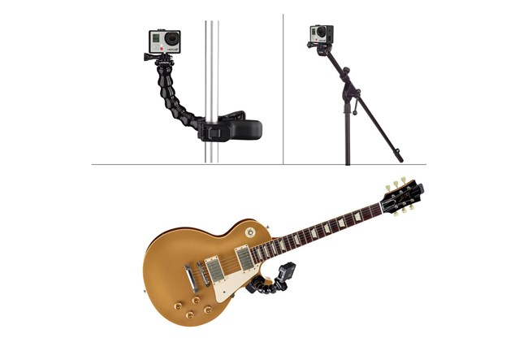
9. Bundle it

Slide 22

10. Donate it

Slide 23
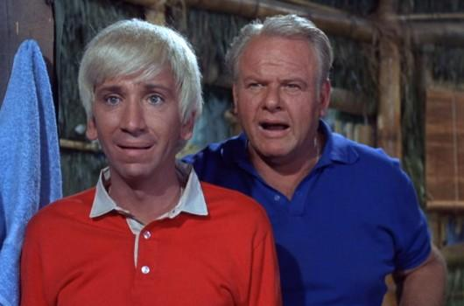
Any Questions for Bob & Alan?

Slide 24
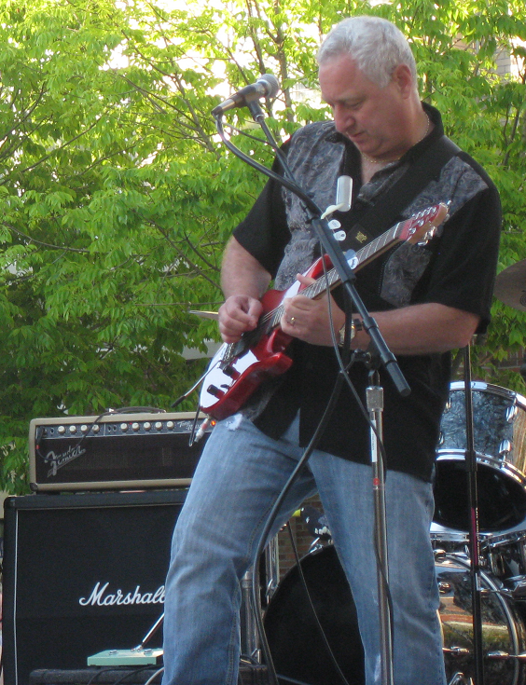

Bob & Alan say…
“Rock on…and have a great show!”

