Slide 1


Slide 2
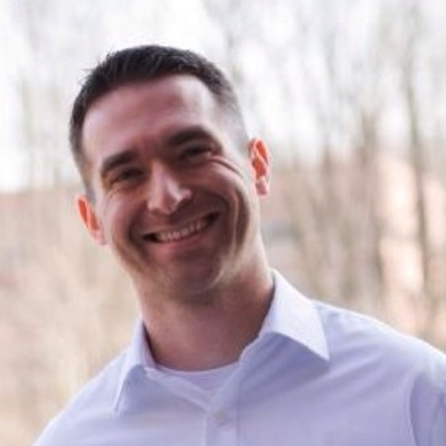
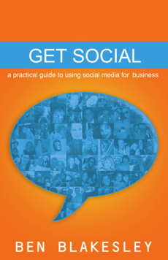
5 Things You MUST
Know About Instagram For Business
Ben Blakesley
@benunh

Slide 3
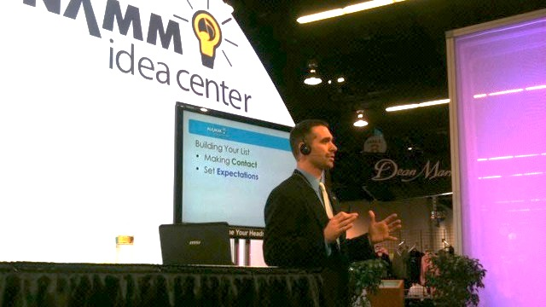

Slide 4



Slide 5


How many monthly active users are on Instagram?
10 million
50 million
300 million
10 real people, 100 million bots

Slide 6
How many photos are posted to Instagram every day?
10 million
40 million
70 million
Do Selfies really count as photos??

Slide 7
How many Likes and Comments happen every second on Instagram?
1,000 likes; 500 comments
4,000 likes; 750 comments
8,500 likes; 1,000 comments
IDK. Too busy double-tapping Grumpy Cat pics…

Slide 8
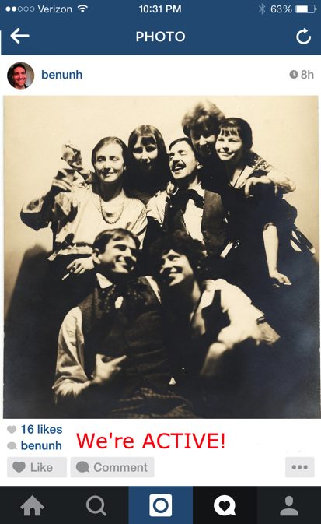
Takeaway:

Slide 9
Random acts of kindness?
YES!
Random acts of Marketing?
NO!

Slide 10
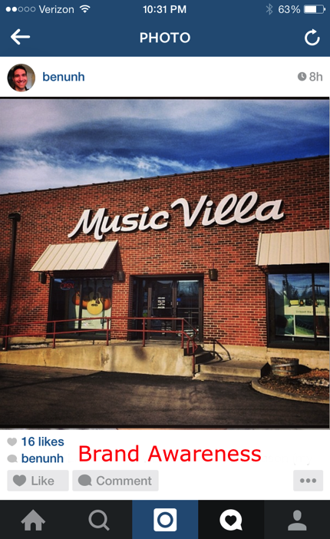
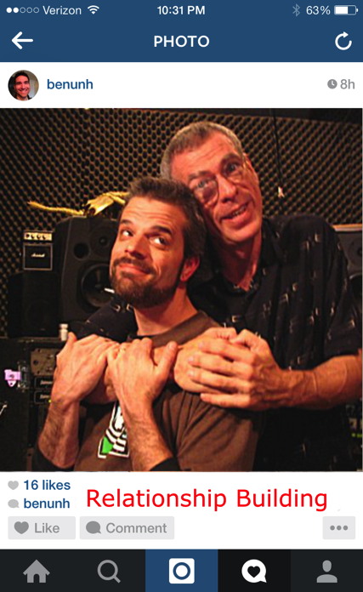
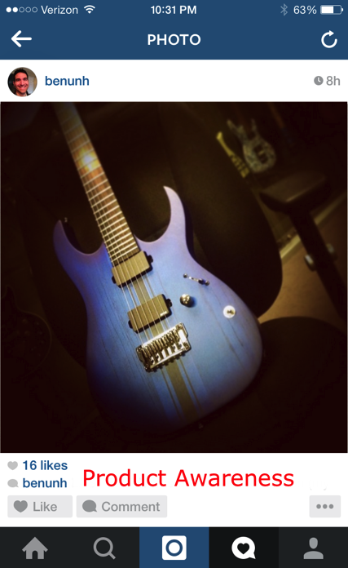
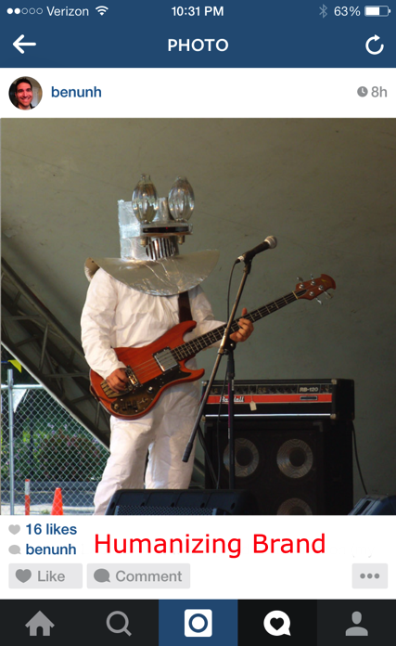
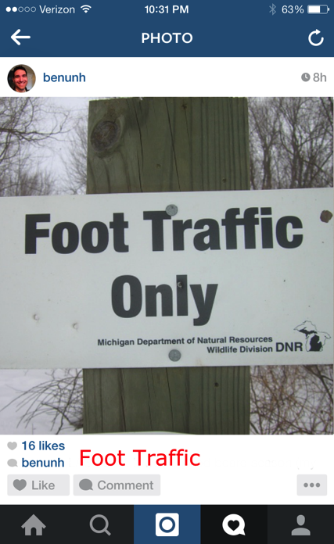

Slide 11
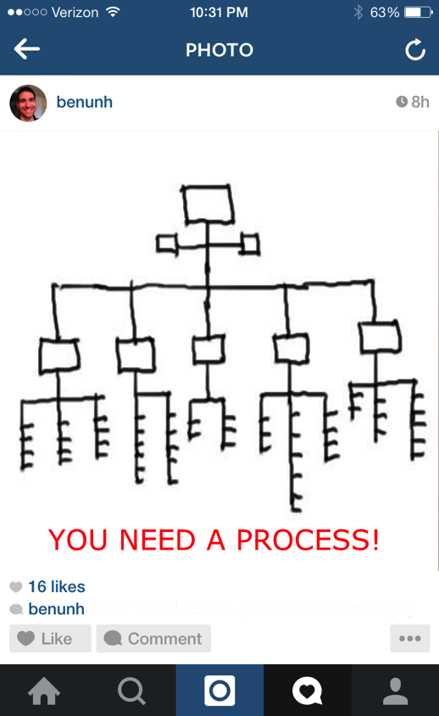

Slide 12
Social Media
PROCESS

Slide 13
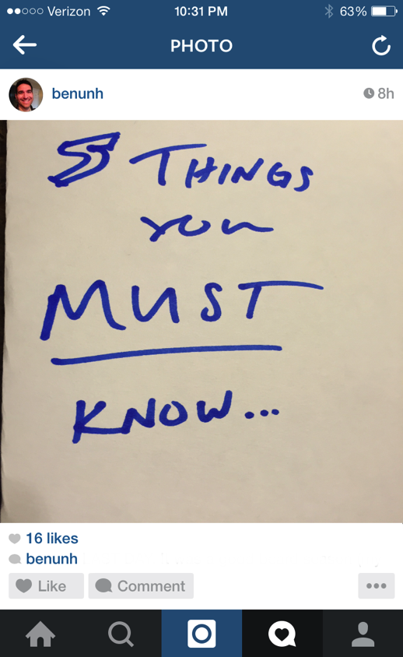

Slide 14
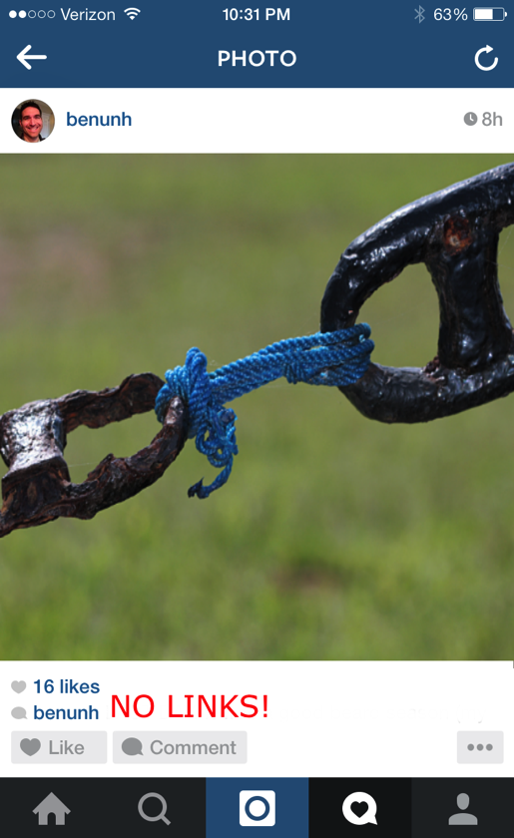
#1

Slide 15
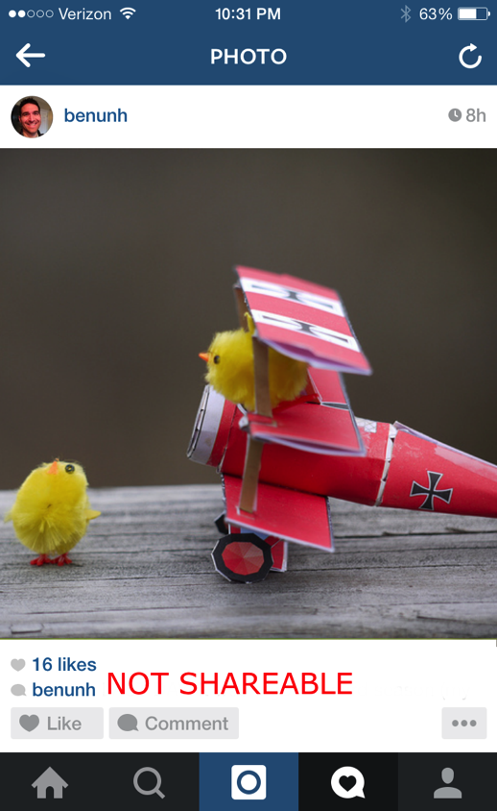
#2

Slide 16
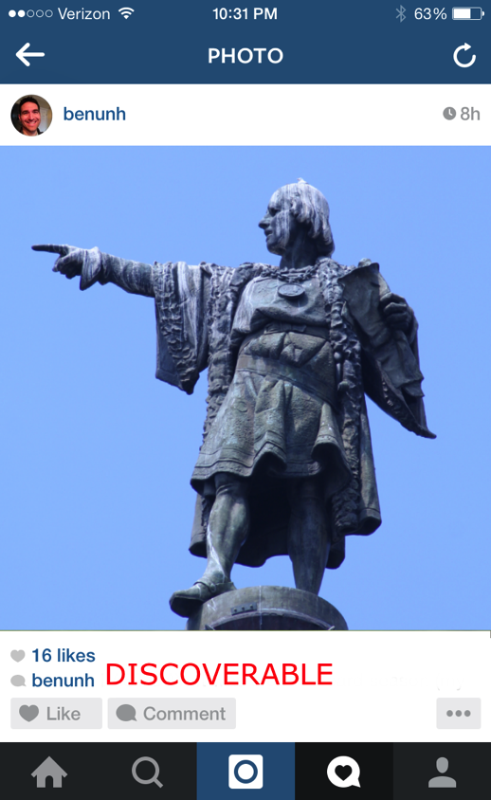
#3

Slide 17
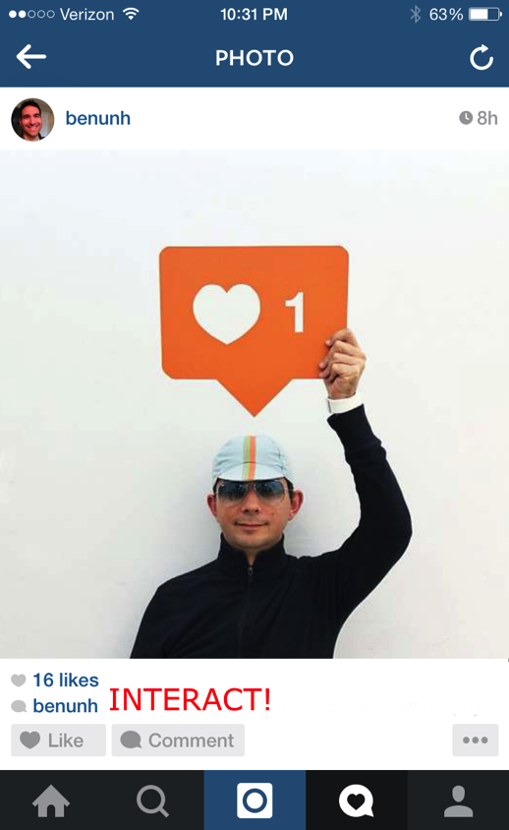
#4

Slide 18
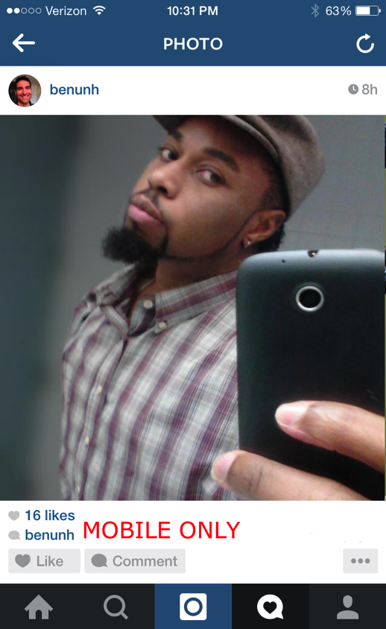
#5

Slide 19
But wait…
THERE’S MORE!

Slide 20
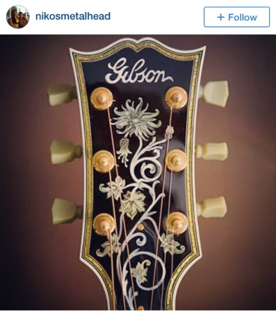
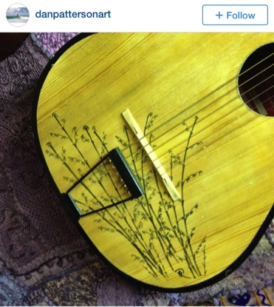
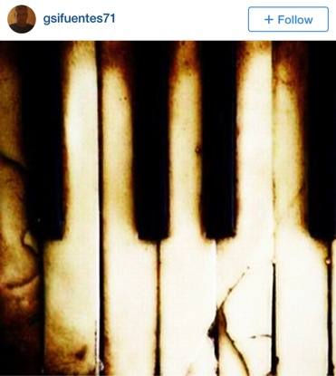
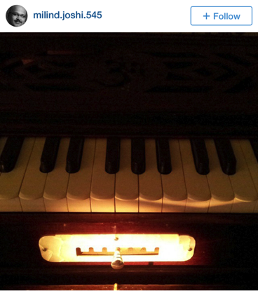
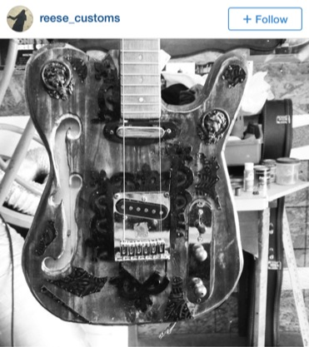
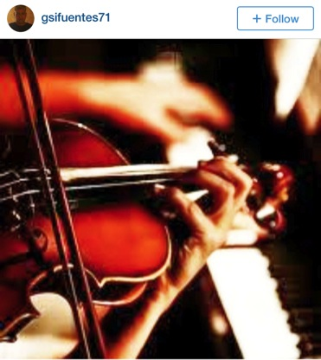

Slide 21
Recap:
Links
Not Shareable
Discoverable
Interaction
Phone Only
BONUS: Beautiful Images

Slide 22
