Slide 1


Slide 2
New Ways to Market Your Store Online
Peter Dods

Slide 3






Email
Facebook
Yelp
Instagram
Vines
Blog Attack

Slide 4
Email–Basic–Where it all started
Email Marketing still > Social Media
Email is golden
Deft Response Companies
  Make a friend
  Use email to leverage into Social Media
No Response Companies
  Last Operational Function
  Last Line of Defense
  Customer Direct Line

Slide 5
Facebook - Social Media
Remember the Movie? The part…
Give Give Give, Ask
Jab, Jab, Jab, Right Hook
The Movie.
Ad VS Great Content
Great Content Creates Context
GMROI?

Slide 6
Facebook - Social Media - Starting point
Budget Breakdown:
  $100 email marketing program
  $300 Social Media
  $1,000 YP advertising
  $2,500 CPC advertising
  $3,500 TV image brand campaign
Social Media represents 4% of our ad budget…tiny

Slide 8
Social Media
Social Media 4% BUT
  Social Media Content Creation
    Huge Costs
    It is a commitment
    Hybrid positions?
    Something someone already likes?
    Full commitment?
    Develop your base…

Slide 9
Creating your base
Mail Import & Tel Import
  Ads manager - a teenager can do this
  “How Do I Create a Custom Audience in Facebook?”
  http://www.facebook.com/help/www/170456843145568

Slide 10
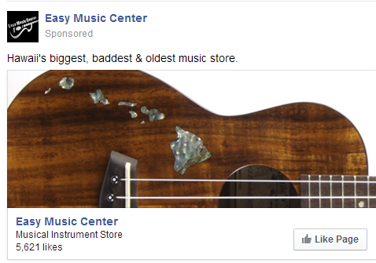
Creating your base
Mail Import
  9,000 Database
  6,500 overlap with Facebook
  5,400 not already liked

Slide 11
Creating your base
TEL IMPORT
  50K database
  7,000 on fbook
  6,200 not already liked
  $200 Budget…
  At the time of this…

Slide 12
Back to that killing the party thing again…
My thoughts…
Make a Friend
Commit resources to deft response and involvement
If you can’t do email, you can’t do this…
Email vs Facebook?
Facebook is not CPC advertising…
Empirical Evidence

Slide 13
Yelp - Is it big where you live?
CA & HI are big markets
Libel?
A Fairfax County jury was presented with an unusual but closely watched case to decide: Did Jane Perez, a Fairfax City resident, defame a D.C. contractor by writing scathing reviews of his work on the popular Internet sites Yelp and Angie’s List? And when Christopher Dietz leveled his own accusations in online posts responding to Perez, did he in turn defame her?
After a five-day trial and eight hours of deliberations, the jury essentially declared a draw when it returned a verdict Friday night that caught both sides off guard: Perez and Dietz had defamed each other, but neither would get a cent in damages.
Source: Washington Post

Slide 14
Protect Your Image
Be Proactive
How They Work
What Reviewers Matter
Libel Response
Yelp removal of response by policy
Deft Response
Caring Response
Monitor Filtered Reviews too
Make a Friend and a Sale

Slide 15
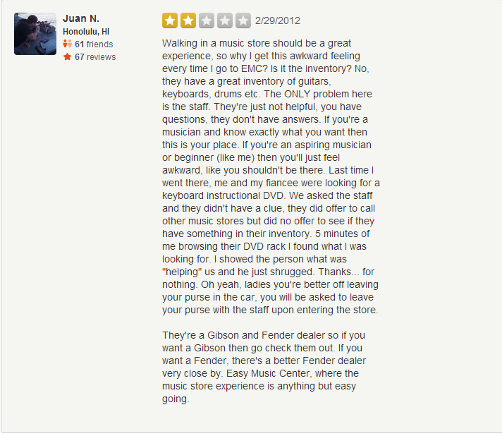
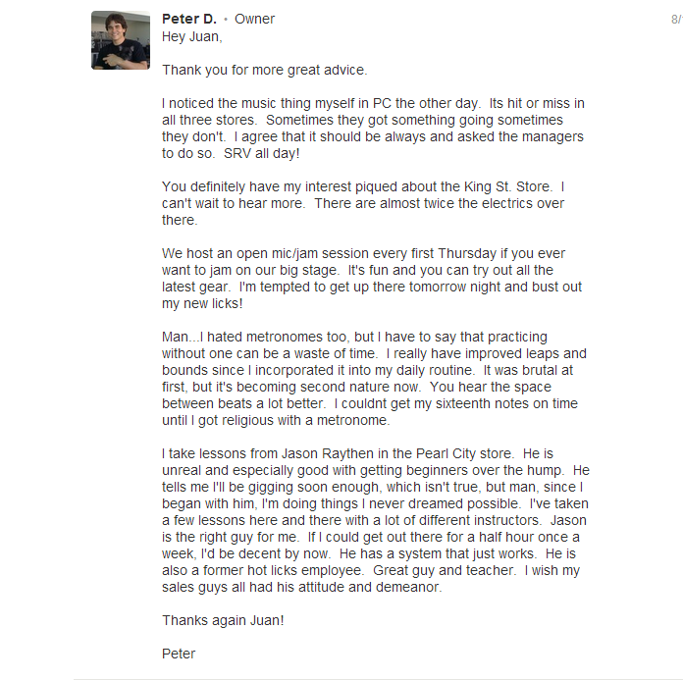

Slide 16
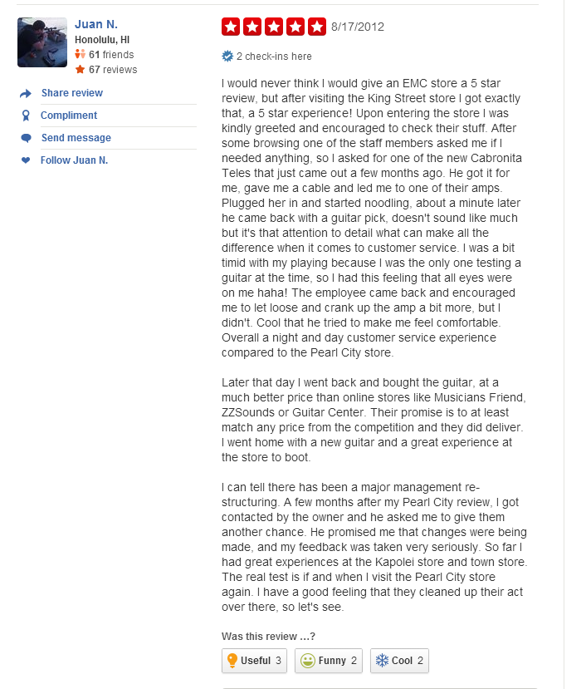
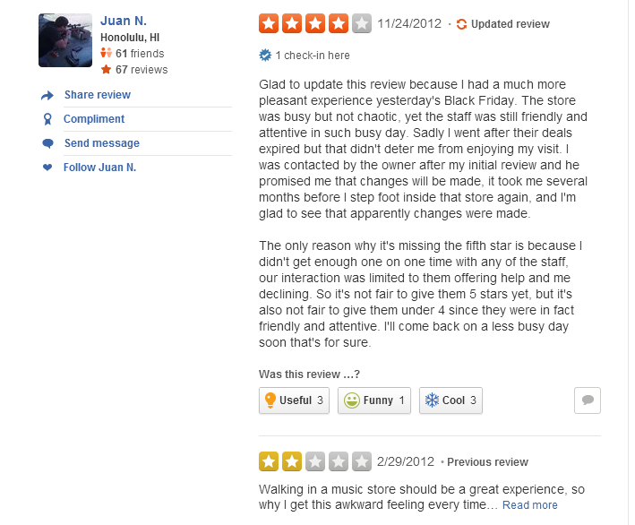
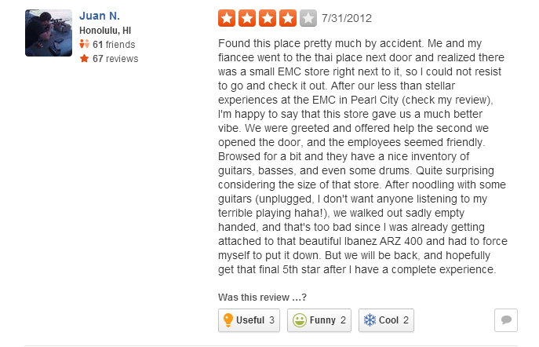
Honolulu Store
Pearl City Store
Kapolei Store
Went from one 2 star, to one 5, and two 4 store reviews!
Also – Juan became my friend, is involved on our Facebook page,
and he made a 1k purchase the first time we met

Slide 17
Instagram
Tough Start…
Hard to build followers
Must start with personal base = dangers for store
Not ready to commit deeply BUT …
We’ve created better content and context by not creating it at all and letting others help...so having your name out there is good

Slide 18
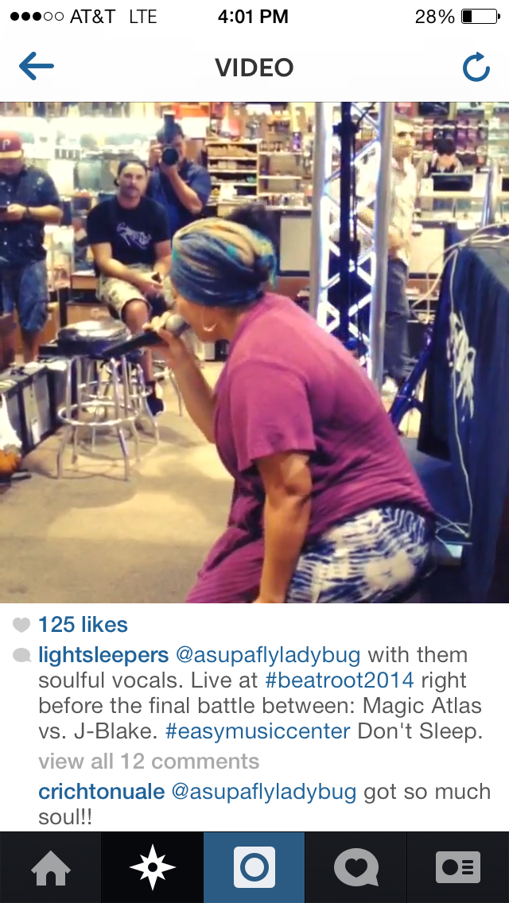
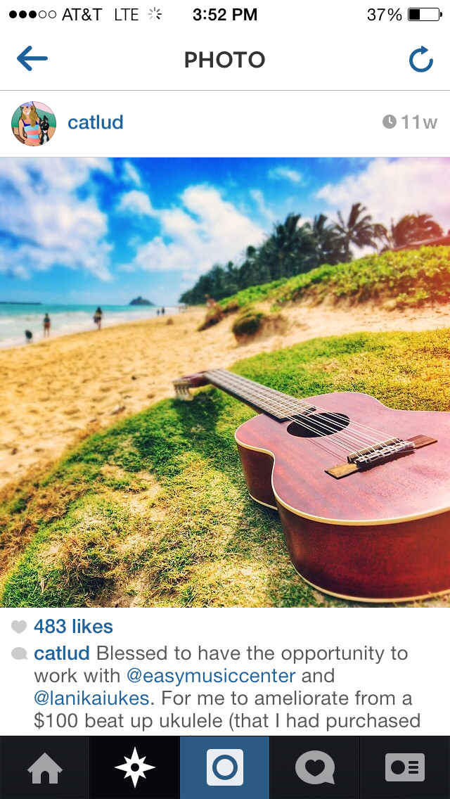
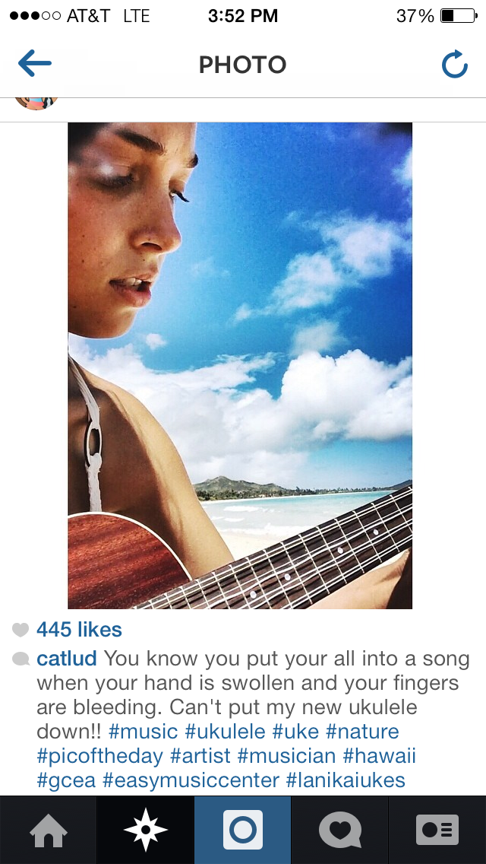

Slide 19
Vines
Prepare to have your mind blown.
Hawaii Vines is a network. Cat Lud is part of that network.
The Facebook page has 75,000 people.
Instagram 8,000
Hawaii Vines 9,000.
Twitter 500
YouTube channel 400 subscribers - but the videos have 10-20,000 views and counting
Our Team Hawaii viner network (the vine famous viners) have 1 million followers all together

Slide 20
Vines
Likes – Just like Facebook
Revine - Share
  1,000 Revines, average Viner has 100 followers = 100,000 people saw it.
  The 10 top Team Hawaii Viners have 10-24k each
  BUT our SUPER Viners like KalaniBallFree and JasonCoffee have 400,000 + followers EACH
  If TEAM HAWAII Revines = 1M people see it
  Viral Marketing at its finest….
  You never know what will go viral.

Slide 21
Vines
Facebook and Twitter posts get buried. Traditional print and radio ads only work for the time they are up. VINE/YouTube is out there forever and continues to be available and found.
People always ask Cat where she got her ukulele…
Discount Code!

Slide 22
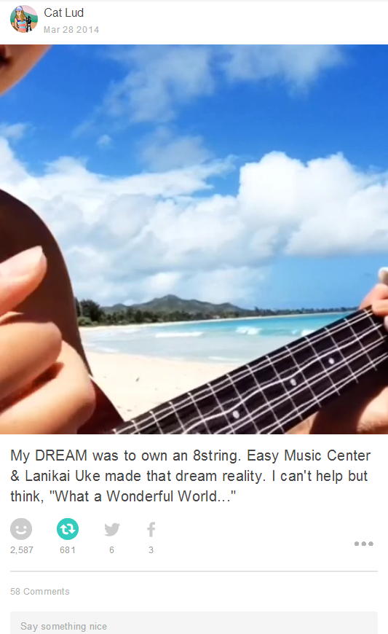
  • 1,000 Revines, average Viner has 100 followers = 100,000 people saw it.
  • 681,000 people saw this post.
  • BUT our SUPER Viners like KalaniBallFree and JasonCoffee have 400,000+ followers EACH.
  • JasonCoffee did Revine this.
  • 400,000 + 681,000 = Over 1M views.
  • For 1M views with Cat creating both content and context for EMC, for a sponsored giveaway with Lanikai (cost EMC ZERO), that’s quite a lot of publicity.
Hopefully the internet is fast enough for this link to work?!

Slide 23
Blog Attack?
Developing resources to commit fully to a specialized niche

