Slide 1


Slide 2
How to Relate to and Motivate the
Next Generation of Employees
Notes:
Millenials – 1981 – 2006
Newest generation to join workforce
Lot of generalizations…
“The new guys…

Slide 3
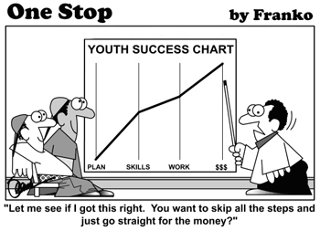
Notes:
Don’t work – Lazy
No clue…
Sagging pants..
If it’s not on their phone…
View new employees coming in…like this.

Slide 4

Notes:
This is something our company has struggled with.

Slide 5
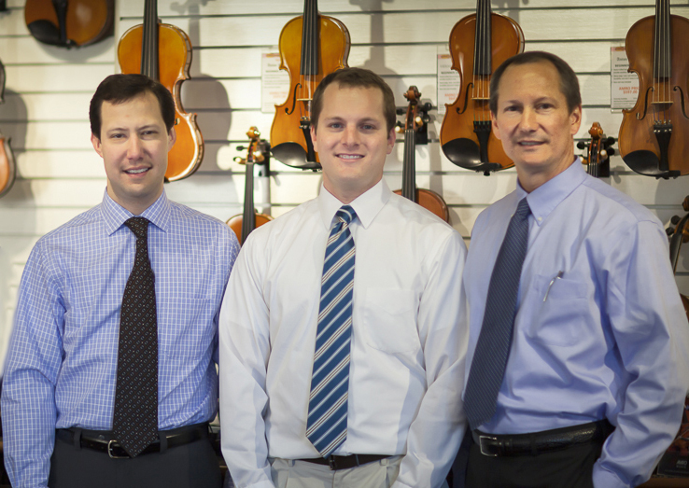
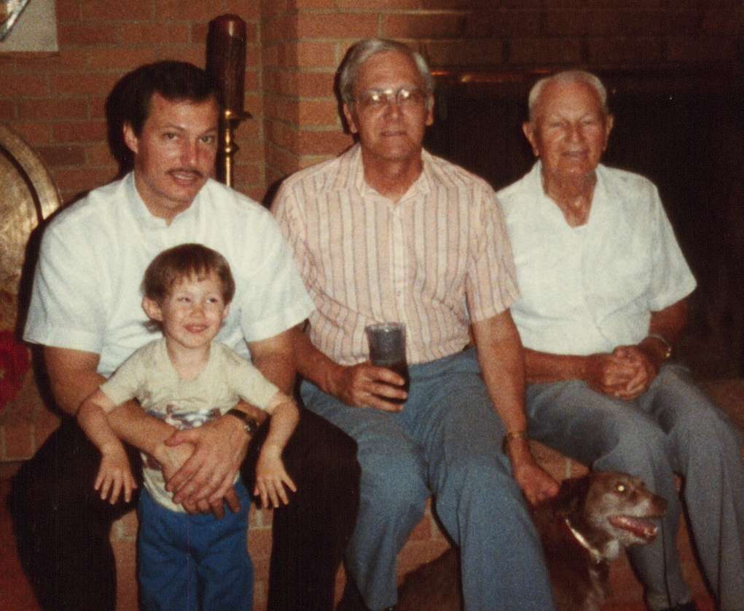
Notes:
4 Generations – seen a lot.
Constantly dealing with changing of the guard.
Newest – lot of passion & energy…
Some differences but really it’s a management

Slide 6
 | Traditionalists | Baby Boomers | Generation X | Millennials
Born | 1925 – 1945
Career Goal | Legacy
Motivators | Self-worth
Work-Personal | Separate
Attitude | Formal
 | “Waste Not, Want Not”
Notes:
Traditionalists
Separate Professional Life from Personal life.
Formal – dress, communication, in corporate outlook
Like org charts
“Waste Not, Want Not”

Slide 7
 | Traditionalists | Baby Boomers | Generation X | Millennials
Born | 1925 – 1945 | 1946 – 1964
Career Goal | Legacy | Career
Motivators | Self-worth | Salary – Titles
Work-Personal | Separate | Less Separate
Attitude | Formal | Business
 | “Waste Not, Want Not” | “Live to Work”
Notes:
Boomers
Goal – Solid, stable career
Lifers – change jobs infrequently
“See changing as a setback”
Motivated – Salary, Titles, & Recognition
Balance is still separate. As “Co-workers”
Attitude is still on the formal spectrum.
Motto – “Live to Work”
“Go to work to provide for family” – JOB
Traditionalist parents.

Slide 8
 | Traditionalists | Baby Boomers | Generation X | Millennials
Born | 1925 – 1945 | 1946 – 1964 | 1965 – 1980
Career Goal | Legacy | Career | “Portable” Career
Motivators | Self-worth | Salary – Titles | Security
Work-Personal | Separate | Less Separate | More Open
Attitude | Formal | Business | Casual
 | “Waste Not, Want Not” | “Live to Work” | “Work to Live”
Notes:
Gen X
“Portable” career – take it with them.
Expect to change 4-5 times during career.
Grew up in a period of change – Internet, Social Media
Kids at home in the afternoons – parents worked.
Independence
Motto – “Work to Live”
Saw effect of parents spending less time.

Slide 9
 | Traditionalists | Baby Boomers | Generation X | Millennials
Born | 1925 – 1945 | 1946 – 1964 | 1965 – 1980 | 1981 - 2006
Career Goal | Legacy | Career | “Portable” Career | “Parallel” Careers
Motivators | Self-worth | Salary – Titles | Security | Personal Life – Balance
Work-Personal | Separate | Less Separate | More Open | Blended
Attitude | Formal | Business | Casual | Very Casual
 | “Waste Not, Want Not” | “Live to Work” | “Work to Live” | “Generation Why”
Notes:
Millennials - Gen Y – Immediate Generation
Want to do more than 1 thing.
Casual attitude – dress & outlook
See “co-workers as friends”
More about WHY – than anything else.
WHY IS THIS IMPORTANT?

Slide 10
Percentage of Millennials in the Workforce
Notes:
M – fasting growing segment of workers today.
Managers…understand younger generations
remember management lessons we’ve learned.

Slide 11
91% of Millennials expect to
change jobs every 1-3 years.
Source: Future Workplace “Multiple Generations @ Work” Survey
Notes:
“Younger people”…change more frequently.
Older – we don’t want to.
We need to hang on to young people…
Experienced 2 – 4 times more.

Slide 12
What can we do to motivate and work together?
Notes:
How can we motivate young people?
Management principles we all know.
Just have to remind ourselves.

Slide 13
Provide Independence
Share the goal line, but let them call the plays.
Set clear goals.
Set expectations upfront.
Provide constant feedback.
Notes:
Provide Autonomy – Independence
Tell them where the Endzone is…let them call the plays.
Share the vision or what the outcome looks like…get out of their way.
Set Goals. Follow up.
Games
Set Expectations – tend to be casual
Promotions -
We forgot…
Provide constant feedback.
Veteran employees – don’t want reviews.
Don’t want to wait…want feedback constantly.

Slide 14
Mentorship
View education as OUR job, not theirs.
Want face time.
Set aside time each day or week to listen and offer guidance.
Set up a mentorship program with other generations.
Notes:
Mentorship
Hardest parts for other generations – source of tension.
Boomers – X’ers – forget younger people NEED affirmation
Young people don’t have access to things we do.
Young workers have had parents – now they are on their own.
Set aside time each day or week to listen & offer guidance.
Ask about projects…”How are you doing with this?”
Setup a formal mentorship program with other generations
Even if they just go to lunch once a month – pick up the bill
Two things –
Get to know each other on a personal level – easier to identify with
Cross generational training – tech vs. on-the-job
Get them INVOLVED

Slide 15
Social Interactions
Don’t see a difference between friend and co-worker.
Encourage collaborative relationships- working in groups.
Host social events – celebrations, off-site events, monthly lunches.
  Include a guest(s) – spouse or family.
Notes:
Social
Millennials blur the lines between work & personal.
Social media
See Co-workers as friends…not JUST co-workers.
Helps create bonds.
Don’t force them to separate the two…don’t have to encourage them.
Collaborative relationships.
Like working in groups.
Host social events –
Monthly Birthday Lunch to celebrate birthdays – cater in food, cake, encourage everyone to eat together.
Include spouses or family – use family as support
Praise them in front of family – win family over.

Slide 16
It’s about the WHY…
Young people want to be a INVOLVED.
Core values and mission statements are important.
See that their job relates to the company goals.
  Making a profit is not enough.
See organization as flat – not interested in hierarchy.
Notes:
Millennials want to be apart of a movement…a cause.
Know that what they do makes a difference.
Rally around a common goal or vision that coincides with their own.
See the impact that their work has on the company’s goal.
Making a profit is NOT enough
Have a bad taste from Financial Meltdown
92% companies should be measured by more than profit.
Transparency is HUGE.
Honest & open cultures
Not interested in office politics & hierarchies.
Think that everyone should have the same level of information.
Can be another source of frustration – employees are going OVER heads

Slide 17
Share YOUR Why…
Put your mission and vision upfront and on the wall.
  Discuss vision and motivation during hiring process.
Explain how each project or task impacts the company goals.
Encourage discussion and seek input.
Be transparent.
Notes:
Don’t be shy about mission & vision.
If you don’t’ have one….MAKE one.
Discuss it during interviews & bring it up every change you can.
Net Impact study – 58% would take a 15% pay cut if it meant working for a company with “shared values.”
Don’t just give a task – talk about the big picture & the impact
No one wants to do mundane busy work.
Encourage & seek input on major decisions.
Doesn’t mean you have to take it….but what they say matters.

Slide 18
Our goal is to create a business environment
where people WANT to work.
Notes:
We have to create a corporate environment/culture where people WANT to work…
Vs. where people NEED to work.
Don’t need pool tables & foosball tables…
Little things – “Tacky Sweater Day” “Team Colors Day”
Recognizing what drives people – accepting differences.
Remember…this is no different than before….
We just have to brush up.

Slide 19
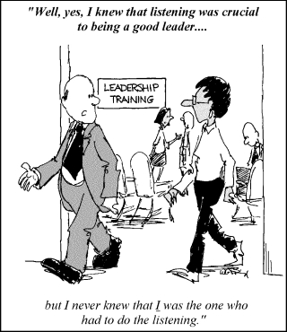
CJ Averwater
Amro Music Stores, Inc.
Email: cj@amromusic.com

