Slide 1

Boost Your Lesson Sign-ups —
And Keep the Students You Have
Liane Rockley, Rockley Music

Slide 2
Boost Your Lesson Sign-ups — and Keep the Students You Have
MARKETING
Direct Mail • Newspaper
RETENTION
Quality of Instructors
Online Advertising • Website
Community Events
Unique and Interesting Classes
Performance Opportunities

Slide 3
MARKETING: DIRECT MAIL
You can reach the students you want based on demographics you pick
Income, zip code, families with children, age, education level are some of the common demographics to choose from
Tends to be more expensive than other types of advertising but traditionally yields results
Many presentations to choose from — postcards, fliers, letters

Slide 4


Slide 5
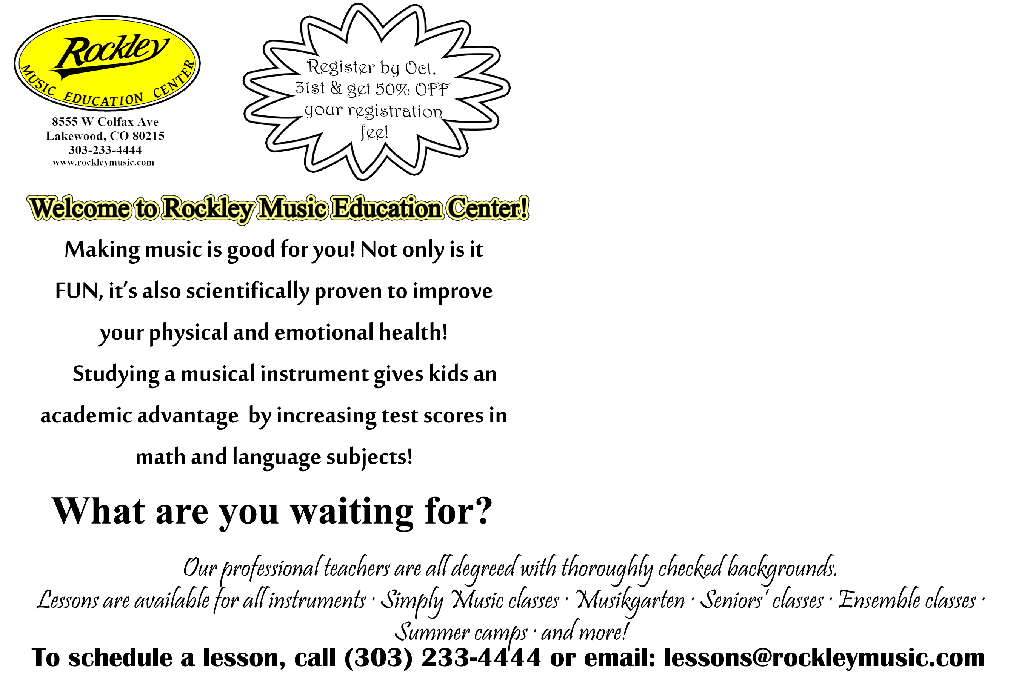

Slide 6


Slide 7
MARKETING: ONLINE ADVERTISING
Email blasts to customer list: Send advertising fliers without any cost to potential students
Facebook: Post pictures of recitals, events, introduce teachers
YP.com: Pay by call advertising on Google, MSN and Yahoo
As with all online advertising, the potential student needs to click/open your email/link. The challenge is to create ads that potential students want to open and to have your advertising appear in a place where it is likely to be selected.

Slide 8
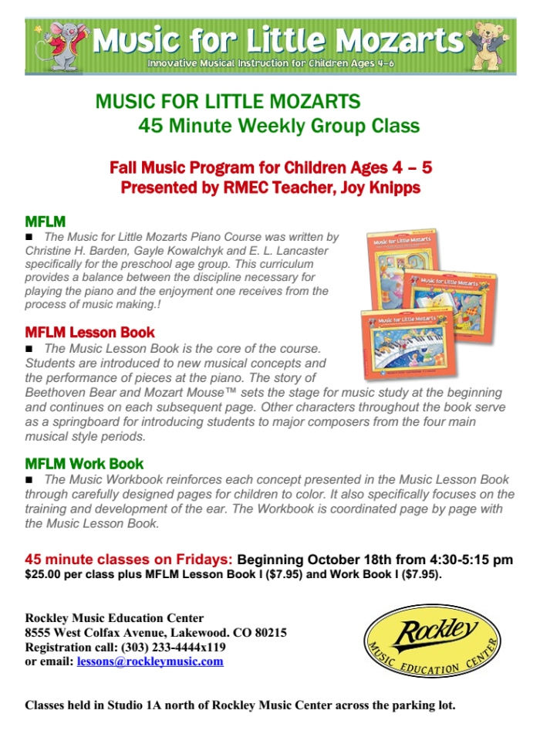



Slide 9
https://www.facebook.com/rockleymusic
Rockley Music Yellow Pages

Slide 10
MARKETING: COMMUNITY EVENTS
Home Shows: Hand out free registration coupons and sign up materials; teachers demonstrate instruments
School Band/Orchestra Rental Night: Hand out Lesson Advertising Packet
Music Educator Conventions or Conferences: Develop relationships with existing teachers for referrals
Silent Auctions for Local Schools/Community Groups: Donate Lesson Gift Certificates or free registration coupons to encourage sign-ups

Slide 11
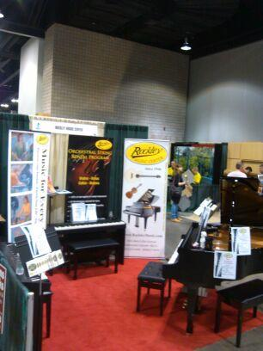
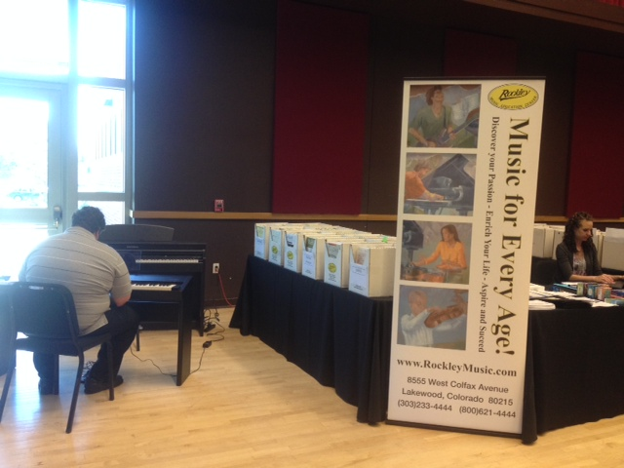
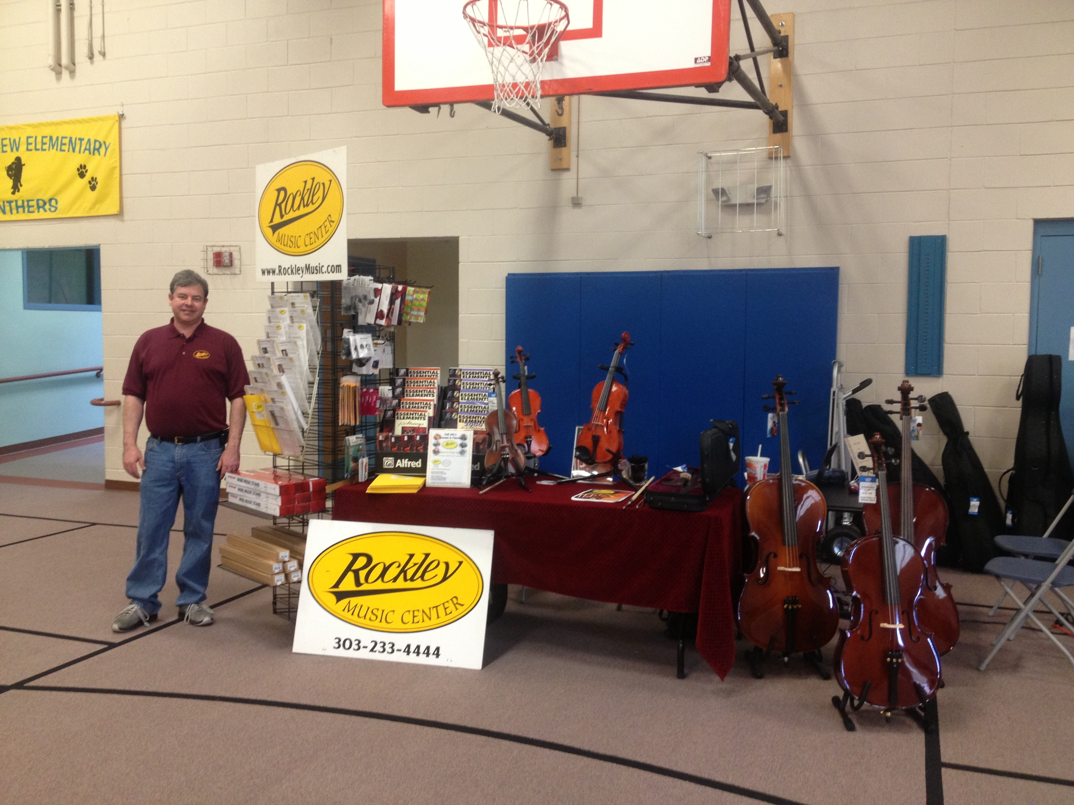
Pictures from some Community
Events we’ve attended
Home and Garden Show
CSMTA State Conference
Instrument Rental Night

Slide 12

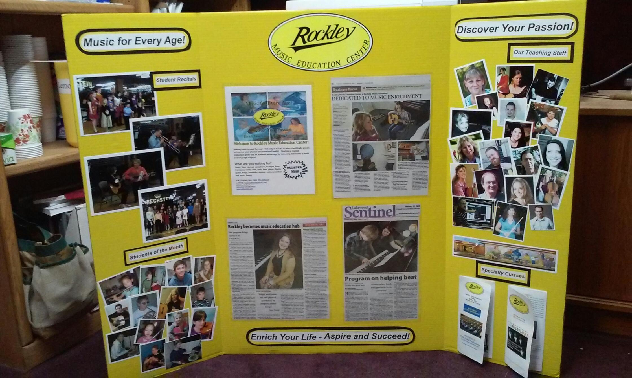
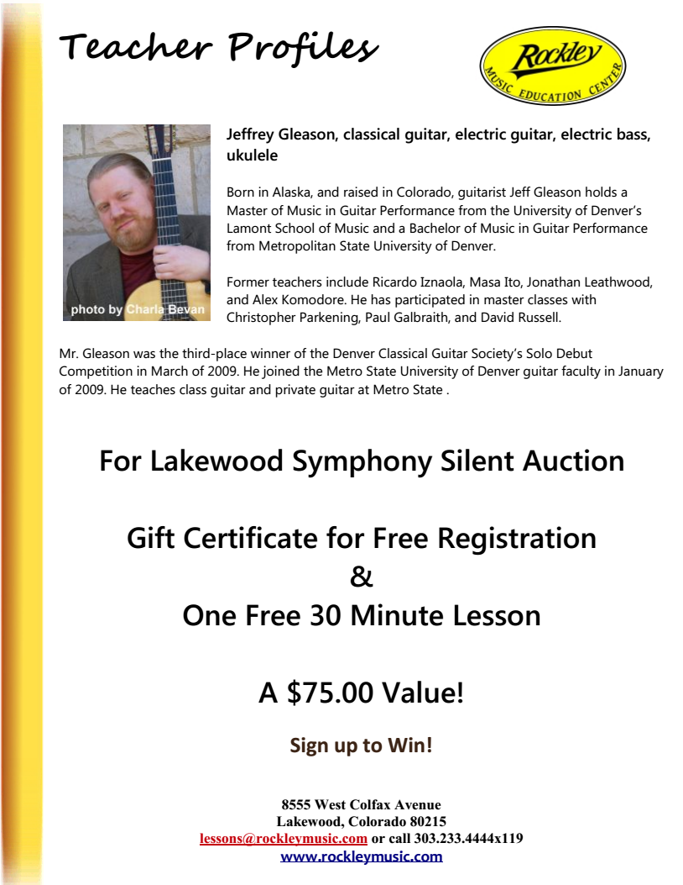
Here are some ideas that we created
for a local Silent Auction

Slide 13
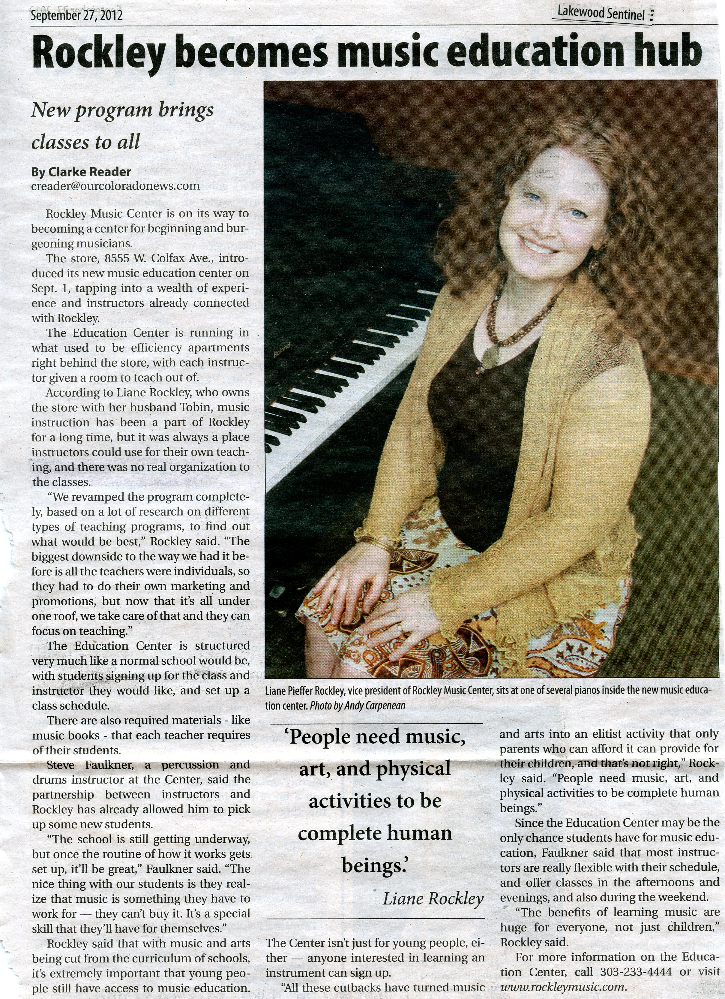
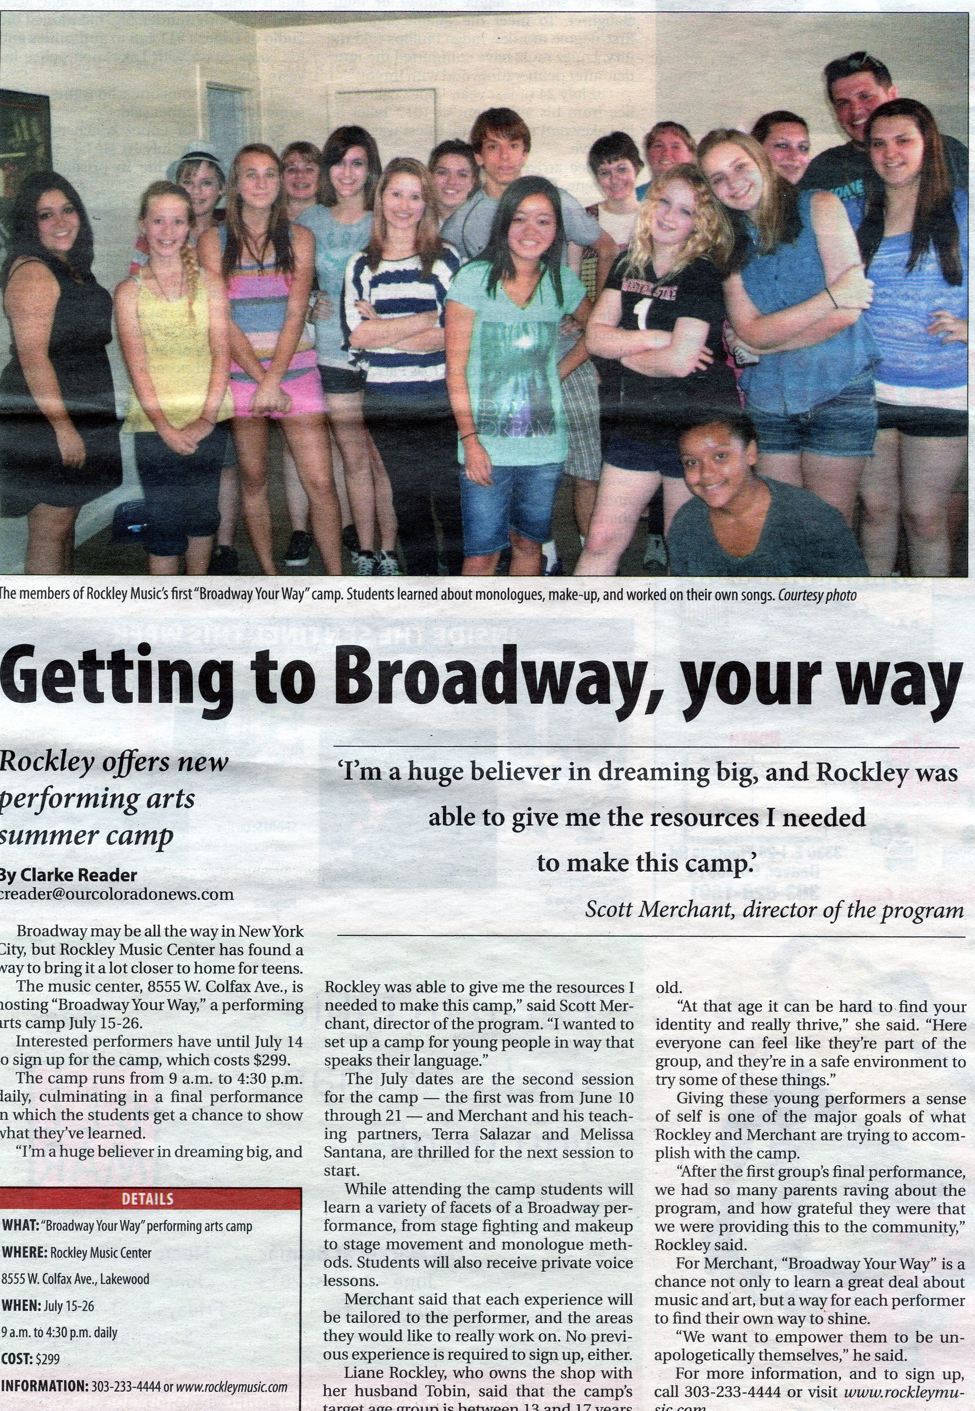
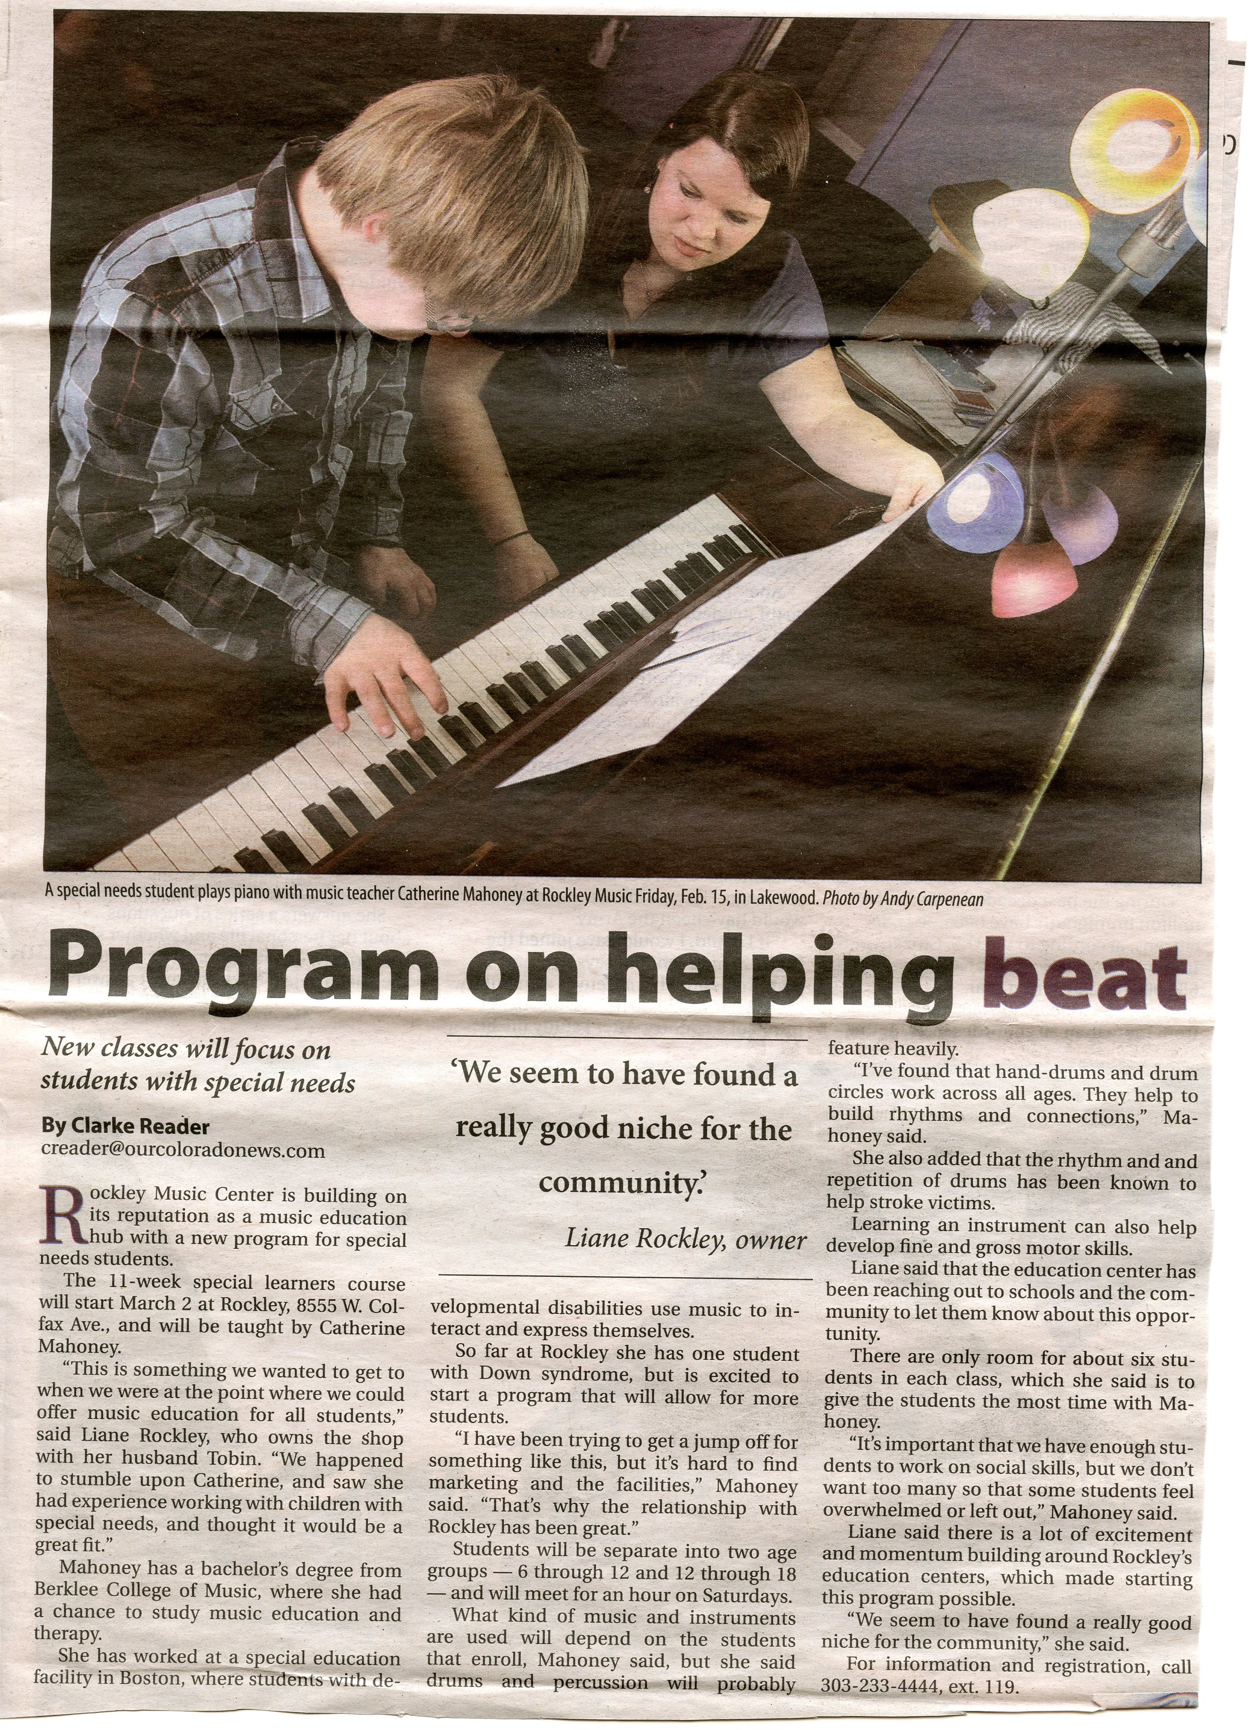
MARKETING: NEWSPAPER

Slide 14
MARKETING: WEBSITE
Your website is one of the most important marketing tools you have
We list our teacher’s profile sheets (which are created by the teacher)
There is also a lesson survey that potential students can fill out
Students can request an appointment with a teacher that they like
RMEC Home Page
Rockley Music - Surveys

Slide 15
RETENTION: QUALITY OF INSTRUCTORS
It is all about having the right teachers — teachers with drive and vision who are invested in the idea of creating new students. Identify who has these qualities among your teachers, or hire someone who does!

Slide 16
RETENTION: UNIQUE/INTERESTING CLASSES
Some potential students are looking for more than just the 30-minute private lesson once a week
Group classes (Group Piano, Guitar, Uke)
Ensemble Classes
Specialty Classes- (Recording Basics Class)

Slide 18
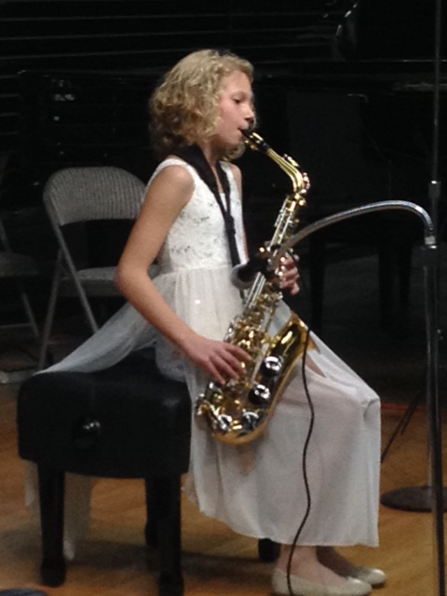
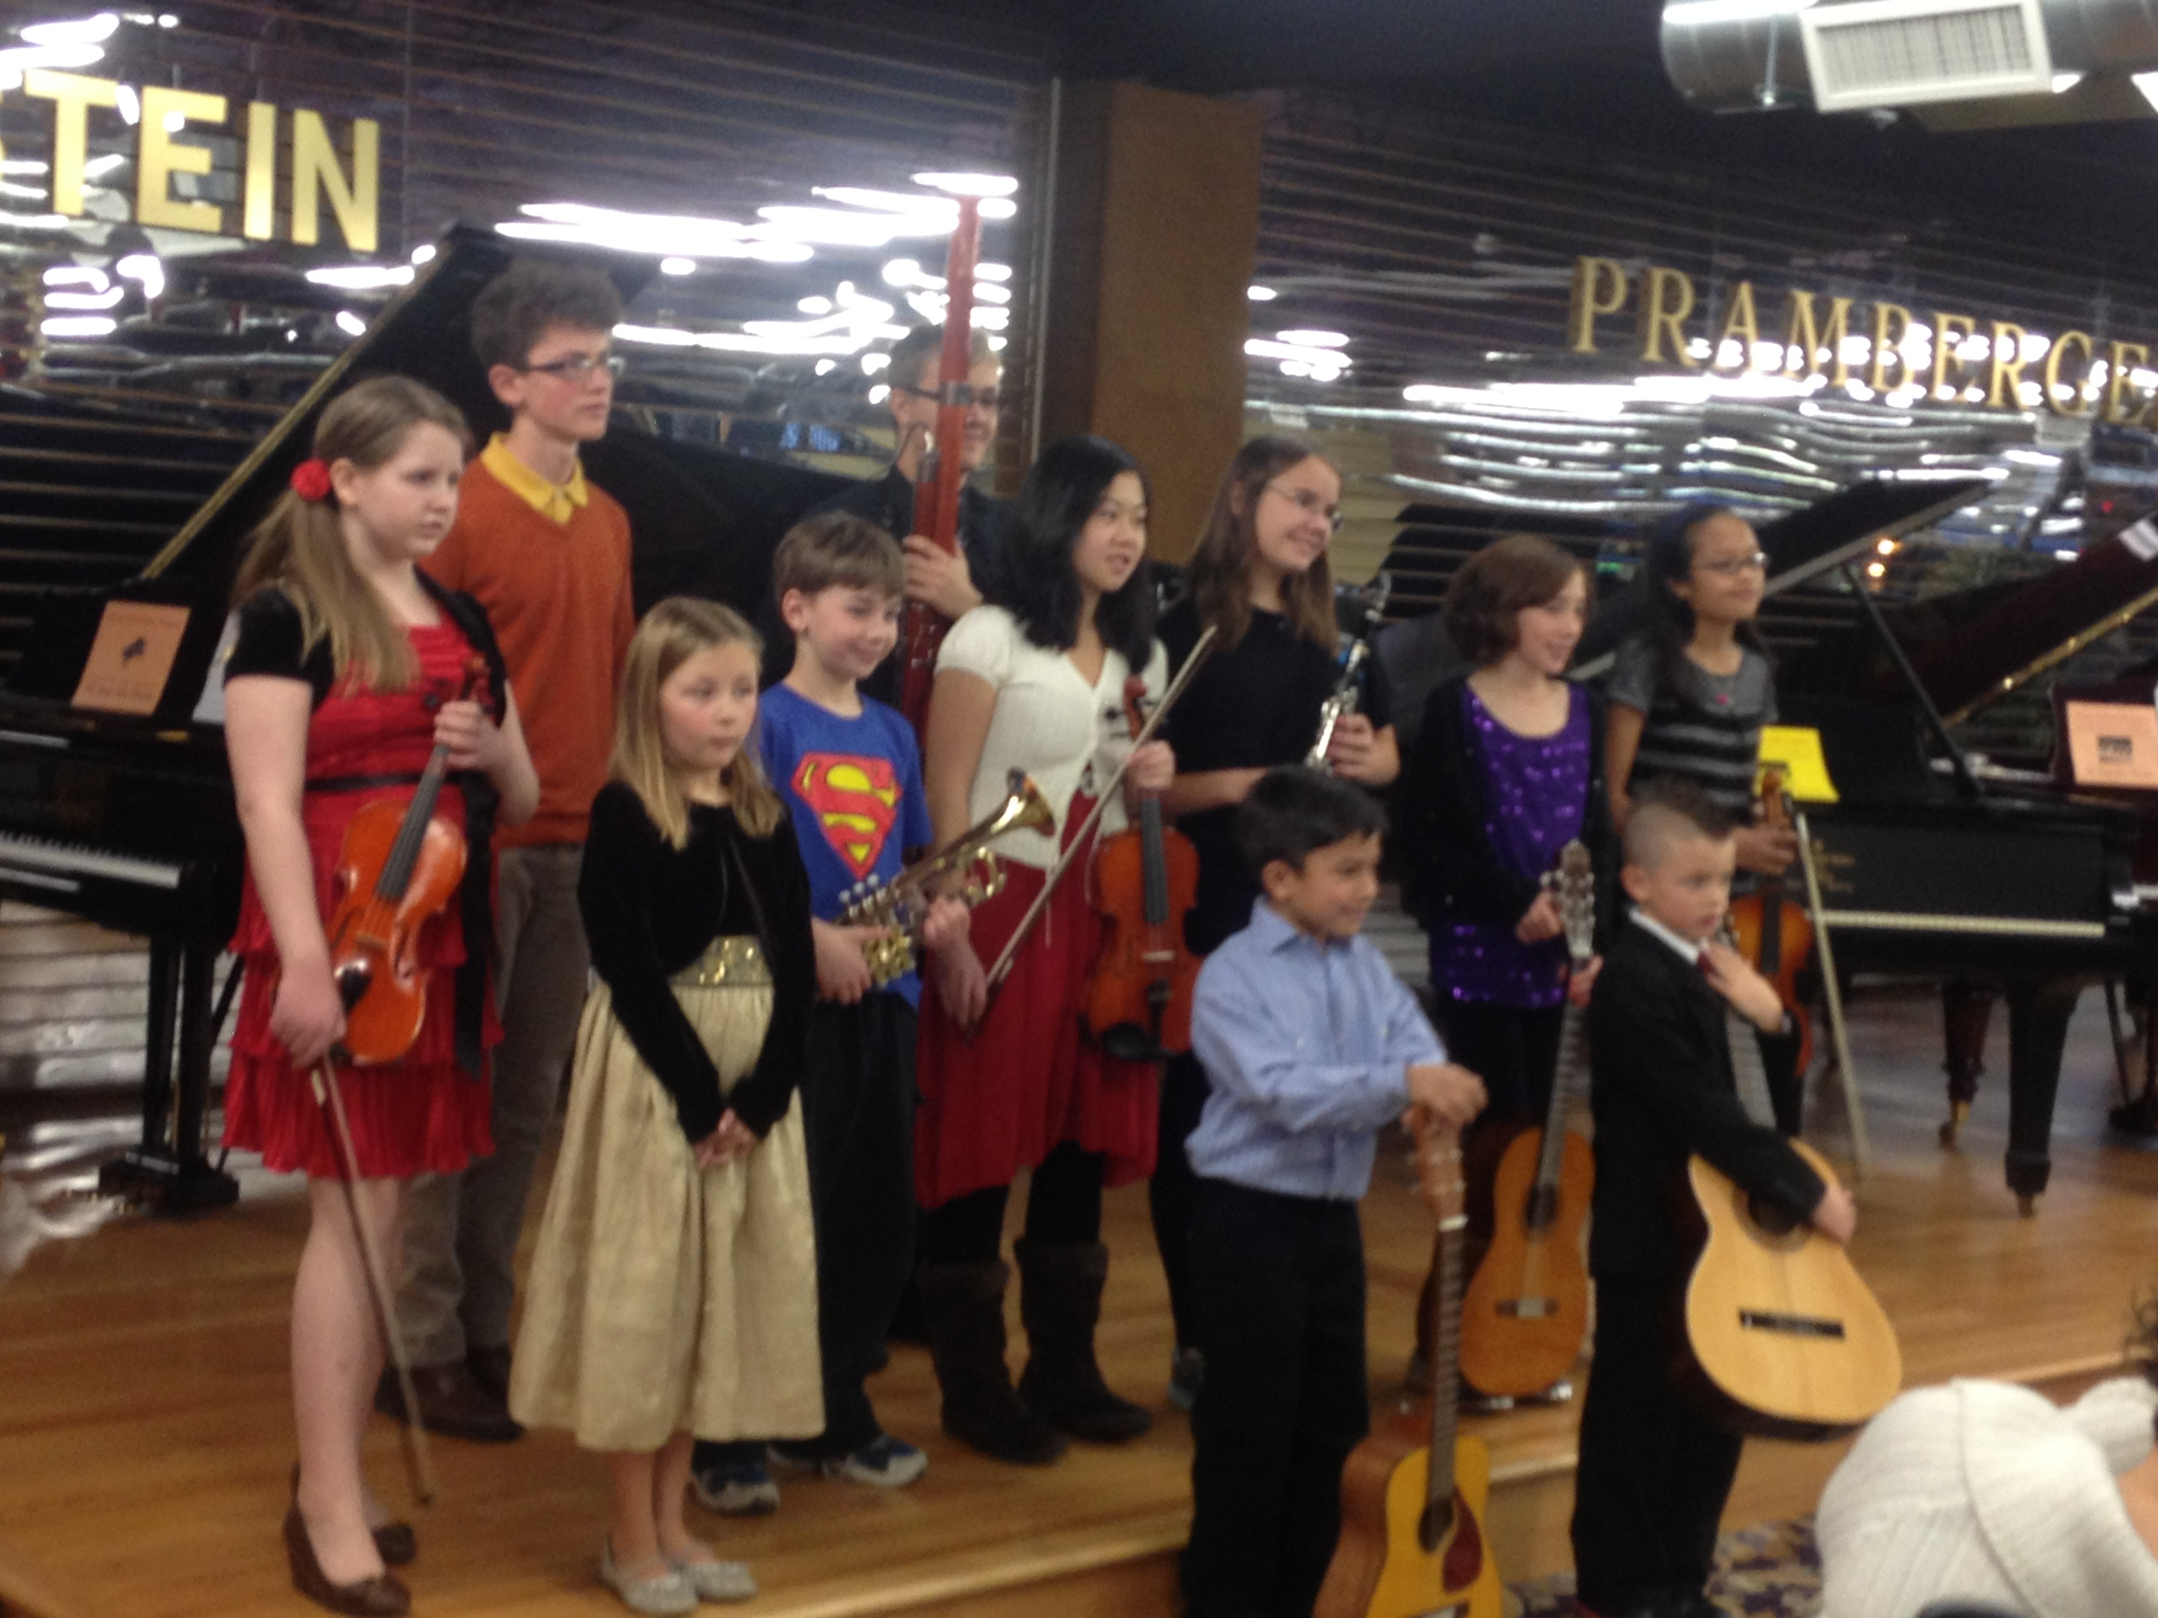
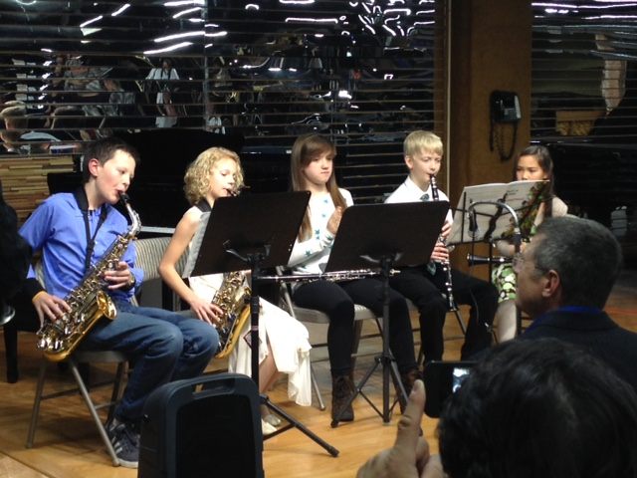
RETENTION: PERFORMANCE OPPORTUNITIES

Slide 19
QUESTIONS?
Email Liane at:
LPROCKLEY@AOL.COM
(or see me afterwards)
Thank you very much for coming!

