Slide 1

What Works For Me:
Best Ideas From Master Retailers
George Hines
and AIMM Panel

Slide 2
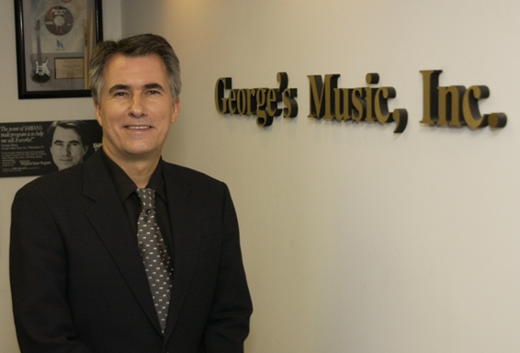

George Hines

Slide 3
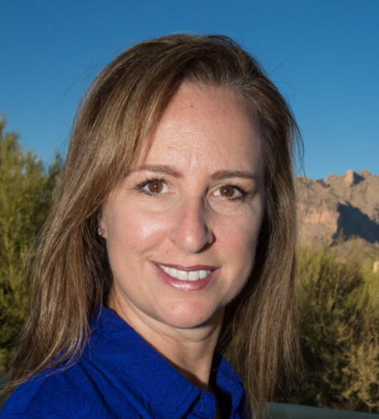
Leslie Faltin

Slide 4
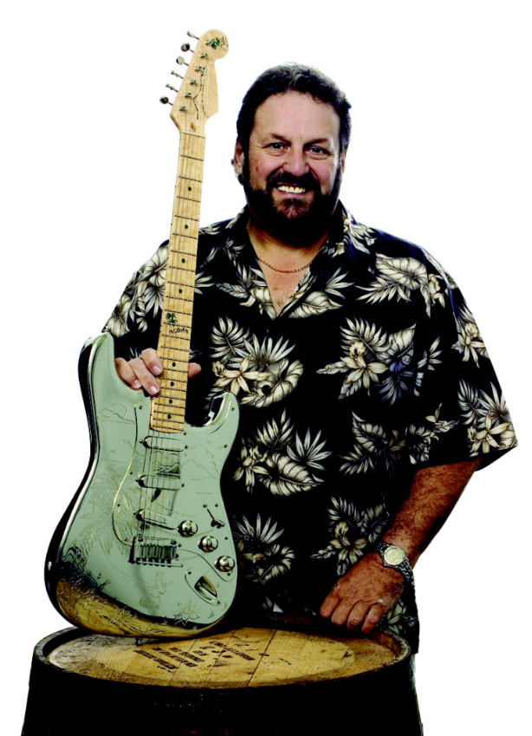

Skip Maggiora

Slide 5


Paul Decker

Slide 6
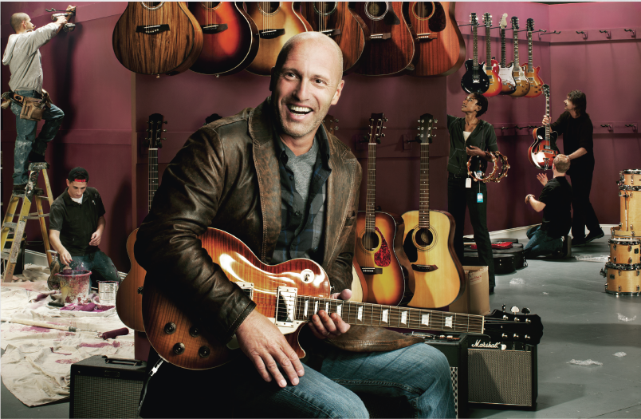

Jon Haber

Slide 7


Ryan West

Slide 8
_{Take-Away Challenges}
Bring these ideas back to your business and see what results you generate!
Takeaway 1: From Leslie Faltin – Instrumental Music
Takeaway 2: From Skip Maggiora – Skip’s Music
Takeaway 3: From Paul Decker – Music Villa
Takeaway 4: From Jon Haber – Alto Music
Takeaway 5: From Ryan West – West Music

Slide 9

Challenge #1
One of the biggest challenges in retail is…
Declining Store Traffic

Slide 10

Challenge Question #1
What is your best strategy to bring people in the door and increase your store traffic?

Slide 11
Lessons Learned #1
Create “Monthly Themed Sales”
Private Lessons, Events, Classes
Strong Social (local) media
Merchandising to create “WOW” factor
Outbound Sales Calls

Slide 12

Challenge #2
Your Company reputation is more than ever defined by customer reviews and online comments.

Slide 13



What methods does your company use to…
Monitor its online reputation?
Increase the quality of the customer reviews?
Does it utilize services like…

Slide 14
Lessons Learned #2
Spot check your online reputation
Monitor Yelp, Google and Yahoo reviews
Do “Exceptional” things and they will talk
Monitor Forums
Use a Customer Service Survey and Review

Slide 15

Challenge #3
Online and Retail Competition
is greater than ever!

Slide 16

Challenge Question #3
What is the top method you use to differentiate yourselves from your competition?

Slide 17
Lessons Learned #3
Exploit - Fear, Uncertainty and Doubt (FUD)
Skip’s Added Value Extras – “S.A.V.E.”
Specialize and be dedicated to online marketing
Combine Bricks ‘n Mortar with online
Personalized “Thank You” cards for orders

Slide 18

Challenge #4
Hiring Staff continues to be an important part in the battle to out-service the competition and strengthen the company position.

Slide 19

Challenge Question #4
What is your top strategy to
find great employees and
keep them growing?

Slide 20
Lessons Learned #4
Always be looking and set expectations
Recruit from your customer base
We run a lean tight team
Hire on personality and promote within
Use Referral bonus and Predictive Index (PI)

Slide 21

Challenge #5
How to effectively advertise and market your company has changed dramatically in the last few years.

Slide 22

Challenge Question #5
What has been one of your most successful strategies to market and advertise your business to increase sales?

Slide 23
Lessons Learned #5
Google AdWords, - “Festival of Books”
Skip’s Music and Sound Expo
Build a community of followers
Facebook and Google AdWords
Email is still most cost effective – keep an eye on your subject lines.

Slide 24

Challenge #6
Retailers need a stronger and more coordinated relationship with suppliers to meet the expectations of the consumer regarding…
New product introductions
Creating Consumer driven events and showcases of products

Slide 25
Challenge Question #6
What strategies have you taken to get closer with your suppliers to better serve the needs of your customers?

Slide 26
Lessons Learned #6
Targeted “Roadshow” events at store
Create a “Win Win” partnership
Give more support to suppliers with quality products and quality sales reps.
Support Suppliers who Support Us.
Vendor Report Cards, Share Sell Through Data, and Scheduled Rep Visits.

Slide 27
Thank You for attending our AIMM Retailer Panel
George Hines
and Panel

