Slide 1


Revving Up Revenue
Daniel Jobe
Friedman, Kannenberg & Co, P.C.

Slide 2
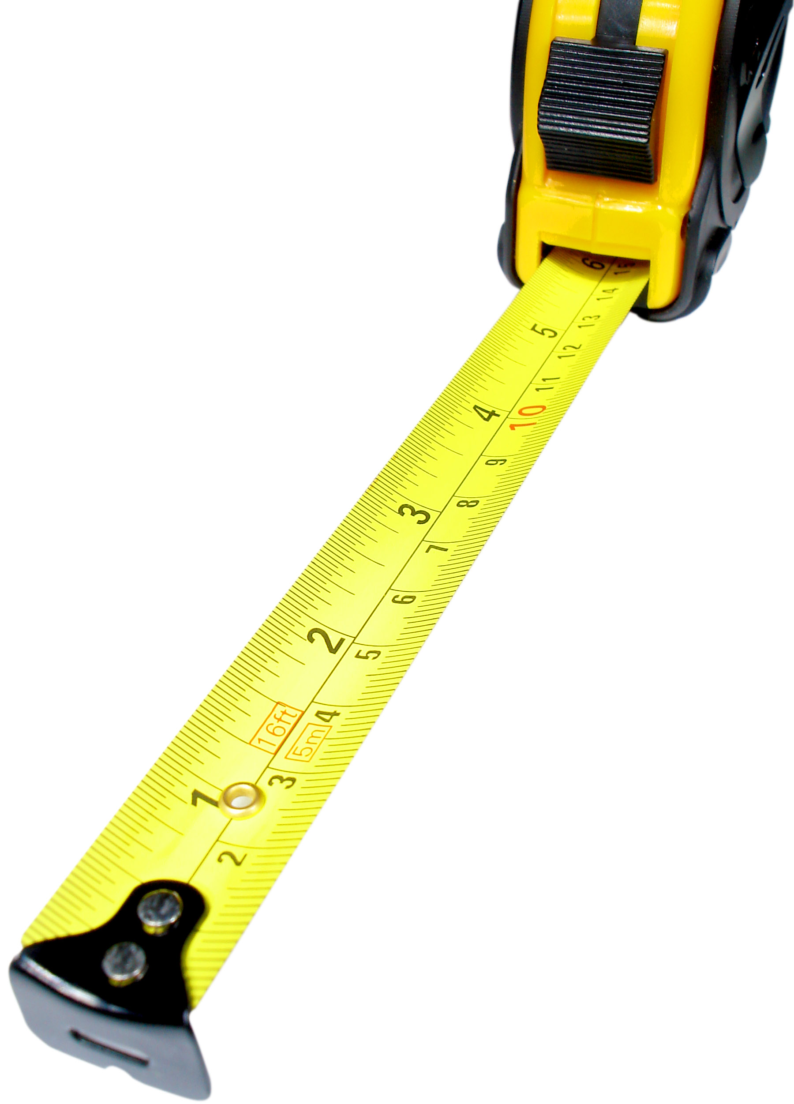
“When something is measured, it improves. When something is measured and reported, it improves exponentially.”
The Hawthorne Effect

Slide 3
Objectives
Determine how to get your staff involved with revenue generation
Develop a system to track revenue generated by income type
Day Off – now you can take one!

Slide 4

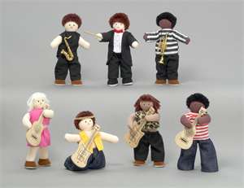


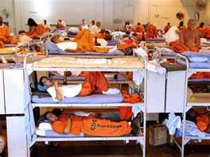

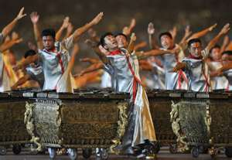
Exponential Delegation

Slide 5

What is the Missing Piece?

Slide 6


Teach them…..
The Objective

Slide 7
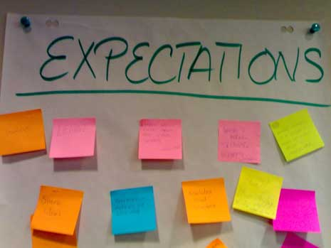

Communicate….

Slide 8
How–To’s
Assign revenue activity to specific staff
Set benchmarks for accountability
Track progress individually
Provide tools to achieve goals

Slide 9

Ten-Year Industry Sales Trajectory
The Music Trades, April 2011

Slide 10
Total Revenues
$850,000
Sales (Inv.)
$450,000
Rental Income
$300,000
Lesson Income
$50,000
Repair Income
$50,000
Sam
$300,000
Jeff
$150,000
Bob
$300,000
Chester
$50,000
Ralph
$35,000
Bert
$15,000

Slide 11

Sales Staff
Items to Breakdown per Sales Staff:
  Gross Profit Dollars vs. Salary (all annualized)
  Items per Sale
  Total Sales

Slide 12
Group Sales Performance

Slide 13
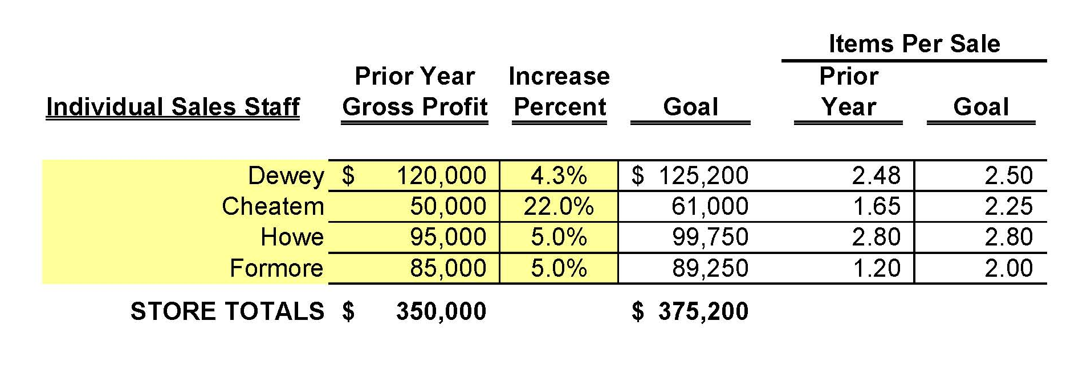
Individual Sales Performance

Slide 14

Repair Staff
Items to consider:
  Paying units by day
  Units repaired annually per person
  Average repair charge

Slide 15
Repair Performance Analysis

Slide 16
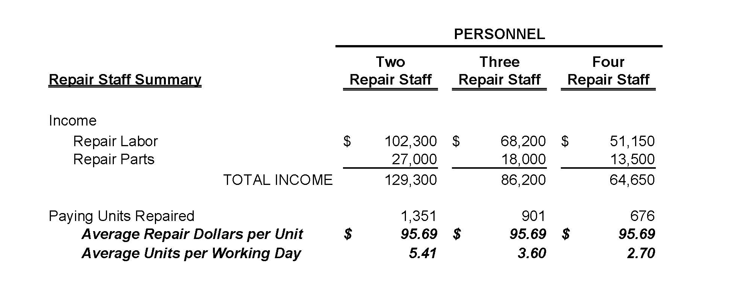
Individual Repair Performance Analysis

Slide 17

Inspect what you expect!

Slide 18

Music Lessons
Items to consider:
  Individual Lessons
    Space utilization
    Incentives by Student Count
  Group Lessons
    Large profit generator
    Safe learning environment
    Promotes family activity

Slide 19
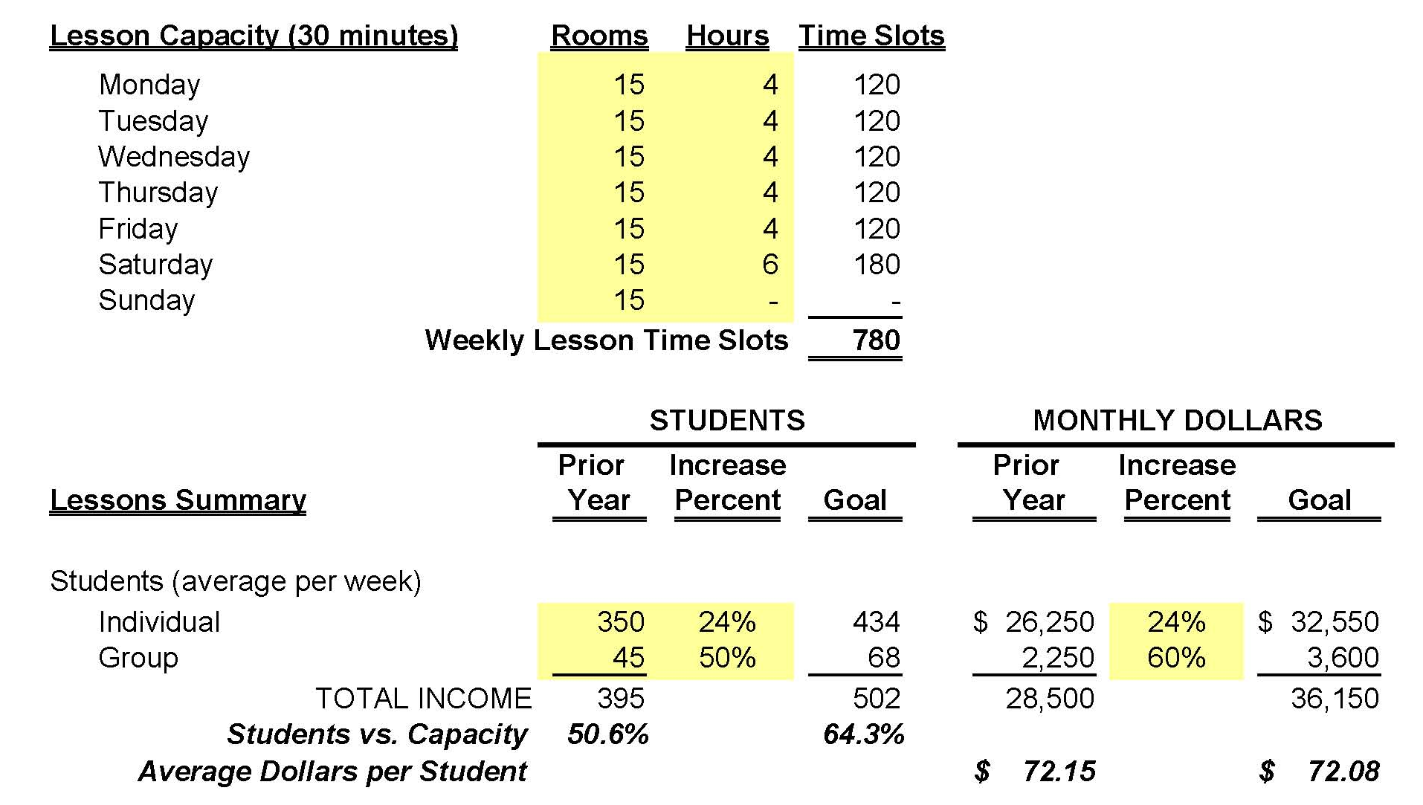
Lesson Tracking

Slide 20

Rentals
Relationships are the key!
  Analyze per Route Day/Week
    Schools Visited
    Active Rentals
    Units Repaired
    Step-ups Generated

Slide 21
“The easiest thing is to react.
The second easiest is to respond. But the hardest thing is to initiate.”
-Seth Godin

Slide 22
Wrap-Up
Distribute the revenue load
Track the progress
Visit www.fkco.com for a more detailed spreadsheet on ways to track performance for various revenue sources.

Slide 23
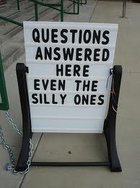
Any
Questions?

Slide 24

“Free” Consulting Meetings
At the Show
Contact Jen outside the Idea Center entrance
after this session to set up a meeting time

