Slide 1
The Panelists
Billy Cuthrell, Progressive Music Center
Ryan West, West Music
Shane Kinney, Drum Center of Portsmouth
Gabriel O’Brien, Larry’s Music Center
Myrna Sislen, Middle C Music
Tom Menrath, Vintage King Audio
Moderated by Frank Alkyer, Music Inc. Magazine

Slide 2
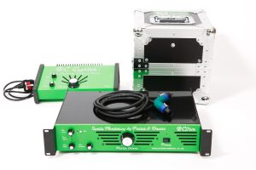
Round 1: Best Add-Ons and Accessories
Porter & Davies
Booth #303

Slide 3
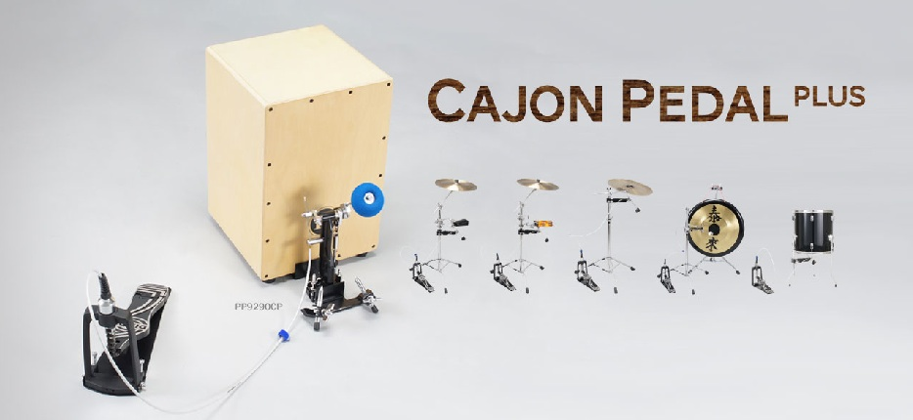
Round 1: Best Add-Ons and Accessories
Dixon Cajon Pedal Plus
Booth #502

Slide 4
Round 1: Best Add-Ons and Accessories
Overtone Labs Tune-Bot Drum Tuner
See it at Pearl
Booth #110

Slide 5
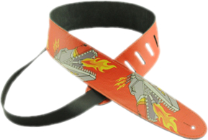
Round 1: Best Add-Ons and Accessories
Henry Heller Straps
Distributed by OMG
Booth #1416

Slide 6
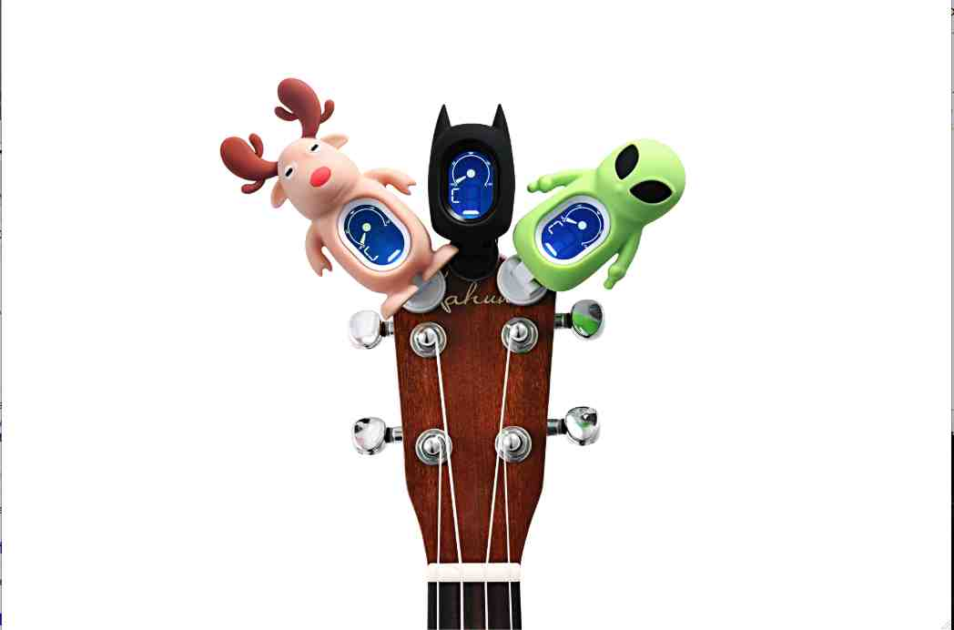
Round 1: Best Add-Ons and Accessories
IMS Technologies Tuners
Booth #900

Slide 7
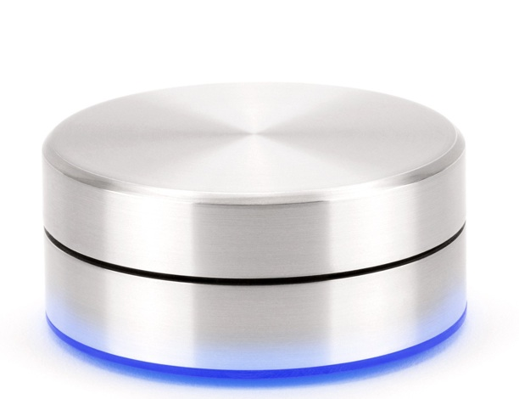
Round 1: Best Add-Ons and Accessories
Griffin PowerMate Wireless Programmable Controller
Booth #555

Slide 8
Round 1: Best Add-Ons and Accessories
Porter & Davies … Booth 303
Dixon Cajon Pedal Plus … Booth 502
Overtone Labs Tune-Bot Drum Tuner … Booth 110
Henry Heller Straps … Booth 1416
IMS Technologies Tuners ... Booth 900
Griffin PowerMate … Booth 555

Slide 9
Round 2: Gotta Stock It
Rich Redmond’s FUNdamentals, Modern Drummer
Distributed by Hal Leonard
Booth #614

Slide 10
Round 2: Gotta Stock It
D’Addario NYXL
Booth #1002

Slide 11
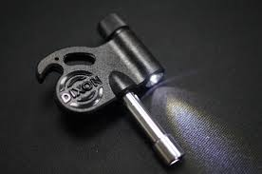
Round 2: Gotta Stock It
Dixon Brite Key
Booth #502

Slide 12
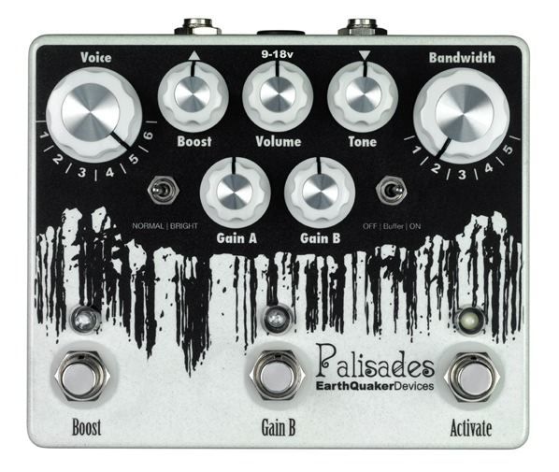
Round 2: Gotta Stock It
EarthQuaker Devices
Booth #1136

Slide 13
Round 2: Gotta Stock It
Alfred Teach Your Child To Play Series & Alfred Mini Music Guides
Booth #734

Slide 14
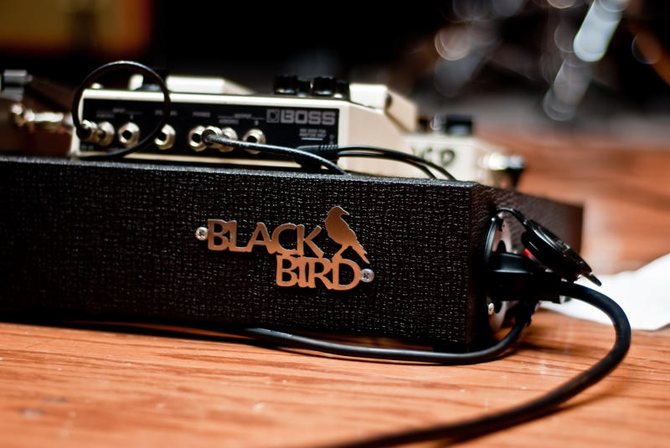
Round 2: Gotta Stock It
Blackbird Custom Pedalboards
Booth #1658

Slide 15
Round 2: Gotta Stock It
Rich Redmond’s FUNdamentals … Booth 614
D’Addario NYXL … Booth 1002
Dixon Brite Key … Booth 502
EarthQuaker Devices … Booth 1136
Alfred Titles ... Booth 734
Blackbird Custom Pedalboards … Booth 1658

Slide 16
Round 3: Companies to Watch
Walden Guitars
Booth #314

Slide 17
Round 3: Companies to Watch
Hal Leonard
Booth #614

Slide 18
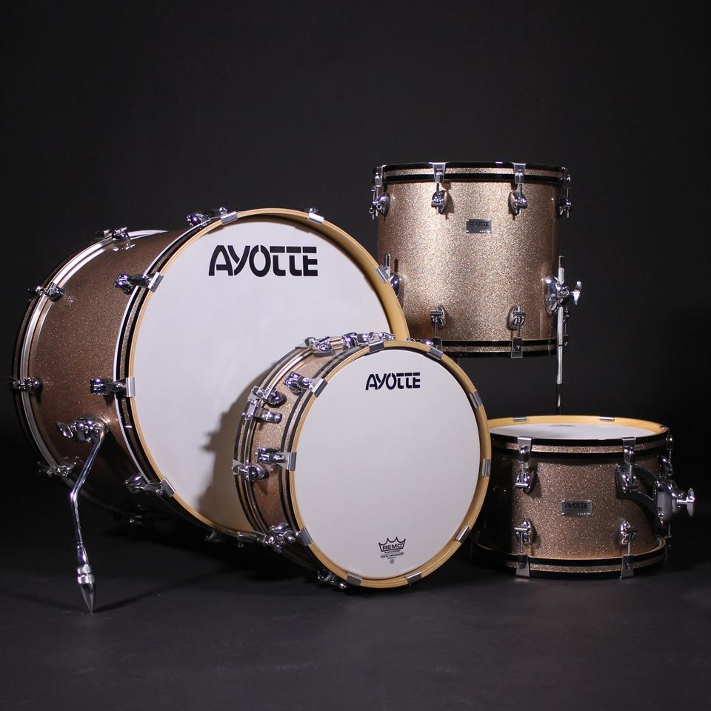
Round 3: Companies to Watch
Ayotte Drums
Booth #210

Slide 19
Round 3: Companies to Watch
Reverend Guitars
Booth #944

Slide 20
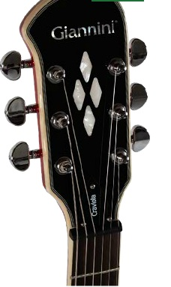
Round 3: Companies to Watch
Giannini USA
Booth #1303

Slide 21
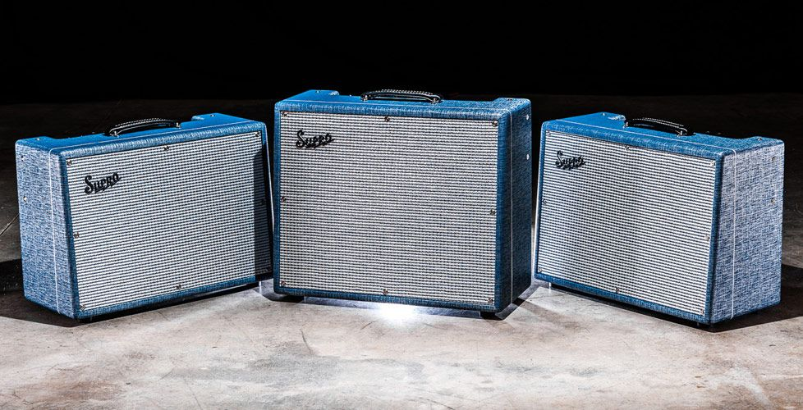
Round 3: Companies to Watch
Supro USA
Booth #1436

Slide 22
Round 3: Companies to Watch
Walden Guitars … Booth 314
Hal Leonard … Booth 614
Ayotte Drums … Booth 210
Reverend Guitars … Booth 944
Giannini USA ... Booth 1303
Supro USA … Booth 1436

Slide 23
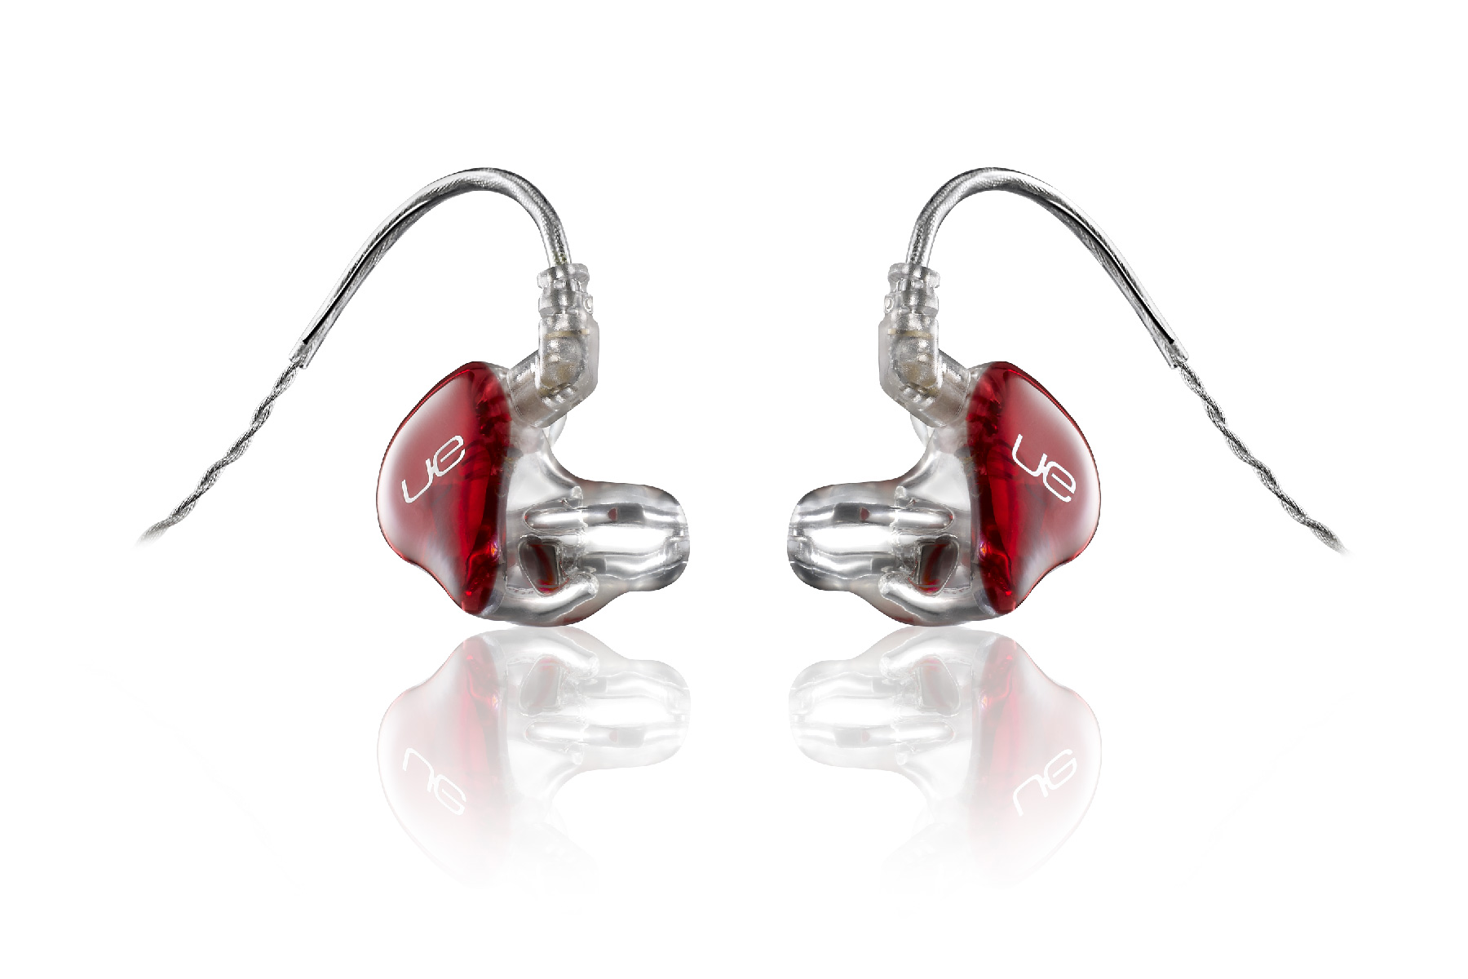
Round 4: Best in Show
Ultimate Ears
Booth #338

Slide 24
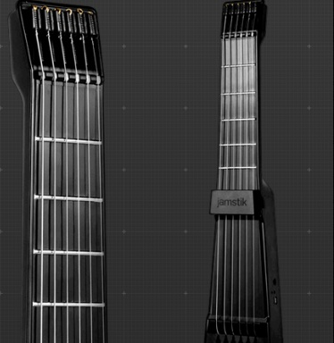
Round 4: Best in Show
Zivix JamStik
Booth #450

Slide 25
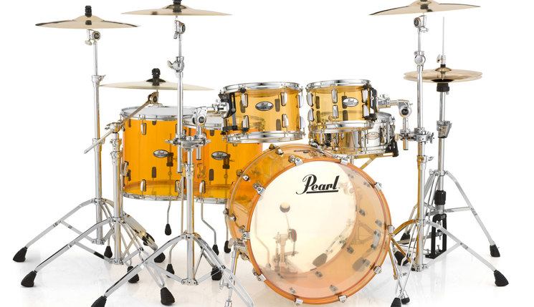
Round 4: Best in Show
Pearl Crystal Beat Drum Series
Booth #110

Slide 26
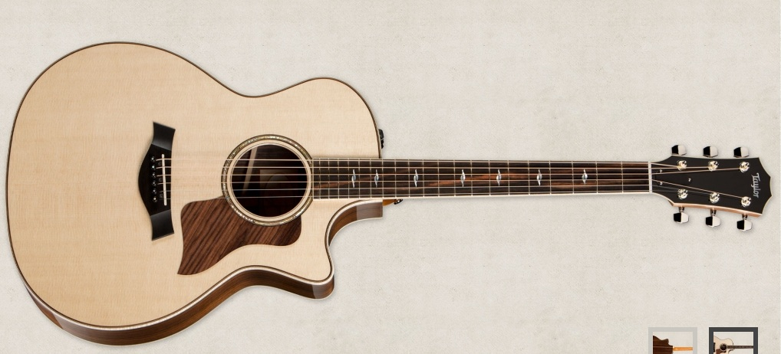
Round 4: Best in Show
Taylor 814ce
Booth #201A

Slide 27
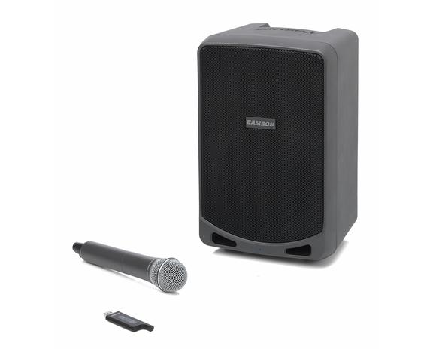
Round 4: Best in Show
Samson Expedition XP106w
Booth #624

Slide 28
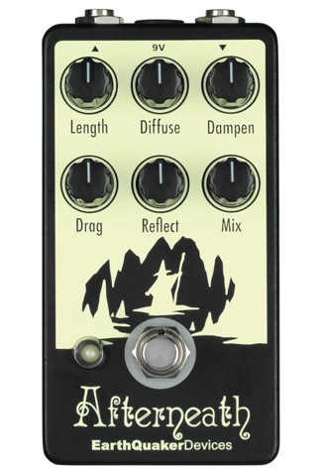
Round 4: Best in Show
EarthQuaker Devices Afterneath
Booth #1136

Slide 29
Round 4: Best in Show
Ultimate Ears … Booth 338
Zivix JamStik … Booth 450
Pearl Crystal Beat Drum Series … Booth 110
Taylor 814ce … Booth 201A
Samson Expedition XP106w ... Booth 624
EarthQuaker Devices Afterneath … Booth 1136

