Slide 1


Slide 2

What’s Your Music Store Worth?

Slide 3
What’s Your Music Store Worth?
Robin Jean Sassi, Esquire

Slide 4
About Your Speaker…

Slide 5
About Your Speaker…
Owner, San Diego Music Studio, Est. 1994

Slide 6

About Your Speaker…
Owner, San Diego Music Studio, Est. 1994

Slide 7
About Your Speaker…
Owner, San Diego Music Studio, Est. 1994
California Licensed Attorney
  Corporate Law
  Business Litigation
  Trusts and Estates
  Disclaimer: The presentation you hear today is not meant to be legal advice and is for educational purposes only. Each individual situation is unique and laws vary from state to state. Conversations here do not establish an attorney-client relationship.

Slide 8
Why do you want to know how much your Music Store is worth?

Slide 9
Why do you want to know how much your Music Store is worth?
Curiosity

Slide 10
Why do you want to know how much your Music Store is worth?
Curiosity
You are interested in selling your store

Slide 11
Why do you want to know how much your Music Store is worth?
Curiosity
You are interested in selling your store
You are interested in buying a store

Slide 12
Why do you want to know how much your Music Store is worth?
Curiosity
You are interested in selling your store
You are interested in buying a store
Estate planning purposes

Slide 13
Why do you want to know how much your Music Store is worth?
Curiosity
You are interested in selling your store
You are interested in buying a store
Estate planning purposes
The Big “D”

Slide 14
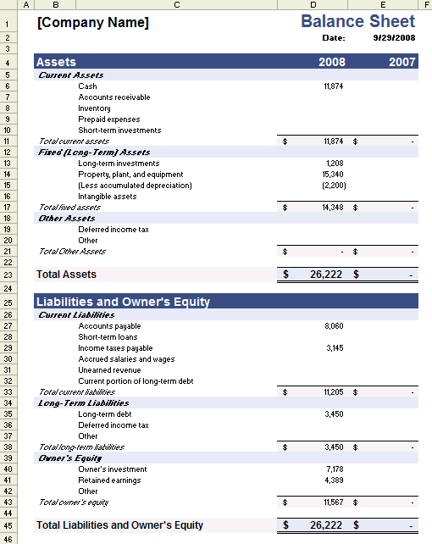
Why do you want to know how much your Music Store is worth?
Curiosity
You are interested in selling your store
You are interested in buying a store
Estate planning purposes
The Big “D”

Slide 15
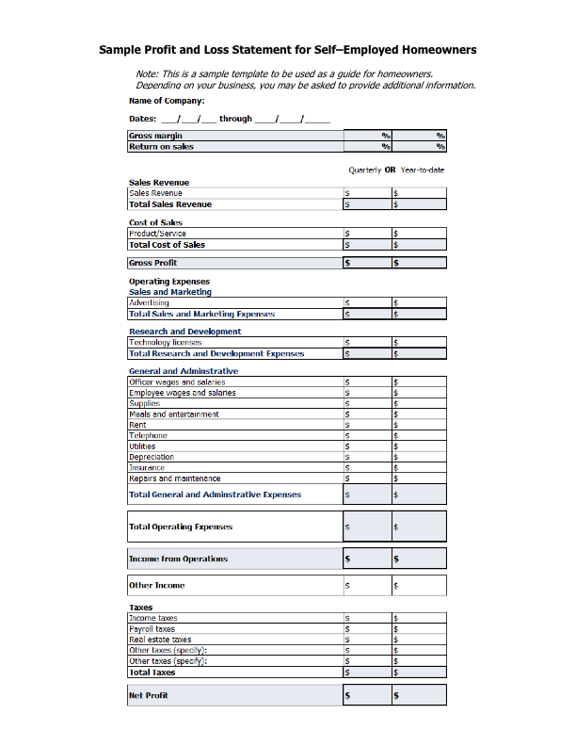
Why do you want to know how much your Music Store is worth?
Curiosity
You are interested in selling your store
You are interested in buying a store
Estate planning purposes
The Big “D”

Slide 16
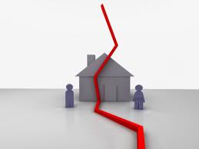
Why do you want to know how much your Music Store is worth?
Curiosity
You are interested in selling your store
You are interested in buying a store
Estate planning purposes
The Big “D”

Slide 17

Market Approach

Slide 18
Market Approach
Whatever the Market will bear!

Slide 19

Asset Approach

Slide 20
Asset Approach
The Balance Sheet

Slide 21
Asset Approach
The Balance Sheet

Slide 22
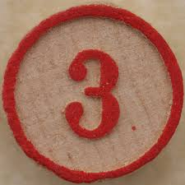
The Income Approach

Slide 23
The Income Approach
The Profit and Loss Statement

Slide 24
The Income Approach
The Profit and Loss Statement

Slide 25
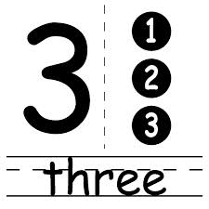
Three Basic Approaches for Buying and Selling
Market Approach
Asset Approach
Income Approach

Slide 26
The Big “D”

Slide 27
The Big “D” →

Slide 28
The Big “D” → D

Slide 29
The Big “D” → D-I

Slide 30
The Big “D” → D-I-V

Slide 31
The Big “D” → D-I-V-O

Slide 32
The Big “D” → D-I-V-O-R

Slide 33
The Big “D” → D-I-V-O-R-C

Slide 34
The Big “D” → D-I-V-O-R-C-E

Slide 35
The Big “D” → D-I-V-O-R-C-E
FACTORS

Slide 36
The Big “D” → D-I-V-O-R-C-E
FACTORS

Slide 37
The Big “D” → D-I-V-O-R-C-E
FACTORS
What State you are in
If you owned the business before marriage
How much you participate in the management of the business
How long you’ve owned the business
Personal Expenses carried by the business
  Meals
  Healthcare
  Car Expenses
  “Other”
Depreciation

Slide 38
The Big “D” → D-I-V-O-R-C-E
FACTORS
What State you are in
If you owned the business before marriage
How much you participate in the management of the business
How long you’ve owned the business
Personal Expenses carried by the business
  Meals
  Healthcare
  Car Expenses
  “Other”
Depreciation

Slide 39
The Promissory Note

Slide 40
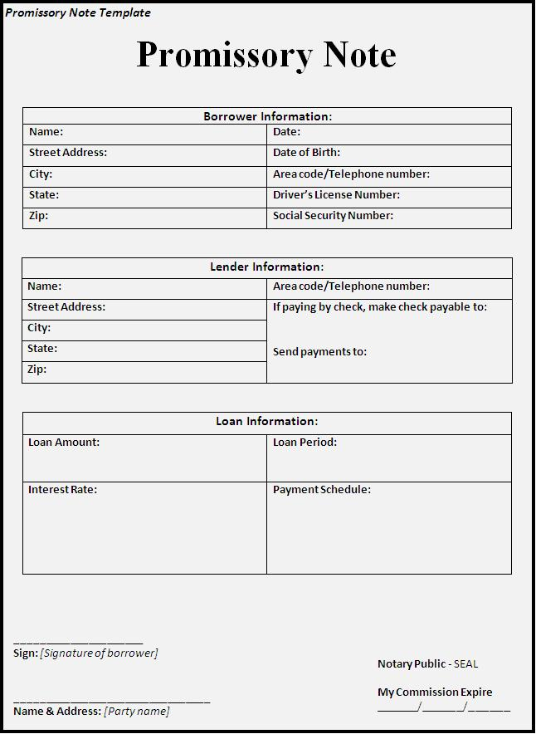
The Promissory Note

Slide 41
The Promissory Note
I “Promise”…

Slide 42
What’s Your Music Store Worth?
Robin Jean Sassi, Esquire

