Slide 1


Slide 2

Hit Songwriting:
Secrets of the Pros

Slide 3
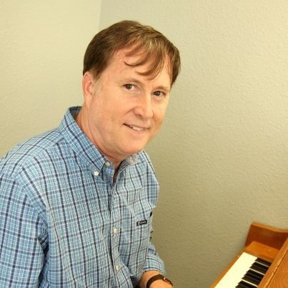
Thornton Cline, moderator
"Love Is The Reason"
Englbert Humperdinck & Gloria Gaynor
"Bottom of the Fifth"
Tim Murphy
"Catch A Snowflake"
Matt Newton

Slide 4

Jan Buckingham, panelist
"Moment of Truth"
Whitney Houston
"I Don't Mind the Thorns"
Lee Greenwood
"Cleopatra, Queen of Denial"
Pam Tillis
"Modern Day Delilah"
Van Stephenson

Slide 5
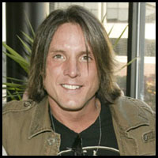
Rhean Boyer, panelist
"Isn't She"
Carolina Rain
"I Ain't Scared"
Carolina Rain
"Get Outta My Way"
Carolina Rain

Slide 6

Michael Puryear, panelist
"Better Than A Hallelujah" Amy Grant
"The Reason/The Star Still Shines"
Diamond Rio
"I Finally Passed The Bar" Michael Peterson &
Travis Tritt

Slide 7
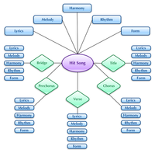
The Mechanics of Hit Songwriting: Pointers and Tips

Slide 8


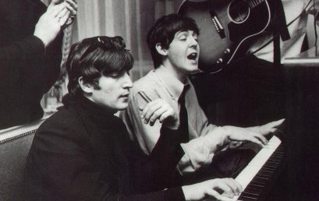
Collaborating versus Solo Writing

Slide 9

Casting and Demoing Songs

Slide 10

Pitching and getting songs recorded "cut"

Slide 11

Earning Income from Hit Songwriting

Slide 12
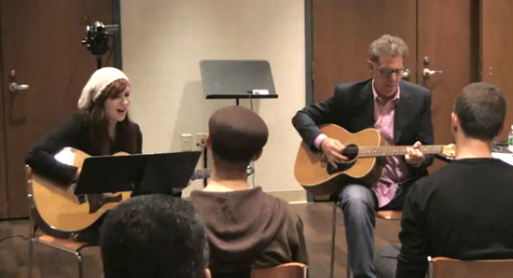
Questions and Answers

Slide 13
Credits and Thank you's
Jan Buckingham
Rhean Boyer
Michael Puryear

