Slide 1

Simple Ways to Improve Your Cash Flow
Alan Friedman
Friedman, Kannenberg & Company, PC
Deb Barker
GE Capital

Slide 2

Simple Ways to Improve Your Cash Flow
Define “debt” and kind of debt found in music retailing today
Discuss short- and long-term debt
Illustrate how “right” debt creates cash flow
Q&A

Slide 3

Short-Term Debt (< 1 Year)
Suppliers (Termination; pre-pay)
Credit Cards (Personal credit scores, rates)
Bank Line of Credit (Payable in full annually, cash flow, set-up fees, lower advance rate)
Accrued Expenses (Typically taxes)
Inventory Finance (Legacy perception, mfg. support)
Best suited for quick-turning inventory or consumables

Slide 4

Long-Term Debt (> 1 Year)
Term Loan – Acquisitions
Mortgage
Inventory Finance
(Fixtures, Inflexibility; deposit ; closing costs)
(Land/Buildings, Inflexibility, deposit ; closing costs)
Not for aged product, only slower-turning inventory
APR ≠ Effective rate: Have you considered all fees & cross-collateral risks?

Slide 5
Challenges facing Independent Dealers Today……..
Dealer Quick Pay
Internet Sales pressure – Race to the bottom?
Bank credit for strong dealers
Dealer not stocking premium product
Open account terms not long enough
eBay / Amazon transaction costs
Higher price = slower turn
Cash Flow
Sell at a higher profit with slower turn … OR …
lower margins and faster turn?

Slide 6

Do you …
Manage your inventory?
Monitor profitability?
Stay involved in the business?
Make a profit but have little cash?
Want more cash on hand?
Successful businesses use other people’s money to grow their business!!

Slide 7
Pop Quiz
Which dealer has the best operating cash flow & profit potential within a 12-month period?
Dealer A : Terms Net 180 | 30% Gross Profit | Inventory 2x per year
Dealer B : Terms 2% net 15 | 32% Gross Profit | Inventory 2x per year
Dealer A : Terms Net 60 | 30% Gross Profit | Inventory 2x per year
Dealer A

Slide 8
 | Business A |  |  | Business B |  |  | Business C
 | Margin | 30% |  | Margin | 30% |  | Margin | 30%
 | Early Pay Discount | 0% |  | Early Pay Discount | 2% |  | Early Pay Discount | 0%
 | Terms | 180 Days |  | Terms | Net 15 |  | Terms | Net 60
 | Retailer Turns : | 2 x |  | Retailer Turns : | 2 x |  | Retailer Turns : | 6 x
Sales | $ 5,000,000.00 |  |  | $ 5,000,000.00 |  |  | $ 5,000,000.00
COGS | $ 3,500,000.00 | 70% |  | $ 3,400,000.00 | 68% |  | $ 3,500,000.00 | 70%
Gross Profit | $ 1,500,000.00 | 30% |  | $ 1,600,000.00 | 32% |  | $ 1,500,000.00 | 30% | A - B
Assets
Ave Inventory | $ 1,750,000.00 | 2x Turn |  | $ 1,700,000.00 | 2x Turn |  | $ 1,750,000.00 | 2x Turn | B ÷ Turn
Ave. Payable | $ 1,750,000.00 | Net 180 |  | $ 141,666.67 | Net 15 |  | $ 583,333.33 | Net 60 | B ÷ Terms
GAP (Financing) | $ - |  |  | $ (1,558,333.33) |  |  | $ (1,166,666.67) |  | C - D
Financing | Inventory Finance |  |  | EPD + Bank LOC |  |  | Supplier Terms + LOC
A
B
C
D
E
FOR EXAMPLE PURPOSES ONLY.

Slide 9
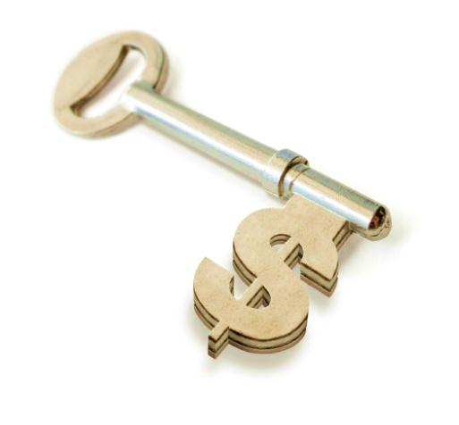
Takeaways…
Match inventory turn with financing term
Pay your supplier or your financier according to the terms
Manage your inventory, avoid aging
Cash-flow
<
Unlock your potential

Slide 10
Disclaimer
“This presentation is for information purposes only. The information contained within this report has been obtained from and is based upon third-party sources which have not been independently verified. No representation or warranty, express or implied, of any kind is made by GE Commercial Distribution Finance Corporation or any of its affiliates as to the accuracy or completeness of the information set forth herein, and nothing contained herein is, or shall be relied upon as, a promise or representation as to the past, present, or the future. You shall not rely upon any information set forth herein in taking or refraining from taking any action. Your use of the information set forth herein is at your own risk.”

