Slide 1

Course Title
What Do I Do
About My Website?
Panel Discussion
Moderated by Danny Rocks
The Company Rocks

Slide 2
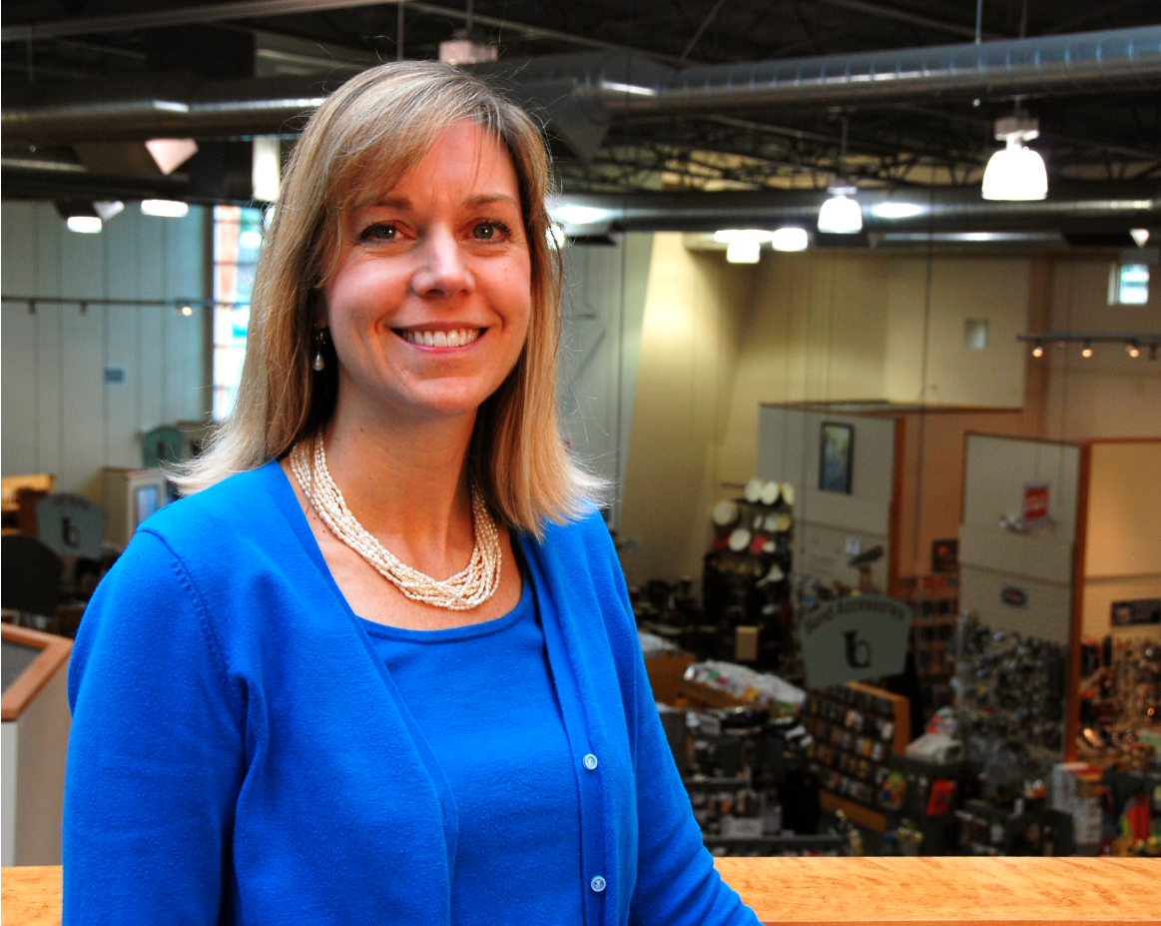

Meet Our Panelists
Whitney Brown Grisaffi
President

Slide 3
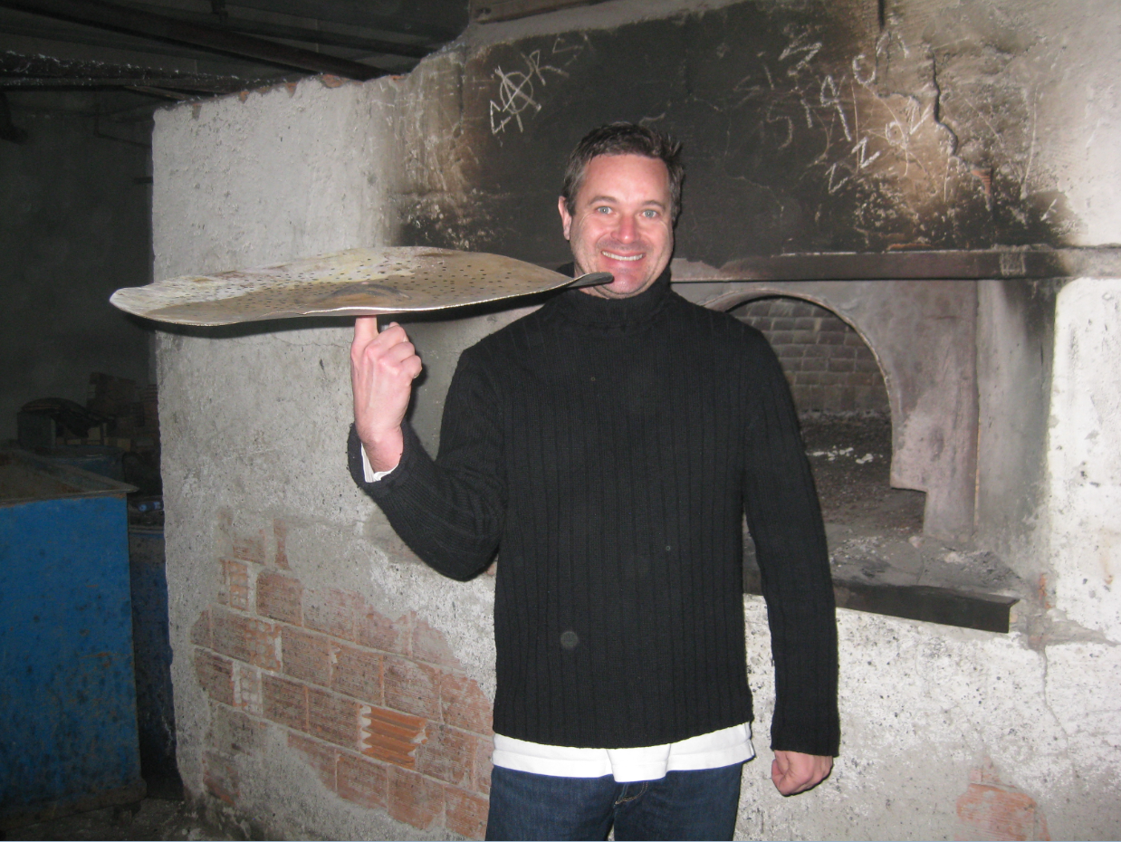

Meet Our Panelists
Brad Boynton
Owner

Slide 4
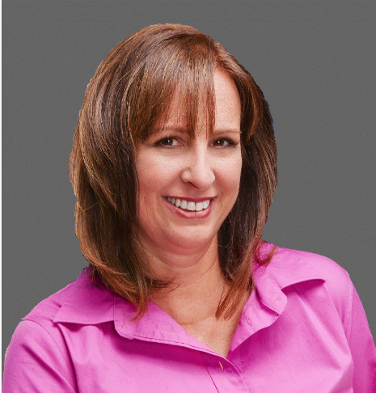

Meet Our Panelists
Leslie Faltin
Owner

Slide 5
Question #1
What role does your website play in your overall business strategy?

Slide 6
Question #2
How satisfied, currently,
are you with your website?

Slide 7
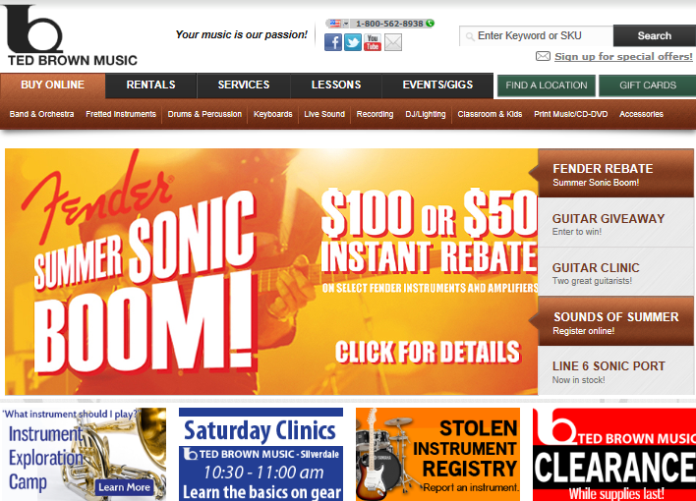
Ted Brown Website

Slide 8
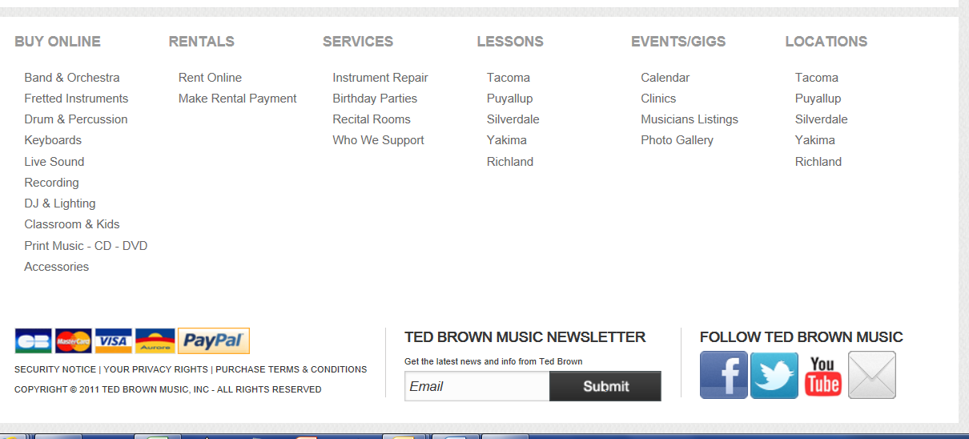
Ted Brown Website

Slide 9
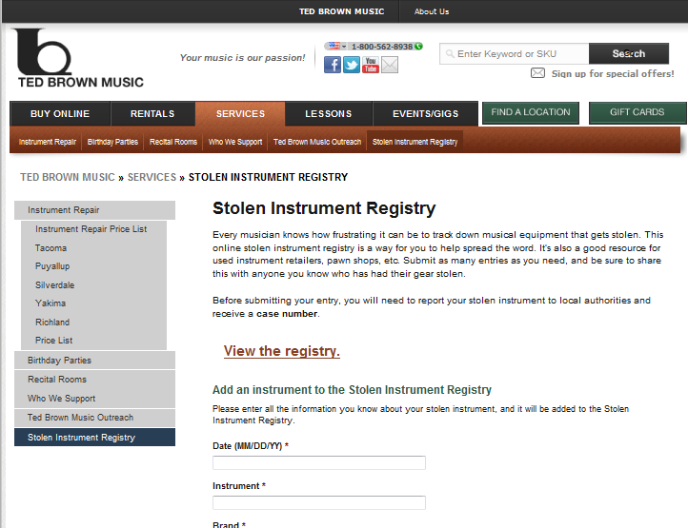
Ted Brown Website

Slide 10
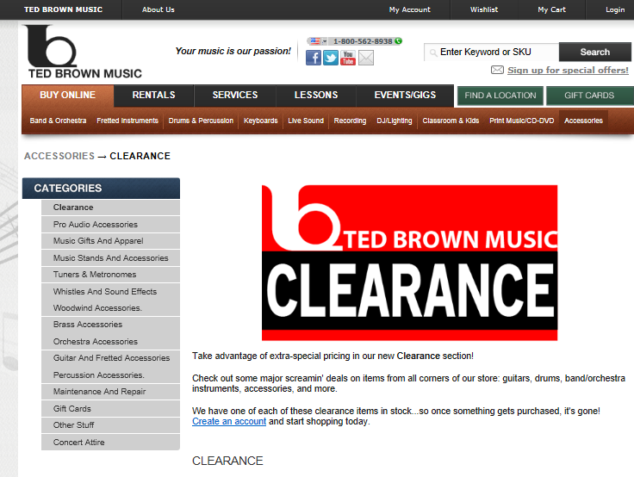
Ted Brown Website

Slide 11
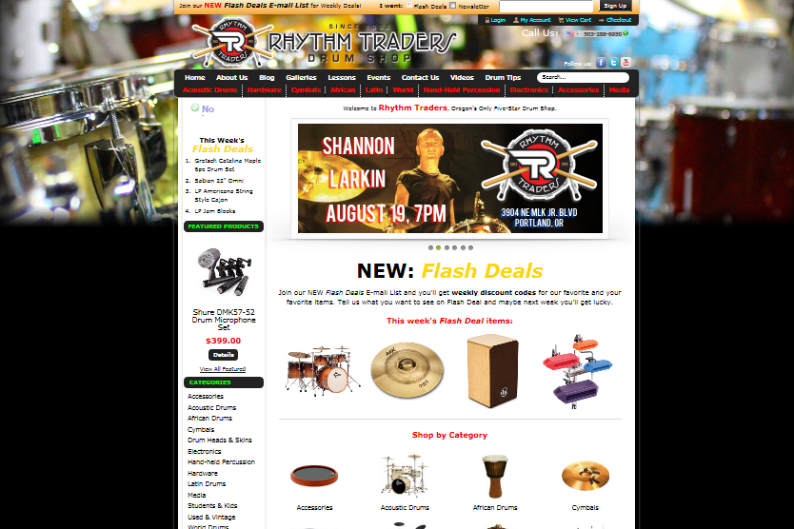
Rhythm Traders Website

Slide 12
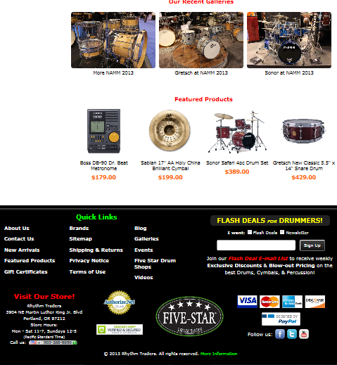
Rhythm Traders Website

Slide 13
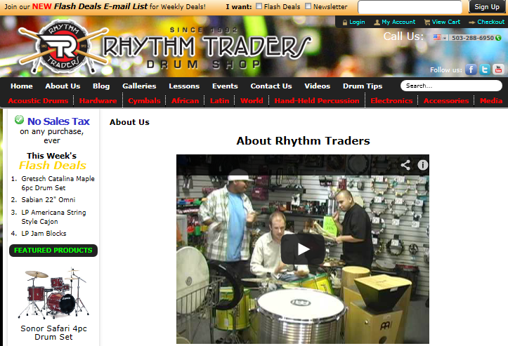
Rhythm Traders Website

Slide 14
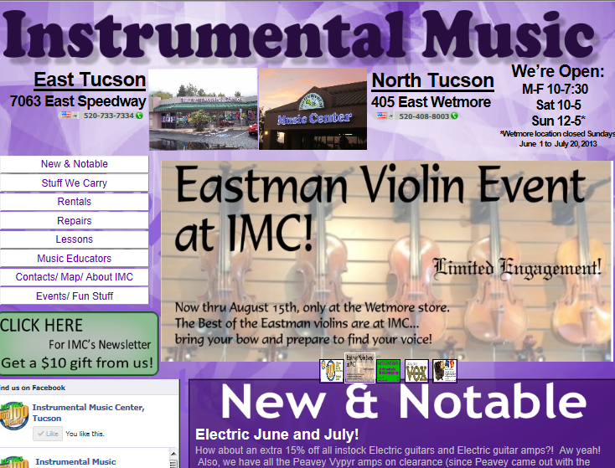
Instrumental Music Website

Slide 15
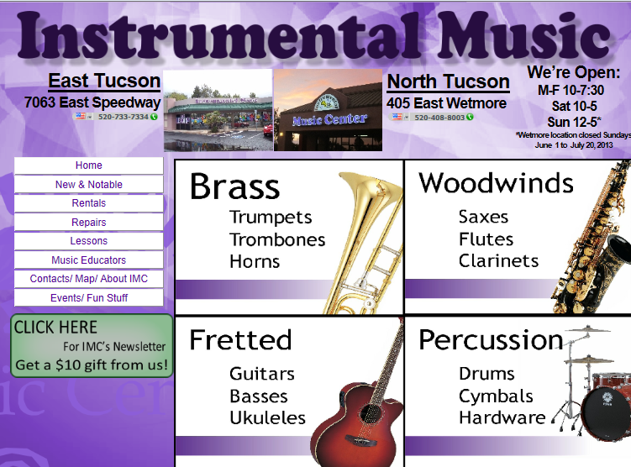
Instrumental Music Website

Slide 16
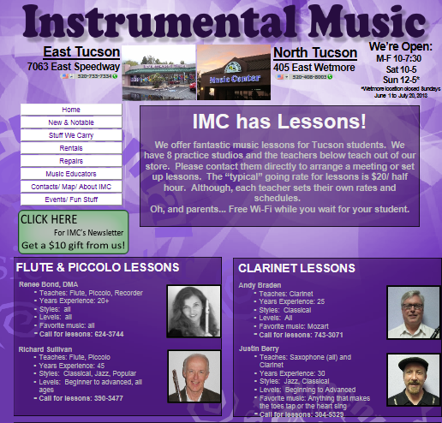
Instrumental Music Website

Slide 17
Question #3
How do you divide up responsibility
for updating & maintaining
your website?

Slide 18
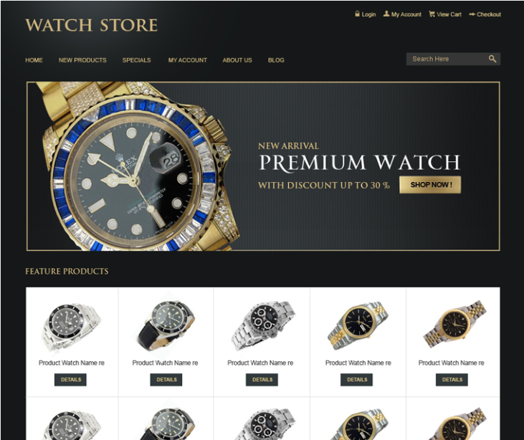
Rhythm Traders Start Point

Slide 19
E-Commerce Enabled?
Should every music store go this route?
What is your approach?

Slide 20
Question #4
What are the “key factors” that music dealers must keep in mind when considering e-commerce?

Slide 21
Marketing & Advertising Your Website
If you build it will they come?
If they come, will they stay?
Organic Search vs. Paid Placement

Slide 22
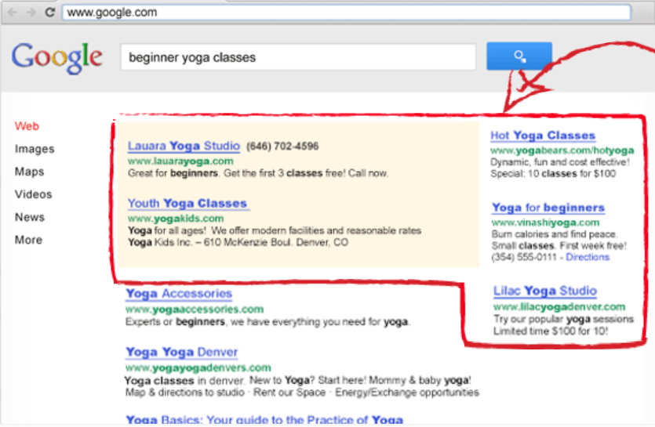

Pay-Per Click Ads
What are the advantages?
What can go wrong?

Slide 23
Finding Your Website
Organic Search
Paid Placement
SEO
Keywords
Pay-per-Click

Slide 24
Using Social Media to drive visitors to Your Website
How to you use Social Media to engage current & future customers with your store / website?

Slide 25





Using Social Media

Slide 26
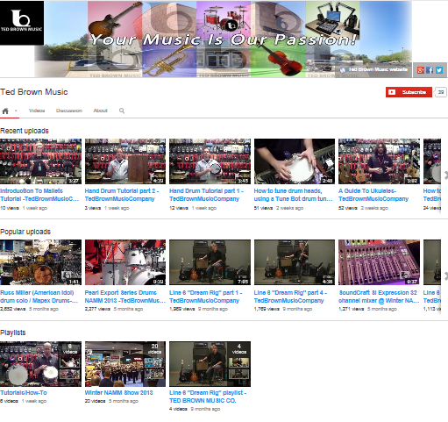
Ted Brown YouTube

Slide 27
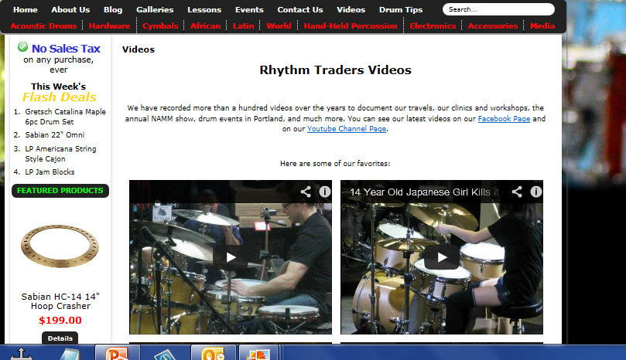
Rhythm Traders Videos

Slide 28
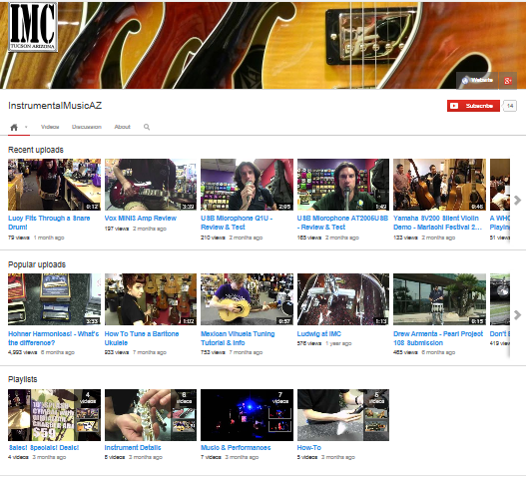
IMC YouTube

Slide 29
Final Thoughts
What is the one “Take-away” point you want to share with our audience?

Slide 30
Thank You Panelists!

